Slide 1



The role of the private sector in climate resilience of fortifications
EFFORTS Congress 2026, Diest
Break-out session 1006206

Slide 2
What is Fortified Futures?

Slide 3

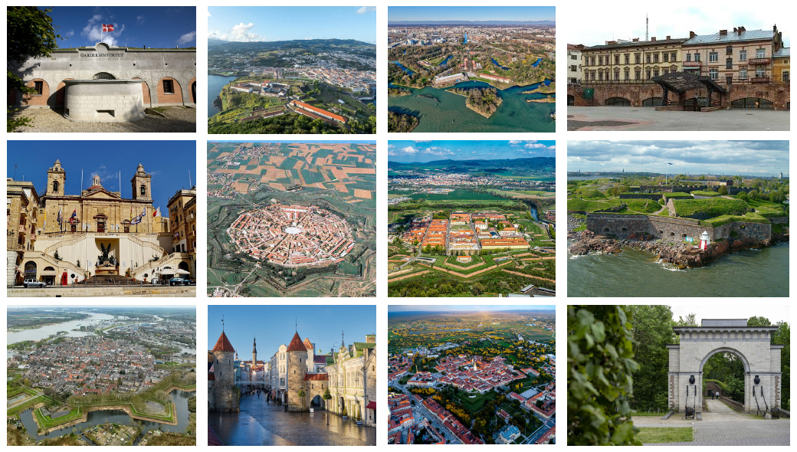
Who we are
  Work group of European fortifications facing climate evolution
  Spin-off of the Resilient Fortress project
  Technical experience and knowledge sharing
  Match-making
  So far led by the Vauban Network and EFFORTS, but built in a participatory way
  In the long term, exploring possibilities for building cooperation projects
What we do
  Meetings (webinars, thematic meetings, technical/logistic short meeting)
  The development collective depot of restauration projects and details is yet to be explored
  Themes: reuse, restoration work, interpretation and communication, re-vegetasation (congress in November 2026 Paris), renewable energies…

Slide 4
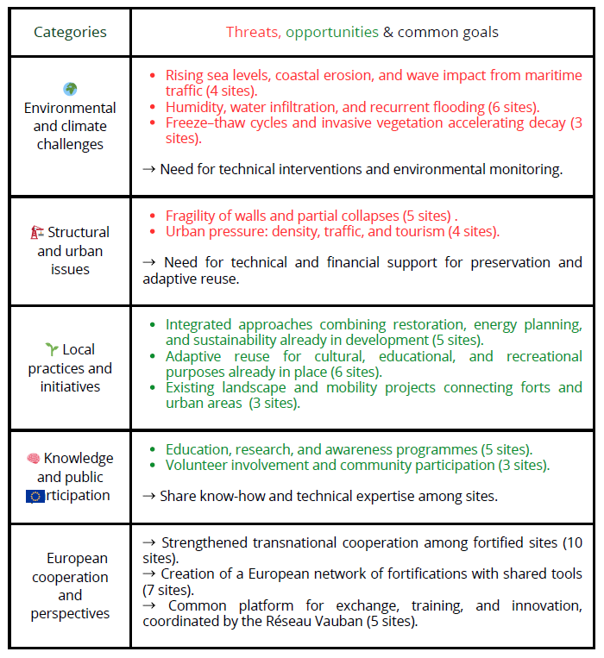
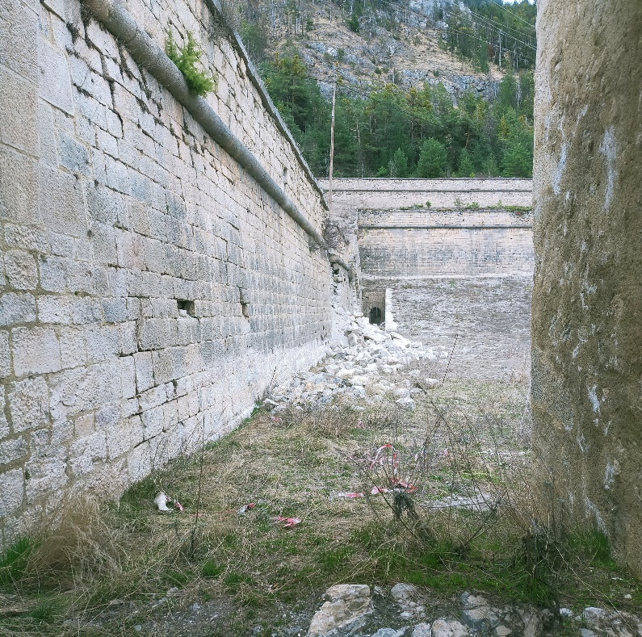
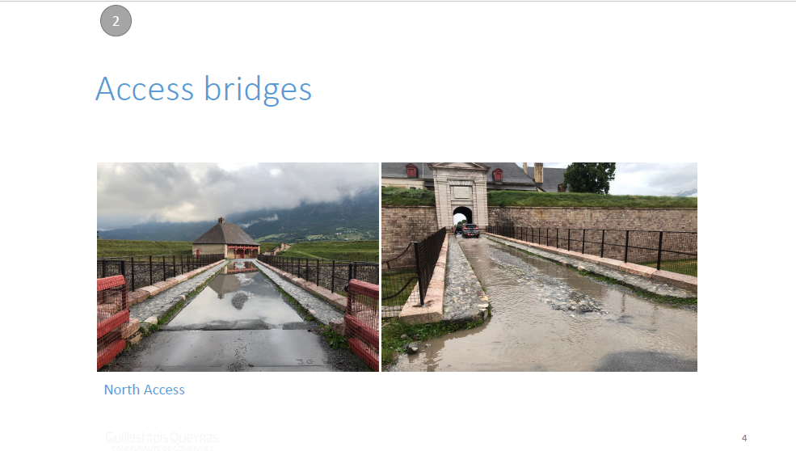
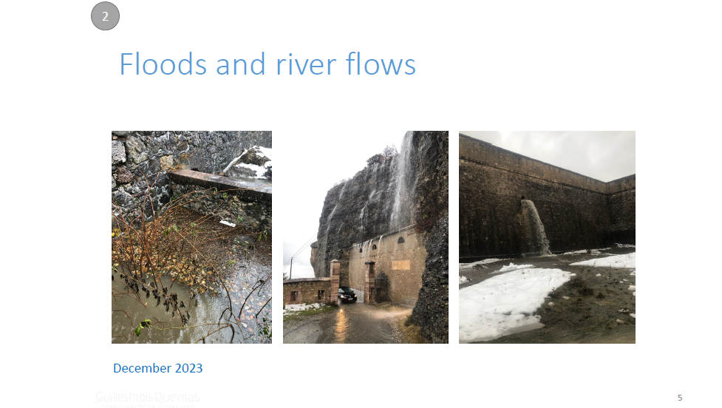
Evolving climate scenarios in fortifications / Growing needs

Slide 5
Workflow 2025-2026
Launch webinar
Pitch presentations #1
Pitch presentations #2
Thematic
meeting : adaptive reuse
Thematic
meeting : restoration
June 2025
January 2026
April 2026
November 2025
March 2026
Mai 2025
Follow-up meeting
Technical meeting
Technical meeting

Slide 6


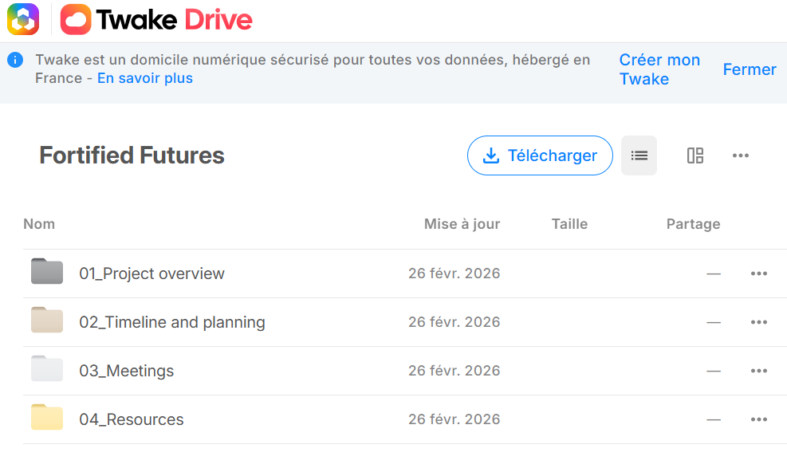
Available resources and how to contribute:
A shared platform
Online drive https://fortifiedfutures-drive.twake.app/#/folder/4b74d40080bc11d0fc9d3b4737033187
Already available!!!

Slide 7
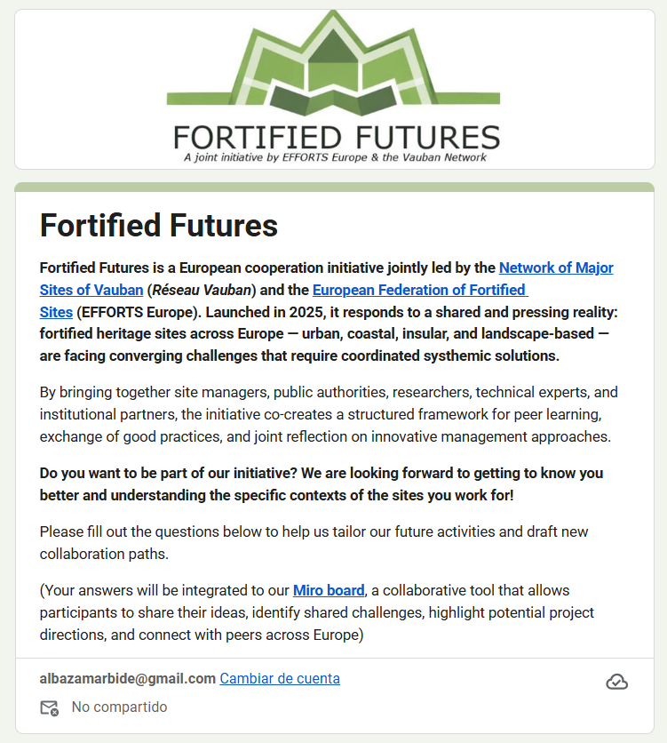
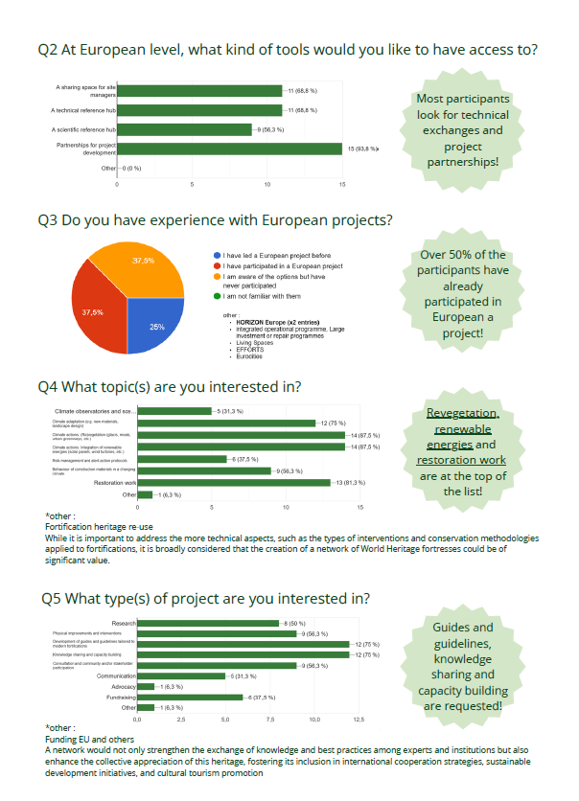
Available resources and how to contribute:
A shared platform
Online drive https://fortifiedfutures-drive.twake.app/#/folder/4b74d40080bc11d0fc9d3b4737033187
Already available!!!
A way to get to know each other and for new participants to introduce themselves to the group
https://docs.google.com/forms/d/e/1FAIpQLSfgonhCXnwYNQDEsHOXSOEck_ivXqwWDUC-CPkA_ELGhB31Bw/viewform
Online survey

Slide 8
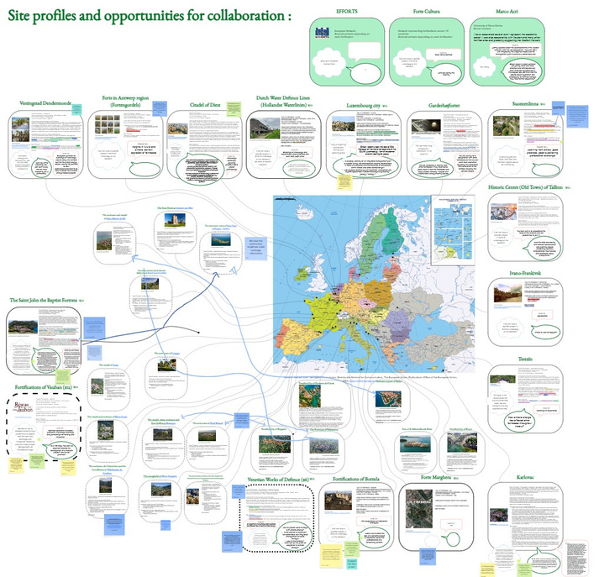
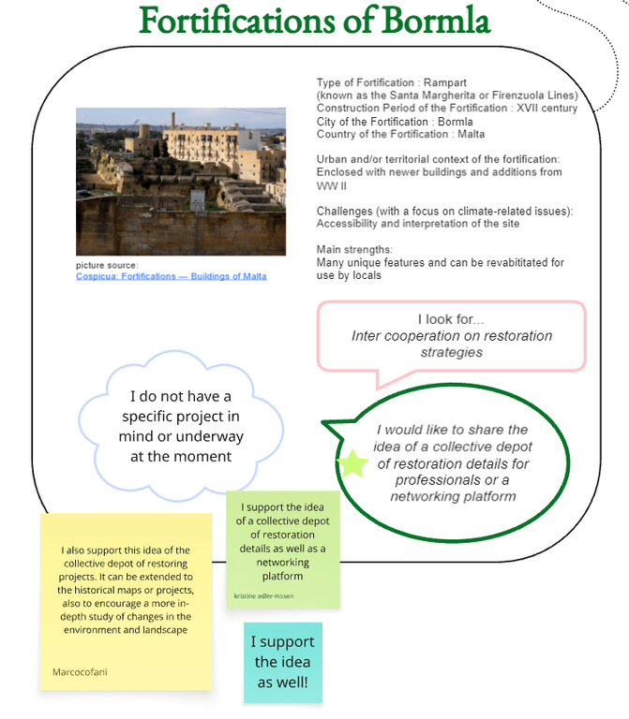
Available resources and how to contribute:
A shared platform
Online drive https://fortifiedfutures-drive.twake.app/#/folder/4b74d40080bc11d0fc9d3b4737033187
Already available!!!
A way to get to know each other and for new participants to introduce themselves to the group
https://docs.google.com/forms/d/e/1FAIpQLSfgonhCXnwYNQDEsHOXSOEck_ivXqwWDUC-CPkA_ELGhB31Bw/viewform
Online survey
Miro board
Site profiles- A tool to quickly understand each-other’s contexts.
New members cans keep adding their profiles here!
https://miro.com/app/board/uXjVIld2Jp4=/

Slide 9
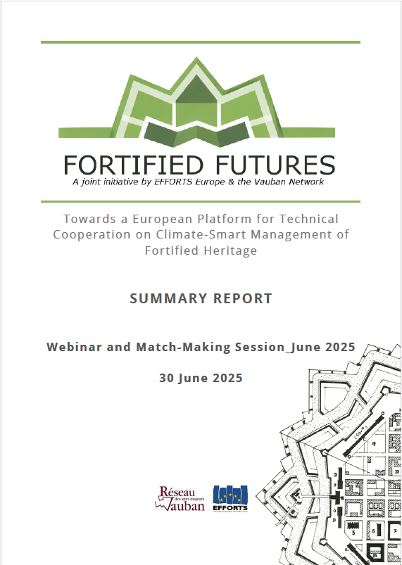
Available resources and how to contribute:
A shared platform
Online drive https://fortifiedfutures-drive.twake.app/#/folder/4b74d40080bc11d0fc9d3b4737033187
Already available!!!
A way to get to know each other and for new participants to introduce themselves to the group
https://docs.google.com/forms/d/e/1FAIpQLSfgonhCXnwYNQDEsHOXSOEck_ivXqwWDUC-CPkA_ELGhB31Bw/viewform
Online survey
Miro board
Site profiles- A tool to quickly understand each-other’s contexts.
New members cans keep adding their profiles here!
https://miro.com/app/board/uXjVIld2Jp4=/
2025 webinar report
An digital copy that can be publicly shared to present the initiative to partners

Slide 10
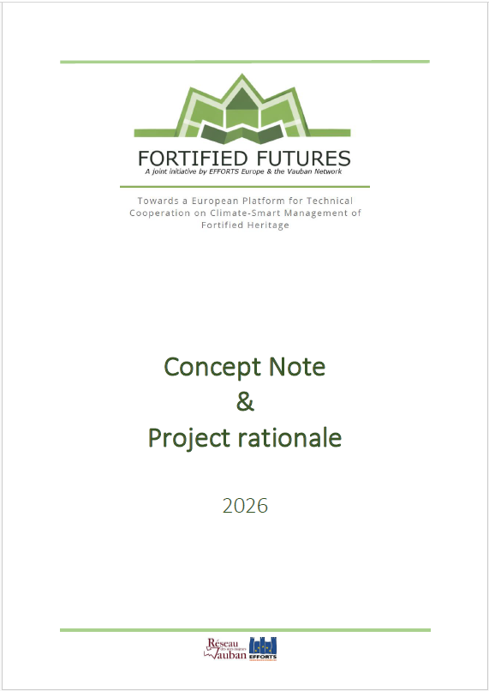
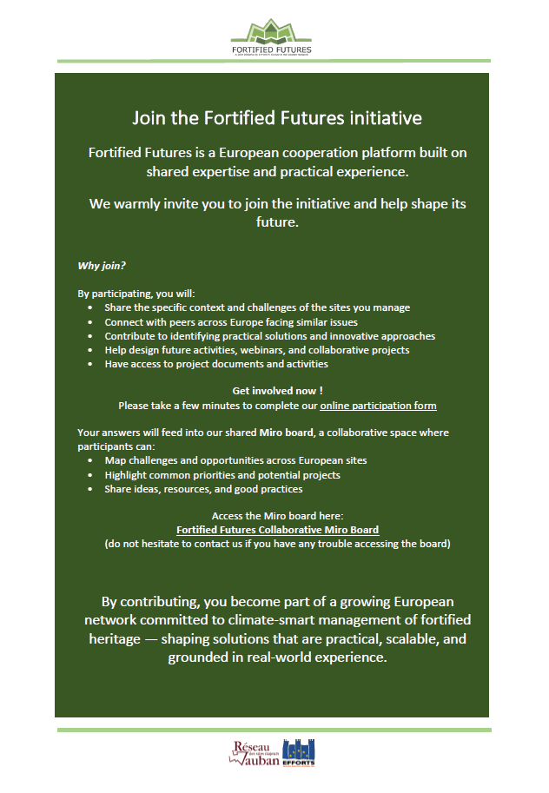
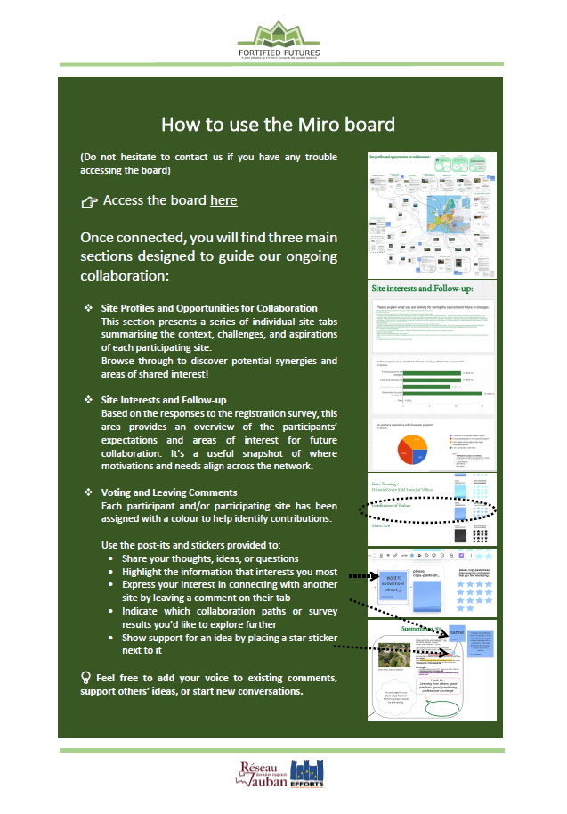
Available resources and how to contribute:
A shared platform
Online drive https://fortifiedfutures-drive.twake.app/#/folder/4b74d40080bc11d0fc9d3b4737033187
Already available!!!
A way to get to know each other and for new participants to introduce themselves to the group
https://docs.google.com/forms/d/e/1FAIpQLSfgonhCXnwYNQDEsHOXSOEck_ivXqwWDUC-CPkA_ELGhB31Bw/viewform
Online survey
Miro board
Site profiles- A tool to quickly understand each-other’s contexts.
New members cans keep adding their profiles here!
https://miro.com/app/board/uXjVIld2Jp4=/
2025 webinar report
An digital copy that can be publicly shared to present the initiative to partners
Written support
  Concept note and 2026 project rationale
  “How to” sheets
  Contact list (in order to participants getting in touch with each-other)

Slide 11

Available resources and how to contribute:
A shared platform
Online drive https://fortifiedfutures-drive.twake.app/#/folder/4b74d40080bc11d0fc9d3b4737033187
Already available!!!
A way to get to know each other and for new participants to introduce themselves to the group
https://docs.google.com/forms/d/e/1FAIpQLSfgonhCXnwYNQDEsHOXSOEck_ivXqwWDUC-CPkA_ELGhB31Bw/viewform
Online survey
Miro board
Site profiles- A tool to quickly understand each-other’s contexts.
New members cans keep adding their profiles here!
https://miro.com/app/board/uXjVIld2Jp4=/
2025 webinar report
An digital copy that can be publicly shared to present the initiative to partners
Written support
  Concept note and 2026 project rationale
  “How to” sheets
  Contact list (in order to participants getting in touch with each-other)
Coming in summer 2026
Meeting minutes
Summaries of the sessions
Recordings (limited time depending on server stockage capacity)
Project sheets
  A collective depot of good practice projects and project ideas by sites looking for partners

Slide 12
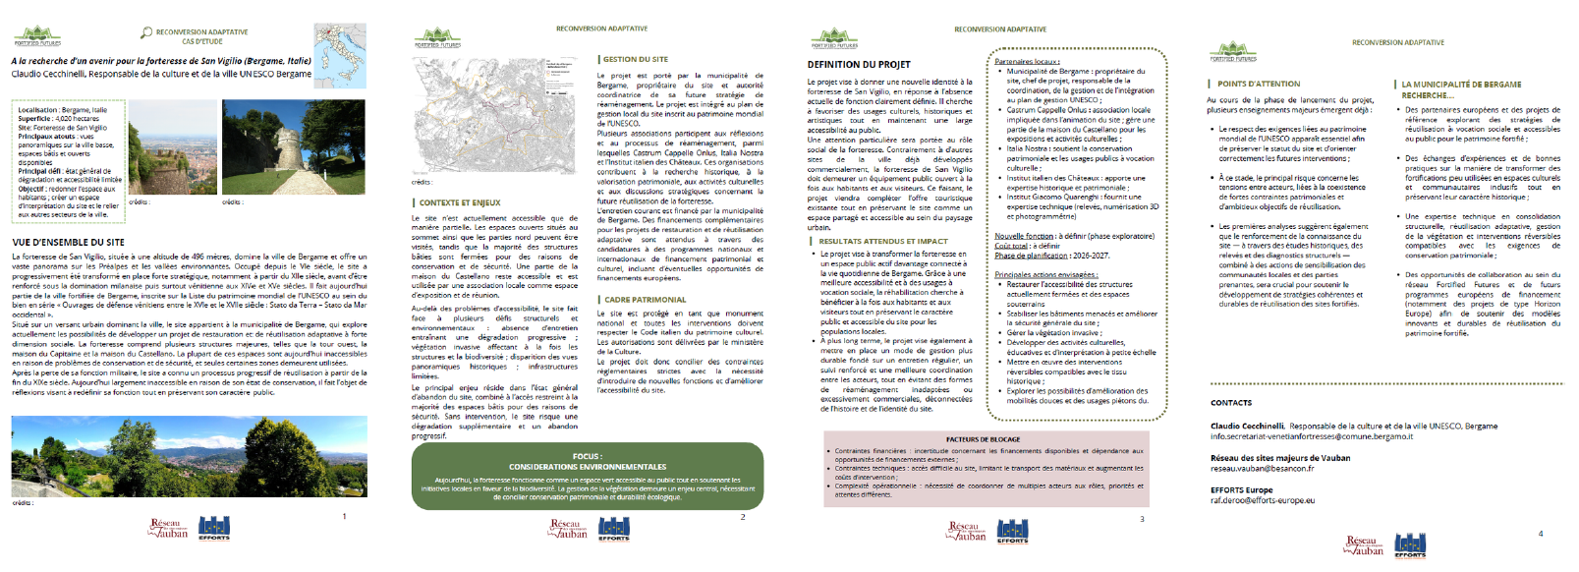
Available resources and how to contribute:
Coming in summer 2026
Meeting minutes
Summaries of the sessions
Recordings (limited time depending on server stockage capacity)
Project sheets
  A collective depot of good practice projects and project ideas by sites looking for partners

Slide 13
Associating the private sector in climate resilience projects in European fortifications
-
Potential projects identified within the Fortified Futures initiative

Slide 14
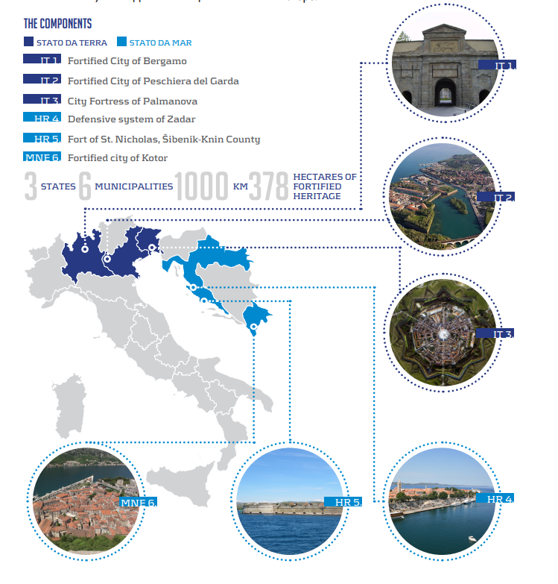
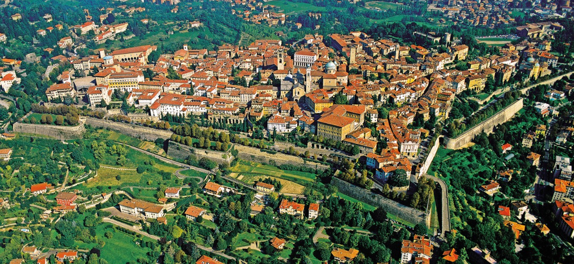
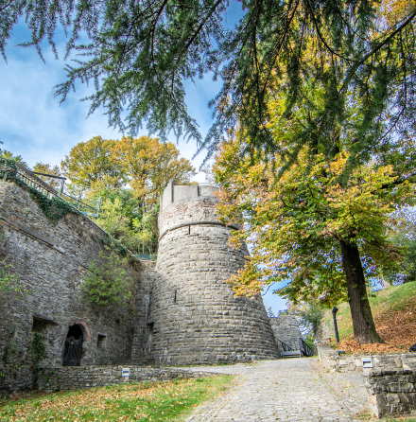

Slide 15
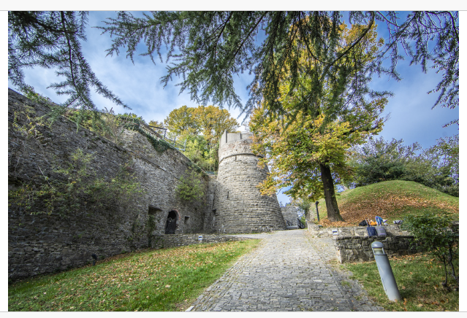
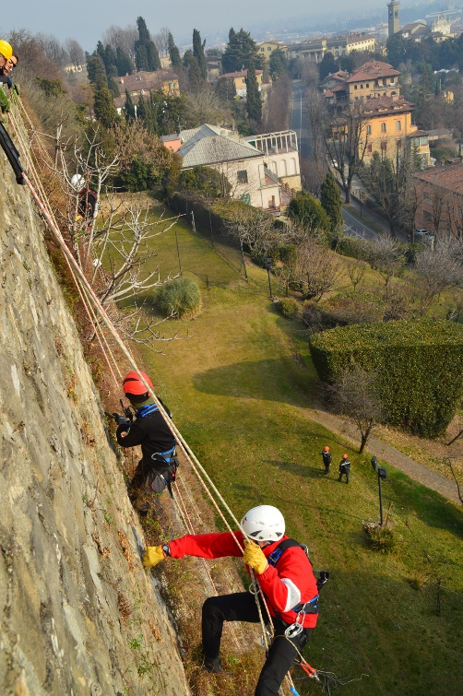
Reuse:
Claudio Ceccinelli - Venitian works of Defence (Bergamo, Italy)
Potential actions we can integrate as part of our project:
Dialogue with private developers, architects, and construction companies to include social and climate dimensions in the project – contract conditions
Research and training on historical and contemporary use of vegetation in fortifications – before the project? As par of the procurement?
Project in development - Key expected actions:
Stabilising endangered buildings and improving overall site safety
Enhancing existing structures and materials through environmentally responsible solutions
Managing invasive vegetation affecting both structures and historic panoramic views
Implementing reversible interventions compatible with heritage conservation, climate and sustainability requirements
Reconnecting the fortress with the daily life of Bergamo through socially oriented uses
Developing small-scale cultural, educational and interpretation activities linked to the UNESCO site
Improving soft mobility access and pedestrian use of the hilltop site
Restoring accessibility to currently closed structures and underground spaces
Preserving the public and accessible character of the site for local inhabitants

Slide 16
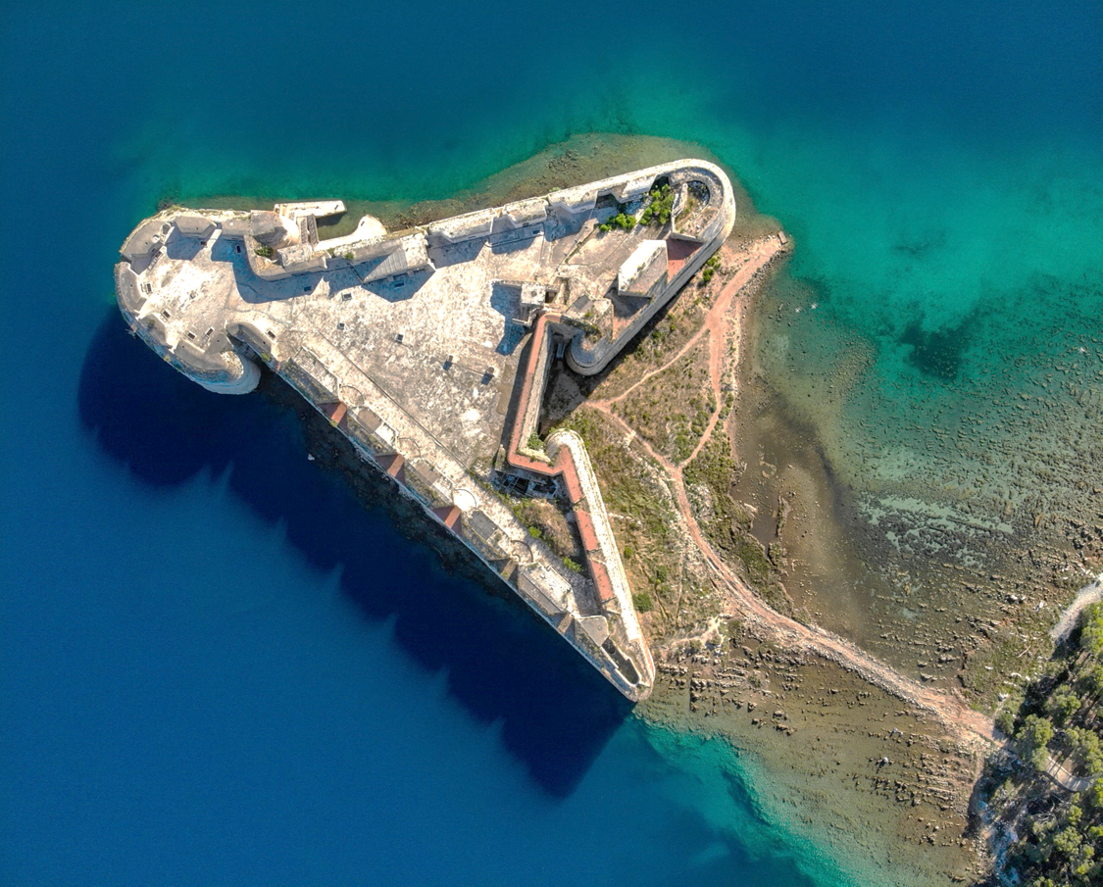
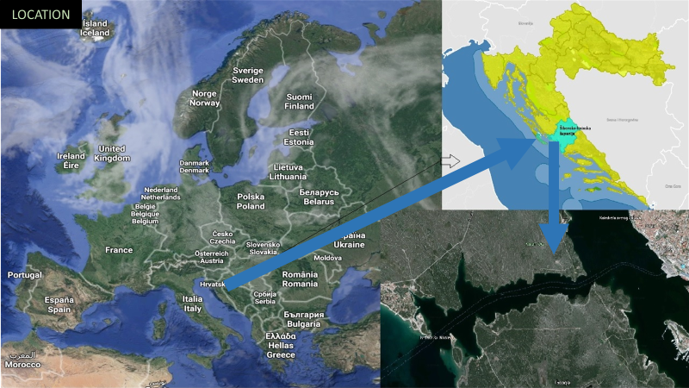
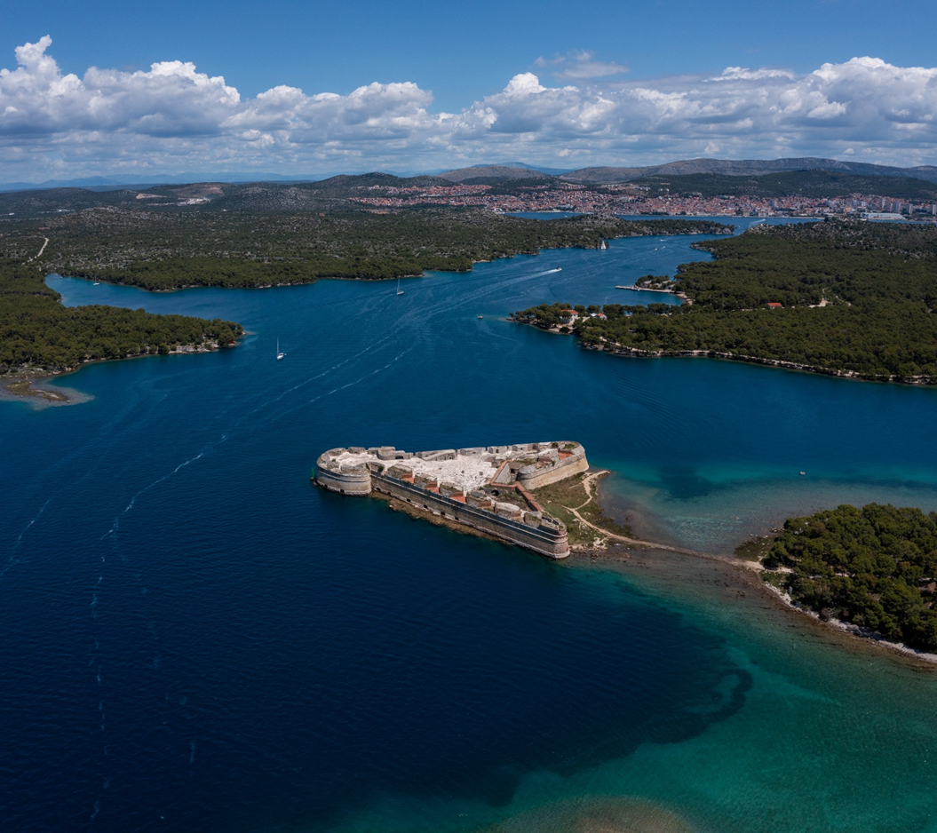
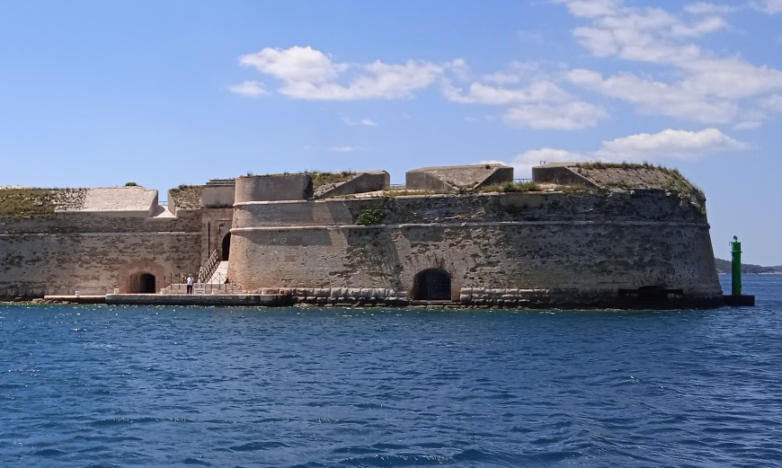

Slide 17
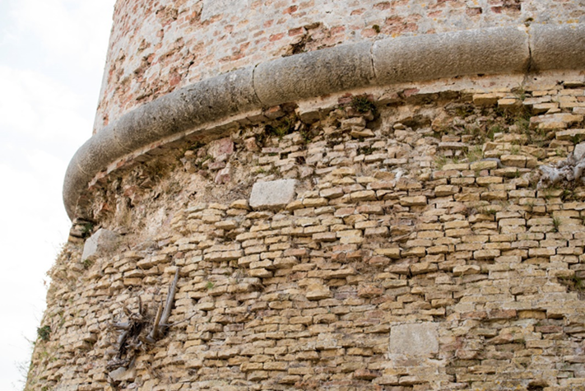
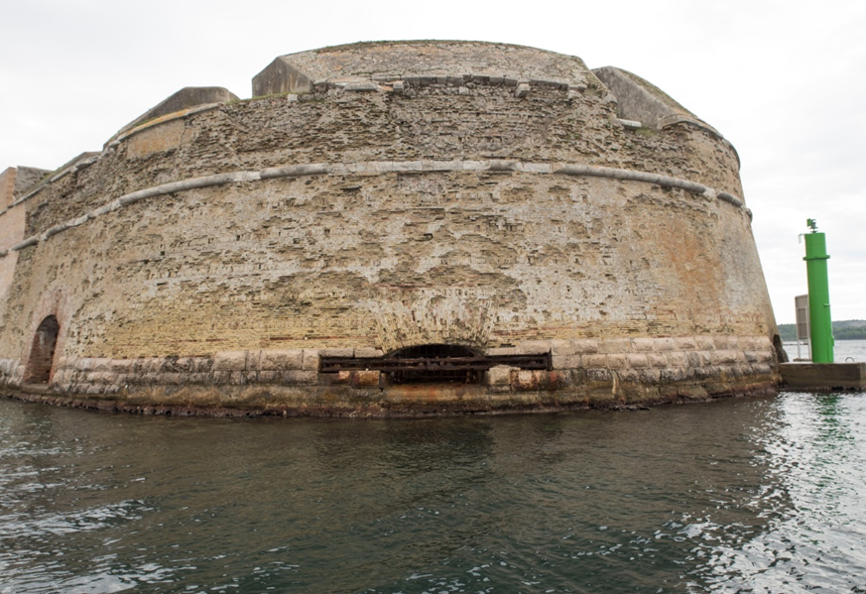
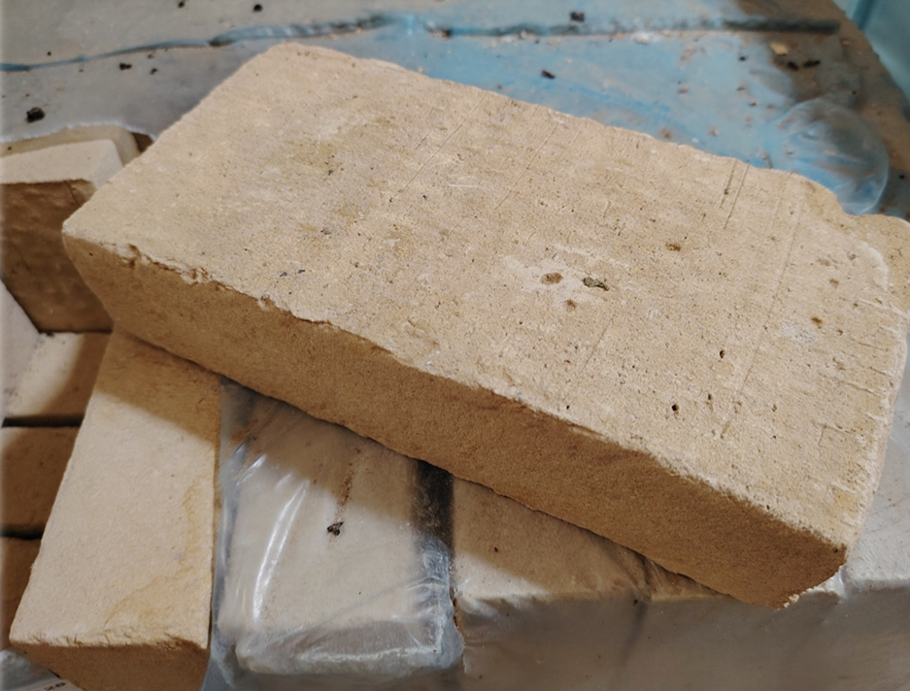
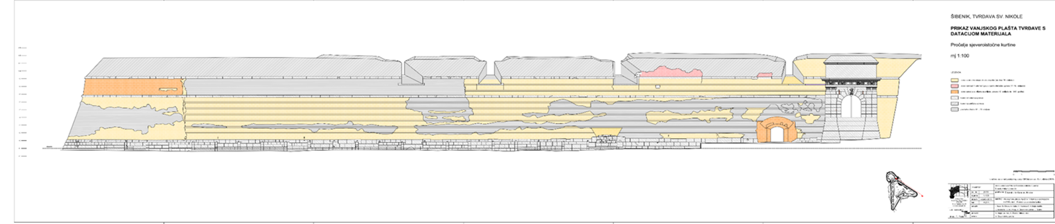
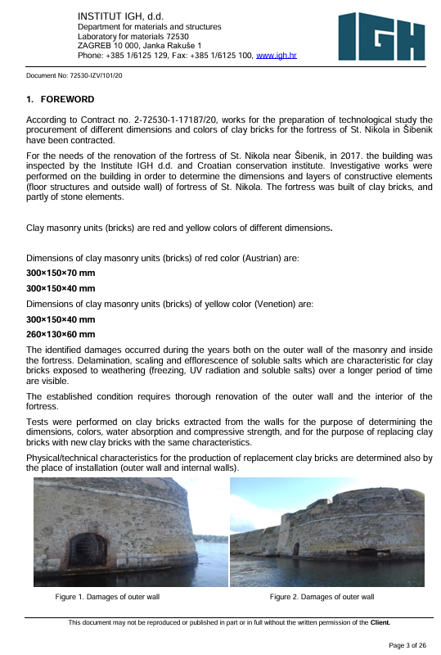
Adapted materials:
Anamarija Kucan - Department for Archeology and Cultural Heritage, Public Institution Nature of the Šibenik-Knin County
Venitian works of Defence (Šibenik, Croatia)
Potential actions we can integrate as part of our project:
Dialogue with private construction companies and material providers
Negotiating the production of new materials adapted the climate requirements
Research and development agreements
Test projects and
related costs
TECHNOLOGICAL STUDY FOR THE PROCUREMENT OF MASONRY UNITS (BRICKS) FOR ST NICHOLAS FORTRESS, Institut IGH, 2020
technical and visual characteristics in accordance with the original brick and with high professional criteria
joint guidelines established in agreement with UNESCO partners

Slide 18
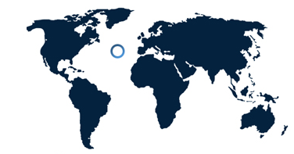
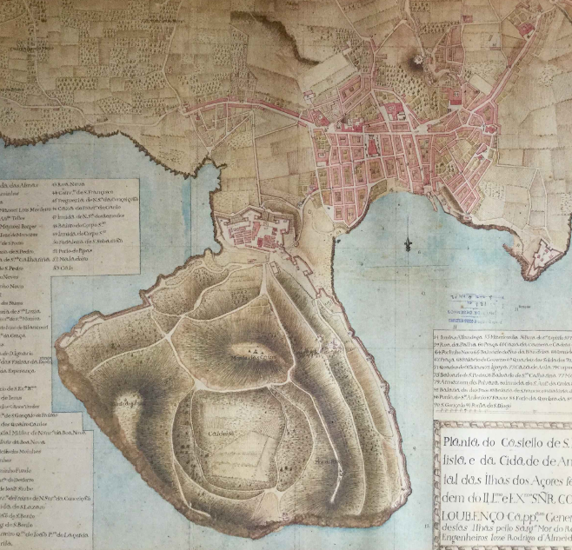
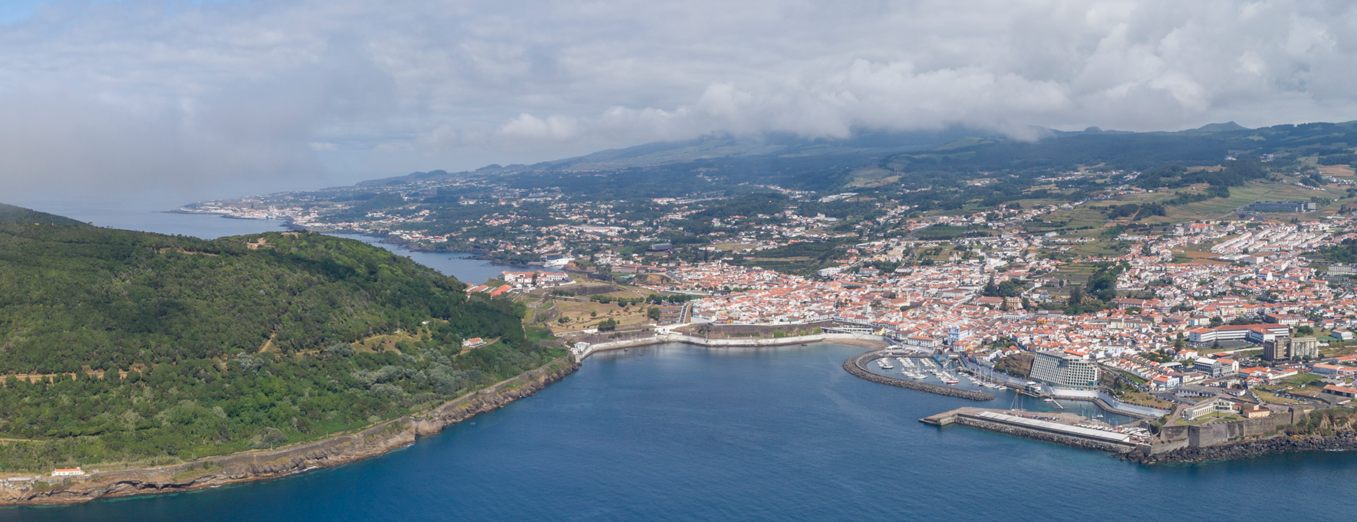

Slide 19
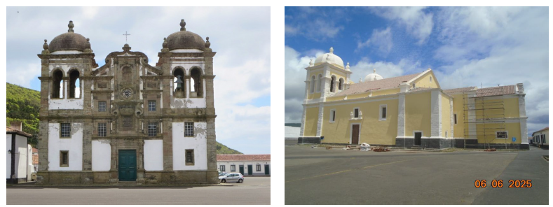
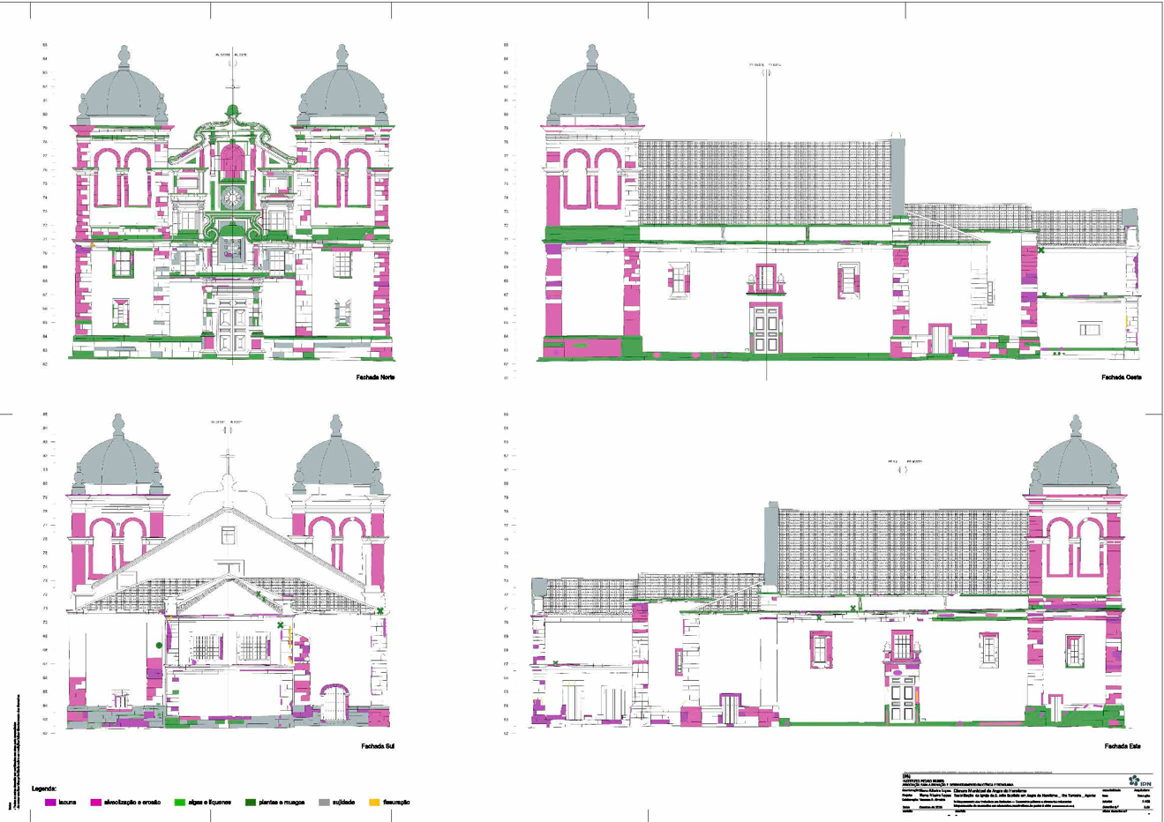
Conservation and limits of acceptable change:
Magda de Oliveira Gonçalves - Fortresses of São João Baptista and São Sebastião (Angra do Heroísmo, Portugal)
Potential actions we can integrate as part of our project:
Discussing limits of acceptable change with public authorities allowing new solutions required by climate contexts
Partnerships with research institutes and departments in private companies allowing sites to be testing grounds at the head of solutions
Scientific and technical reports where provided by a public research institute on the mainland. They proved essential in underpinning and guiding the restoration design phase.
Reinterpretation and enhancement of the building, strengthening its identity and its potential for public enjoyment through low impact intervention.
  Application of lime mortar and protective paint to repel water and avoid further damage of the stone, which involved inevitably the transformation of the aesthetic of the building

Slide 20
Discussion #1 – projects (20’)
1.1 Have you recently faced a similar challenge, and already developed a related PPP you would like to share?
PPPs for heritage regeneration
Climate-smart PPPs
…but both?
1. Did one of the examples presented resonate with your own experience or site?

Slide 21
Discussion #1 – projects (20’)
1.1 Have you recently faced a similar challenge, and already developed a related PPP you would like to share?
PPPs for heritage regeneration
Climate-smart PPPs
…but both?
1. Did one of the examples presented resonate with your own experience or site?
Who are/would be your potential partners?
Are they ready to take the climate and resiliency vision into account? How?
What could be the additional costs of demanding this vision to be taken into account?
How can we contribute to creating a context of well-aware partners that will be able to respond to our needs?
1.2 Do you have other examples that could feed this collective reflection?

Slide 22
Discussion #2 – next steps for the Fortified Futures initiative (20’)
2.1 How can we influence private partners to include our needs when there is no law enforcing the integration of future climate scenarios?
2. So far, we are an exchange platform…
Model contracts, requirements document
Database of companies habilitated to work with heritage and sustainability?
  Ex. innovation companies trained to work with heritage
  Ex. heritage companies trained in climate resilience
Have you experience such kind of action? Does a label exist in your country?

Slide 23
Discussion #2 – next steps for the Fortified Futures initiative (20’)
2.1 How can we influence private partners to include our needs when there is no law enforcing the integration of future climate scenarios?
2. So far, we are an exchange platform…
1.2 Should we as a European work group try to push advocacy towards…
Model contracts, requirements document
Database of companies habilitated to work with heritage and sustainability?
  Ex. innovation companies trained to work with heritage
  Ex. heritage companies trained in climate resilience
Have you experience such kind of action? Does a label exist in your country?
a “Green heritage label”
a “guideline” (for partners, developers, governmental agencies)
a “EU norm”
a dedicated “training program” with schools

Slide 24
Discussion #2 – next steps for the Fortified Futures initiative (20’)
2.1 How can we influence private partners to include our needs when there is no law enforcing the integration of future climate scenarios?
1.3 If any, what role could/should the private sector play in the evolution of our initiative?
2. So far, we are an exchange platform…
1.2 Should we as a European work group try to push advocacy towards…
Model contracts, requirements document
Database of companies habilitated to work with heritage and sustainability?
  Ex. innovation companies trained to work with heritage
  Ex. heritage companies trained in climate resilience
Have you experience such kind of action? Does a label exist in your country?
a “Green heritage label”
a “guideline” (for partners, developers, governmental agencies)
a “EU norm”
a dedicated “training program” with schools

Slide 25
Discussion #2 – next steps for the Fortified Futures initiative (20’)
2.1 How can we influence private partners to include our needs when there is no law enforcing the integration of future climate scenarios?
1.3 If any, what role could/should the private sector play in the evolution of our initiative?
2. So far, we are an exchange platform…
1.4 How do we integrate this questions in our work in 2027?
1.2 Should we as a European work group try to push advocacy towards…
Model contracts, requirements document
Database of companies habilitated to work with heritage and sustainability?
  Ex. innovation companies trained to work with heritage
  Ex. heritage companies trained in climate resilience
Have you experience such kind of action? Does a label exist in your country?
Starting with a “manifesto”
A results dissemination phase among private partners
Including these question in future EU project montage (ex. Using “green” restoration projects as a tests for PPPs)
a “Green heritage label”
a “guideline” (for partners, developers, governmental agencies)
a “EU norm”
a dedicated “training program” with schools

Slide 26

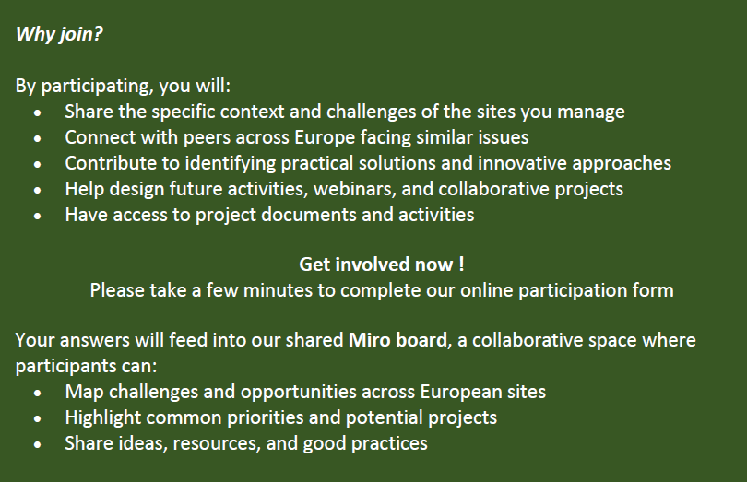
Would you like to join us?

Slide 27
Workflow 2026-2027
Launch webinar
Pitch presentations #1
Pitch presentations #2
Thematic
meeting : adaptive reuse
Thematic
meeting : restoration
Break-out
EFFORTS congress
Thematic
meeting : interpretation
Thematic
meeting : to be decided
June 2025
January 2026
April 2026
June 2026
September 2026
November 2026
November 2025
March 2026
Mai 2026
October 2026
2027
Publication?
Project montage?
Advocacy?
Follow-up meeting
Technical meeting
Technical meeting
Technical meeting

Slide 28
Thank you for your participation
See you at the next Fortified Futures meeting in September!
EuropeanFederation of Fortified Sites
Trierstraat / rue de Trèves 67, 1040 Brussel / Bruxelles
+32 (0)477.623.792
rafael.deroo@efforts-europe.eu
www.efforts-europe.eu
Facebook : /effortseurope/
Twitter : effortseurope
Instagram : Efforts Europe
Réseau des sites majeurs de Vauban
2, rue Mégevand – F 25034 Besançon cedex
+33 3 81 41 53 95 / +33 6 32 96 33 34
reseau.vauban@besancon.fr
www.sites-vauban.org
Facebook: rsmvaubanunesco
Instagram: reseau_vauban_unesco
LinkedIn: Réseau des sites majeurs de Vauban

