Slide 1
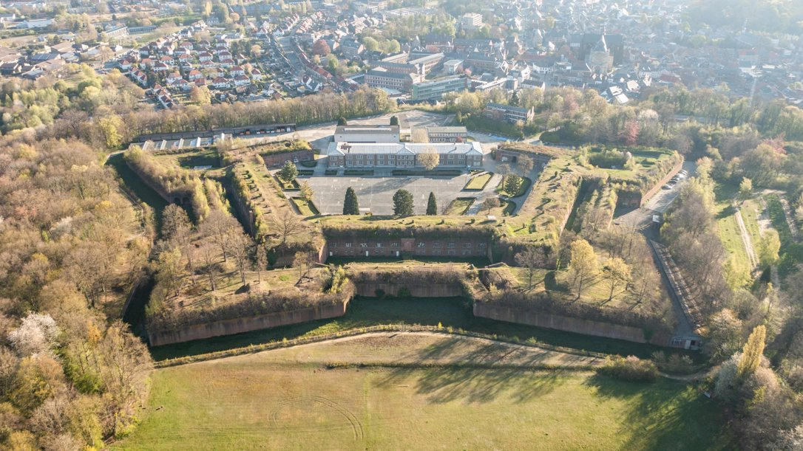


Resilience in today’s societal challenges
EFFORTS 2026 CONGRESS DIEST (BE)
10 June 2026
Mireille van der Meij

Slide 2
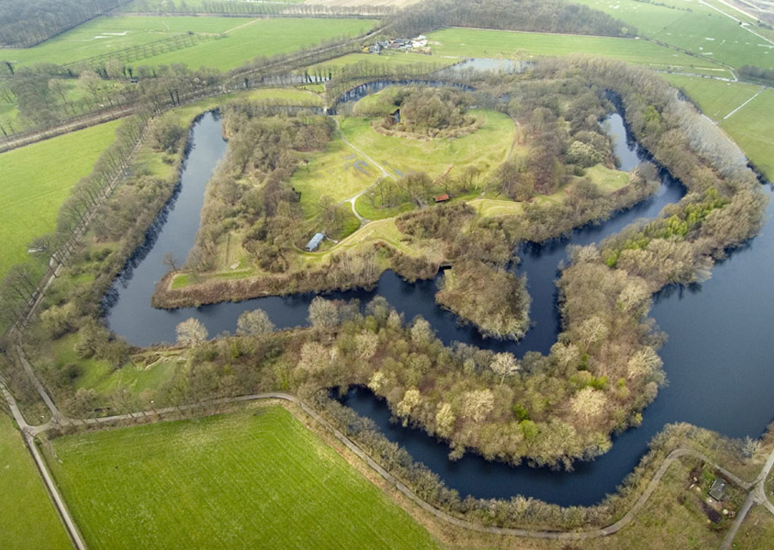
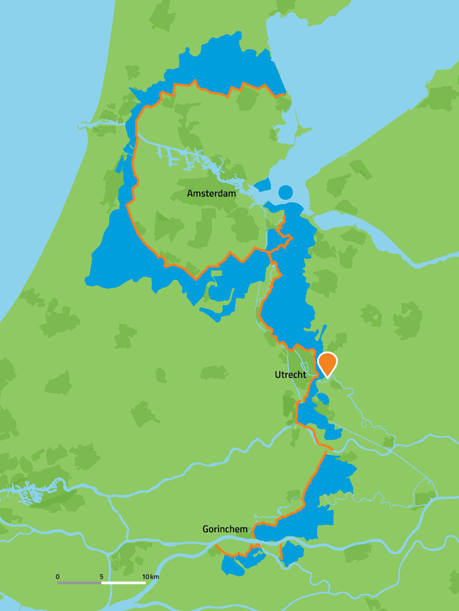
Fortress Rhijnauwen
Notes:
The largest Fortress of the Dutch Water Defence Line and UNESCO heritage

Slide 3

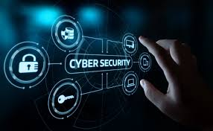
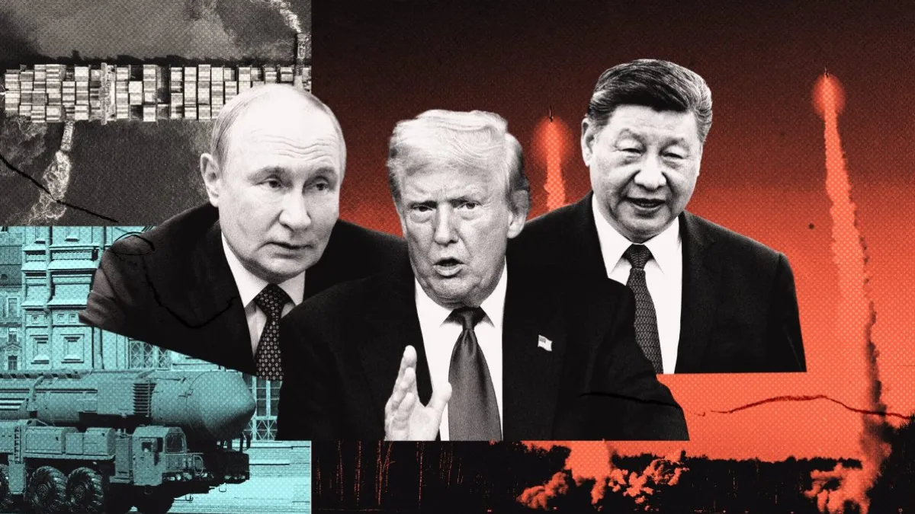
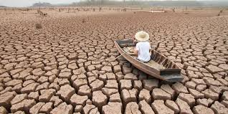
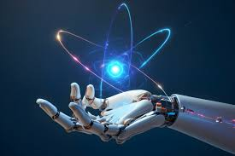
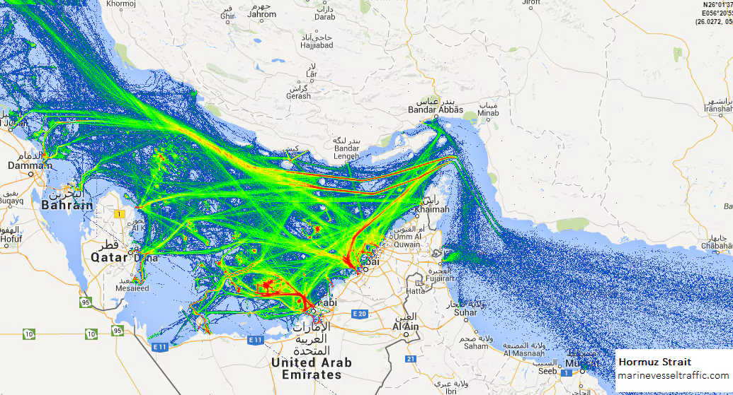
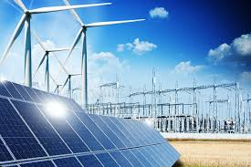
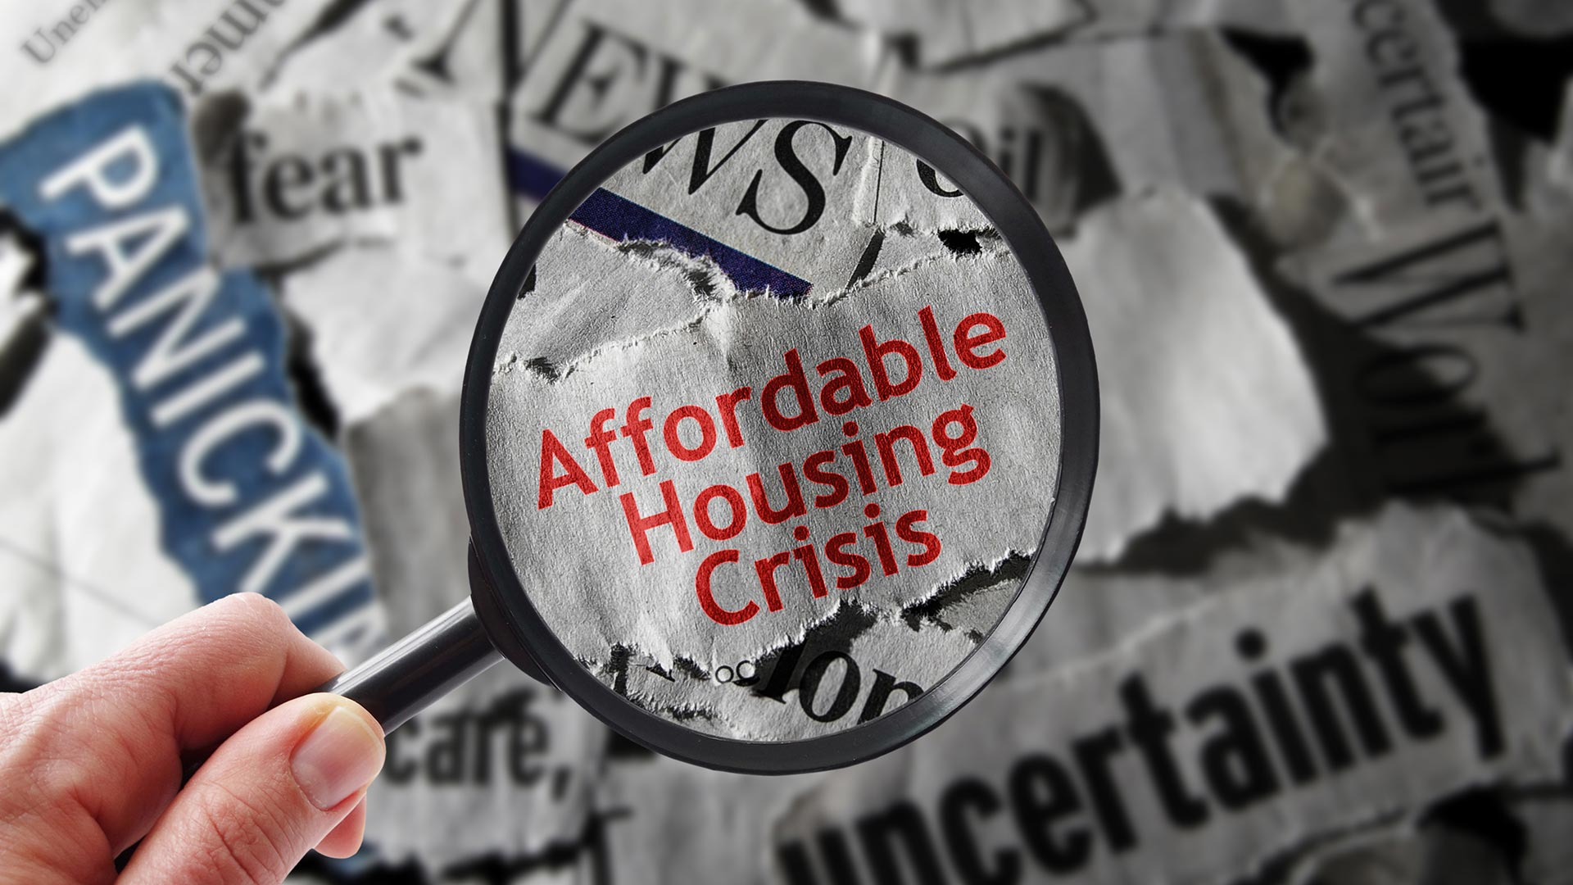
Today’s societal challenges
Pandemics
Cyber security
Geopolitical tensions
Climate change
AI and technological disruption
Energy security
Supply chain vulnerabilities
Housing and affordability crisis
Notes:
A U.S. soldier investigates the scene of a suicide bombing at the border crossing between Afghanistan and Pakistan on June 19 in Torkham, Nangarhar province, Afghanistan. Three Taliban suicide bombers attacked and burned 37 NATO military fuel vehicles during an assault on an outpost along the main supply route for coalition forces.

Slide 4
Resilience
Sustainability
Defence

Slide 5
Resilience
the ability to be happy, successful, etc. again after something difficult or bad has happened
the qualityof being able to return quickly to a previous good condition after problems
the ability of a substance to return to its usual shape after being bent, stretched, or pressed
Cambridge English Dictionary

Slide 6


How authorities use “resilience”
EU Preparedness Union Strategy
EU’s Critical Entities Resilience Directive NATO
resilience consists of the following five building blocks: to anticipate, prepare, alert, respond and secure.7
resilience means a critical entity’s ability to prevent, protect against, respond to, resist, mitigate, absorb, accommodate and recover from an incident.
resilience refers to the capacity, at the national and collective level, to prepare for, resist, respond to and quickly recover from strategic shocks and disruptions across the full spectrum of threats.
Notes:
The word "resilience" has become extremely common in government, policy, military, economic, and political language over the past few decades. While it originally referred to the ability of a material to spring back after being bent or stretched, authorities now use it much more broadly.
How authorities use "resilience"
Governments and institutions often define resilience as the ability of a system, community, or nation to withstand shocks, adapt, and continue functioning.

Slide 7
Disruptions are not sudden
Notes:
The word "resilience" has become extremely common in government, policy, military, economic, and political language over the past few decades. While it originally referred to the ability of a material to spring back after being bent or stretched, authorities now use it much more broadly.
How authorities use "resilience"
Governments and institutions often define resilience as the ability of a system, community, or nation to withstand shocks, adapt, and continue functioning.

Slide 8
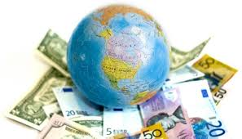
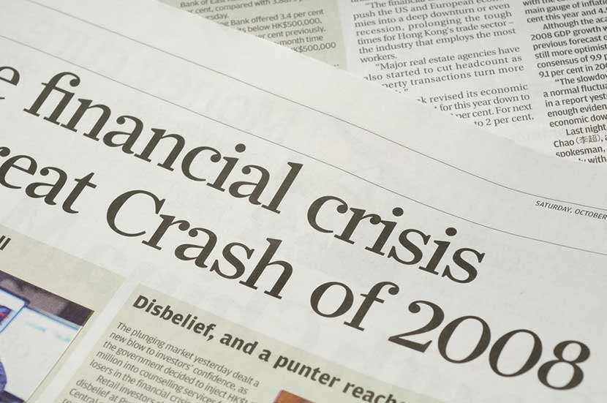
Evolvement over the past decades
1990–2008
Efficiency
2008–2020
Stability
> 2020
Resilience
How do we cope with
continuous disruptions?
How do we manage the
consequences of growth?
How can we maximise
economic growth?
Globalization
Liberalization of markets
Technological optimism
European integration
Outsourcing and efficiency
Growth of the internet
Financial instability
Rising inequality
Housing crises
Political polarization
Migration pressures
Populism
Social media's disruptive effects
Growing awareness of climate change

Slide 9
Age of resilience
Pandemics
Cyber security
Geopolitical tensions
Climate change
AI and technological disruption
Energy security
Supply chain vulnerabilities
Housing and affordability crisis
Notes:
A U.S. soldier investigates the scene of a suicide bombing at the border crossing between Afghanistan and Pakistan on June 19 in Torkham, Nangarhar province, Afghanistan. Three Taliban suicide bombers attacked and burned 37 NATO military fuel vehicles during an assault on an outpost along the main supply route for coalition forces.

Slide 10
Resilience
Sustainability
Defence

Slide 11

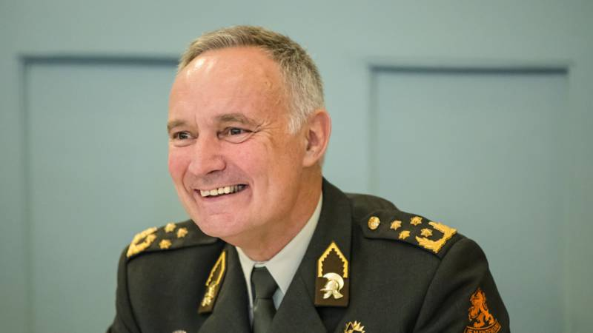
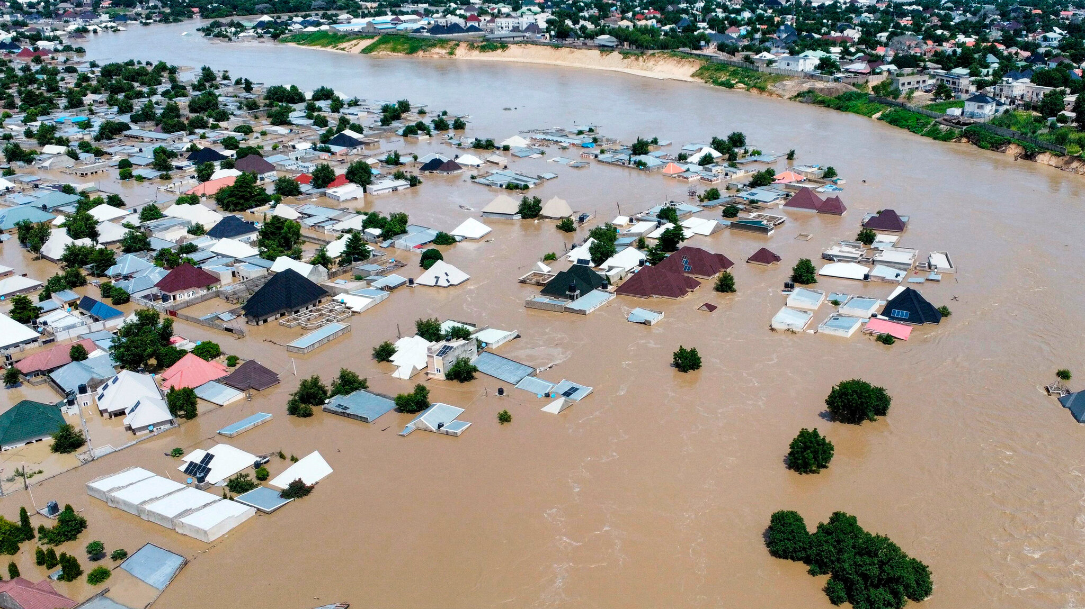
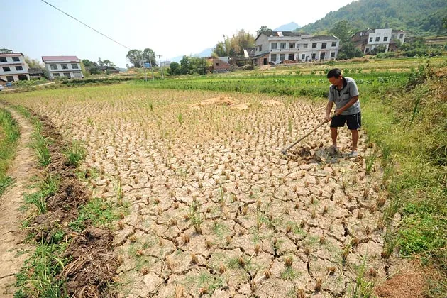
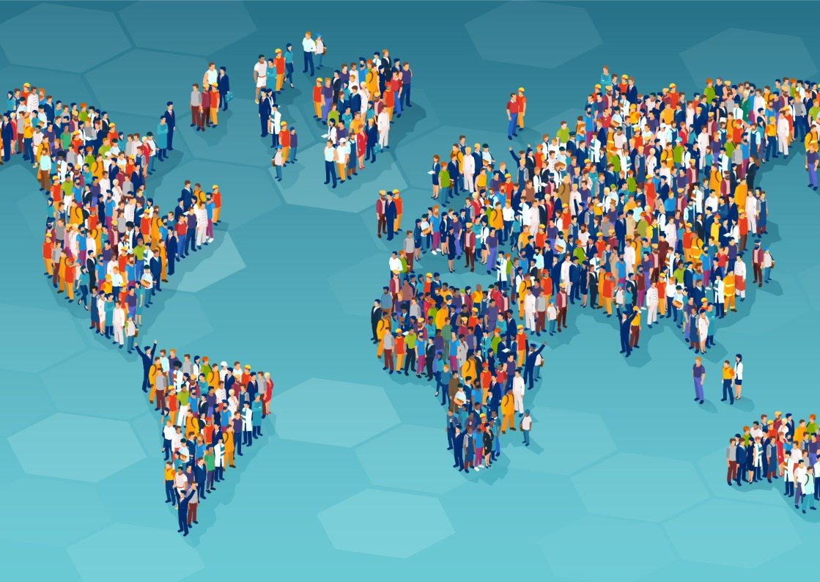
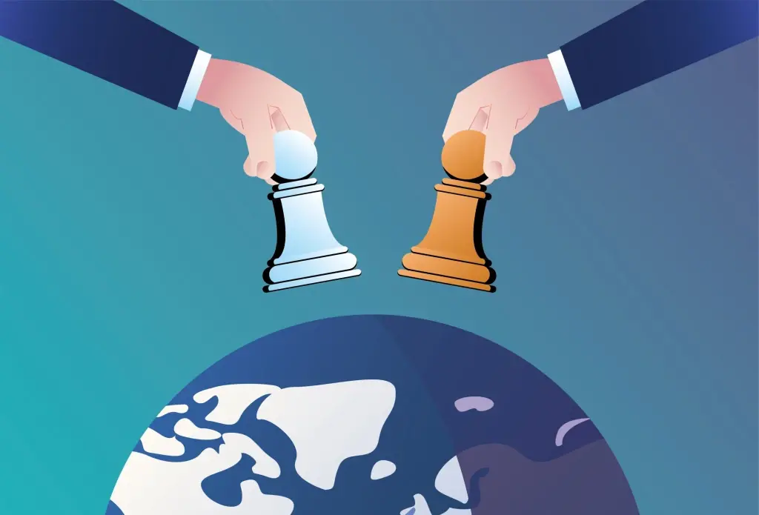
Megatrends
A world under pressure
Tom Middendorp
Climate General
Supply
Demand
Climate change
Resource scarcity
Population growth
Geopolitical fragmentation
Notes:
Tom Middendorp Chief of Defense from 2012 – 2017 veiligheidsvraagstukken door klimaatverandering
Climate change gamechanger for security

Slide 12

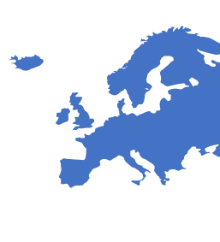

Today’s security issues
Energy security
Resource independence
Climate adaptation

Slide 13
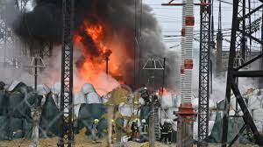
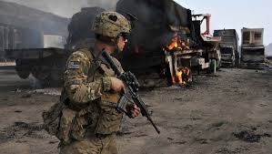
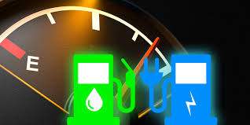
Energy security
Energy transition
Energy transition is not about emissions, but about strategic realism
Notes:
Enery transistion is not about idealism but about strategic realism
It is not about the emissions, but about the mission
30% of governmental energy use is in defense
10-12% of casualities are related to fuel and water transport
In Afghanistan and Iraq most of the US casualities were in fuel transport
Verandering komt door urgentie en perspectief (kansen voor de toekomst)
Korte en lange termijn verbinden met elkaar
renewable energy is increasingly discussed not only as a climate solution but also as a security strategy.
A U.S. soldier investigates the scene of a suicide bombing at the border crossing between Afghanistan and Pakistan on June 19 in Torkham, Nangarhar province, Afghanistan. Three Taliban suicide bombers attacked and burned 37 NATO military fuel vehicles during an assault on an outpost along the main supply route for coalition forces.

Slide 14
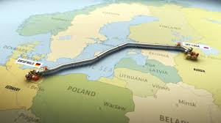

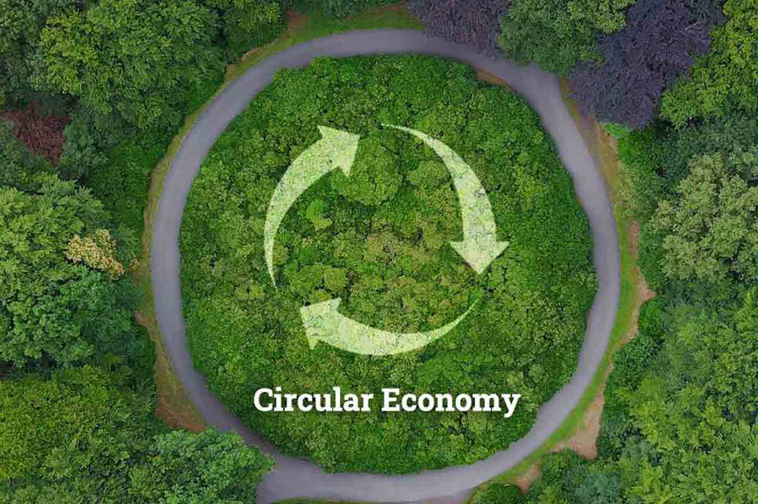
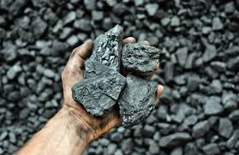
Resource independence
Energy transition
Circular Economy
Circularity not only contributes to environmental sustainability but also to economic resilience and strategic security
Notes:
2026 Middle East oil disruption exposed Europe’s vulnerability to fuel supply shocks.

Slide 15
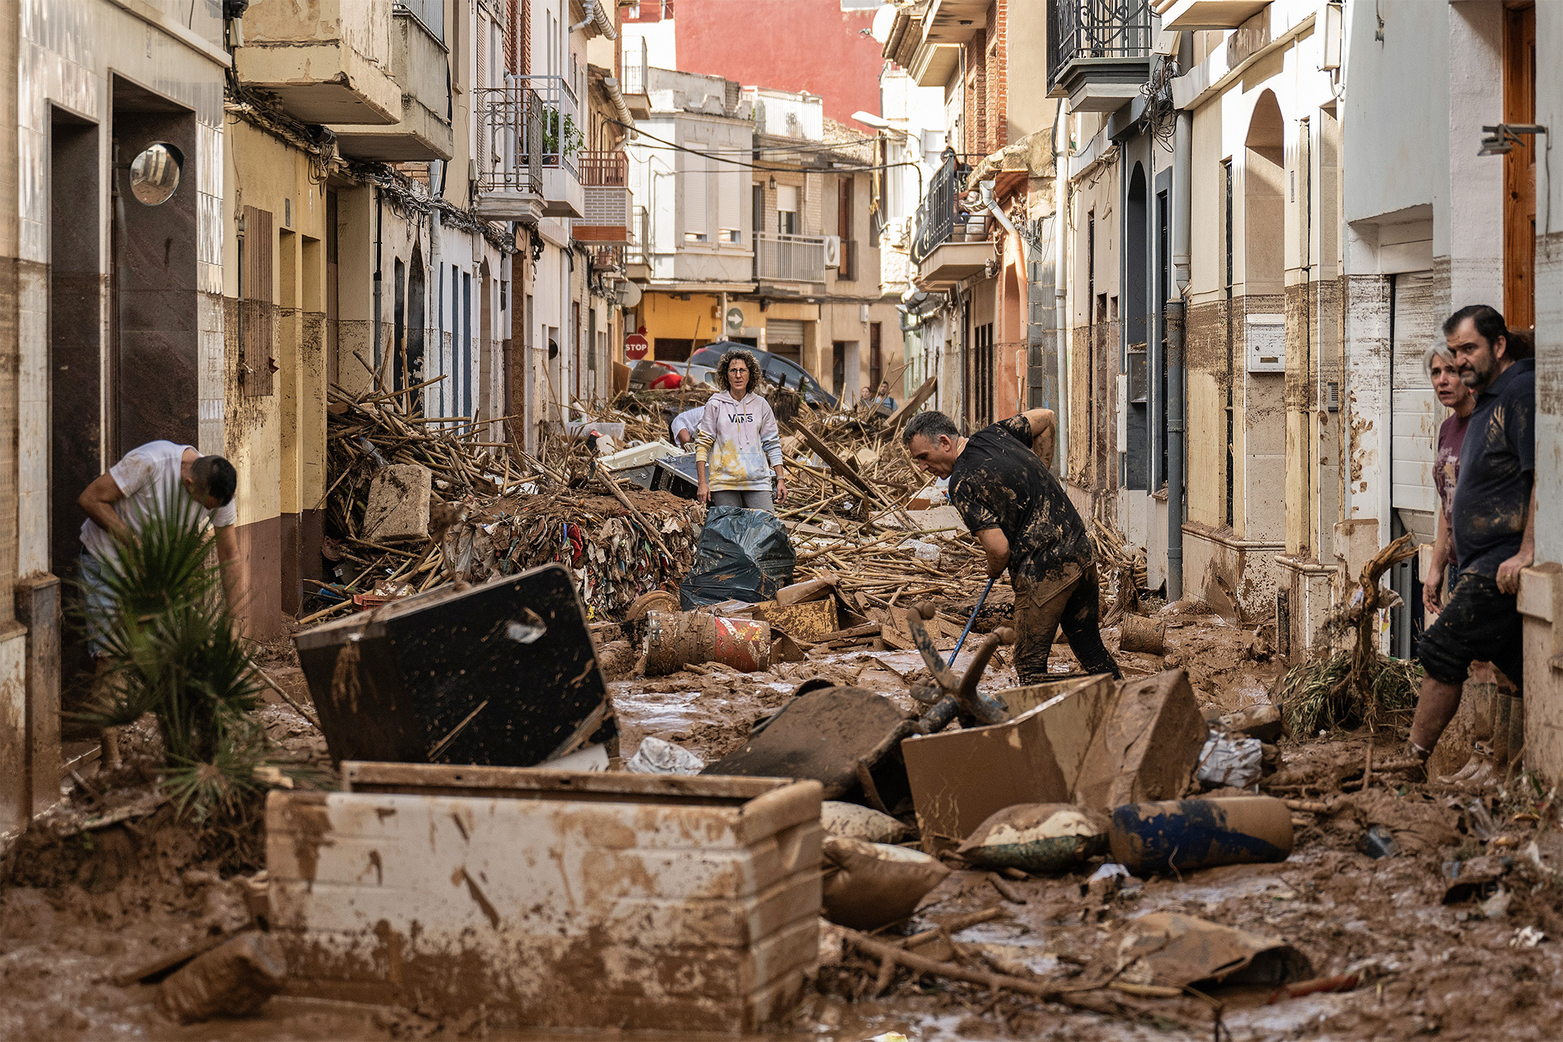
Climate adaptation
Valencia flooding 2024
One of the deadliest natural disasters in Spanish history
The largest deployment of troops in peacetime
Showed critical shortcomings in Spanish disaster prepardness
Notes:
In late October 2024, Spain experienced one of its deadliest floods in decades, with the Valencia region and nearby areas suffering devastating impacts. Over 200 lives were tragically lost, thousands were displaced, and the destruction of infrastructure and livelihoods was extensive. It exposed critical shortcomings in Spain’s disaster preparedness
Sánchez said the deployment of 10.000 troops and police was Spain's largest in peacetime, in response to one of the worst floods in Europe this century.

Slide 16
Resilience
Resist and adapt
Sustainability
Long term capacity
Defence
Protection from disruptions

Slide 17
Resilience is not a new idea
Notes:
Although resilience feels like a contemporary concept, societies have always designed systems to cope with uncertainty:
water systems,
infrastructure,
defensive landscapes,
fortified settlements.
Zuiderwaterlinie
UNESCO waterlinie
GLACIS

Slide 18
Early resilient infrastructure
The broader purpose of a fortress
Protecting populations
Securing food and water supplies
Ensuring continuity of society
Preserving trade routes
Maintaining governance during crises
Notes:
Fortresses as Early Resilience Infrastructure
We tend to think of a fortress as a military object, but historically it served a much broader purpose:
Protecting populations
Securing food and water supplies
Maintaining governance during crises
Preserving trade routes
Ensuring continuity of society
In modern language, these are all aspects of resilience.
A fortress was not merely designed to stop an attack. It was designed to ensure that a community could continue functioning under extreme pressure.

Slide 19
Fortresses and resilience principles
Anticipate shocks:
a crisis will happen
Build redundancy: multilayers as failure was expected
Maintain adaptive capacity:
medieval walls fortified bastions military landscapes cultural and civic infrastructures
Notes:
Resilience Before the Word Existed
Modern resilience literature emerged largely from ecology, disaster management, and systems theory in the late 20th century.
Yet fortress builders intuitively understood several resilience principles:
1. Anticipate shocks
A fortress assumed:
A crisis will happen.
Not:
A crisis might happen.
Likewise, modern resilience planning assumes:
Pandemics will occur.
Cyberattacks will occur.
Climate disruptions will occur.
2. Build redundancy
Fortresses rarely depended on a single wall, gate, well, or supply route.
Multiple layers existed because failure was expected.
Today:
Multiple energy sources
Backup communication systems
Alternative suppliers
This is the same principle.
3. Maintain adaptive capacity
Fortresses evolved continuously.
Medieval walls became bastioned fortifications.
Bastioned fortifications became military landscapes.
Military landscapes became cultural and civic infrastructure.
They survived because they adapted.
That is essentially the definition of resilience:
The ability to absorb disturbance while maintaining identity and function.

Slide 20
Built to endure. Designed to adapt.
Notes:
“Forts show that sustainability is not only about efficiency, but also about sustainability in the sense of longevity: structures that remain relevant for generations because they are able to adapt.”
“Europese forten beschermden ooit territoria.
Vandaag kunnen ze helpen onze samenleving te beschermen tegen klimaatstress, energie-afhankelijkheid en verlies van gemeenschapszin.”
Of:
“Misschien zijn forten niet het erfgoed van vroegere crises — maar infrastructuren voor toekomstige weerbaarheid

Slide 21
Sustainability and resilience: a close connection
Sustainability
Resilience
Long term balance on environment, economy and society
Resilience is the capacity to resist and adapt, endure, and remain meaningful in times of change.

Slide 22
Resilience in today’s societal challenges
EFFORTS 2026 CONGRESS DIEST (BE)
10 June 2026
Mireille van der Meij

Slide 23
Resilience
Resist
Adapt
Notes:
https://css.ethz.ch/en/center/CSS-news/2026/05/what-do-we-mean-when-we-talk-about-resilience.html
One important takeaway from the conference was that resilience should not simply be understood as the ability to absorb shocks and recover from them. Human, political, ecological, and infrastructural systems do not come under pressure only through sudden disruptions.

Slide 24
A close connection
Sustainability
Resilience
resilience as a prerequisite for sustainability, and sustainability as a long-term objective that resilience helps achieve.

Slide 25
Protection from threats
Protecting society’s
ability to function
Protecting territory
Defense
Armies
Borders
Military operations
Which include Energy networks
Communication systems
Data infrastructure
Food systems
Water systems
Healthcare systems
Transportation networks
Resilience
Disaster management
Infrastructure
Sustainability
Civil protection
CyberattacksSabotageDisinformationEconomic coercionAttacks on energy infrastructure the rise of hybrid threats
Notes:
Recognition that societies can be vulnerable in many ways beyond military invasion

Slide 26
Resilience: what does it mean?
EU Preparedness Union Strategy
resilience consists of the following five building blocks: to anticipate, prepare, alert, respond and secure.7
Cambridge Business English Dictionary
Resilience: the quality of being able to return to a previous good condition after problems
The resilience of the economy has come to a surprise to some
NATO
resilience refers to the capacity, at the national and collective level, to prepare for, resist, respond to and quickly recover from strategic shocks and disruptions across the full spectrum of threats.
EU’s Critical Entities Resilience Directive
resilience means a critical entity’s ability to prevent, protect against, respond to, resist, mitigate, absorb, accommodate and recover from an incident.

Slide 27
Today’s societal challenges demand sustainability and resilience
Uncertainty becomes structural
Need to change and become sustainable
And todays societal challenges demand

Slide 28
The geopolitical side of the energy transition
Notes:
Waarom duurzaamheid nu strategisch wordt
De energietransitie heeft ook een geopolitieke kant:
minder afhankelijkheid van Russisch gas,
concurrentie om lithium, kobalt en zeldzame aardmetalen,
strategische positie van chiptechnologie,
controle over batterijketens.
Daarom investeren landen tegelijk in:
groene industrie,
defensie-industrie,
technologische soevereiniteit.
Je ziet in Europa een beweging naar een soort “duurzame veiligheidsstaat”:
sterkere industrie,
eigen energievoorziening,
defensiecapaciteit,
crisisbestendige economie.

Slide 29
The importance of circularity
Buy use dispose – linear system
Reuse, repair and recycle – circular system

Slide 30
The need to prepare for the effects of climate change on the long term
Bonaire case

Slide 31
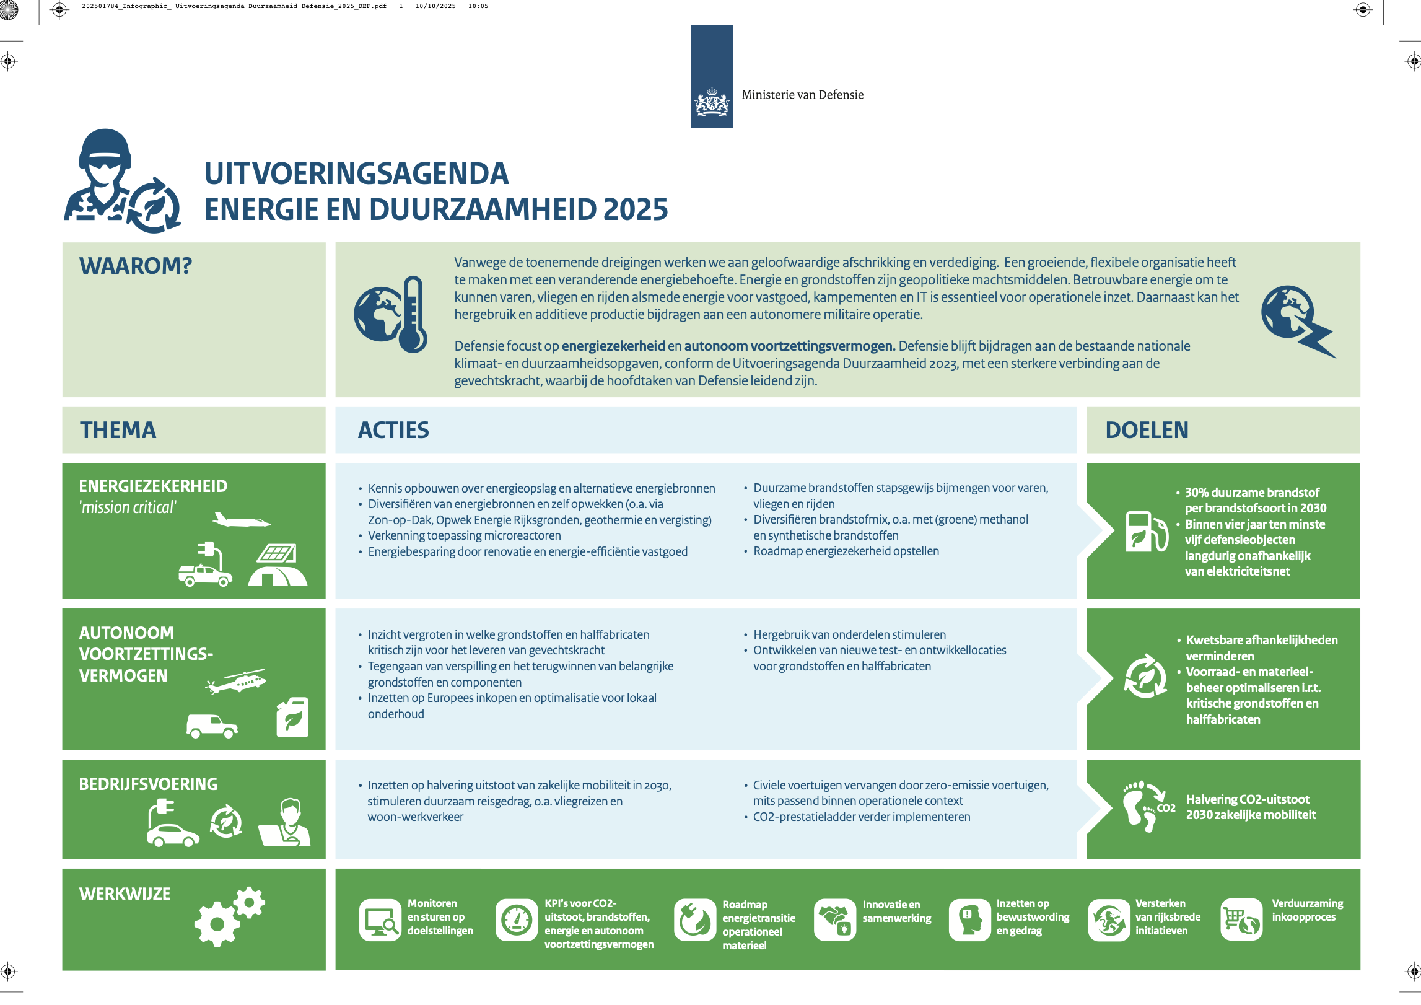
How does this effect policy making at the Dutch Min of Defense?

Slide 32
Resilience is not a new idea
Although resilience feels like a contemporary concept, societies have always designed systems to cope with uncertainty:
water systems,
infrastructure,
defensive landscapes,
fortified settlements.
Zuiderwaterlinie
UNESCO waterlinie
GLACIS

Slide 33
How can fortress contribute today to resilience?

Slide 34
Built to endure. Designed to adapt.
Notes:
“Forts show that sustainability is not only about efficiency, but also about sustainability in the sense of longevity: structures that remain relevant for generations because they are able to adapt.”
“Europese forten beschermden ooit territoria.
Vandaag kunnen ze helpen onze samenleving te beschermen tegen klimaatstress, energie-afhankelijkheid en verlies van gemeenschapszin.”
Of:
“Misschien zijn forten niet het erfgoed van vroegere crises — maar infrastructuren voor toekomstige weerbaarheid

