Slide 1
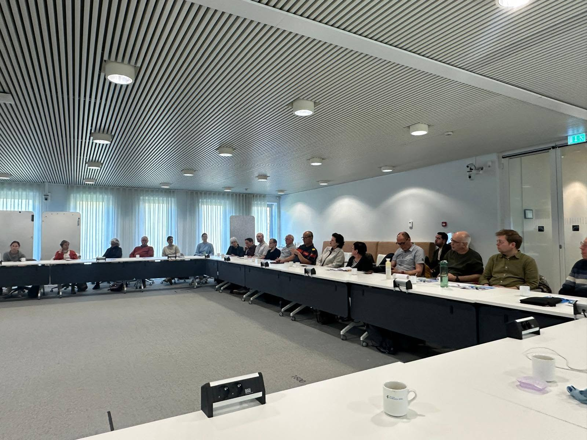




The resilience case of Stichting Vestingwerken Westelijk Noord-Brabant and Zuiderwaterlinie
Dennis van Nieuwenhuijzen PhD.
Chair Stichting Vestingwerken Westelijk Noord-Brabant and Coordinator Europe ICOFORT

Slide 2
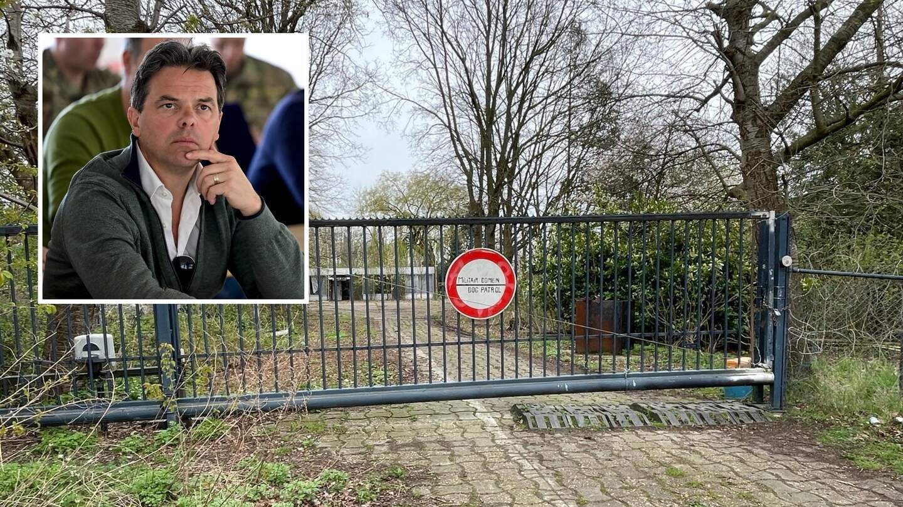
Ministry of Defence puts Fort Sint-Marie back into use: “Important for the Waasland”

Slide 3
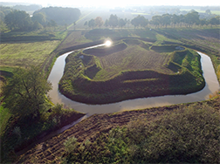
An example from the past how a fort is connected to civic resilience: entrenchement of Loobeek near Venray.

Slide 4
Fortifications and their role in civic resilience
First of all civic resilience is an important (but much forgotten) sustainibility topic. Sustainibility is not only an socio-economic or environmental issue, now a day it is more over a geo-political matter
Fortified heritage and its role in society issues such as civic resilience
- place of bonding, bridging and linking
Resillience dialogues: Bringing engaged inhabitants, organisations and governments together to discuss different themes concerning civic resillience
→ At the end we want to combine all conclusions of the dialogues
into a publication as a sort of guidance how to face crises with the help or
re-use of military heritage

Slide 5
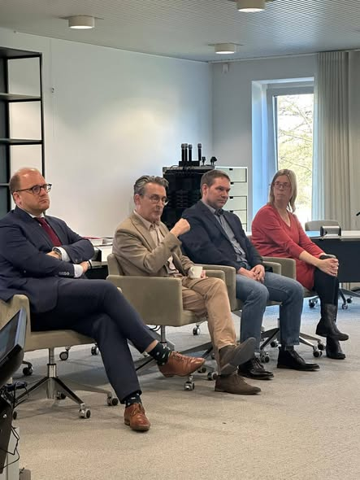
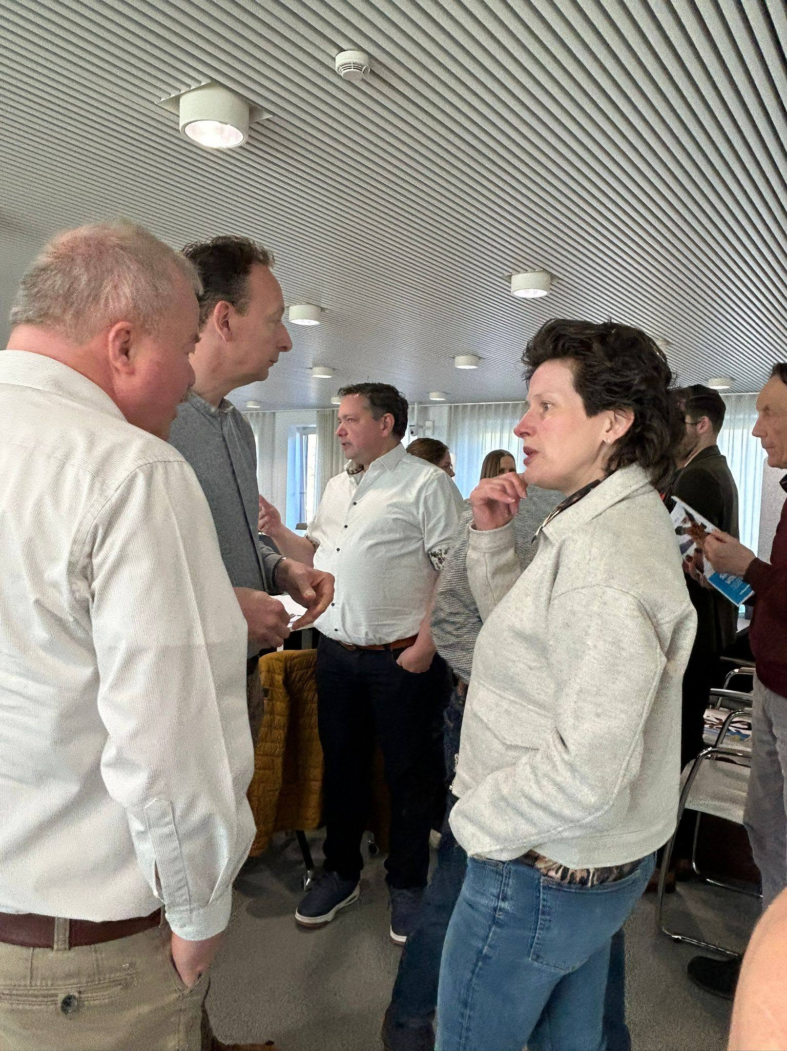
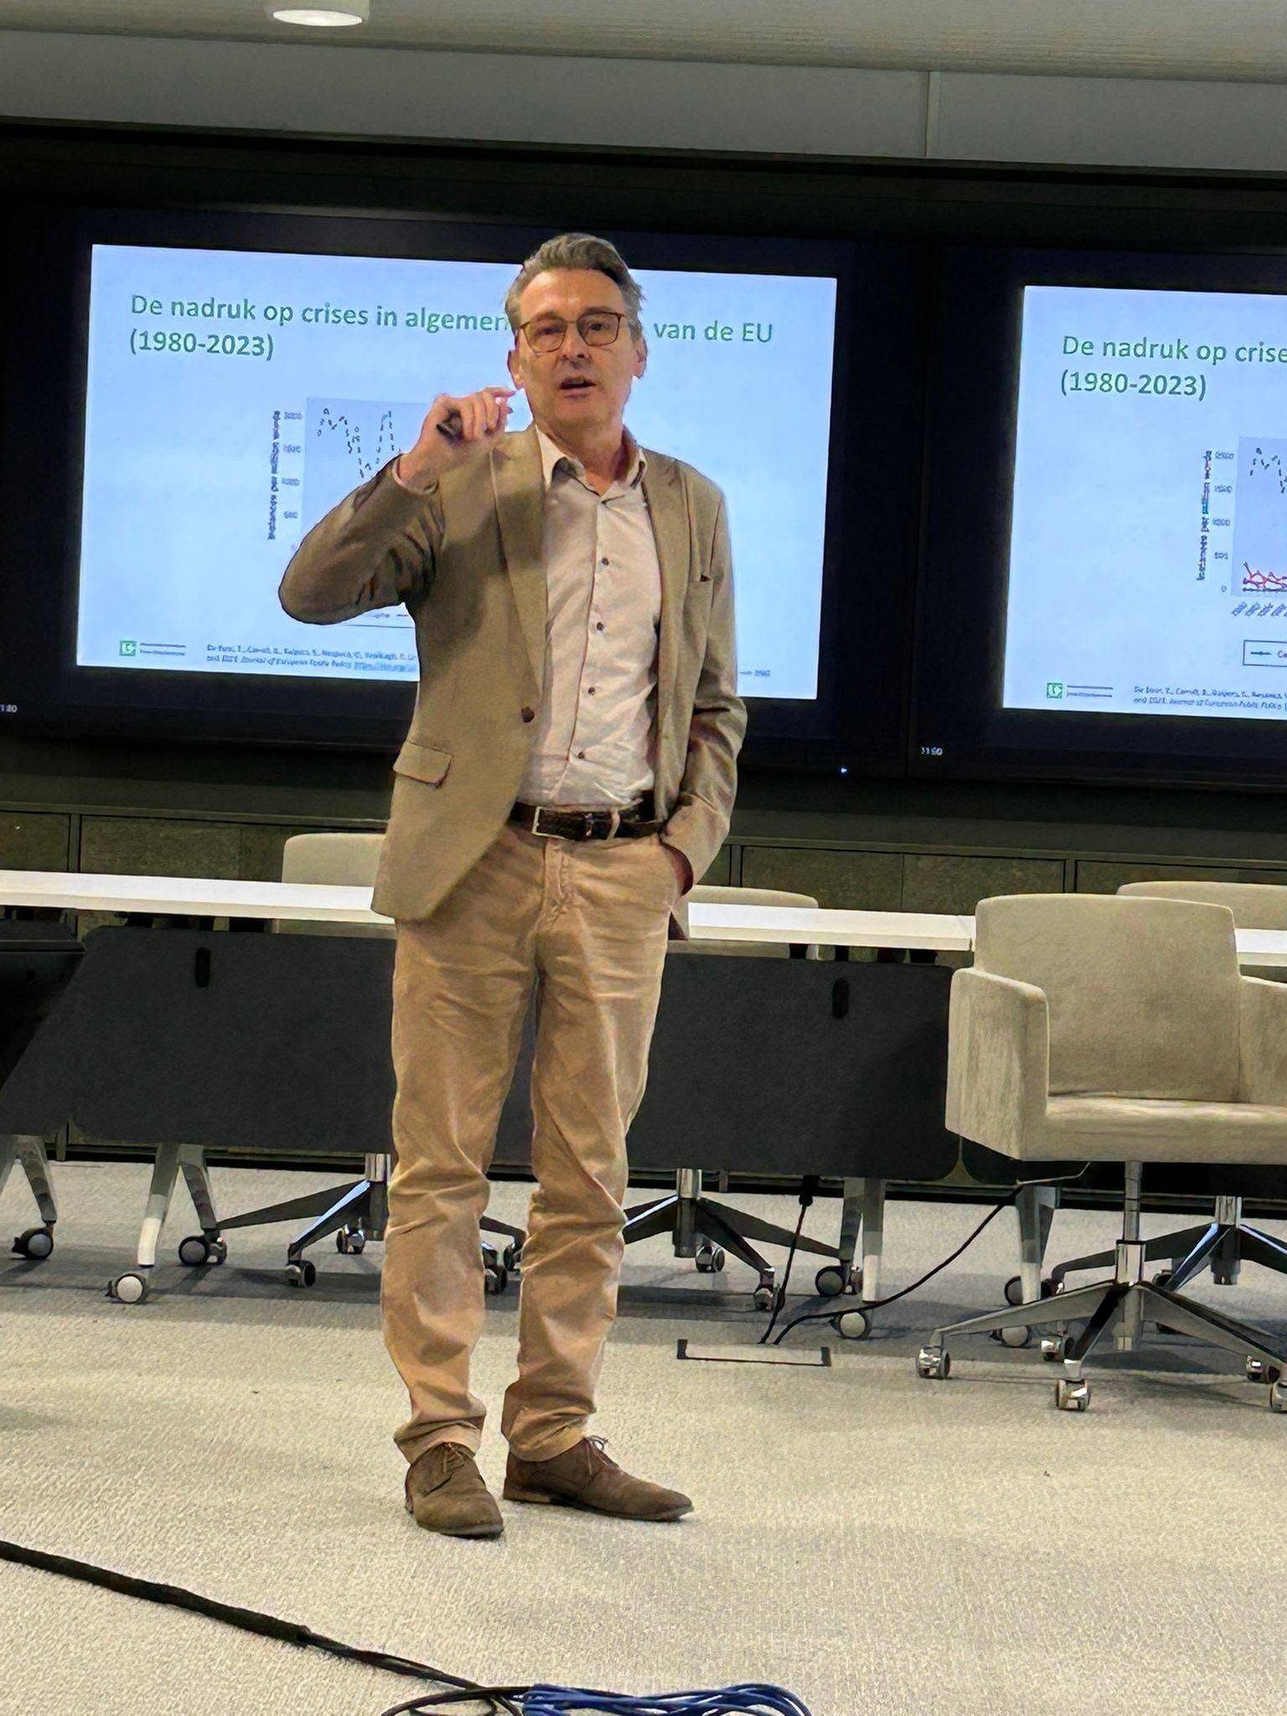
First Resilience Dialogue in Breda, 8th of april 2026 concerning civic resilience

Slide 6
What’s next?
We are now in full preperation of the second resilience dialogue, this time with the theme Military heritage as a strategic resource for a resilient society with the cooperation of the University of Utrecht, Tilburg, Avans University of applied sciences in Breda/Den Bosch and the Dutch Defence Academy

