Slide 1
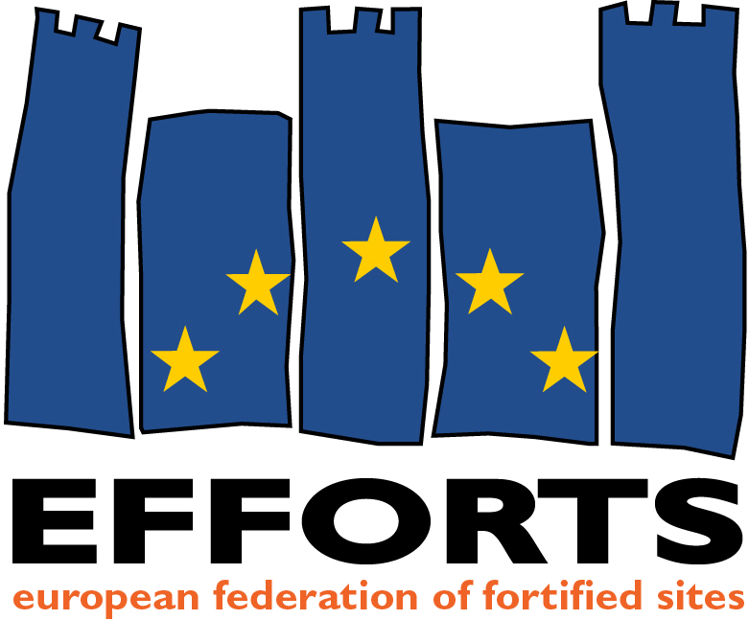
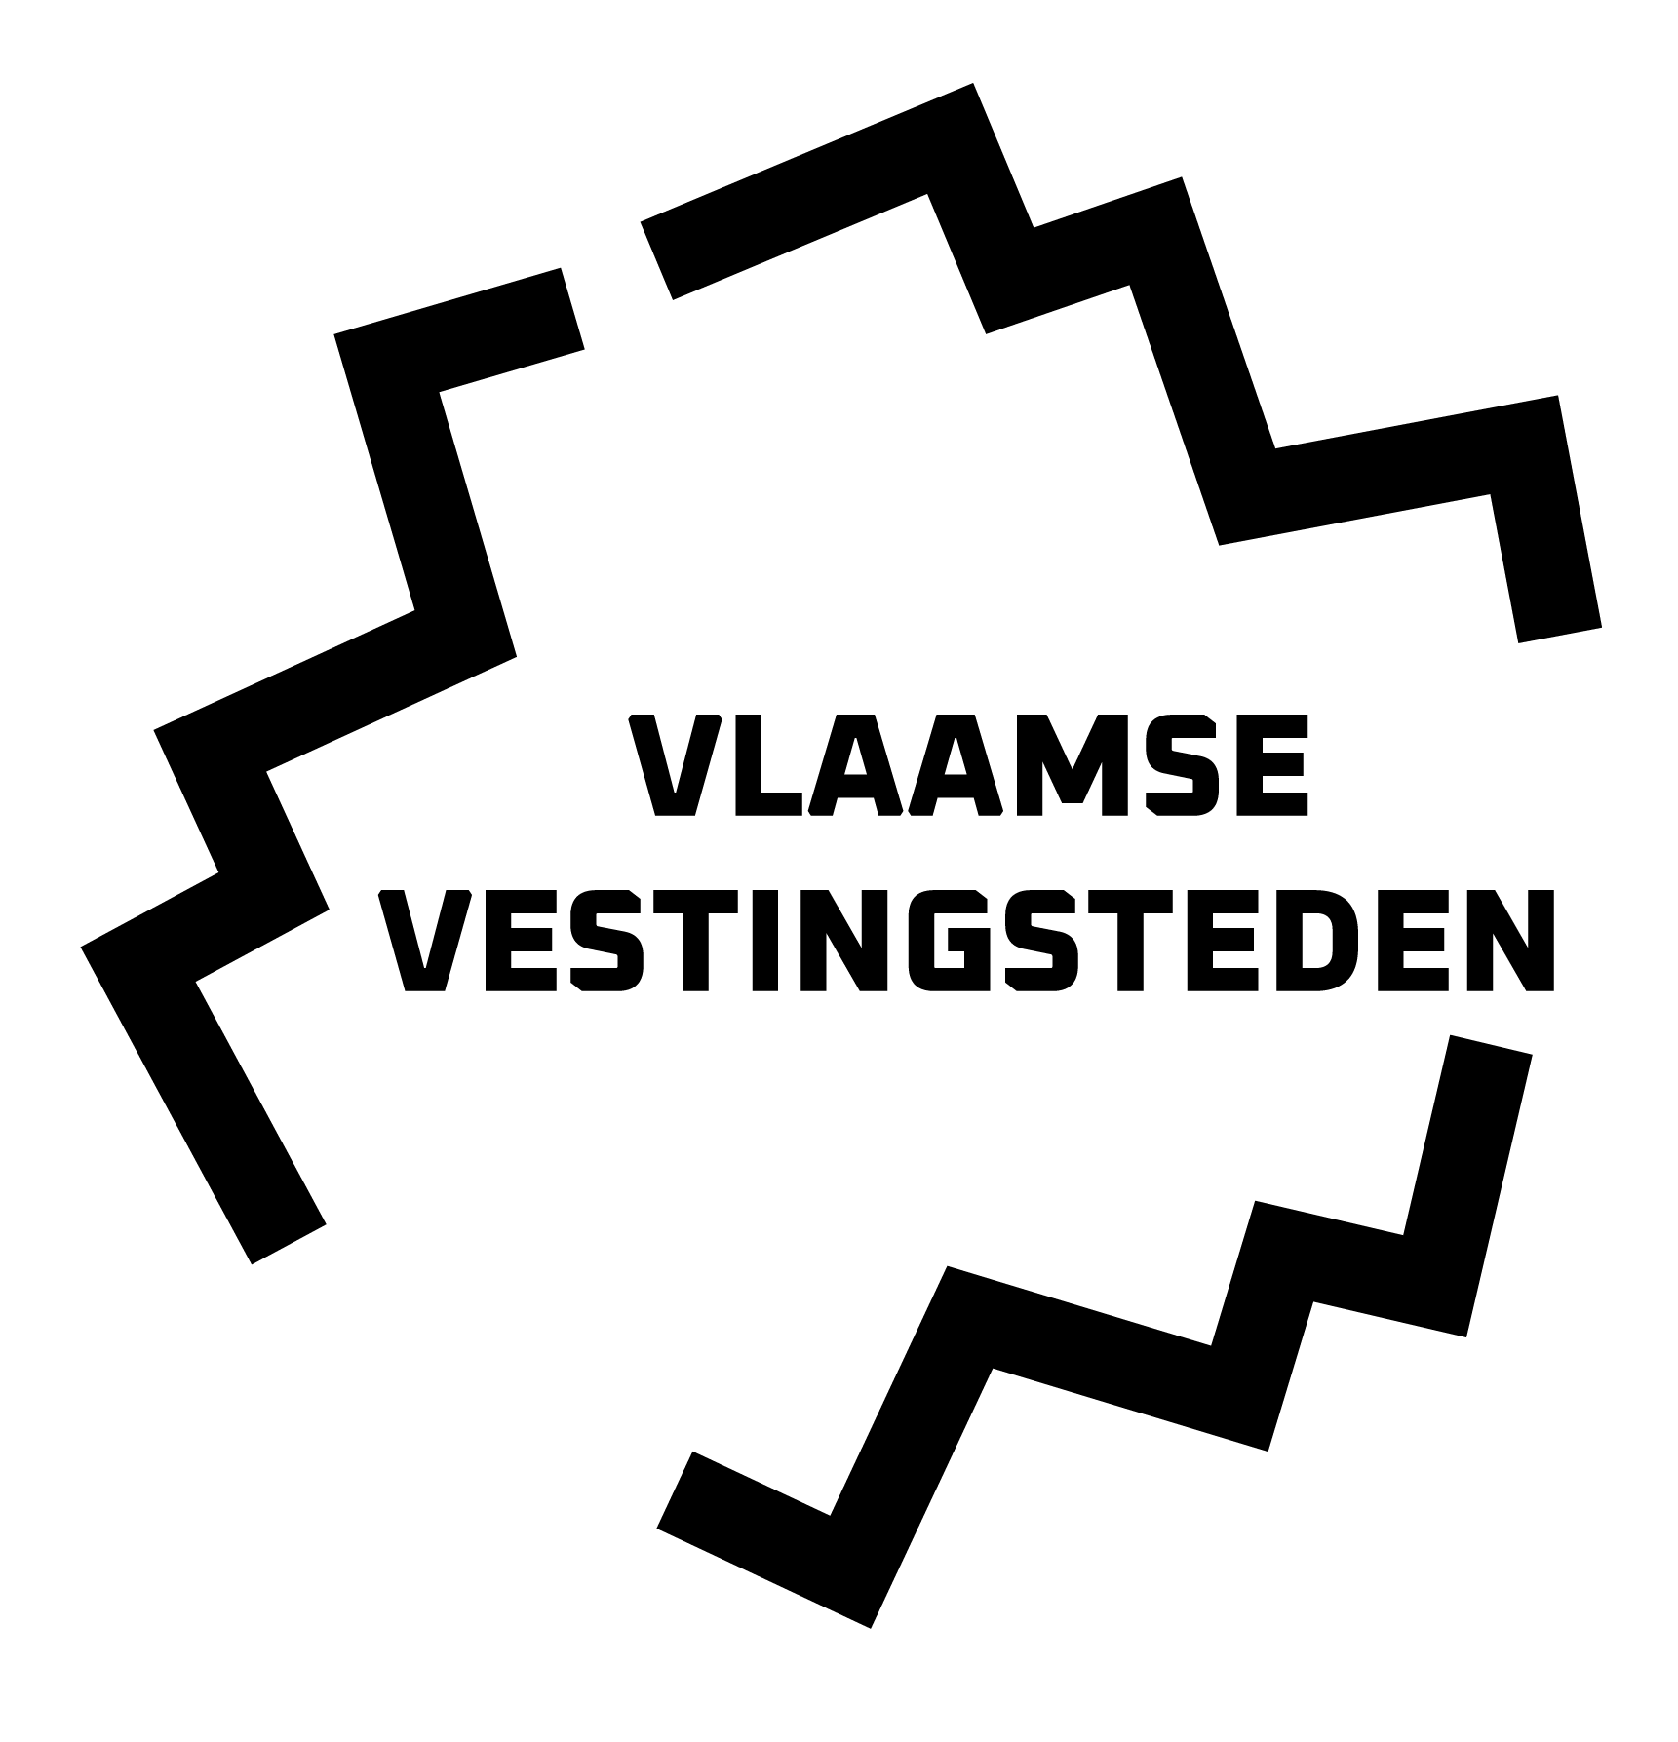
Issues on Public-Private Partnership in Fortified Heritage Development
Lessons from the Ongoing Transformation of the Citadel of Diest
Bart Severi

Slide 2
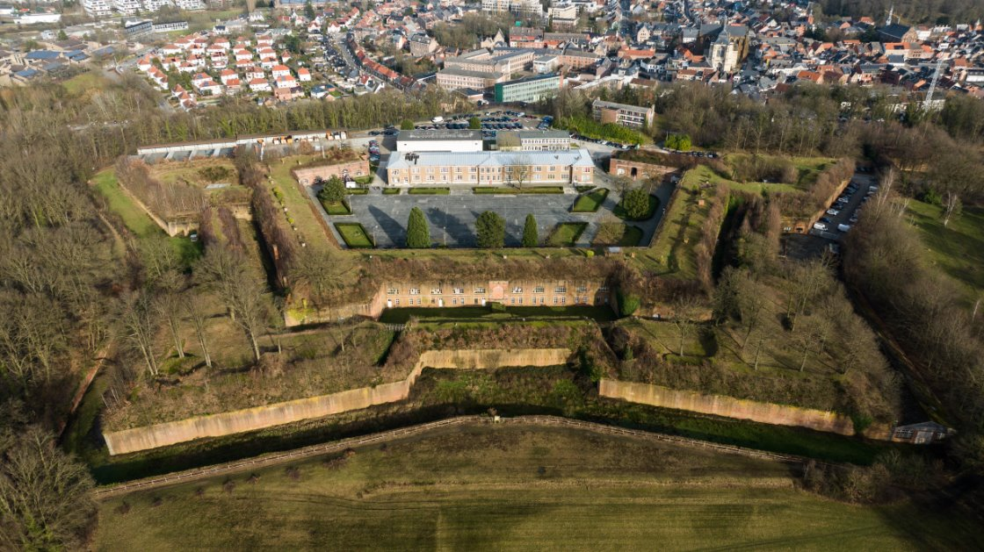

Slide 3
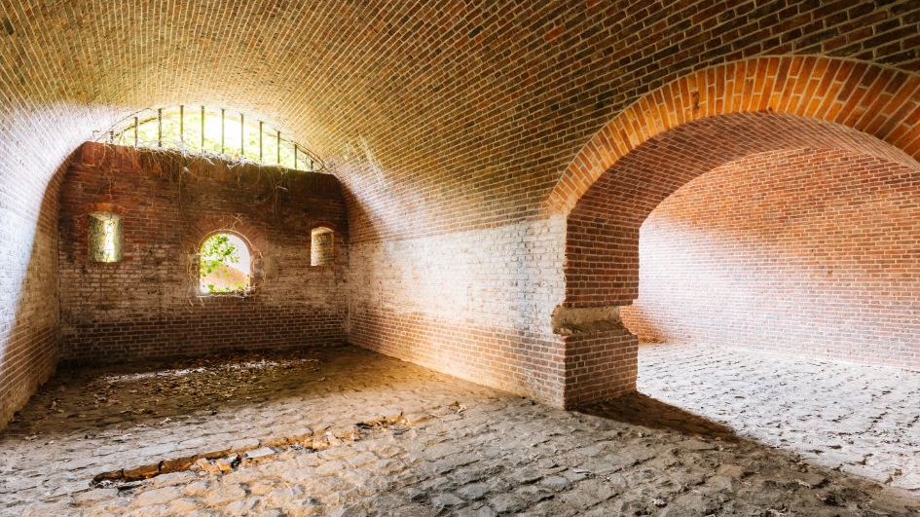

Slide 4
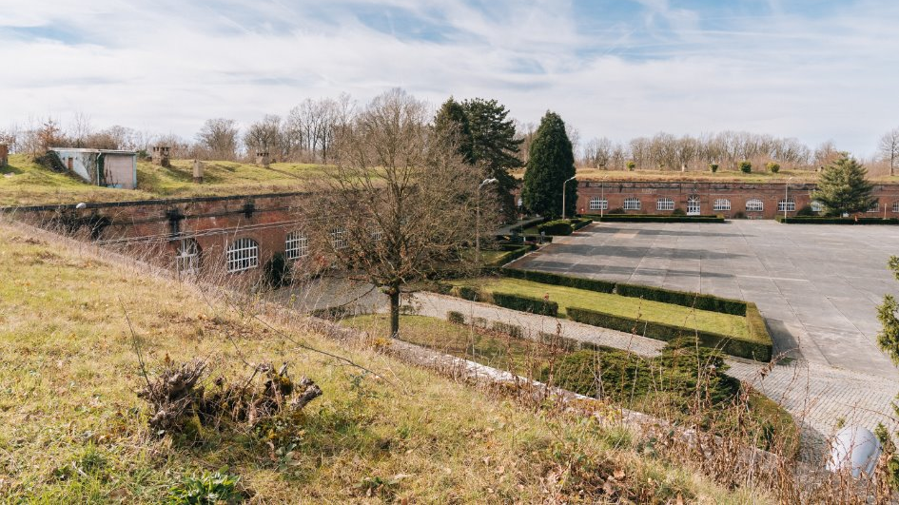

Slide 5
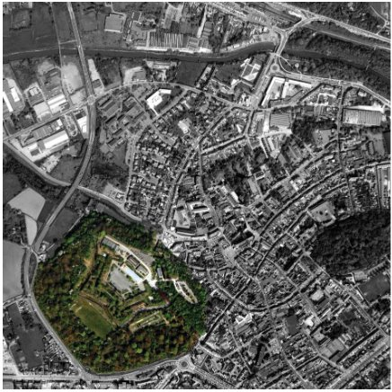
Covering 15% of the city centre
Goal: develop a vibrant new urban district with public and private functions
Vision: set a new standard for urban development, heritage restauration, and sustainability

Slide 6
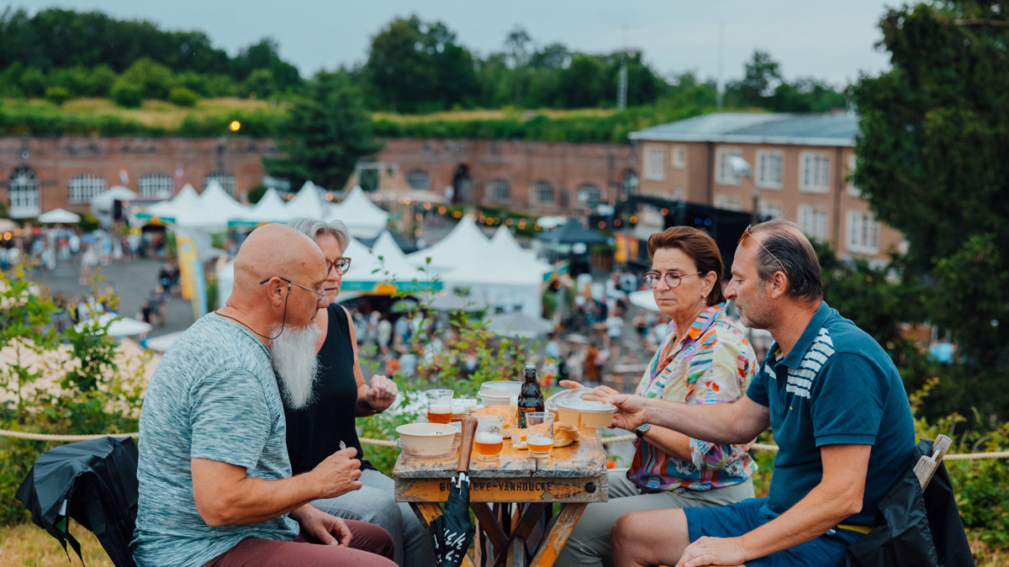

Slide 7
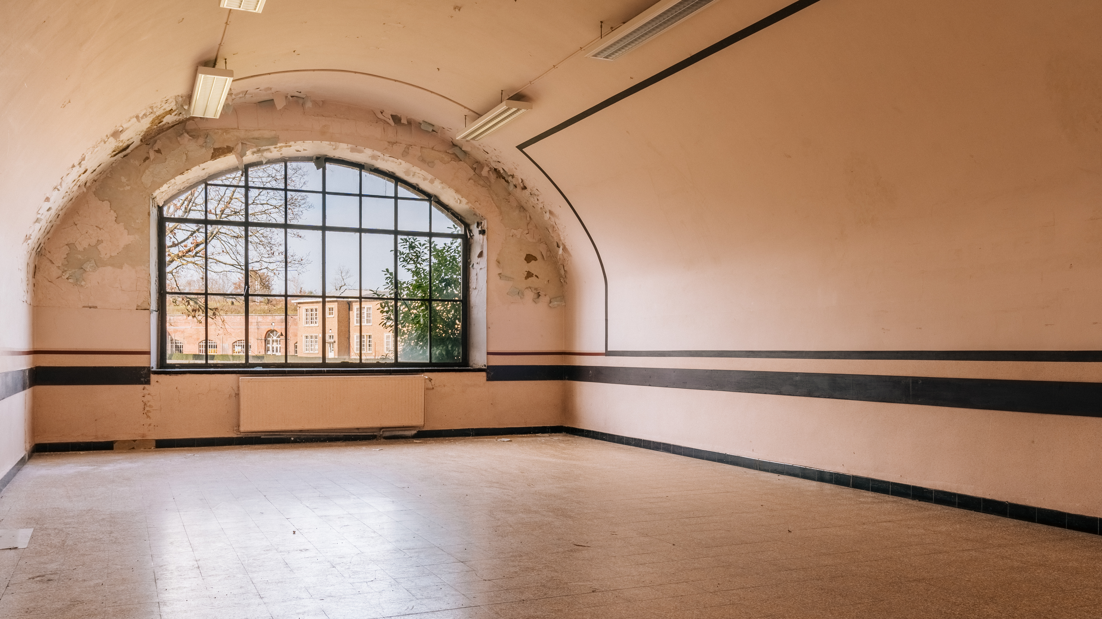

Slide 8
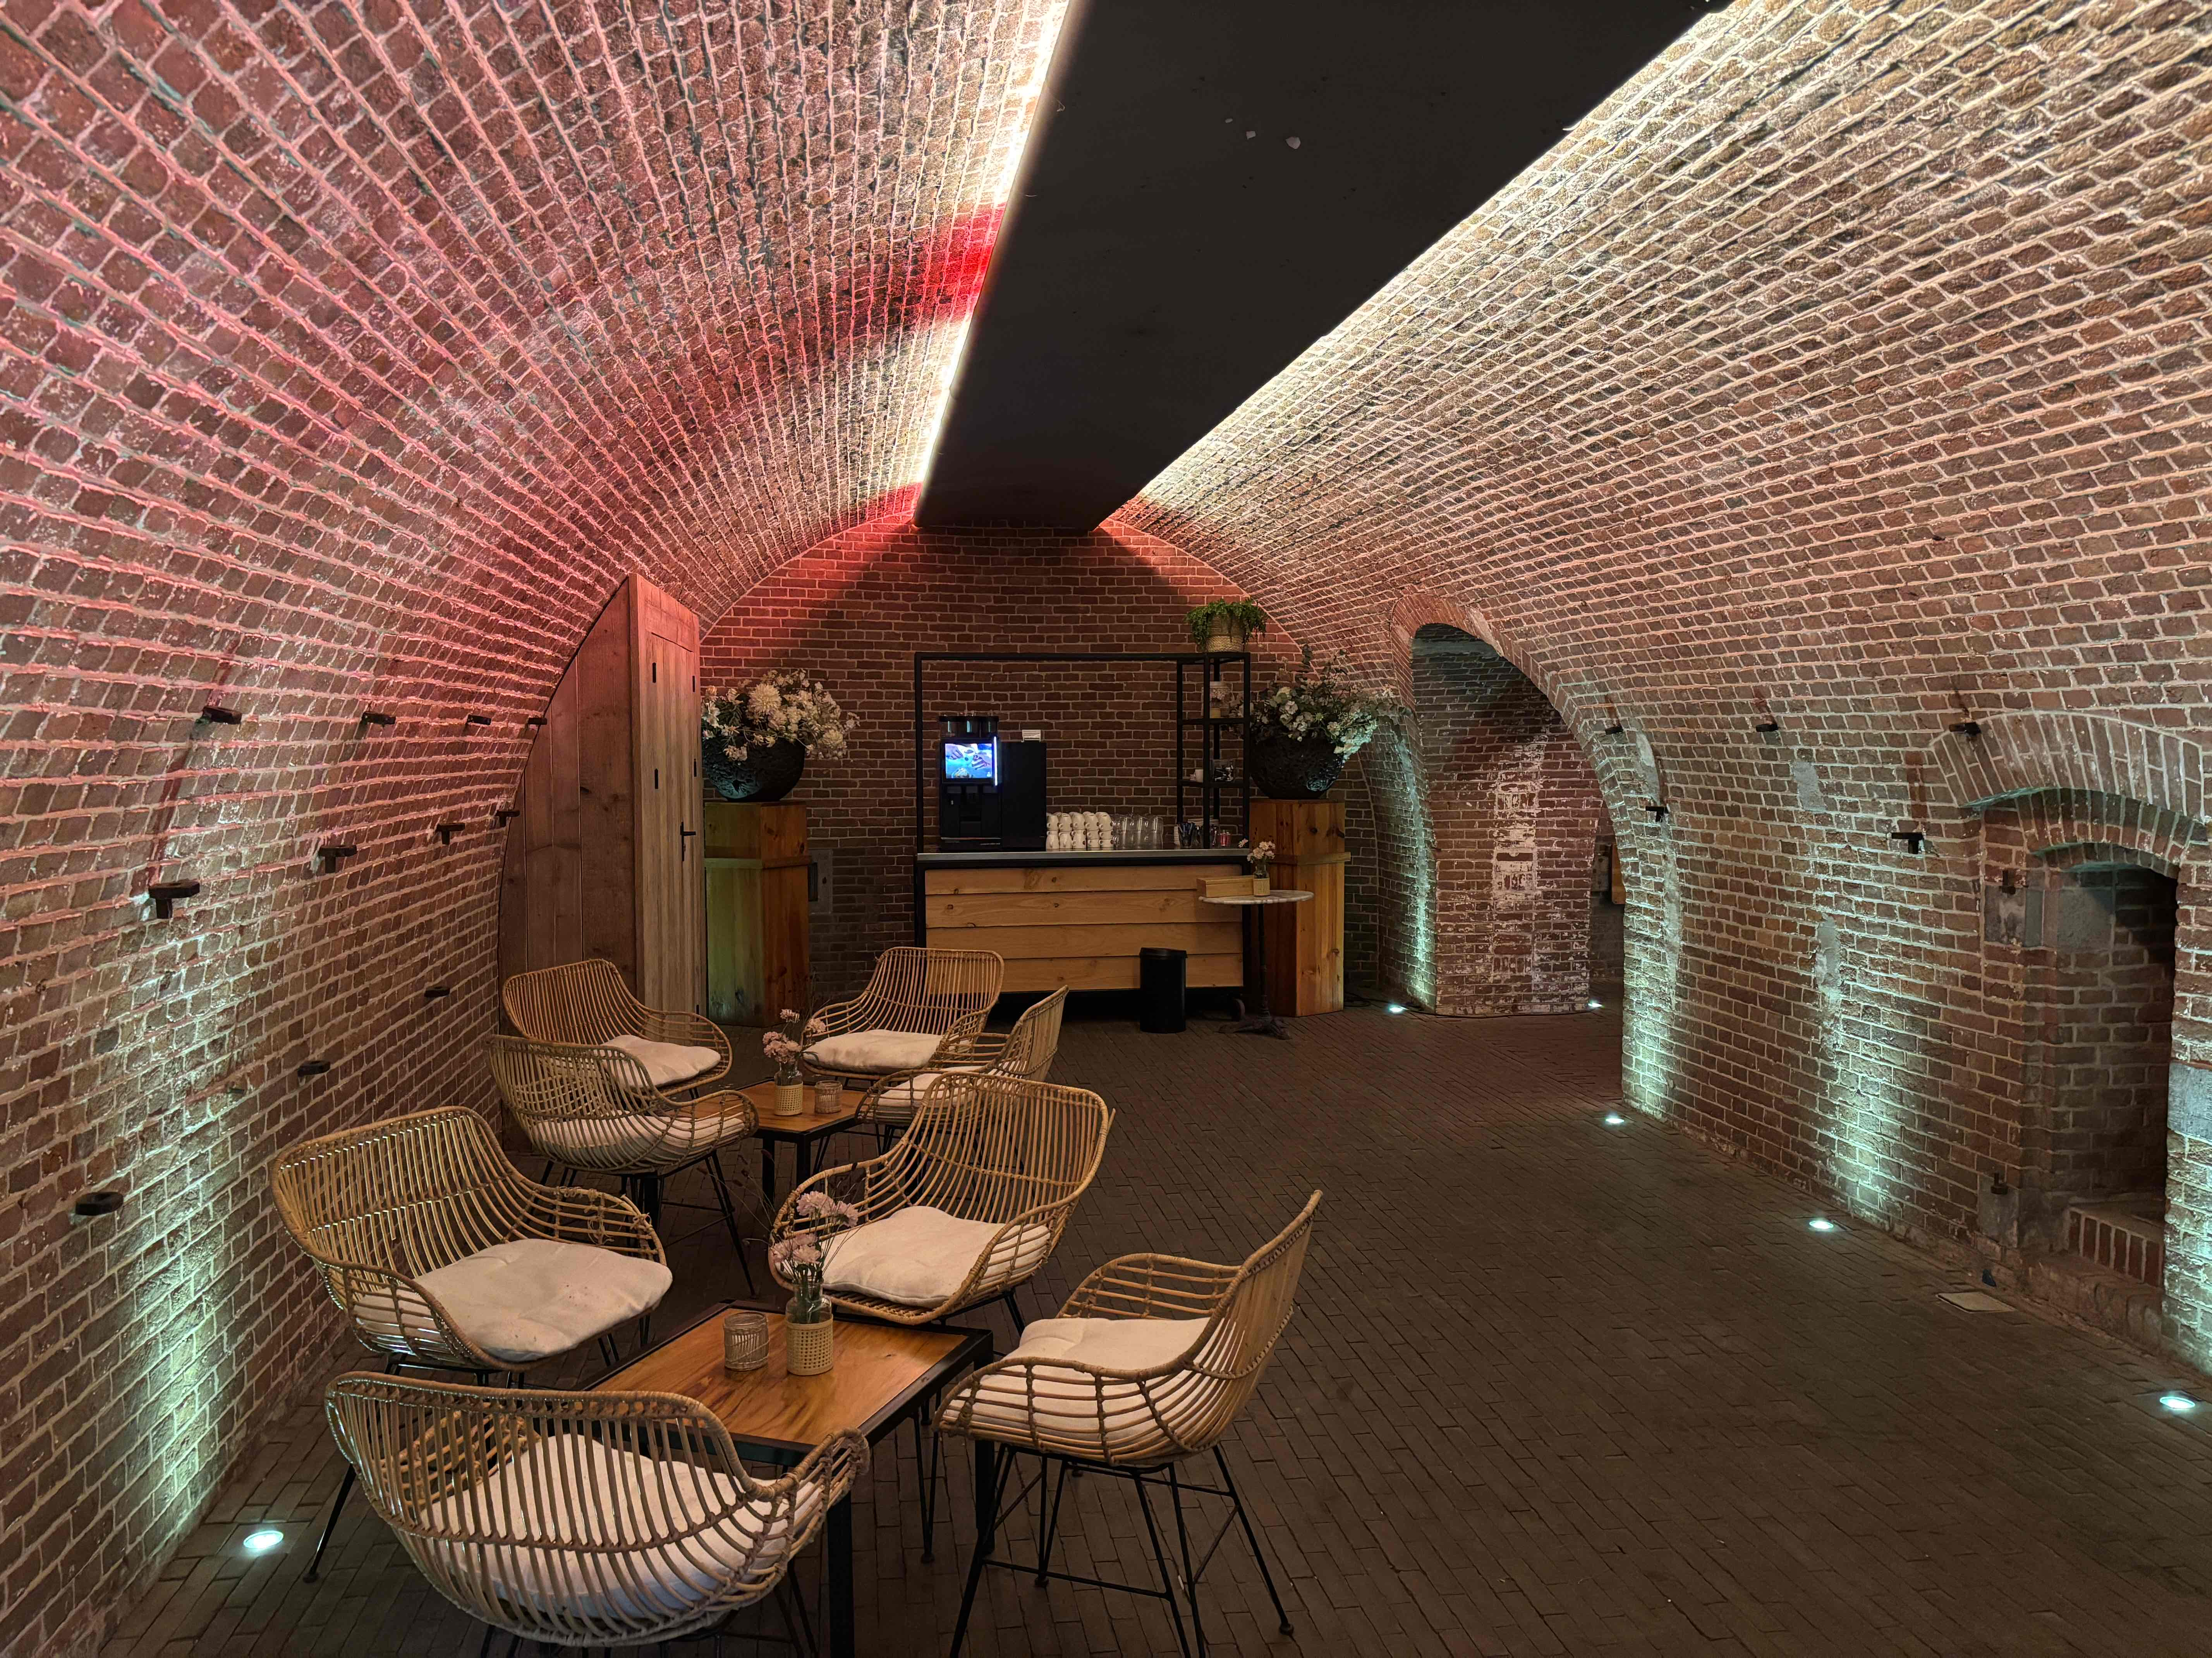
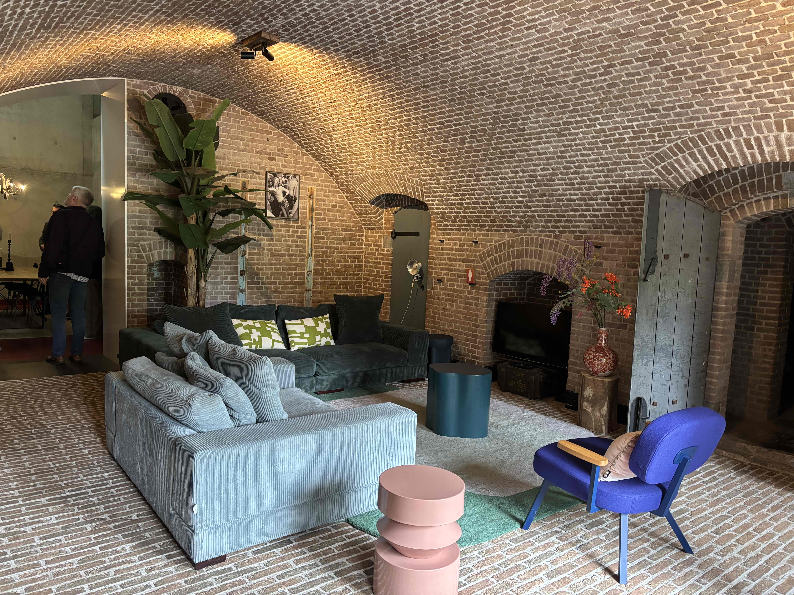
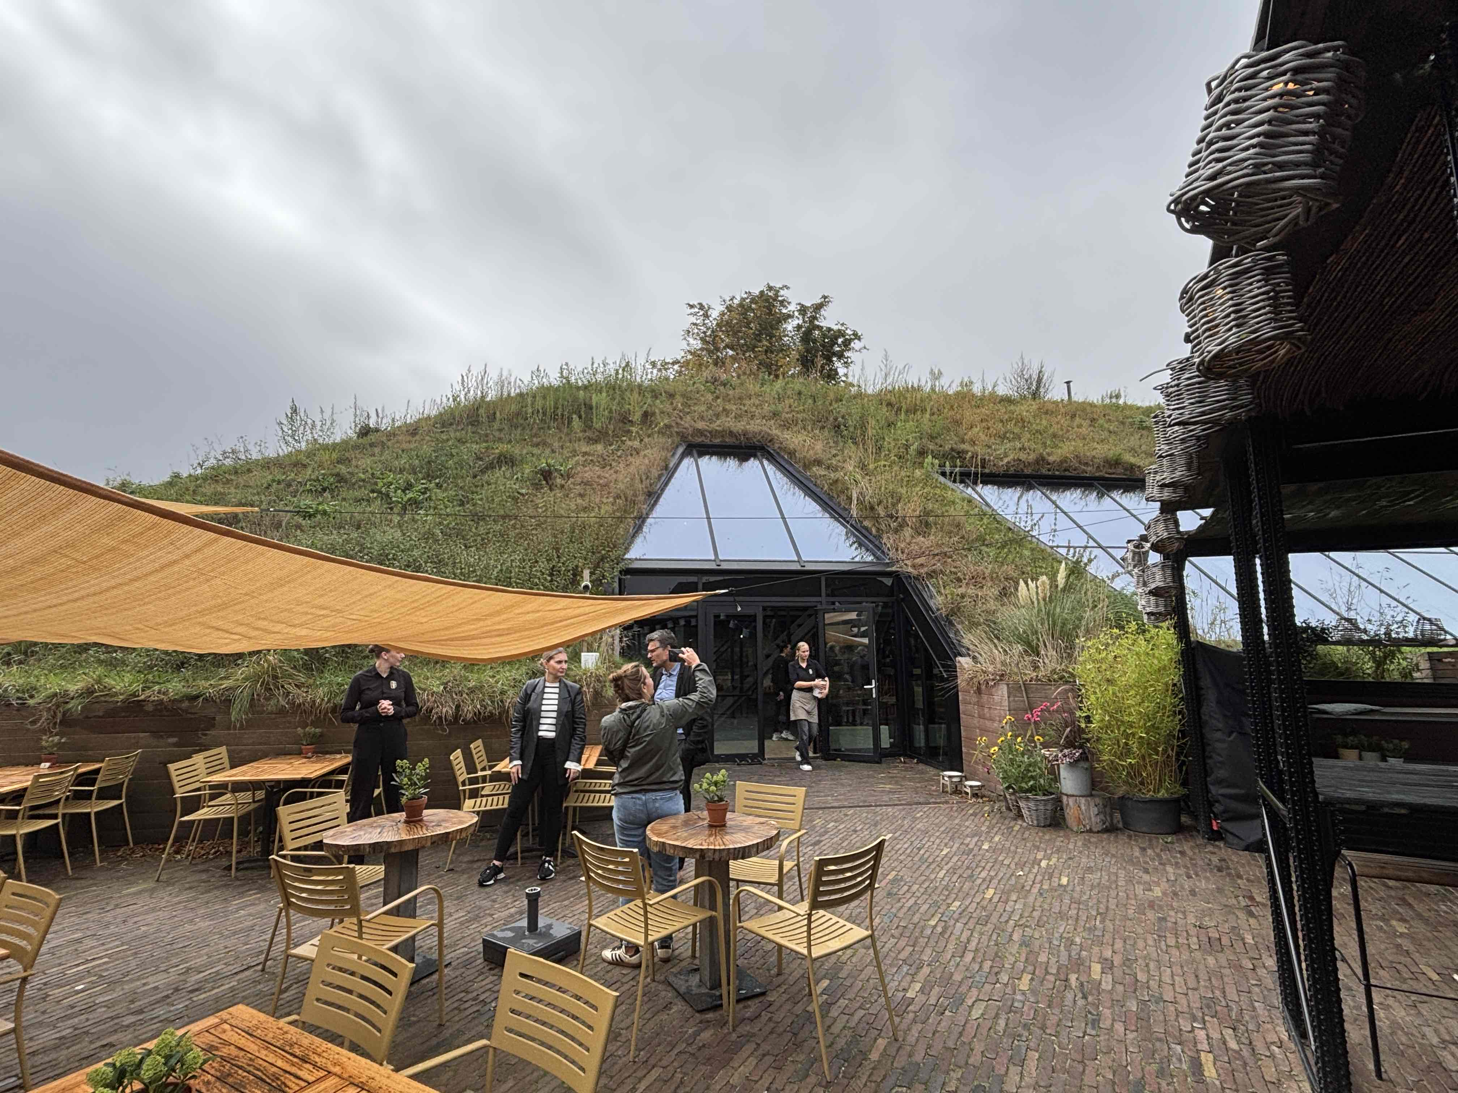
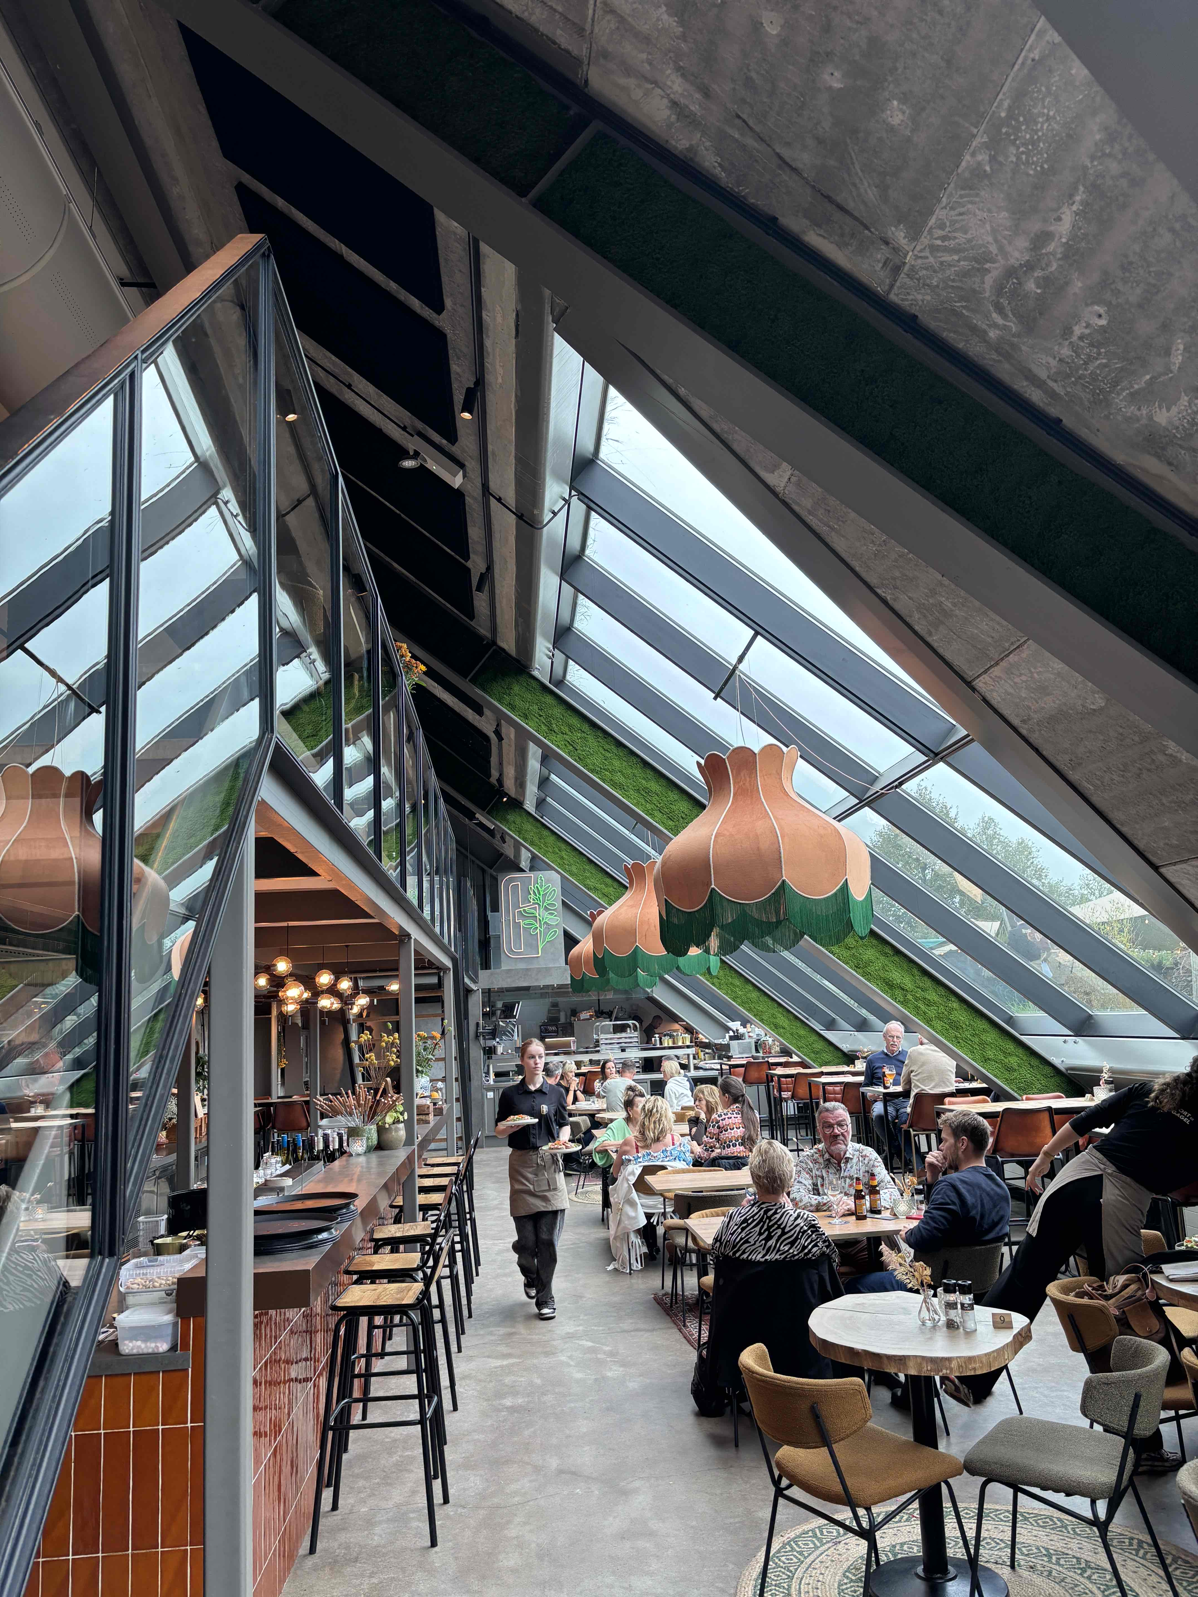
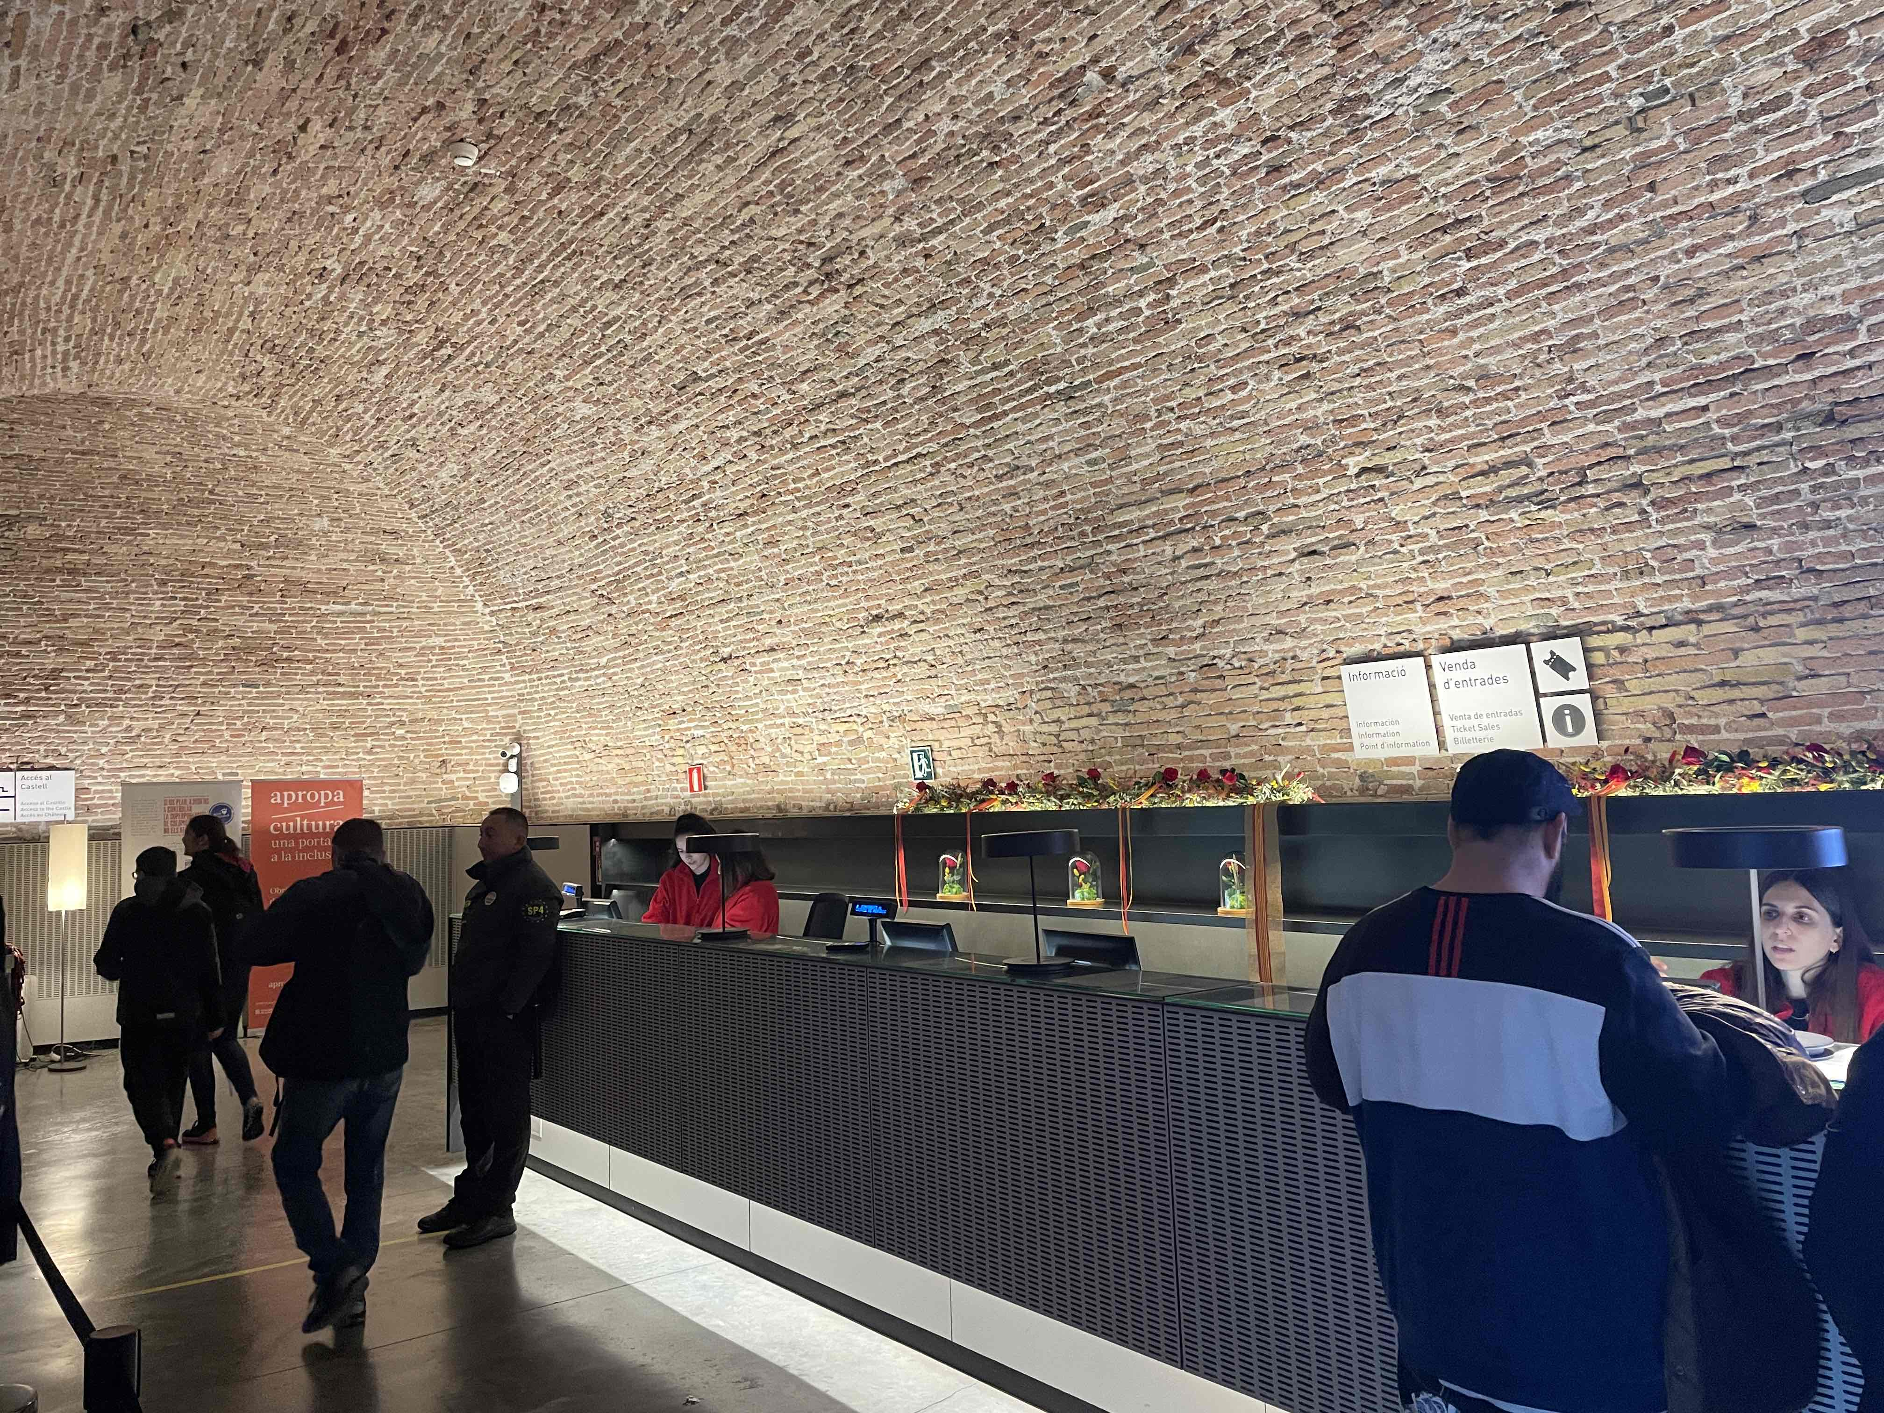

Slide 9
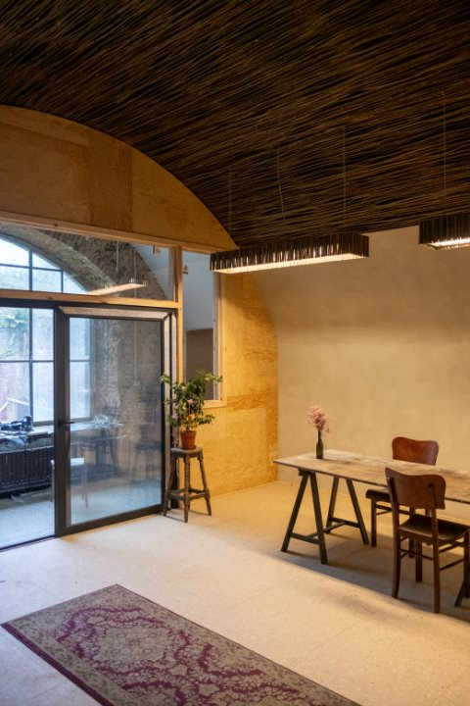
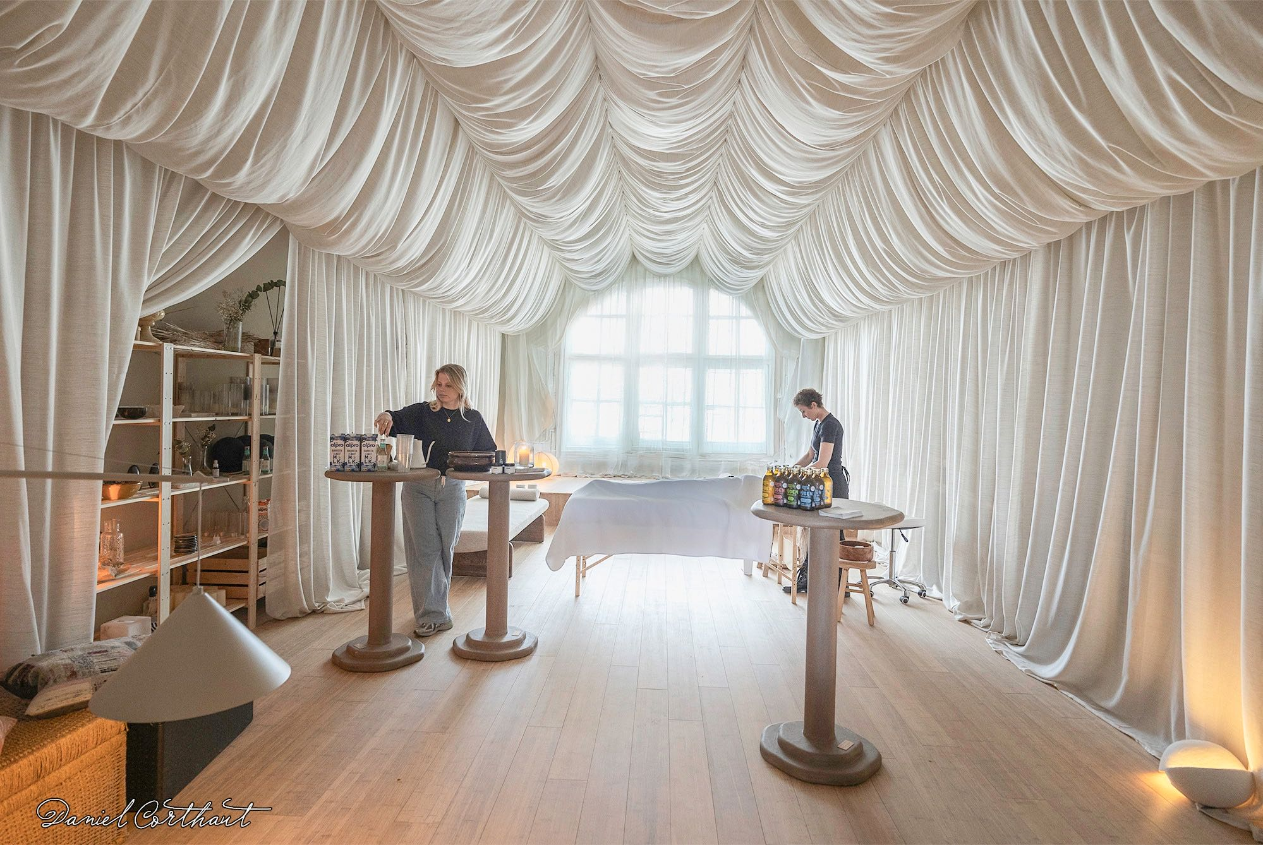
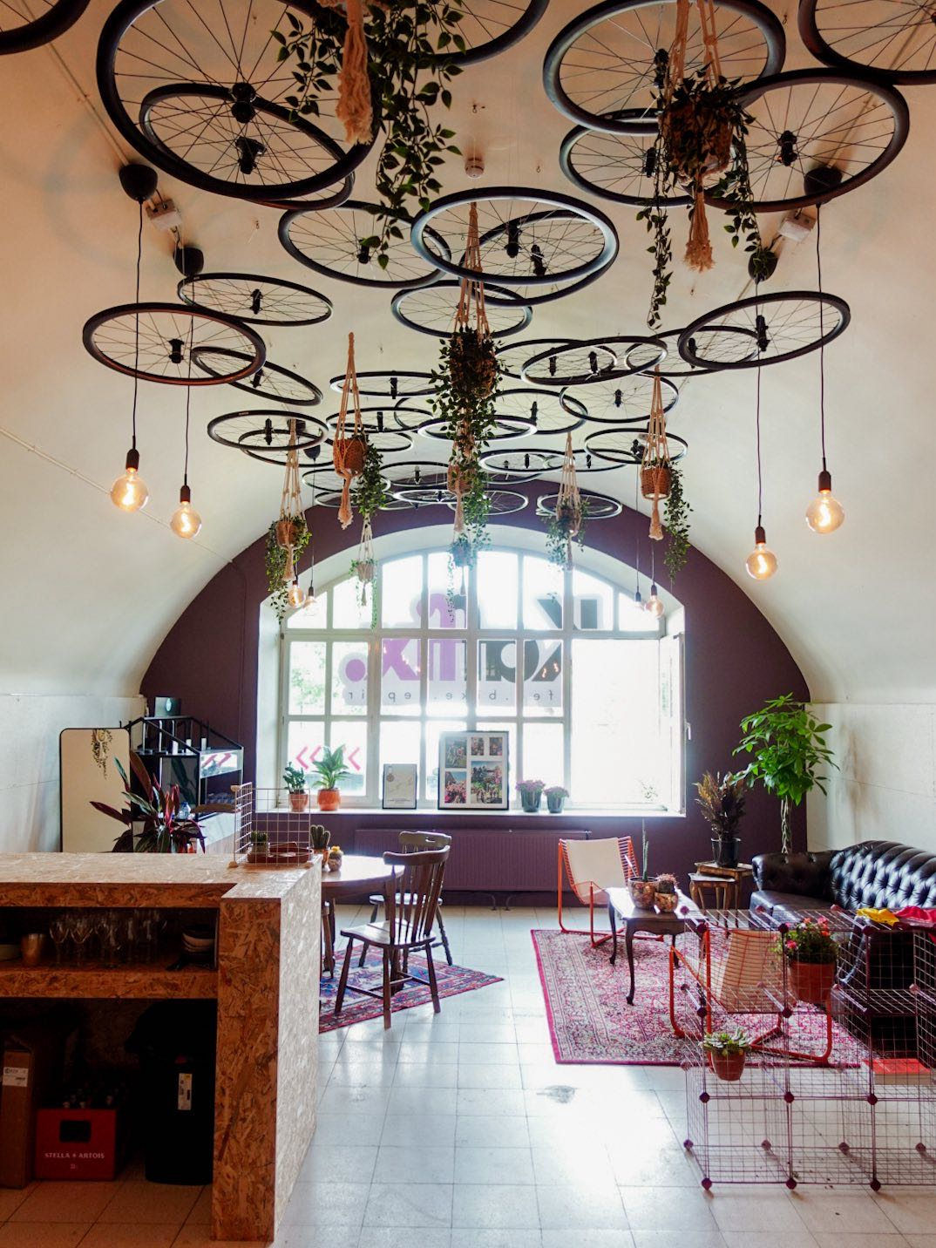
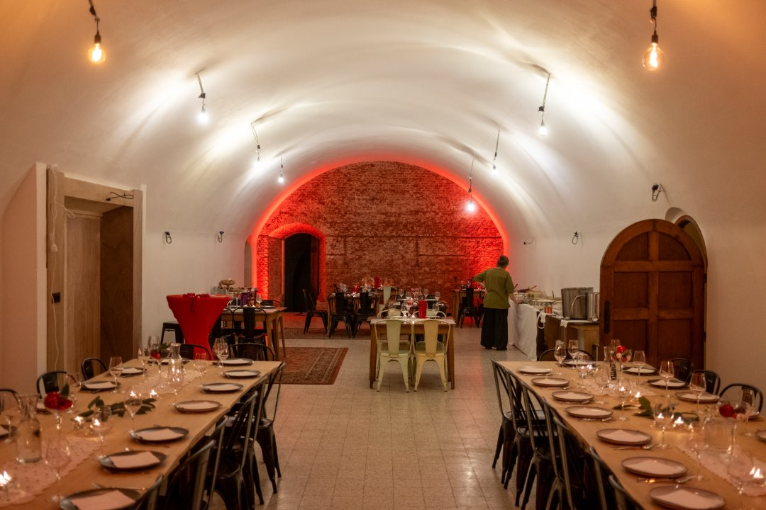
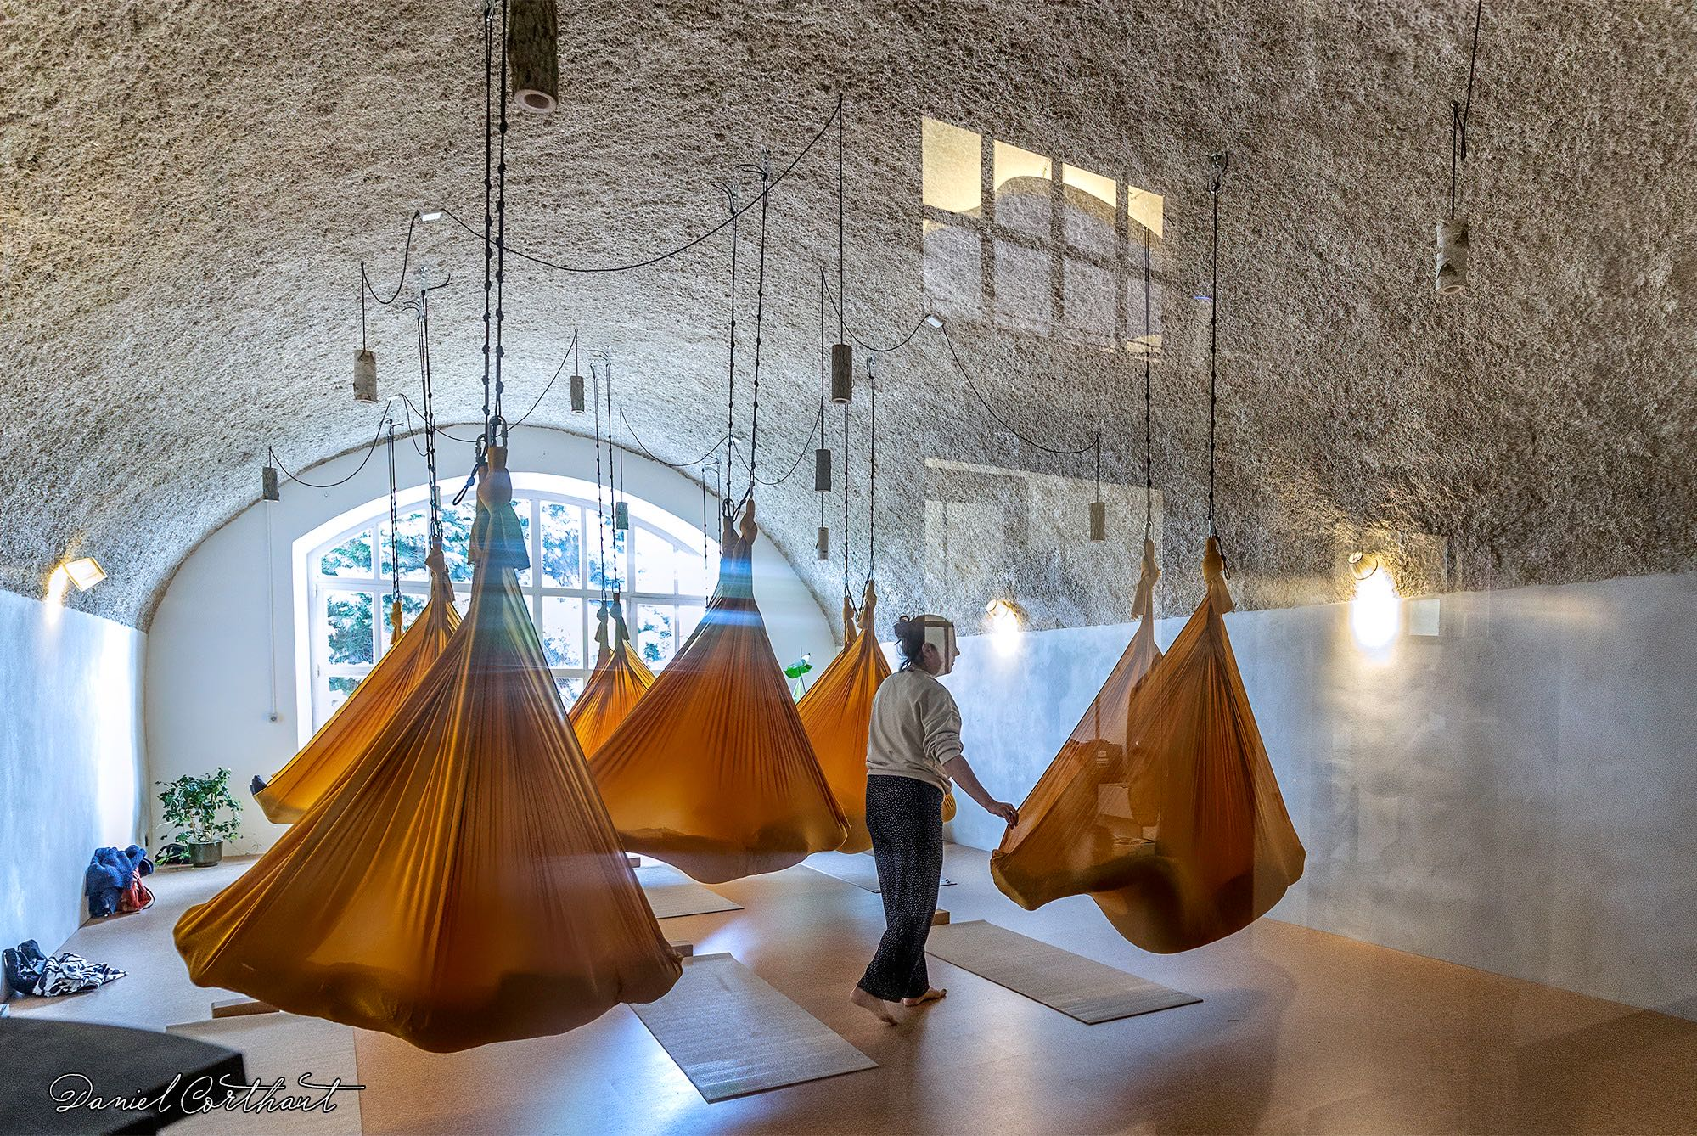

Slide 10
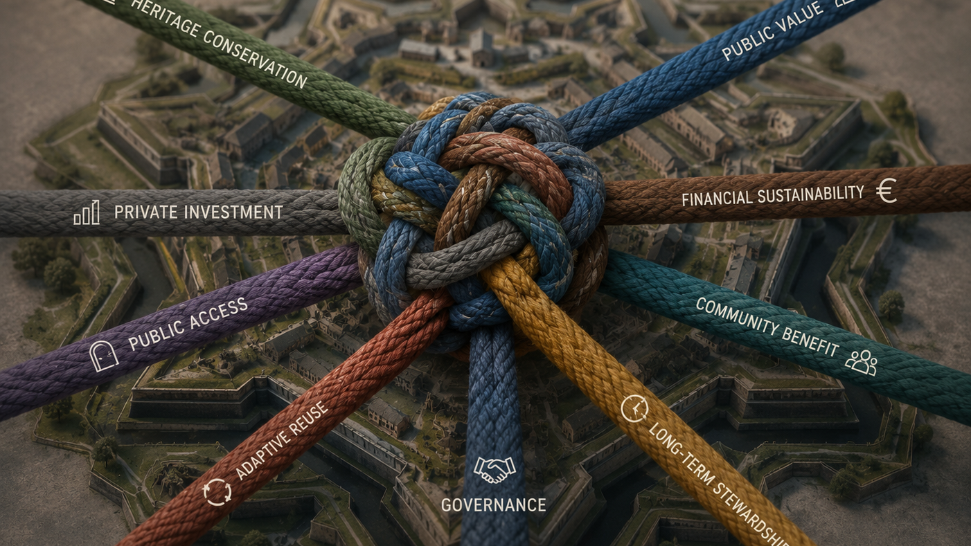

Slide 11
First Knot: Programme
Slow Urbanism
Time is an asset
Housing
Political support
MICE Facilities
Economic demand
Choose the right scale
Notes:
Keep the balance with the draagkracht of the heritage site and the surrounding city

Slide 12
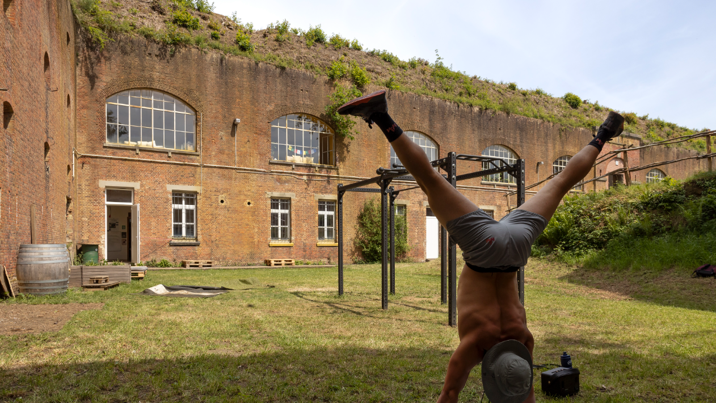

Slide 13
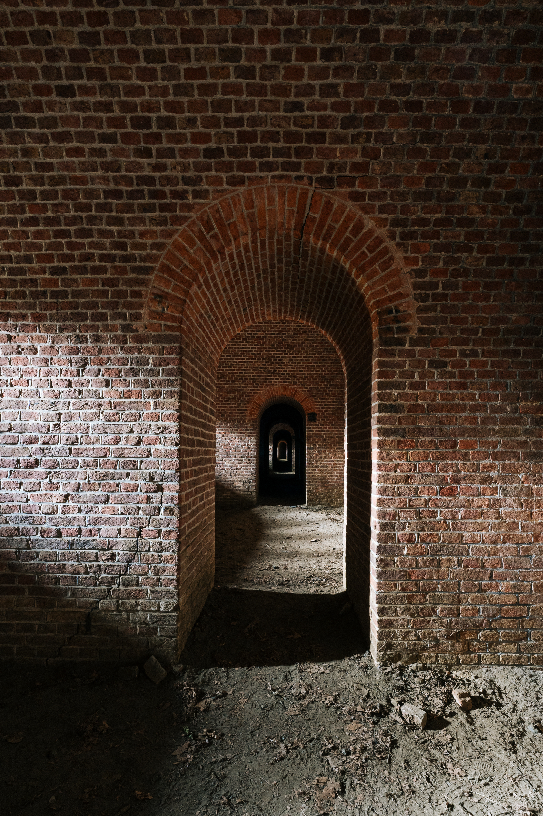
Second Knot: Retaining Public Stewardship
Strategic Control
Long-term leaseholds on land and housing
Acquiring expertise
Notes:
Erfpacht op grond nieuwbouw en op gebouwen erfgoed

Slide 14
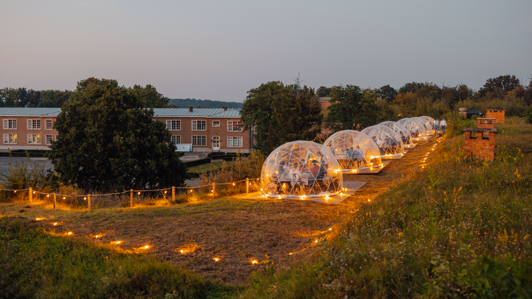

Slide 15
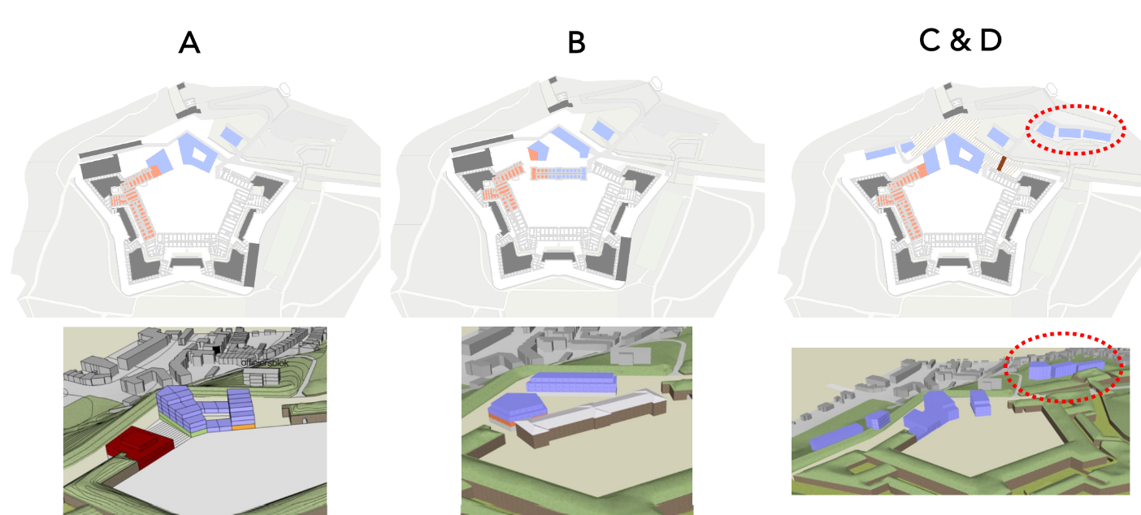
Third Knot: Location

Slide 16
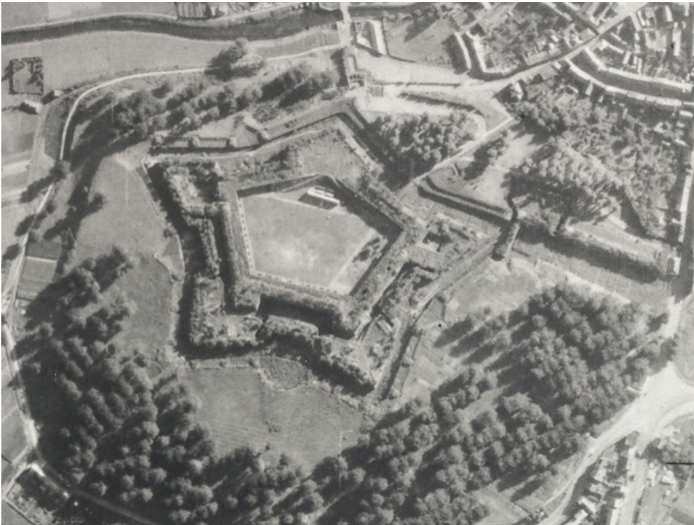
Third Knot: Location
Historical Inspiration
Reflecting the original spatial structure of the former northern bastion

Slide 17
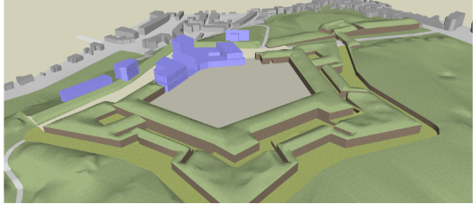
Third Knot: Location
Historical Inspiration
Reflecting the original spatial structure of the former northern bastion
Preserving the balance between a new development and the site’s heritage character

Slide 18
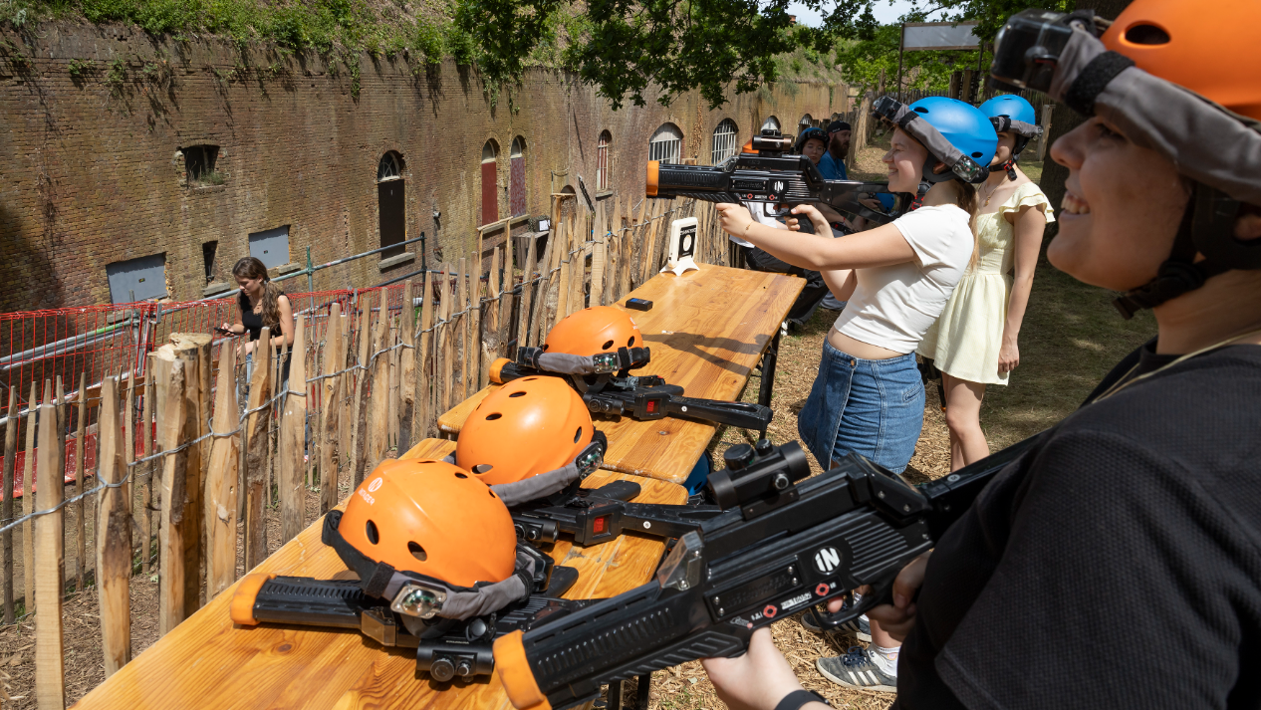

Slide 19
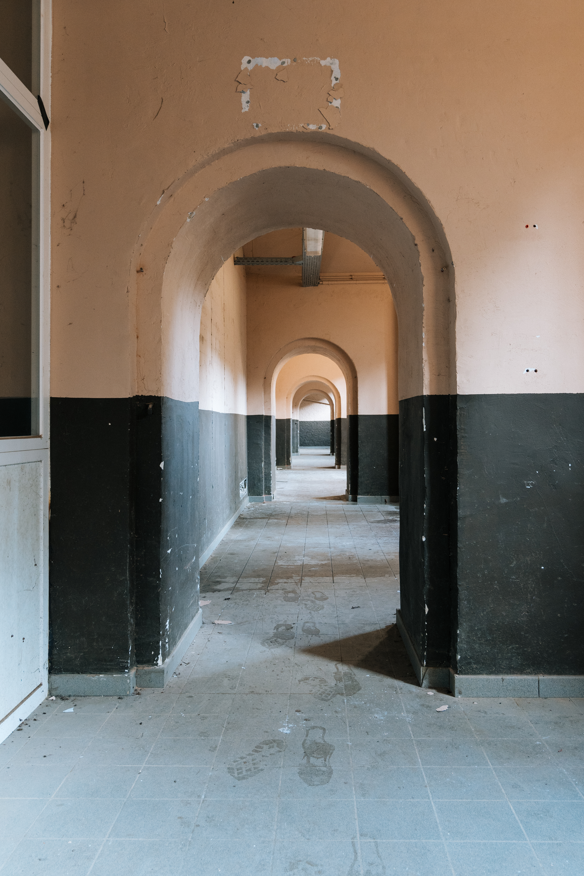
Fourth Knot: Budget
Balancing public participation with private participation
How much public participation?
Heritage = public
Redirecting revenue streams to the project itself
Notes:
Kleine stad, beperkt budget, hoge ambities; stad doet erfgoedrestauratie (buitenschil, dak); side note: we need public funding ourselves (subsidies)

Slide 20
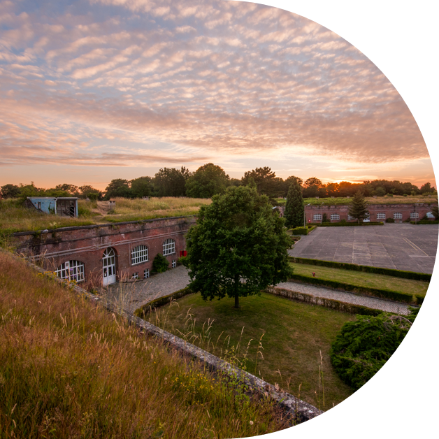
Project Site
www.diest.be/herbestemmingcitadel
Notes:
Sometimes history is made not by conquering cities, but by helping them recover.

