Slide 1



Night of Fortresses and GIFTS network

Slide 2
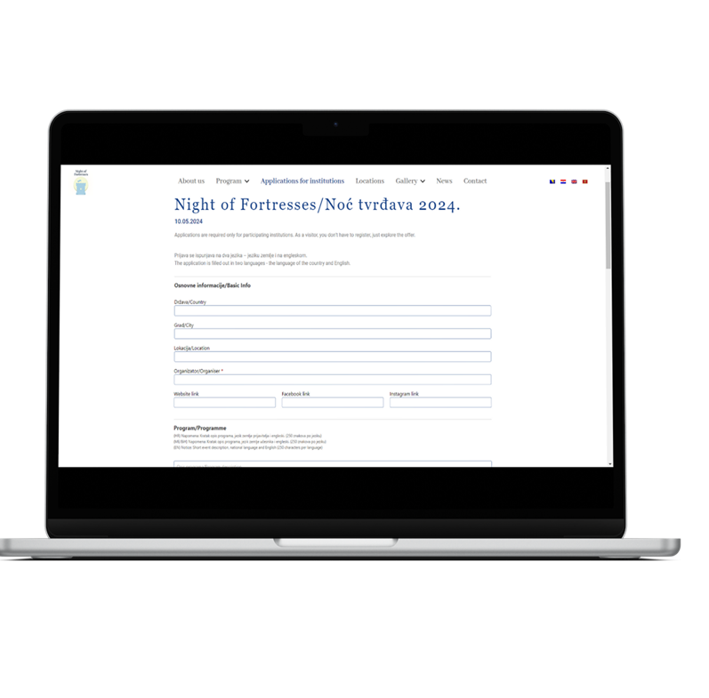
Cultural heritage managers in HR-BA-ME were invited to join the event – no participation fee
Programming - from open door days to organizing various cultural-artistic, educational and entertainment programs for visitors, including exhibitions, lectures, workshops, musical performances, film screenings, dance performances, plays, guides...
Programs are applied and announced through a simple questionnaire on the Night of Fortresses website (https://nightofortresses.org/en).
All events organized during the event must be free of charge for visitors

Slide 3

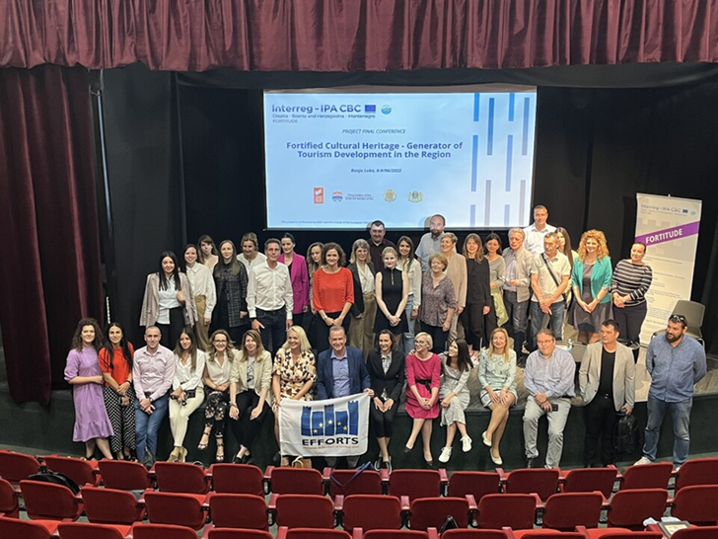
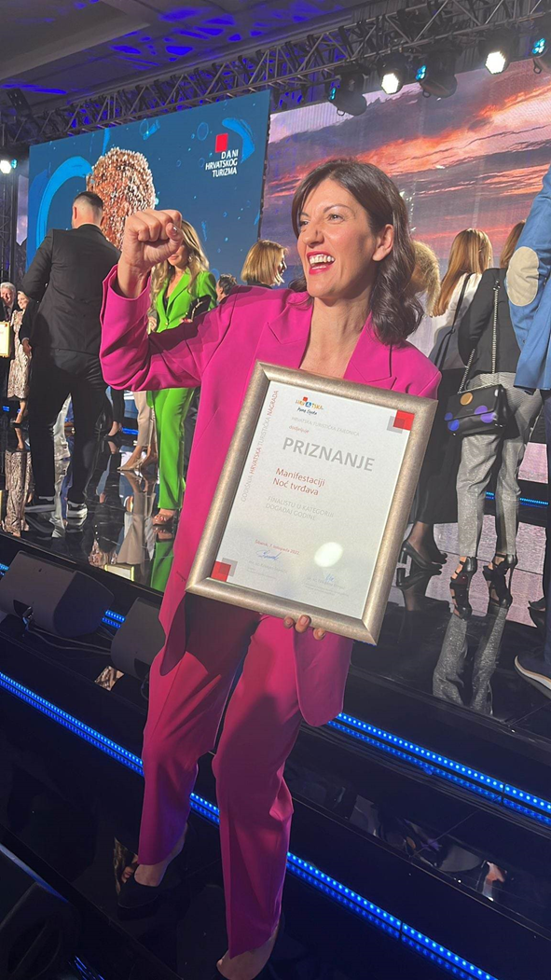
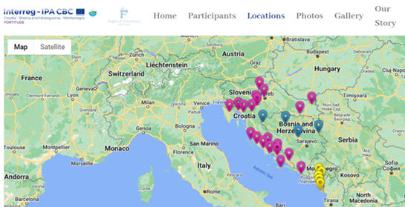
First edition, 2022 - finalist in the "Event of the Year" category at the Days of Croatian Tourism 2022, organized by the Croatian Tourist Board
Cooperation with international associations EFFORTS and FORTE CULTURA established
40+ participating locations

Slide 4
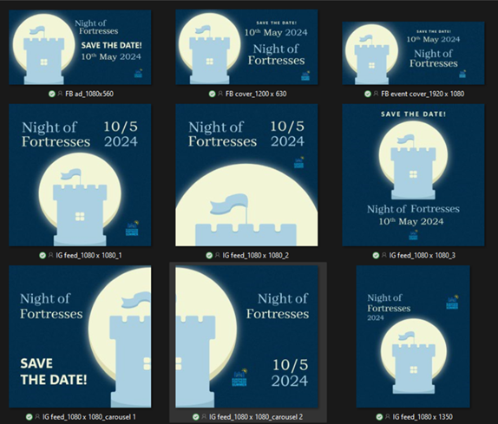
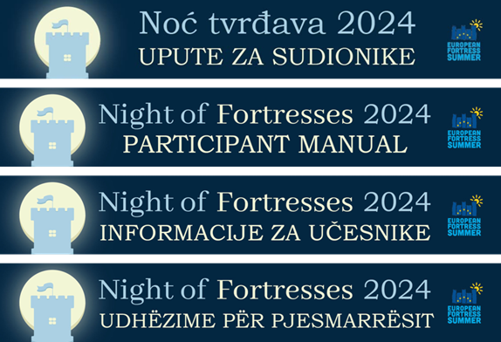
DEVELOPMENTS IN 2023/2024
Participation kit containing necessary visual elements – new logo for a unique visual identity
Instructions for participant organizers in English, Croatian, Bosnian, Serbian, Montenegrin and Albanian
Communication manual for participants (basics of communication, e.g. writing press releases, creating lists, how to communicate on social networks)
A team of national event coordinators in HR, BA and ME – Memorandum of cooperation
Creation of marketing campaigns (local and national), media buying, agreement on distribution of costs
Background work on attracting new members, renewing contacts with old ones, exchanging ideas, sharing knowledge
Subsequent communication, telephone contact with former and future participants
Promotion of event and network of organizers in other countries

Slide 5
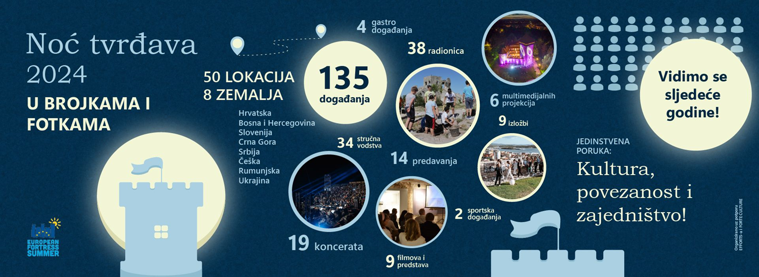
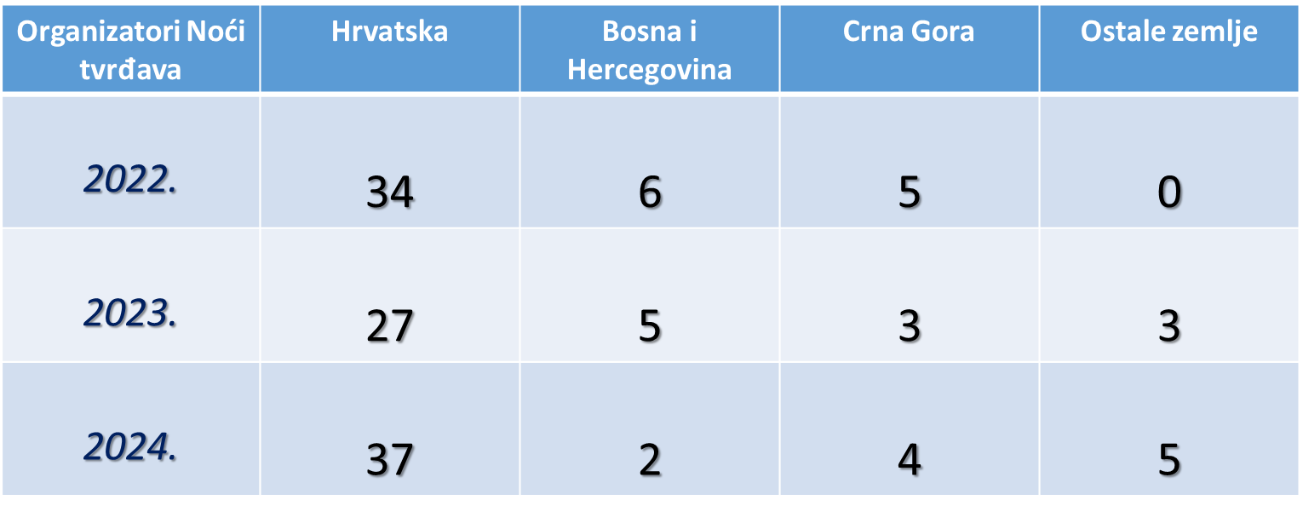
RESULTS 2024
Three editions of the event (2022-2024) connected and promoted programs at 50 sites in 8 European countries.
Observed trends:
  Croatia: largest number of participants from year one, wide and stabile network of stakeholders
  BiH, Montenegro: smaller number of participants, less stable network
  Partners from other countries joining: Romania, Serbia, Slovenia, Czech Republic and Ukraine

Slide 6
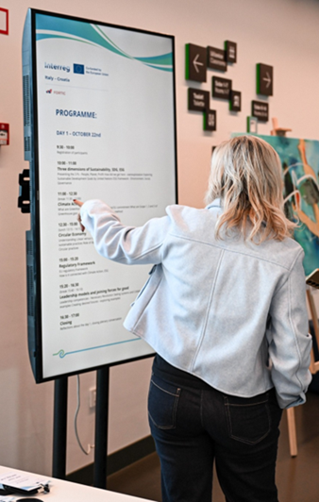
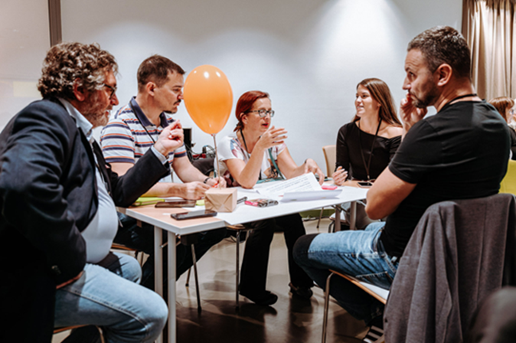

2025 – SUPPORTED BY 2 NEW EUROPEAN TERRITORIAL COOPERATION PROJECTS
Timely preparations: First CB capacity building for organizers: Green-Sustain Lab (October 2024, Šibenik)
NOF Goes Green Guidelines – document available to participants as a result of a collaborative workshop facilitated by external expert in sustainable development (logistics and infrastructure, event planning and organizing)
Night of Fortresses Goes Green initiative: an established international event in 2025 becomes a tool to raise public awareness of sustainability and green practices at established sites
Event branding strategy developed by external experts
GIFTS network of organizers in forming

Slide 7
NOF GG 2025: RESULTS
73 participation applications – 75 sites in 10 countries (+50% participants, 2 new countries)
Observed trends:
  Croatia: largest number of participants from year one, wide and stabile network of stakeholders – and growing
  BiH, Montenegro: still smaller number of participants, increased networking resulted in growth of participants
  Stabile partnerships from countries who joined event in 2023-2024: Romania, Serbia, Slovenia, Czech Republic and Ukraine; new participants in Serbia and Czech Republic
  New entries: Italy and Lithuania – result of FORTIC project and an ERASMUS+ project led by Fortress of Culture Šibenik
NOF ORGANIZERS | HR | BA | ME | IT | RO | CZE | UKR | RS | SI | LT
2022 | 34 | 6 | 5 | 0 | 0 | 0 | 0 | 0 | 0 | 0
2023 | 30 | 5 | 3 | 0 | 1 | 1 | 0 | 1 | 0 | 0
2024 | 39 | 2 | 4 | 0 | 1 | 1 | 1 | 1 | 1 | 0
2025 | 41 | 5 | 9 | 8 | 1 | 2 | 1 | 4 | 1 | 1

Slide 8
NOF GG 2025: RESULTS
Increased variety and number of organized programmes/activities

Slide 9
NOF GG 2025: HOW WAS IT IN BAR?
UBACITE SVOJE MATERIJALE – NPR VIDEO

Slide 10
NOF GG 2025: HOW WAS IT IN ULCINJ?
UBACITE SVOJE MATERIJALE – NPR VIDEO

Slide 11
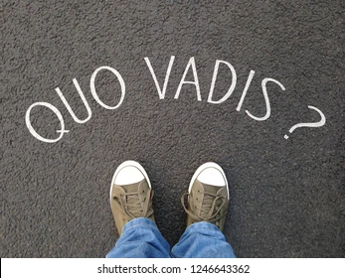
Night of fortresses in the future…
= brand pillar of GIFTS network

Slide 12

OUR GOALS
GIFTS network enhances European territorial cooperation in cultural, creative and tourism sector.
mission
Facilitate territorial cooperation and exchange to foster sustainable cultural management.
Enhance of the role of culture on local, national and European levels.
We are a growing European network in sustainable management of cultural and historical spaces, innovative programming, and the creation of inspiring cultural experiences that enrich and engage our visitors and communities.
vision

Slide 13

1
International cooperation and networking
OUR PRIORITES
2
Members’ capacity building
3
Fostering partnerships and cultural initiatives
GIFTS network strategic priorities are:
4
Connecting culture with tourism -showcasing joint values: Night of Fortresses
5
Increasing relevance and visibility of the network and its members

Slide 14
ENLIST FOR NETWORK MEMBERSHIP
*https://nightoffortresses.org/en/gifts-network/gifts-mreza-prijava/
2. PARTICIPATE IN GIFTS NETWORK MEETINGS
& INVITE CONNECTIONS TO JOIN
1st meeting – Karlovac, June 2025
2nd meeting – Banja Luka, November 2025
3rd meeting – Bar, June 2026
4th meeting – Trebinje, November 2026
….
*one-day sessions
*exchange of practices
*planning future actions
*inviting new potential members from host area to participate and join
STEPS AND
„TO DO’S”
International cooperation and networking

Slide 15
GET INVITES AND PARTICIPATE IN CAPACITY BUILDING ACTIVITIES
WEBINAR: Night of Fortresses branding strategy, September 2025
WORKSHOP: Sustainable management of cultural tourism destinations and events, October 2025 – Šibenik
WORKSHOP: Sustainable reuse of cultural heritage infrastructure: green procurement, energy efficiency measures, carbon footprint – March 2026, Šibenik
*webinar duration: 60 minutes
*workshops: 3-day sessions, facilitated by external experts for sustainable development
2. ORGANIZE CAPACITY BUILDING ACTIVITIES
AND INVITE NETWORK MEMBERS
STEPS AND
„TO DO’S”
Members’ capacity building

Slide 16
USE NETWORK WEB SITE TO FIND PARTNERS FOR YOUR NEW PROJECTS AND INITIATIVES
https://nightoffortresses.org/en
*list of network members will be added
USE NETWORK MEETINGS TO PRESENT AND LAUNCH NEW IDEAS TO MEMBERS
USE NIGHT OF FORTRESSES AS A PLATFORM FOR CONNECTING WITH LOCAL AND REGIONAL PARTNERS
CAPITALISE THE NETWORK AND NIGHT OF FORTRESSES IN OTHER PROJECTS
*example: FORTIC – Interreg Italy-Croatia
STEPS AND
„TO DO’S”
Fostering partnerships and cultural initiatives

Slide 17
PREPARE AND ORGANIZE NIGHT OF FORTRESSES PROGRAMME AT YOUR SITE/VENUE
*Night of Fortresses takes place on the 2nd weekend of May
*save the dates: 8th-9th May 2026
2. FOLLOW NIGHT OF FORTRESSES GOES GREEN GUIDELINES FOR ORGANIZERS
*https://nightoffortresses.org/en/night-of-fortresses-goes-green/
3. USE NIGHT OF FORTRESSES GOES GREEN VISUAL IDENTITY ON YOUR SITE/VENUE/PROGRAMME
*Branding strategy: https://bit.ly/4qHOSsd
STEPS AND
„TO DO’S”
Connecting culture with tourism and showcasing joint values: Night of Fortresses

Slide 18
PRESENT NETWORK AND EVENT IN INTERNATIONAL EXPERTS’ GAHTERINGS
*EFFORTS Annual Congress 2025 –Municipality of Bar, Municipality of Ulcinj
*FORTMED 2026 – Fortress of Culture Šibenik
*FORTE CULTURA Annual Congress 2026
*…
2. PRODUCE NIGHT OF FORTRESSES MERCHANDISE AT YOUR SITE
*souvenirs - reusable bags, reusable water bottles, magnets, cups, T-shirts etc.)
3. PROMOTE NIGHT OF FORTRESSES AND GIFTS NETWORK
*promo-videos, social media campaigns, paid promotion
*use Night of Fortresses Branding Strategy as baseline tool for communication tone
STEPS AND
„TO DO’S”
Increasing relevance and visibility of the network and its members

Slide 19



Slide 20
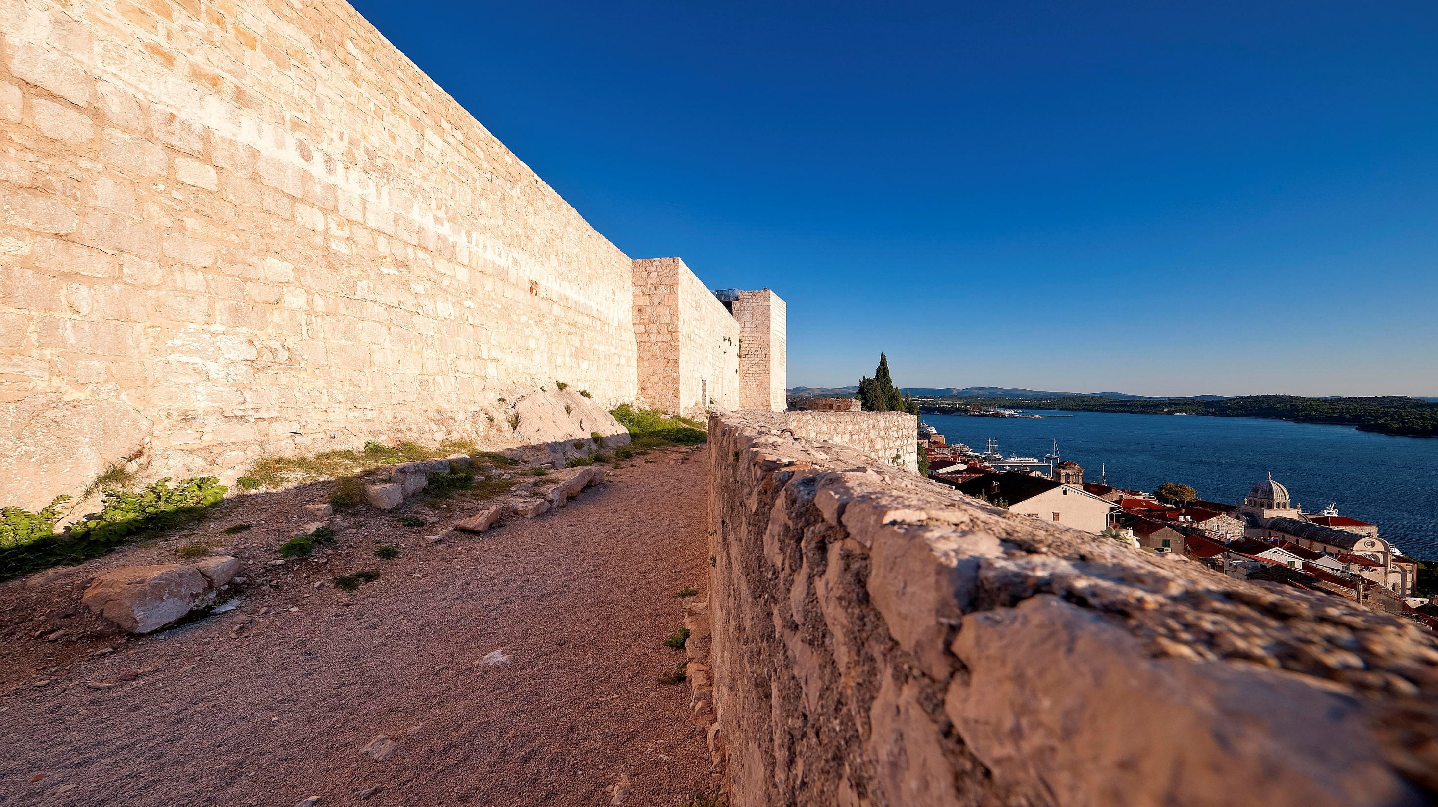



PUBLIC INSTITUTION IN CULTURE FORTRESS OF CULTURE ŠIBENIK
Đurđa Vrljević Šarić, Head of International Cooperation and Projects Department
djurdja@tvrdjava-kulture.hr

