Slide 1


Oudenaarde: Fortress City – Past, Present and Future – History, achievements & vision – City of Oudenaarde
Eva Roels & Stijn Lybeert
25 / 12 / 3
Notes:
Welcome to everyone. Today my colleague Stijn and I will guide you through the remarkable fortress history of Oudenaarde — a story that begins in the 10th century and still shapes our landscape, our urban structure and even our future vision.

Slide 2
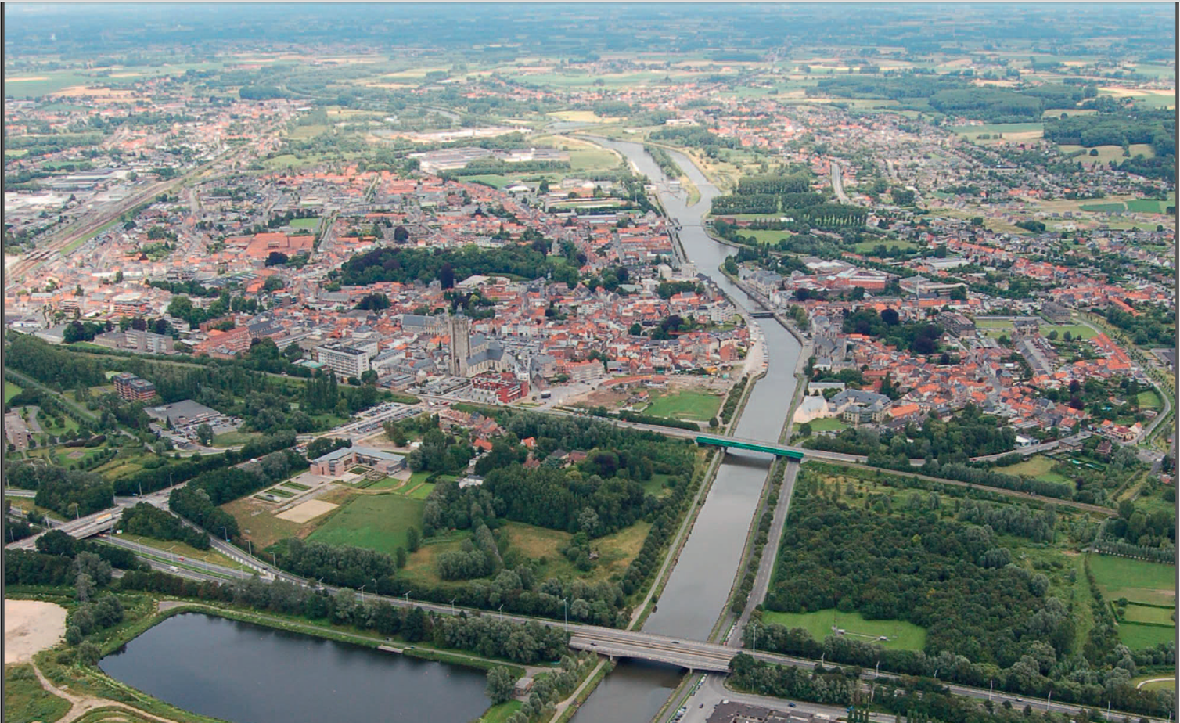
Introduction
Oudenaarde has an exceptional yet largely invisible fortress heritage.
Provide insight into the historical development of the city fortifications.
Overview of recent heritage and tourism initiatives.
A look ahead: how can we make this military past visible and meaningful for the future?
Notes:
Oudenaarde has an exceptional yet largely invisible fortress heritage.
Although Oudenaarde played a crucial role as a fortified city for centuries, very little of that military past is still visible in today’s urban landscape. Much of the structure has been demolished or integrated into later developments. This makes the fortress heritage exceptional in importance, but also challenging to be understood by visitors and even locals.
The presentation is composed of three parts:
……. The goal is not only to preserve history, but to activate it as a resource for education, tourism, and identity.” Colleague Stijn will take you through the historical evolution.

Slide 3
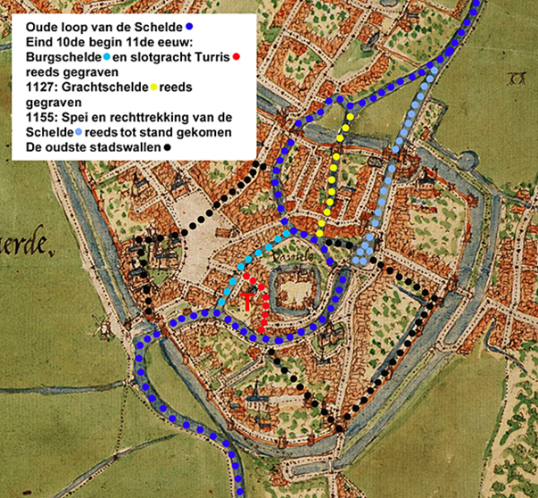
Part 1 - Historical evolution
Origins of the city (10th–11th century)
First mention of Oudenaarde: early 11th- century.
Construction of the turris Aldenardensis along the Scheldt: military and economic function.
First city enclosure: earthen rampart + 500 m ditch, covering 5–6 ha.
Archaeological traces found on the Market Square in 2008.
Notes:
From its very foundation, Oudenaarde was a strategic city. Likely due to the intervention of the Count of Flanders, Oudenaarde arose at the end of the tenth or the beginning of the eleventh century. The count established a fortification in Oudenaarde, known in sources as the “turris Aldenardensis.”

Slide 4
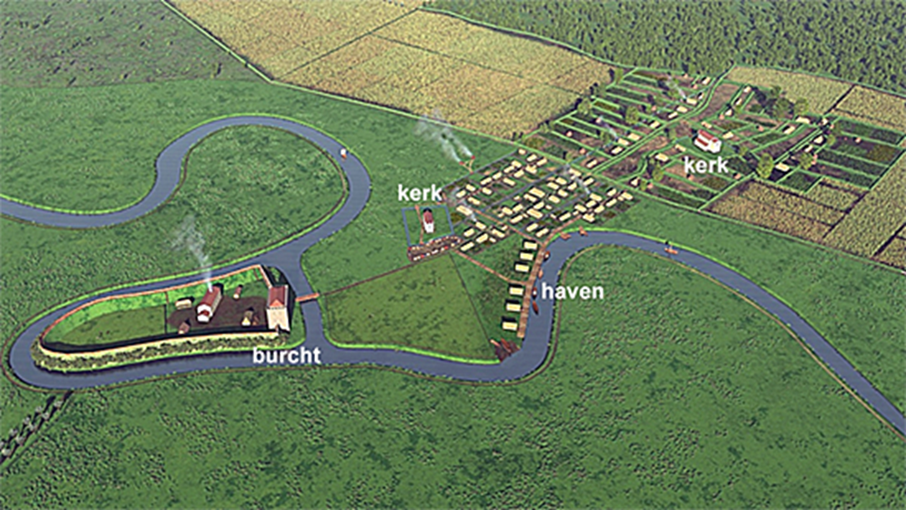
Part 1 - Historical evolution
Rivalry with Ename
After the Treaty of Verdun (843), the Scheldt became a border river.
Ename (974) grew into an Ottonian frontier stronghold.
The Counts of Flanders built Oudenaarde as a counterfort (1030).
Destruction of Ename in shifted population and trade towards Oudenaarde.
The city’s origins lie in military strategy and territorial control.
Notes:
This comital stronghold was intended to counterbalance the fortification at Ename, which had been erected by the German emperor. The Scheldt River formed the political border between the Holy Roman Empire and the French kingdom, in which the Count of Flanders had become a powerful vassal. After the annexation of the area between the Scheldt and Dender to Flanders, the fortification at Ename lost its significance, and the nearby settlement of Oudenaarde gained importance.

Slide 5
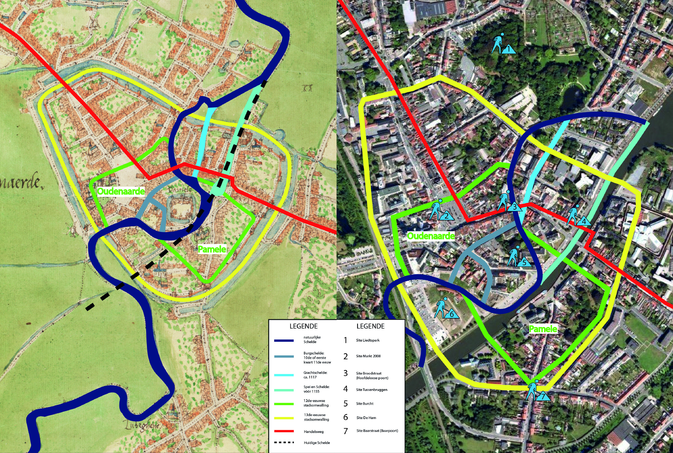
Part 1 - Historical evolution
The Scheldt as a shaper of the city
The Scheldt’s natural meanders strongly influenced early urban growth.
Human interventions: Burgschelde (10th–11th c.), Grachtschelde (12th c.), straightening at Spei (c. 1155).
Today these watercourses are gone, but their lines survive in the street pattern.
Water engineering played a decisive role in shaping the fortress.

Slide 6
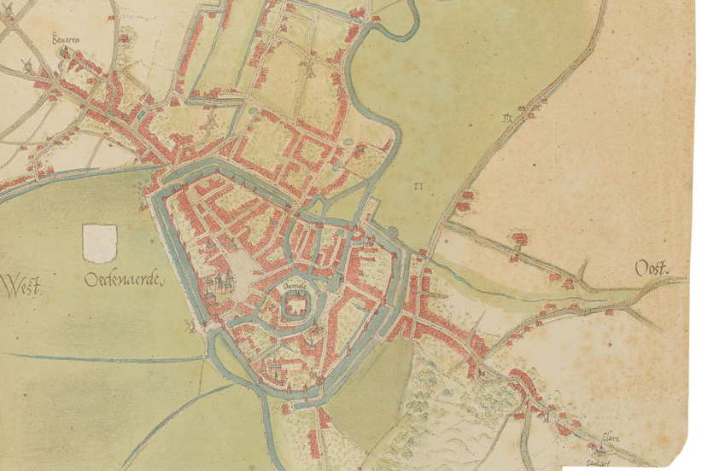
Part 1 - Historical evolution
Two city centres become one
City charter granted in 1189 by Philip of Alsace.
Two centres developed: Oudenaarde (left bank) and Pamele (right bank). Only in 1593 were both fully united.
Late 13th-century expansion: major city wall with five gates + creation of the Market Square.
In the 16th-century the city fortification was equipped with bastions.
Almost nothing of this medieval structure survives above ground today.
© Map van Deventer,
ca. 1585
Notes:
Successive city fortifications were built to protect the city. A city wall primarily served as military defense but also symbolised urban autonomy. The evolution of the city wall reflected the city’s importance and the technical progress of warfare. The first fortification around Oudenaarde, like the city’s privileges, likely dates back to the 12th century. Late 13th-century expansion: major city wall with five gates + creation of the Market Square.
Presumably, the city fortification was equipped with bastions for the first time during this period. The bastions were designed by the French Calvinist François de la Noüe

Slide 7
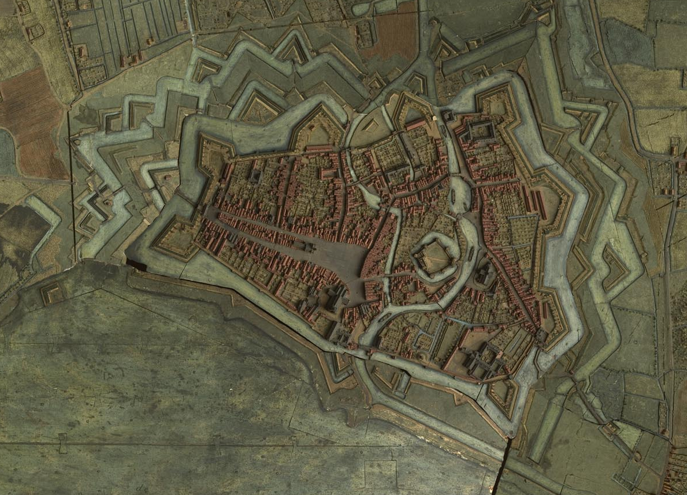
Part 1 – Historical evolution
Vauban and the 17th-century
Around 1670 the city was modernised as a fortress under Louis XIV.
Vauban-style works: four bastions, ravelins, lunettes, wide moats.
After the War of the Spanish Succession, the area returned to the Southern Netherlands.
Emperor Joseph II ordered the demolition of the fortifications in 1782
The Liedts family purchased large sections, influencing the later landscape of the Liedtspark.
Notes:
In the 17th century, Oudenaarde remained a strategically important city in the border area between France and the Spanish (and later Austrian) Netherlands. Many battles were fought in and around the city during this period.
Between 1667 and 1678, Oudenaarde was a French city, and the fortress was thoroughly adapted under the direction of the famous French military engineer Vauban. He focused mainly on the southeastern border of the fortifications, as it could be easily shelled from the Kerzelareberg. Vauban also perfected the system of sluices, which allowed large parts of the Scheldt valley to be flooded during a siege.
In the 18th century, the fortress of Oudenaarde lost its importance within the new international geopolitical context and was largely dismantled and sold. Only during the War of the Austrian Succession (1740–1748) did the fortifications of Oudenaarde temporarily regain importance, especially during a brief period of French rule (this is also when the model of Oudenaarde—dated 1746—was made).

Slide 8
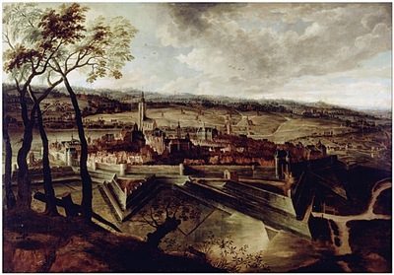
Part 1 – Historical evolution
The impressive 18th-century fortress
Maps (used for the Nézot model, c. 1746) show a vast double defensive line.
Clearly visible: bastions, ravelins, ramparts and moats.
It is difficult to imagine today how fortified Oudenaarde once was.
© ‘Panoramisch waarheidsgetrouw zicht op de stad Oudenaarde met zijn stervormige omwalling en versterking van Vauban’ door I.D. Maire (stadhuis Oudenaarde)

Slide 9
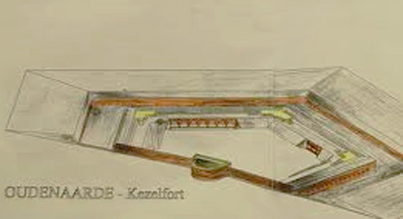
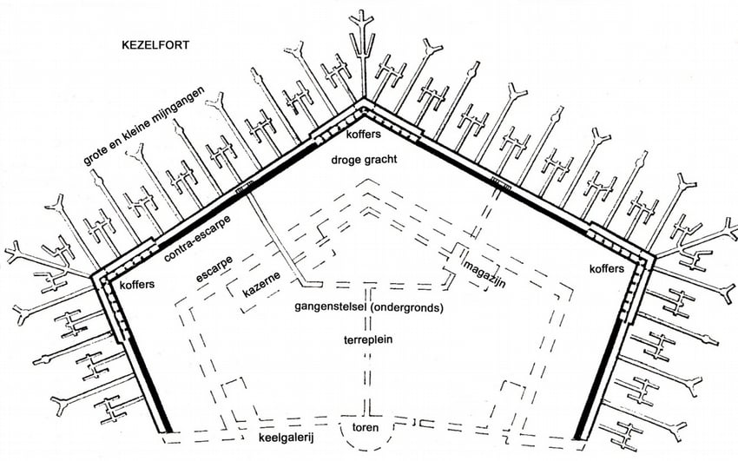
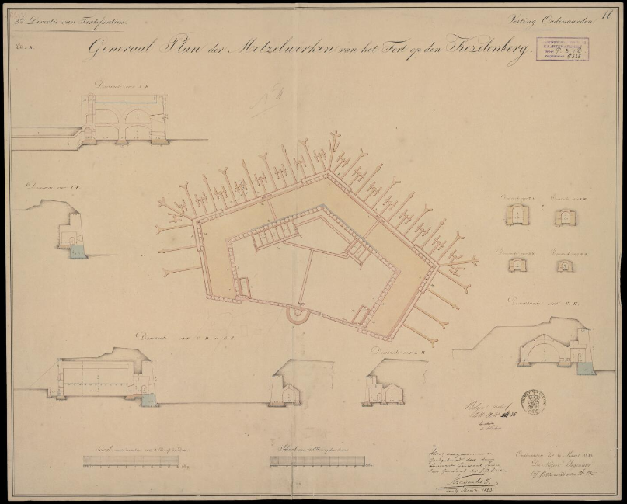
Part 1 – Historical evolution
19th-century: Dutch rule & the Kezelfort
New bastioned fortifications were started in 1821, but halted after Belgian independence.
Kezelfort built as part of the Wellington Barrier system.
Features: dry moat, bombproof casemates, underground passages, unique countermine system.
Used by German troops for shooting exercises during both World Wars.
Today: highly valuable but fragile and partly inaccessible.
Notes:
In the 19th century, the fortress regained importance during Dutch rule (1815–1830). For the Netherlands, Oudenaarde was again an important stronghold in the defence of the southern border with France. The fortress was modernised. During the Dutch period, the Kezelfort was established on the heights at Edelare, south of Oudenaarde. A similar fort was planned on the heights of Bevere, but these works were never started.

Slide 10
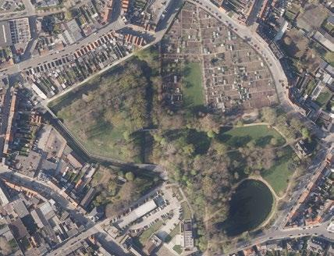
Part 2 – Tourism & heritage initiatives
Liedtspark: restoration of the ravelin
The only surviving ravelin; previously in poor condition.
Protected in 2010; restoration began in 2011 (Interreg project Manoeuvres).
Moat reopened, slopes partially rebuilt.
New foot and cycle paths, bridge and adapted planting.
Popular location: city park / guided tours
Notes:
The second part of the presentation will highlight what has already been done in recent years to make this history accessible—ranging from digital tools and research projects to tourism initiatives and collaborations. These efforts show a growing interest in rediscovering and valorising the city’s military past.
First of all we : the ravelin in the Liedtspark: as we walk towards the bus roday, we’ll pass by this restored part, which has now been made visible again. It was in very poor condition, but thanks to an Interreg project “Manoeuvres”, restoration works were conducted in 2011.
The moat was reopened, the slopes rebuilt, and new paths and bridges were added. It is now a popular site, since it is in the middle of the city park, giving immediate access to the city, and is included in our guided tours program.

Slide 11
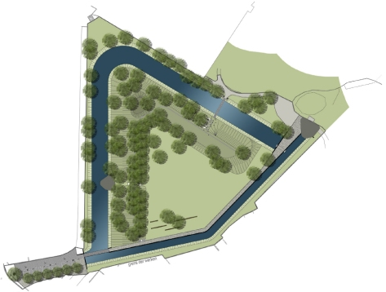
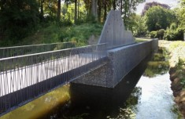
Part 2 – Tourism & heritage initiatives
Liedtspark
The military structure was not only restored but made legible again.
A concrete profile wall indicates the original height of the ramparts.
A digital educational game about the site’s military history is under development.
© Abscis Architecten
Notes:
The goal was not only to restore, but also to reinterpret the site.
A concrete profile wall shows the original height of the ramparts — a simple but effective tool to help visitors understand the structure.
We are working on the development of an educational game to bring the military history of the city to life for families and young people, giving them a better understanding of this part of history.

Slide 12
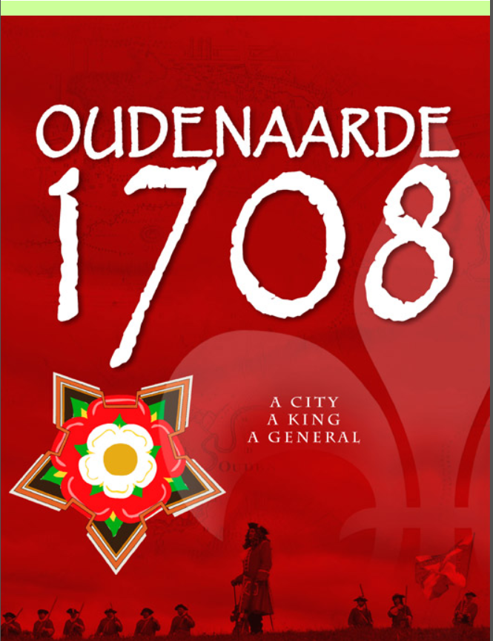
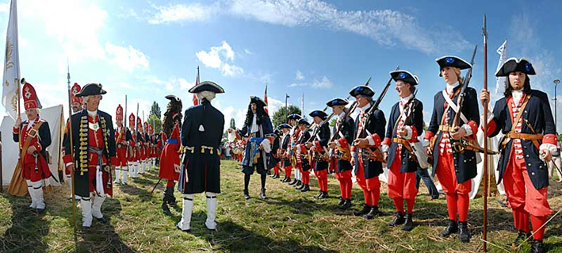
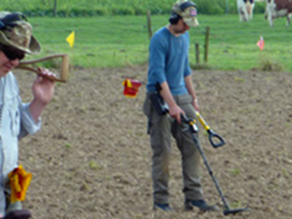
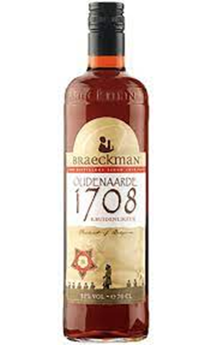
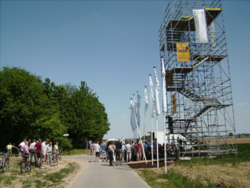
Part 2 – Tourism & heritage initiatives
Battle of Oudenaarde (1708)
Major battle of the War of the Spanish Succession; fought in fields around the city.
Great impact on inhabitants; troops were quartered in the fortified town.
2008 project: exhibition, historical reenactment, routes, regional product, lookout tower, archaeological pilot “Casus Belli”.
Notes:
The Battle of Oudenaarde didn’t take place in the city itself but had major consequences for its inhabitants. Troops stayed within the fortified town, and the battle was a turning point in the War of the Spanish Succession. In 2008, a project was launched to commemorate the battle. Key activities included:
An exhibition about the battle and its historical context.
Historical reenactments to bring the events to life.
Creation of walking and cycling routes highlighting the battlefield areas.
Promotion of a regional product linked to the event.
Construction of a lookout tower for visitors to understand the battlefield geography.
An archaeological pilot project called “Casus Belli” exploring battlefield remains.
Overall, the 2008 project combined history, culture, and tourism, allowing both locals and visitors to connect with Oudenaarde’s past.

Slide 13
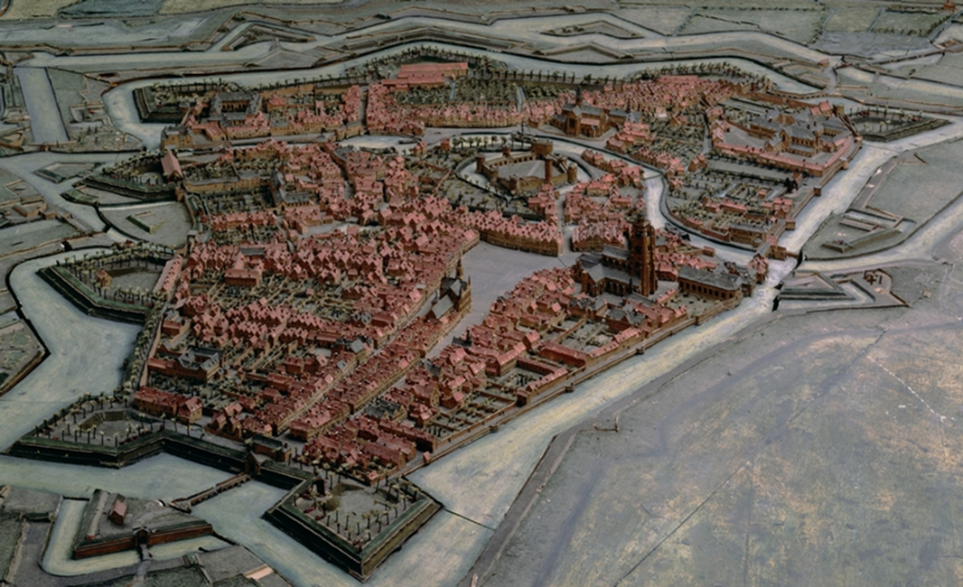
Part 2 – Tourism & heritage initiatives
Nézot model (1746)
Highly detailed model showing the fortress at its peak.
Exhibited in 2008; fully digitised through 233 high-resolution photos.
Publicly accessible via Erfgoedinzicht.
An essential tool for visualising vanished fortification structures.
erfgoed in zicht
Notes:
The scale model of Oudenaarde is a detailed miniature of the city, created in 1747 by Nicolas Nézot, based on plans by the French military engineer Vauban. For us, it is an important source for understanding the city’s evolution and for illustrating Vauban’s strategic concepts. In 2008, the city succeeded in obtaining permission for the model—owned by the French state and exhibited at the Palais des Beaux-Arts in Lille—to come to Oudenaarde for the mentioned exhibition on the Battle of Oudenaarde. This offered the perfect opportunity to fully digitize the model.

Slide 14
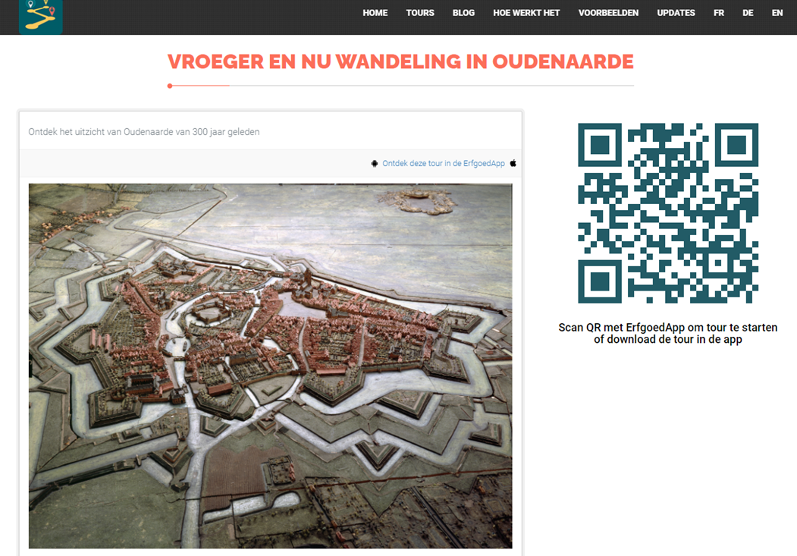
Part 2 – Tourism & heritage initiatives
Heritage App: digital walking tour
A self-guided trail comparing historical images with the contemporary city.
Includes photos of the Nézot model for orientation.
Encourages users to discover surviving traces of the fortress.
Notes:
A digital walking Tour was developed a couple of years ago. This heritage app is a low-threshold way for visitors and residents to explore the city’s past.
It is combining old photographs, model images and current views.
And it encourages people to look closely and discover what remains of the fortified city — and what has vanished.

Slide 15
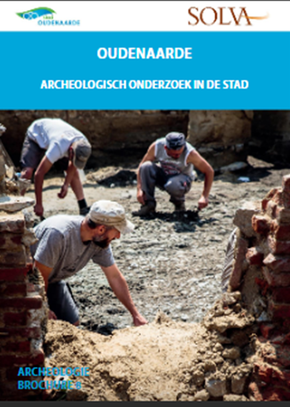
Part 2 – Tourism & heritage initiatives
Archaeology & public outreach (with SOLVA)
Major excavations prior to market and sewer works in the historic centre.
Results shared through brochures, on-site tours, lectures and exhibitions.
Permanent ground marking installed at the site of a newly discovered city gate in the Baarstraat.
Notes:
Due to major reconstruction and sewer works, a lot of archaeological research could be conducted. Most of the research has been done by Solva, Intermunicipal Association of the region.
The results are actively shared with the public.
There are organised on-site tours, lectures and exhibitions, showing how archaeology can contribute directly to public understanding.
In the Baarstraat, where a city gate was found, a permanent ground marking now indicates its exact location.

Slide 16
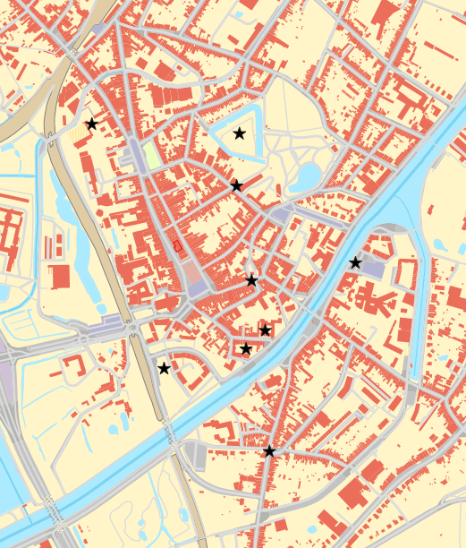
Location excavated parts within the city fortress

Slide 17
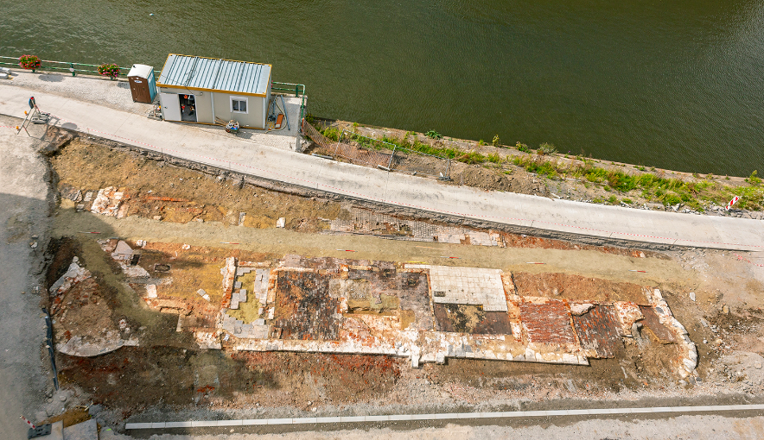
Oudenaarde Bergen-op-Zoomplein
Kasteel van
Bourgondië
(castle of Burgundy)

Slide 18
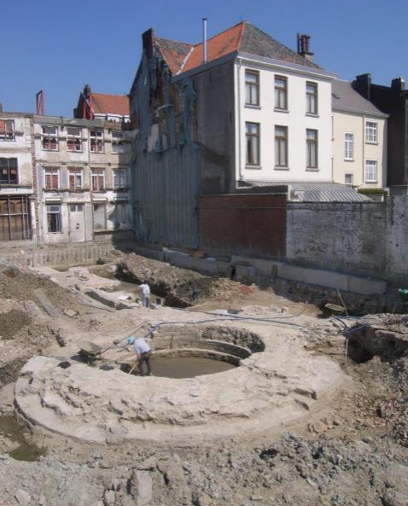
Oudenaarde Kasteelstraat
Agentschap Onroerend Erfgoed & Ruben Willaert
Fortress of Oudenaarde / Castle of Pamele, masonry and moat

Slide 19
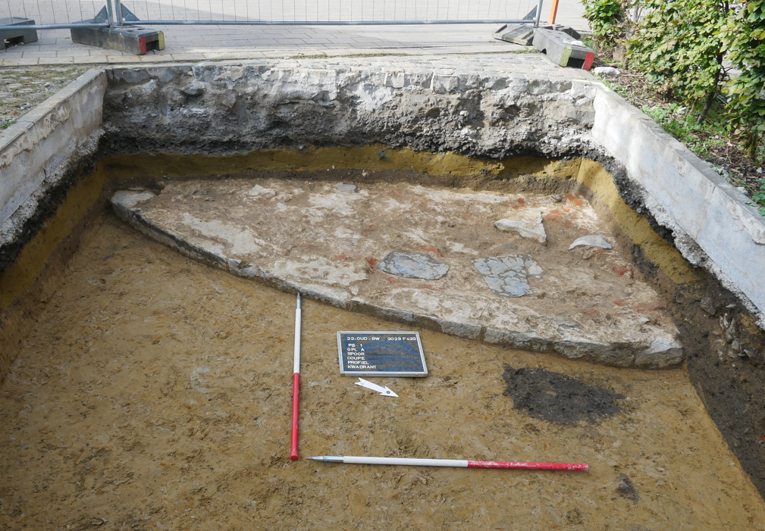
Oudenaarde Brandwoeker
City Tower (Kattepoort) & City Moat (Bastion)

Slide 20
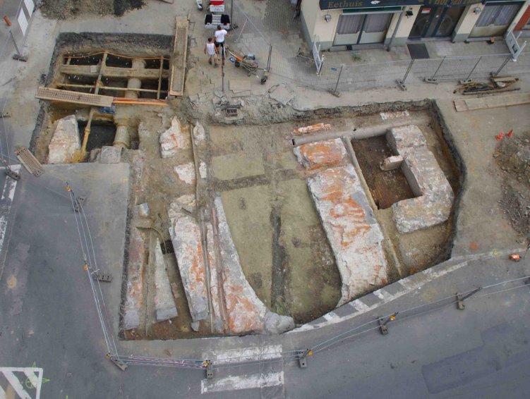
Oudenaarde Baarstraat
Baarpoort
(name of the gate)

Slide 21
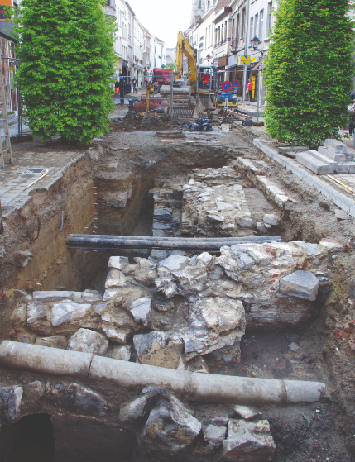
Oudenaarde Broodstraat
Tower and bridge of the first city fortifications

Slide 22
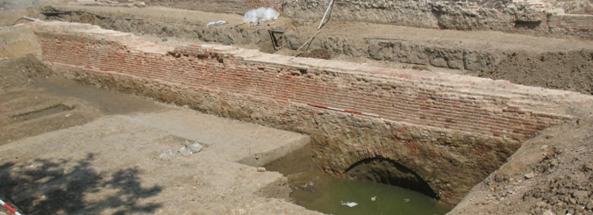
Oudenaarde De Ham
Ename Expertise Centrum
City wall and moat

Slide 23
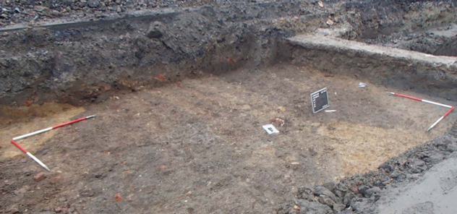
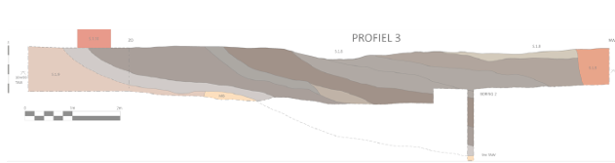
Oudenaarde Tacambaroplein
BAAC
City moat

Slide 24
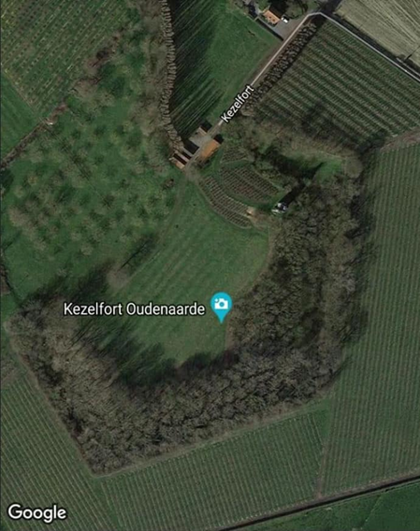
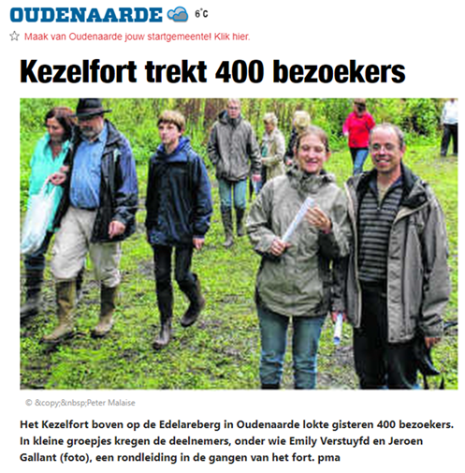
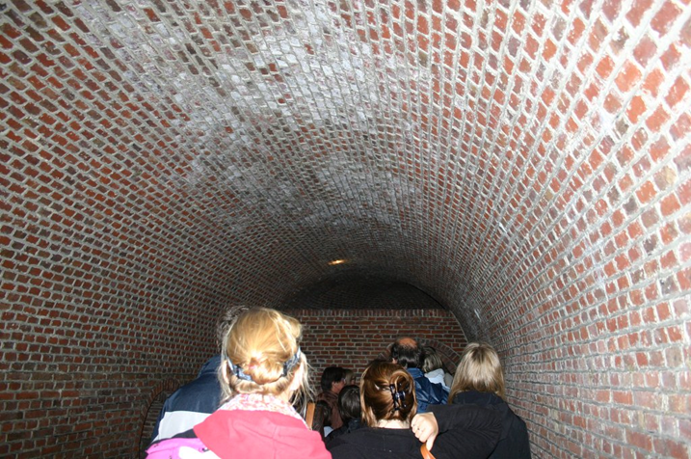
Part 2 – Tourism & heritage initiatives
Kezelfort: potential and challenges
Public enthusiasm is high; guided tours always fully booked.
Main challenges:
bat habitat (strictly protected),
poor structural condition,
privately owned site.
Ongoing discussions with partners to explore respectful access.
“Virtual Oudenaarde” aims to offer a 360° visit of the interior.
Notes:
Public interest in the Kezelfort is enormous. Occasionally tours are organized, and these are always fully booked.
But several challenges remain: the fort is a protected bat habitat, its structural condition is fragile, and it lies on private property.
We are in ongoing dialogue with partners such as the Flemish Ardennes Regional Landscape to see how respectful access might be possible.
In the meantime, we are in negotiant with the owners to have the permission make a 360° digital visit, which is an excellent temporary solution

Slide 25
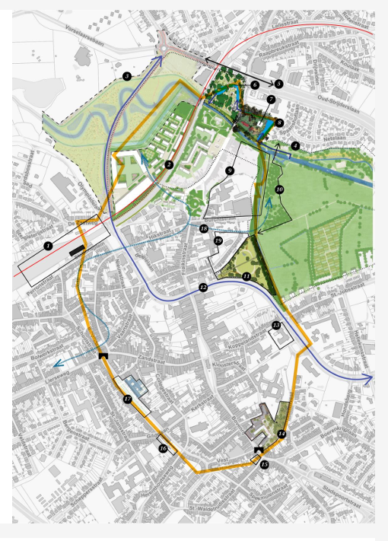
Part 3 – Vision for the future
Principles for future fortress heritage
Fortified cities can form the basis for contemporary spatial development
Military heritage can play a key role in tackling climate challenges, urban congestion, etc
Make invisible structures visible again. Combine physical restoration with digital interpretation.
Respect the balance between nature and heritage (e.g., bat habitat at Kezelfort).
Strengthen connections between several sites: ravelin – Liedtspark – Kezelfort – Scheldt.
Use this kind of heritage as a driver for education, tourism and identity.
Notes:
Fortified cities like Oudenaarde are more than military relics; today they form an experiential layer within the city that can guide contemporary spatial development.
Furthermore, historic military sites, like city walls and forts, can play a key role in tackling climate challenges, urban congestion, and the spread of concrete. By uncovering old moats, transforming forts into green spaces, and converting unused city walls into safe, nature-friendly walking and cycling paths, densely built-up urban areas can breathe again.
Invisible structures can be revealed through a combination of physical restoration and digital interpretation, allowing visitors to experience the past.
At the same time, we must respect the balance between nature and heritage, for example by preserving bat habitats at Kezelfort.
Connecting sites like the ravelin, Liedtspark, Kezelfort, and the Scheldt strengthens urban networks and visitor experience.
Finally, such heritage serves as a driver for education, tourism, and local identity, making it both relevant and valuable for today’s city

Slide 26
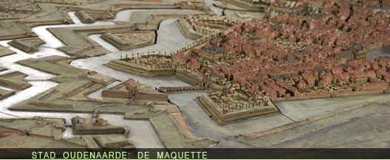
Part 3 – Vision for the future
Possible future projects
Augmented reality reconstructions at key locations using the Nézot model, through generative AI, e.g. digitalisation 2.0
A full fortress walking route.
Marking historic walls/part of the fortifications where possible, e.g. Baarstraat
Making the Kezelfort more accessible
New storytelling themes: Vauban, the Battle of Oudenaarde, frontier defence.
Notes:
These are some possible future steps: augmented-reality reconstructions at key locations;
Recordings and 3D scans: generative AI can digitally restore damaged artefacts, recreate lost elements, and enable immersive experiences for education and tourism. Collaboration Arras to work together on the digitalisation of the the model 2.0, and making it fully accessible to the public.
A complete fortress walking route;
marking historic walls or parts of the fortifications in the modern city in a modern way (visual signs), e.g. Baarstraat,
Making the Kezelfort more accessible
Each of these projects would help bring the lost fortress landscape back to life.

Slide 27

Part 3 – Vision for the future
Why invest in this heritage?
Strengthens the city’s identity.
Creates unique tourism assets.
Raises historical awareness among residents and visitors.
Connects landscape, memory and the future.
A strategic, long-term investment in Oudenaarde’s character.
Notes:
Reason together in this Efforts confrence and participating in other activities: need to learn form each other.
It strengthens the identity of the city and creates distinctive tourism assets. It supports education and raises awareness among residents and visitors. And ultimately, it connects our past with our landscape and our future ambitions. Investing in this heritage is investing in the long-term character and attractiveness of cities, like Oudenaarde.

Slide 28
Visit Oudenaarde
Stadhuis
Markt
9700 Oudenaarde
055 31 72 51
visit@oudenaarde.be
https://visit.oudenaarde.be
@visitoudenaarde

