Slide 1
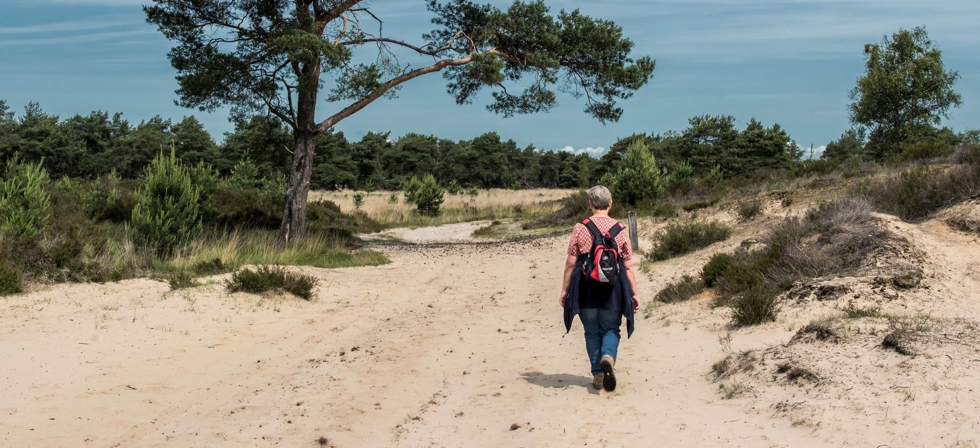

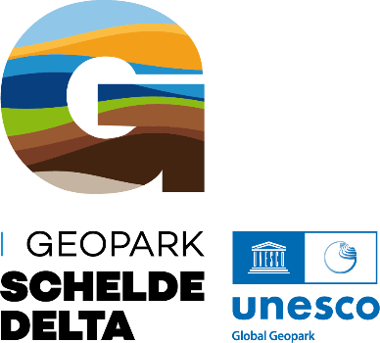
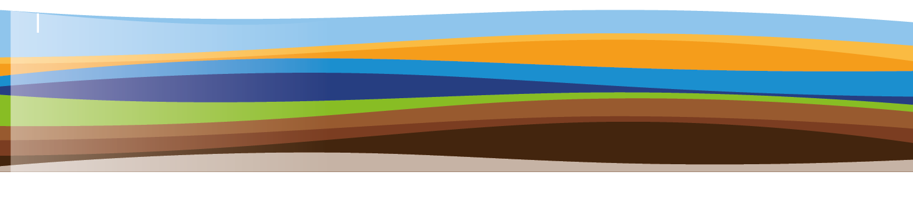
Geopark Schelde Delta – UNESCO label for a Flemish–Dutch partner network

Slide 2
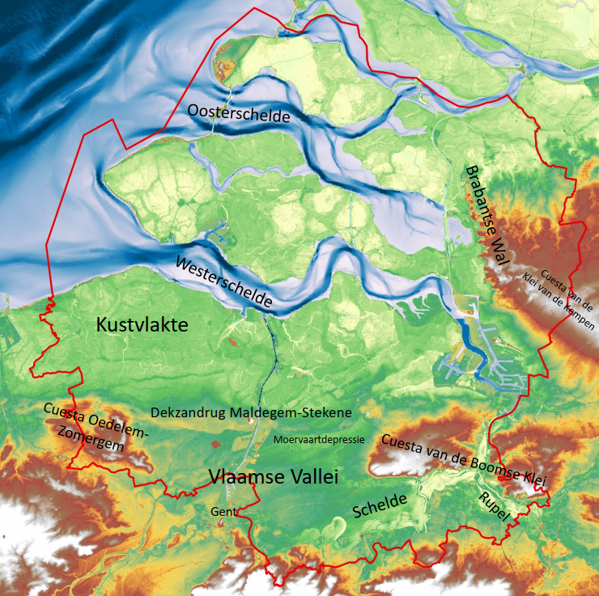
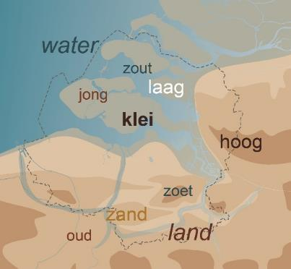
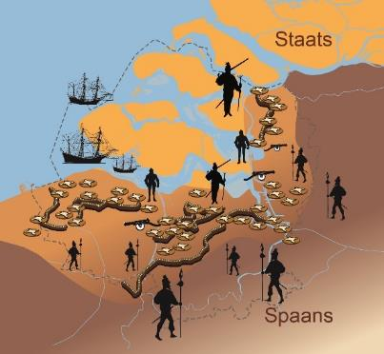
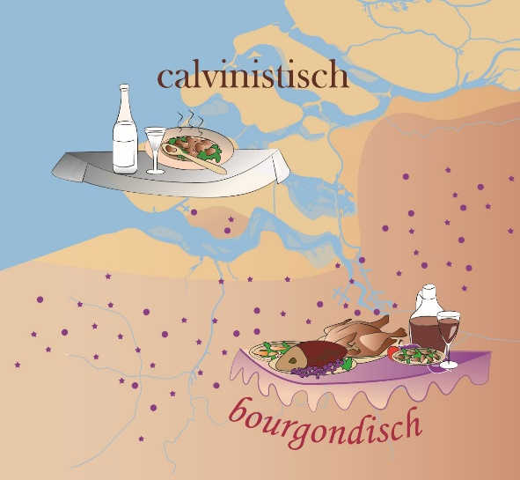
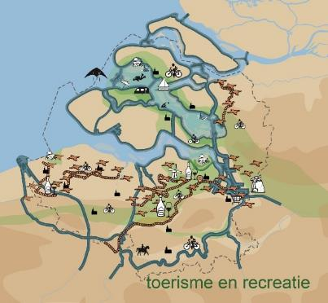
The Schelde Delta as a unique cross-border region

Slide 3

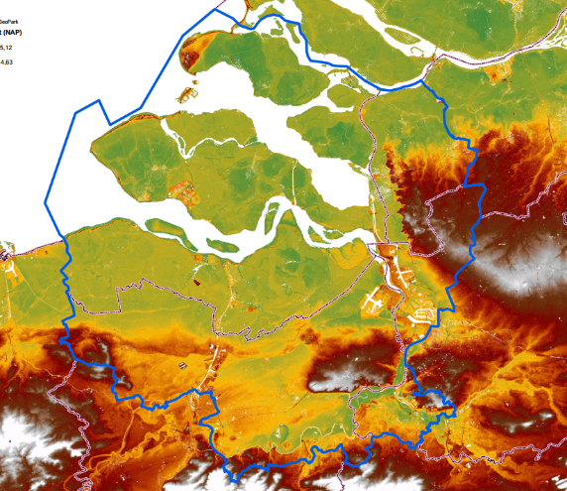
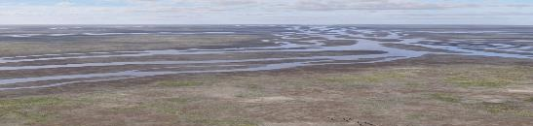
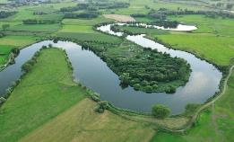
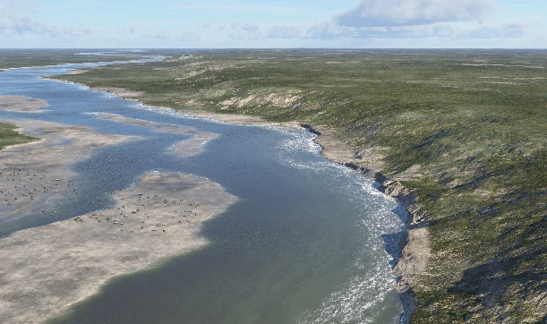
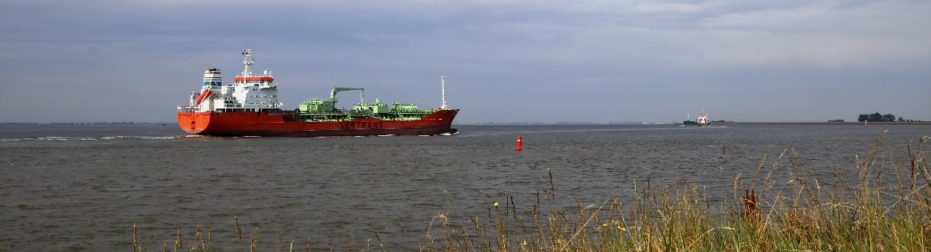
Characteristic: The continuous shifting of the Schelde River

Slide 4
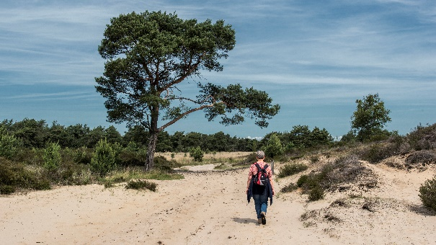
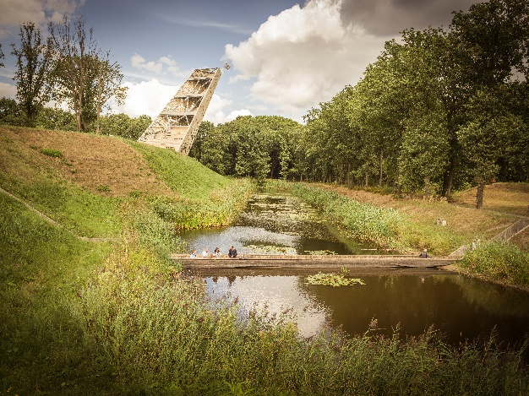
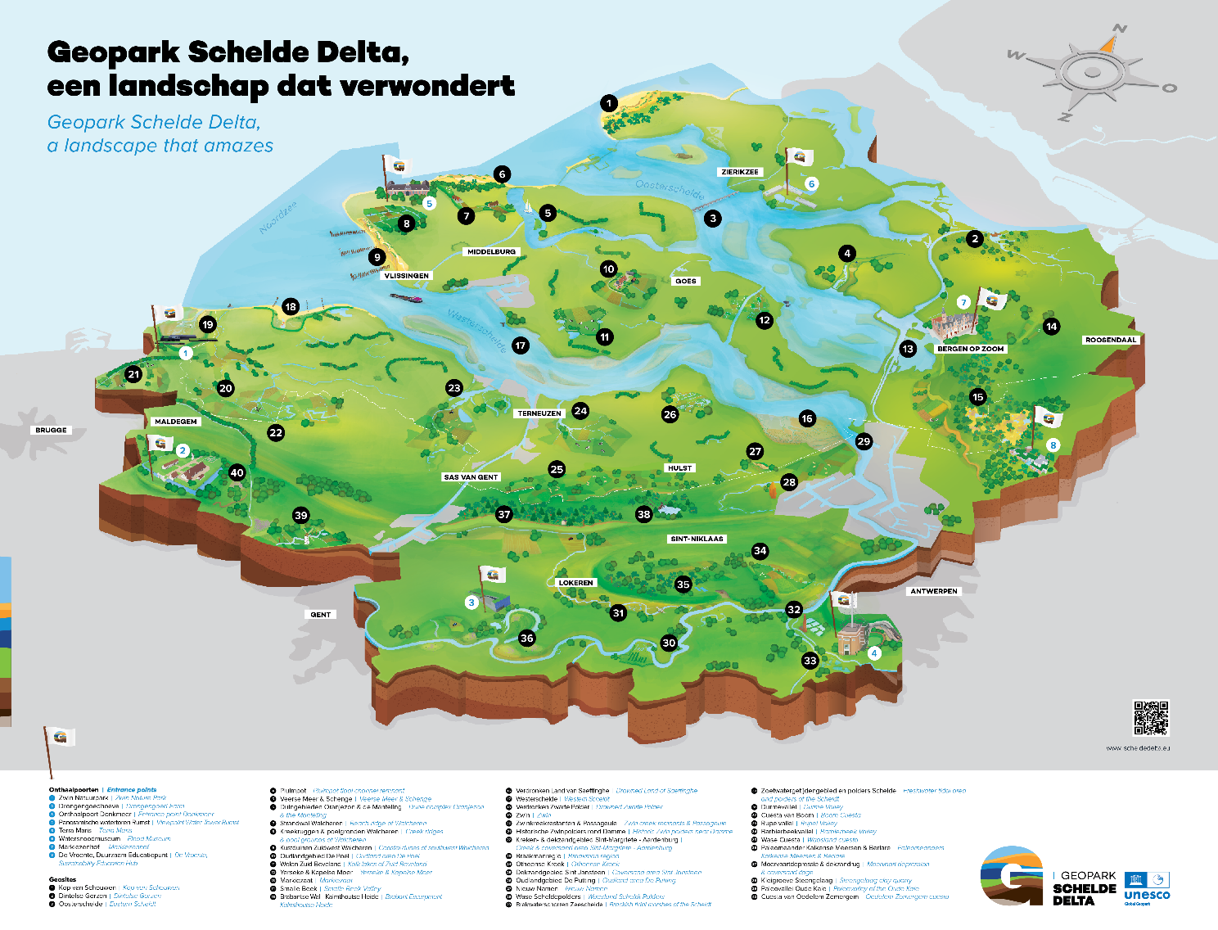
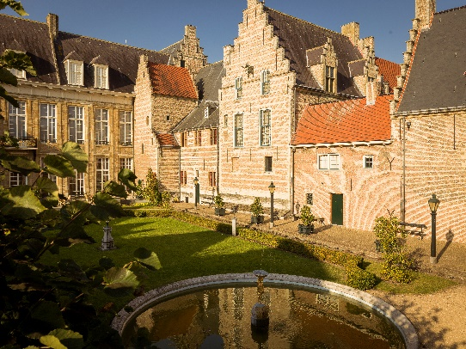
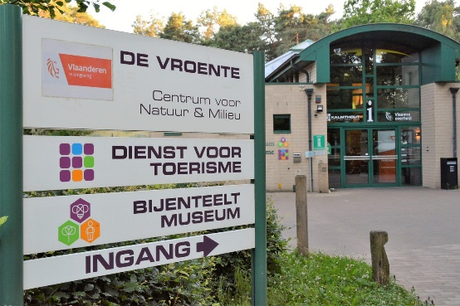
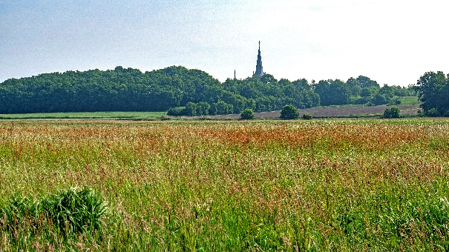
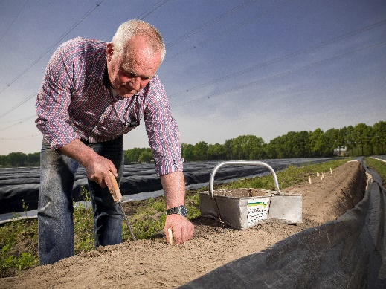
Experience map geopark schelde delta

Slide 5
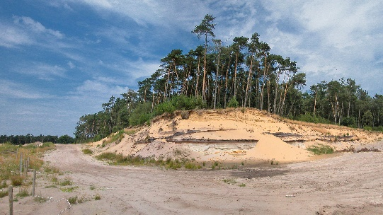
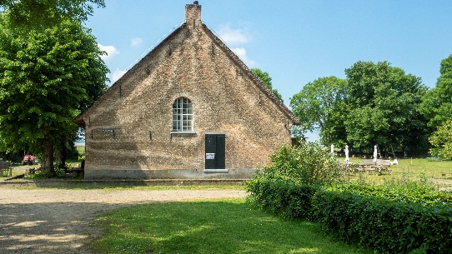
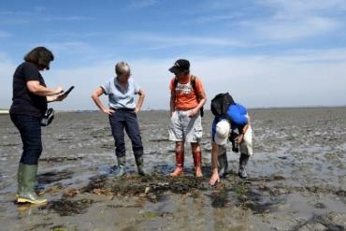
WhAT IS the UNESCO Global GEOPARK status?
A globally unique combination of:
Geology, landscape, cultural (and historical) heritage, and nature
Numerous locations that make the story visible and tangible
Related education, sustainable tourism/recreation, and research
The origin and the past offering lessons, inspiration, and direction for a sustainable future
A partner network committed to shared ambition
It revolves around the 4 B’s:
Experience – Awareness – Utilisation – Management

Slide 6
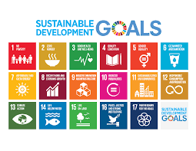
Waar het om draait
Experience
Visitor centres
Geosites
Museums and exhibitions
Walking and cycling routes
Application of innovations
Awareness
School programmes
Lectures
Excursions
Courses
Scientific research
Utilisation
Area promotion
Partners/ambassadors
Geo-tourism
Supporting entrepreneurs
Regional products
Management
Embedding in policy
Inspiration
Knowledge exchange
Participation in projects

Slide 7

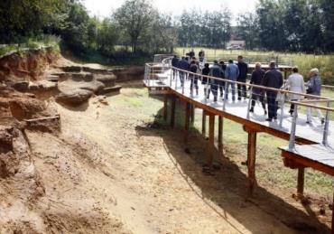
A “Michelin star” for unique landscapes
A partner network receives the UNESCO Global Geopark status.
Locations that take centre stage must have adequate protection under existing frameworks.
Partners maintain their own identity but communicate in a recognisable way.
It contributes to (inter)national visibility and reputation.
It increases access to (European) funding: Living/Experiencing the Schelde.
It adds another layer to regional storytelling.
It offers opportunities for sustainable (geo)tourism and tourism dispersal.
It embeds sustainability in the context of historical development.
It stimulates cross-border cooperation.

Slide 8






Storylines geopark schelde delta
TUSSEN OERLAND
EN MENSENHAND
POORT NAAR DE WERELD
LEVEN MET HET WATER
BESTREDEN GEBIED
BESTAAN EN WERKEN
ZILT EN ZOET

Slide 9
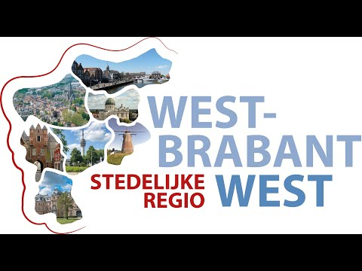
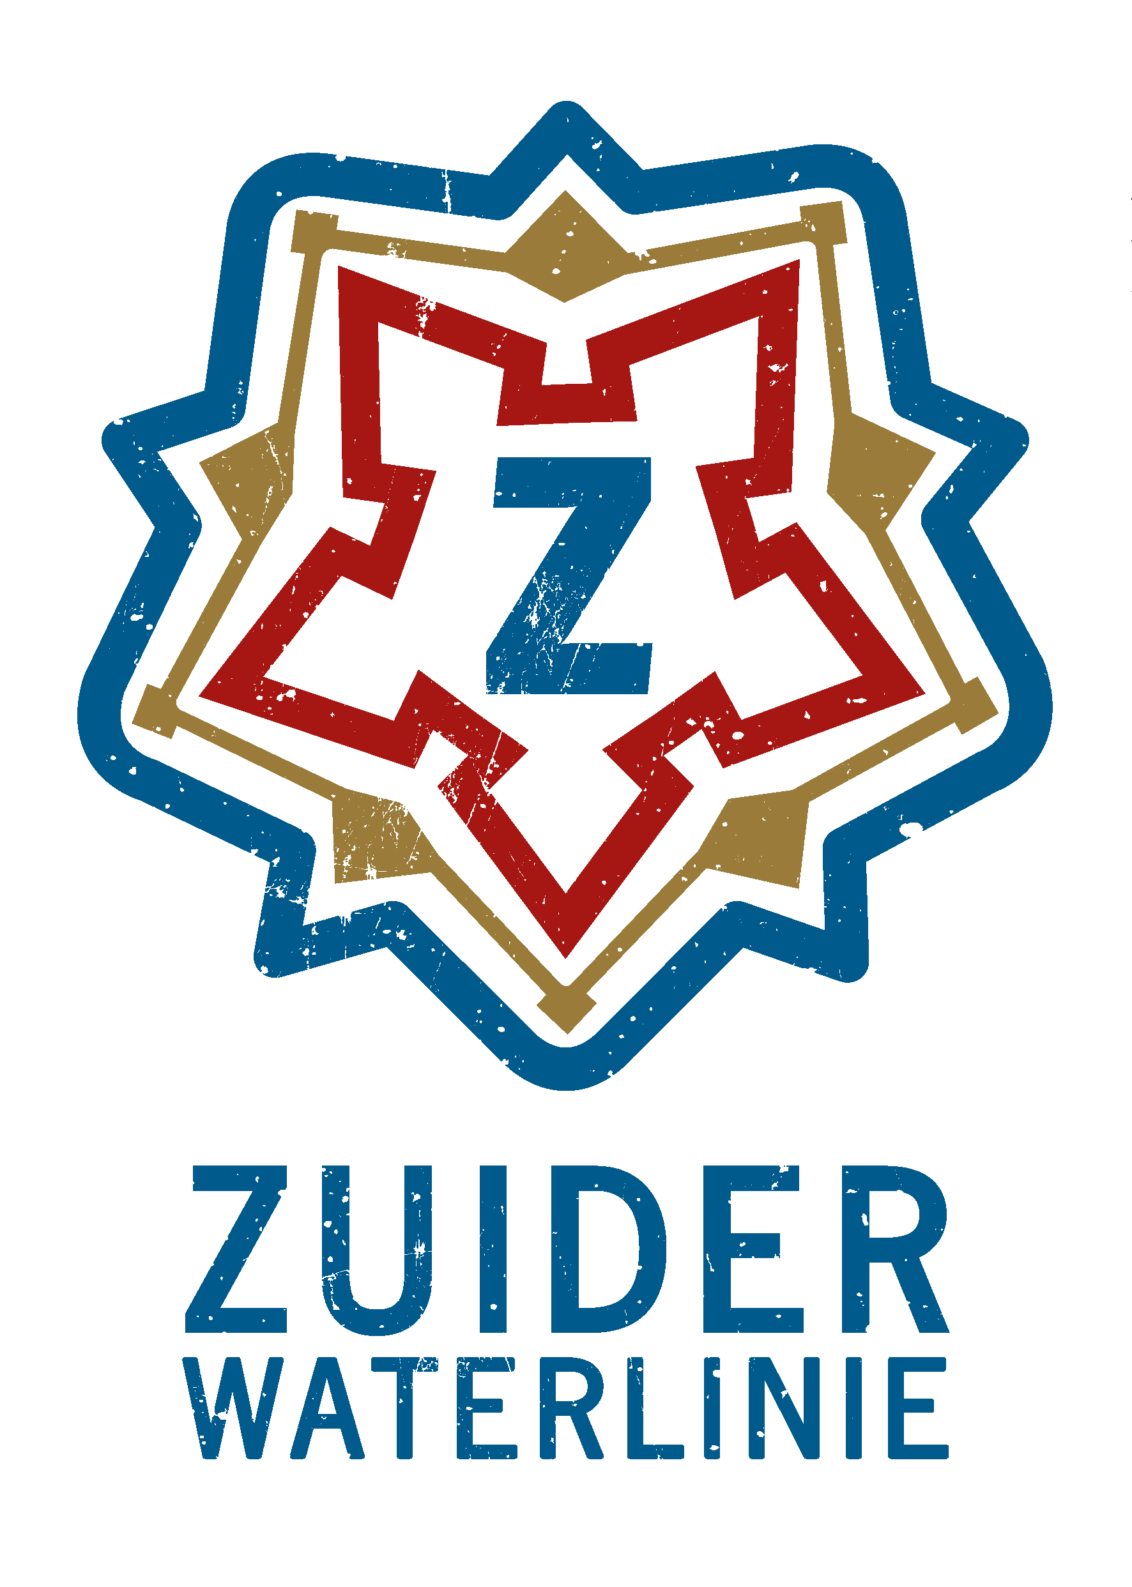


Wat doen we nu?
Zuiderwaterlinie
Linie van de Eendracht
Action Agenda Leisure Economy Brabantse Wal
Urban Region West-Brabant West

Slide 10
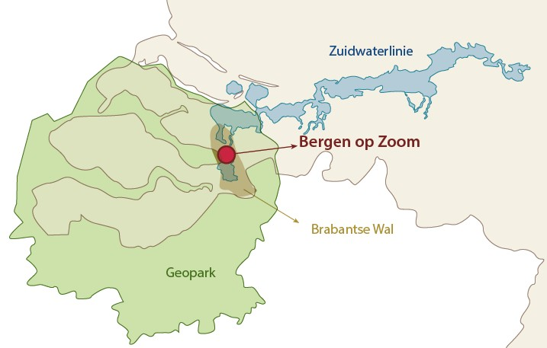

Slide 11
Betekenis Geopark voor de Brabantse Wal
Meaning of the Geopark for Brabantse Wal
Municipality of Steenbergen
(Policy Framework Economic Strength 2022–2025)
Agrofood related to leisure economy
Geofood
Using heritage to strengthen recreational opportunities
Work package Communication/Marketing
Linie van de Eendracht / Living Schelde
Municipality of Bergen op Zoom
(Economic Vision / Vision 2035)
Leisure economy as a leading economic principle
Sustainable tourism
Further developing (im)material heritage
Entering (supra)regional collaborations
Collaboration as one of five programme lines
Sustainable Living City on the Schelde
Management and sustainable development as programme line
Municipality of Woensdrecht
(Economic Vision Woensdrecht / Vision 2035)
Cycling municipality with high natural quality
Ambition for sustainable tourism and recreation offering

Slide 12
Betekenis Geopark voor de Brabantse Wal
Geopark Schelde Delta is a tool to:
Strengthen the pride of our own residents
Implement our strategic visions
Enrich our living environment
Increase Brabantse Wal visibility
Collaborate regionally on shared themes
Sustainable Development Goals
SDG 8 – Decent work and economic growth
SDG 11 – Sustainable cities and communities
SDG 17 – Partnerships for the goals

Slide 13
4. Toekomstbeeld/
Ideaalbeeld
Future Vision / Ideal Vision
Geopark Schelde Delta as a widely recognised concept
Multiple tangible successes on the Brabantse Wal
Stronger profiling of the Brabantse Wal outside North Brabant
Extension of the UNESCO label

