Slide 1

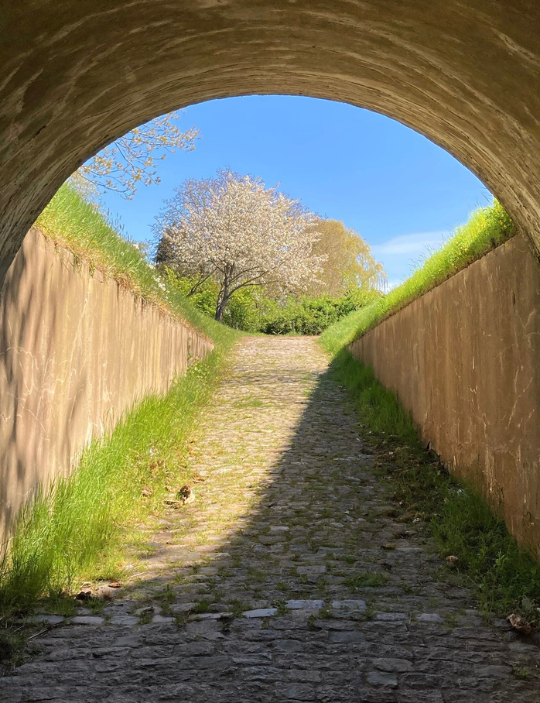
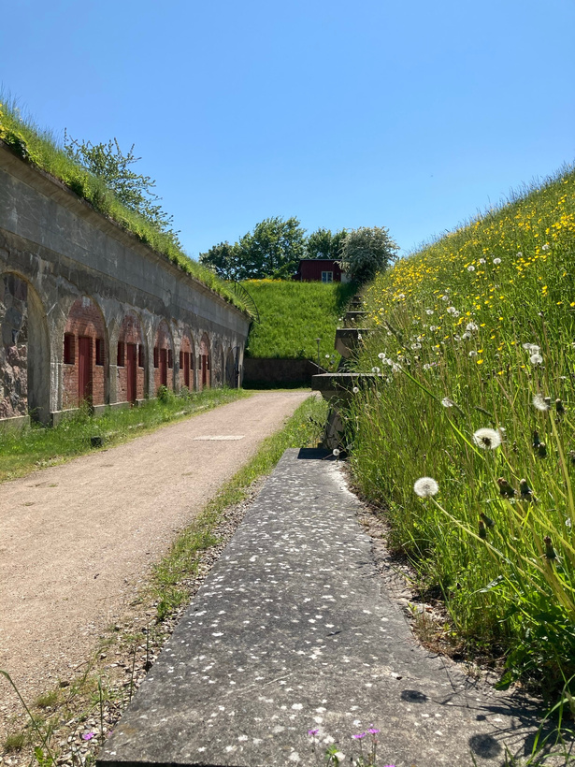
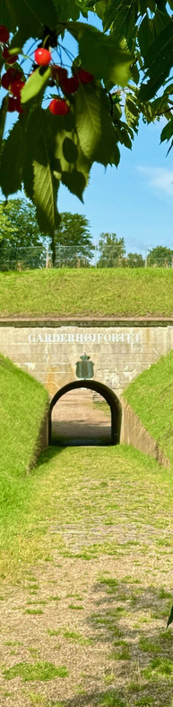
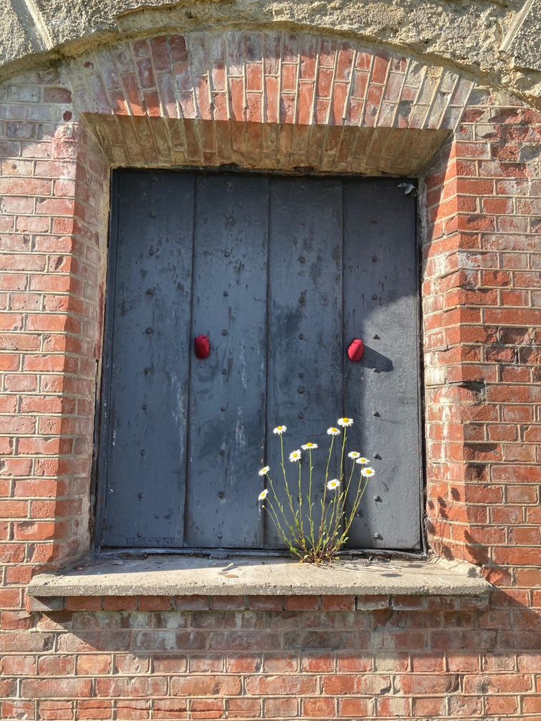
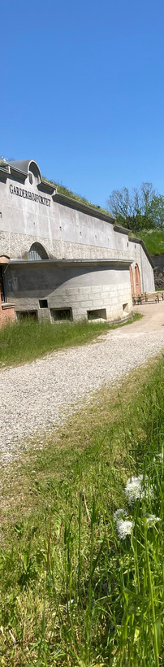
Garderhøj Fortress
Gentofte, Denmark

Slide 2
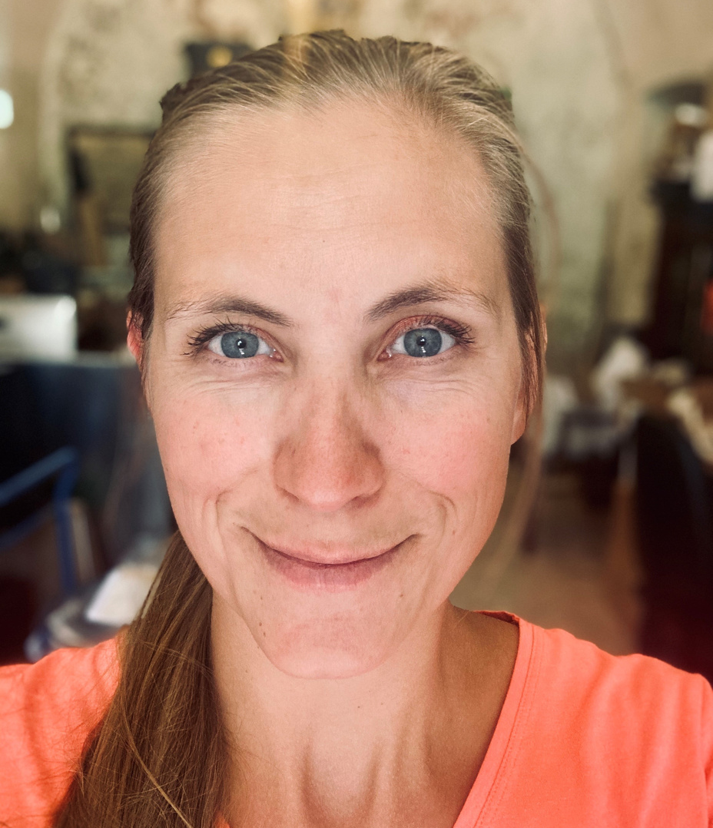
Kristine Adler-Nissen
I am the manager of the Garderhoej Fortress and have been there since the fortress opened as a museum in 2013.
I came from a position at the Science Center, Experimentarium, where I had been working since 2001.
+45 28351457
kkan@gentofte.dk
https://garderhojfort.dk/en/

Slide 3
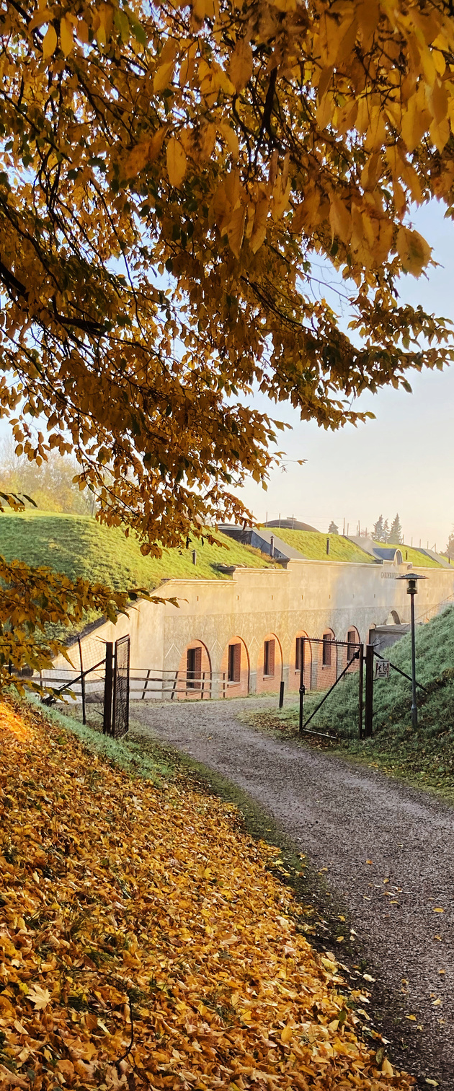
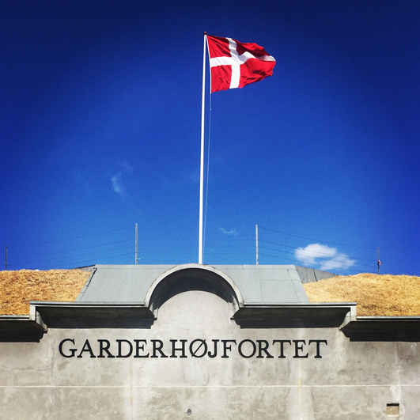
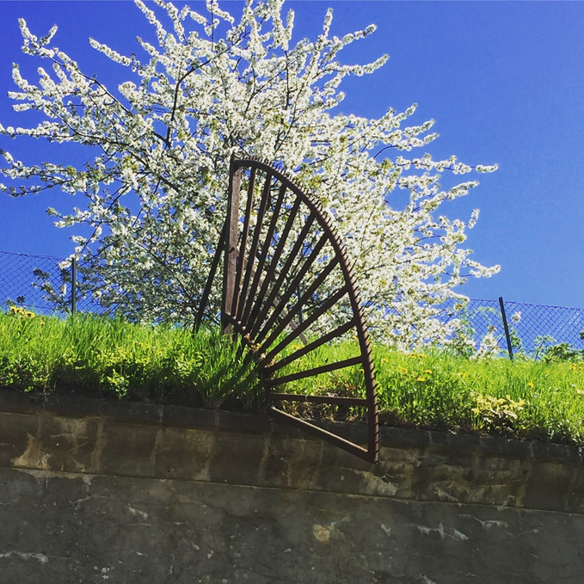
Pitch of cross-border ideas
01
Introduction
02
About the fortress
03
Our activities
04
Our exhibitions
05
Idea 1: Education
06
Idea 2: Augmented reality
07
A small research question

Slide 4
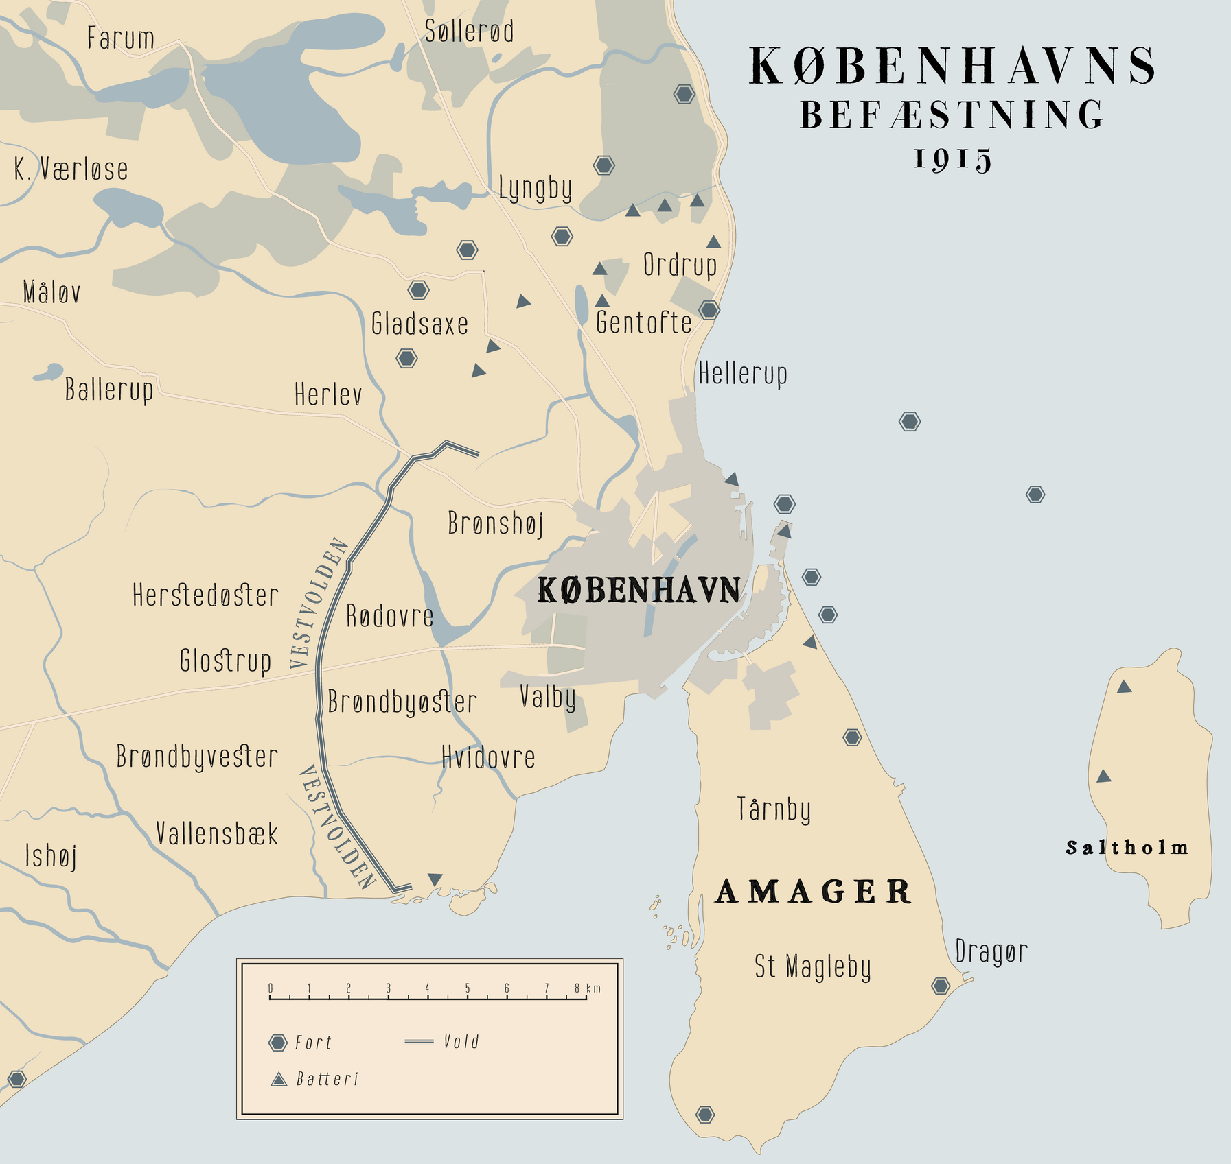

About the fortress
The Garderhoej Fortress is a part of the fortification ring around Copenhagen. The fortification was built in the period from 1885-1910 and reinforced during WW1. The fortifications were constructed after the defeat to the Germans in 1864, in an effort to protect the Danish capitol.
Garderhoej Fortress

Slide 5
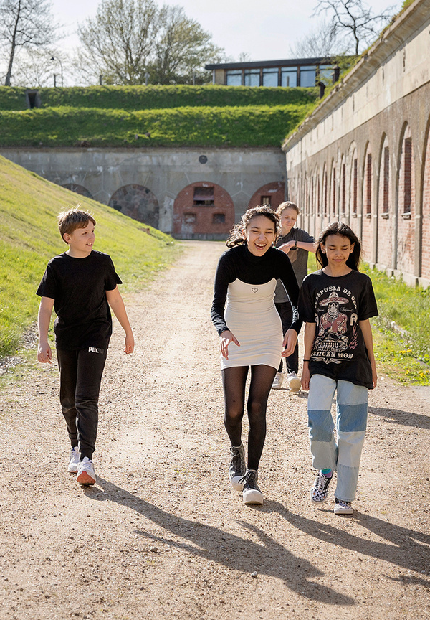
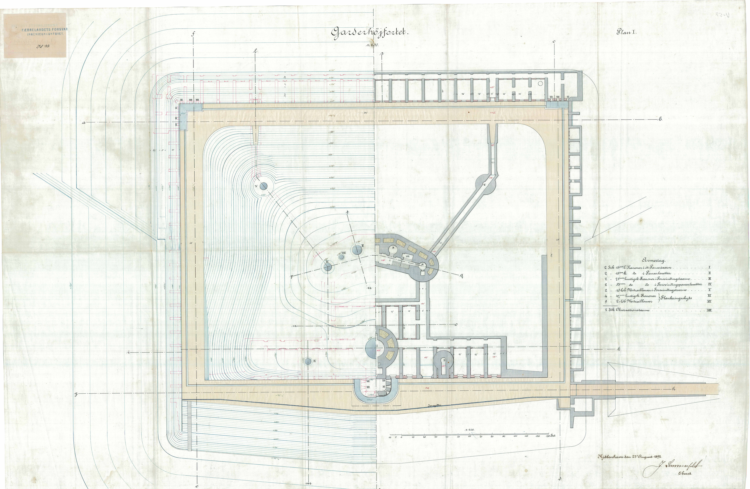
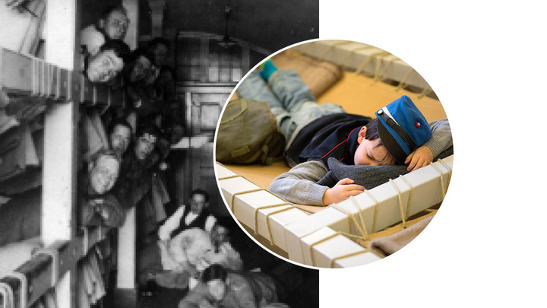
About the fortress
During WW1 50.000 soldiers manned the fortifications, as the Danish goverment feared a new German attack. The Garderhoej Fortress held approx. 400 of these soldiers. After the war, the fortifications were outdated and most were discontinued.

Slide 6
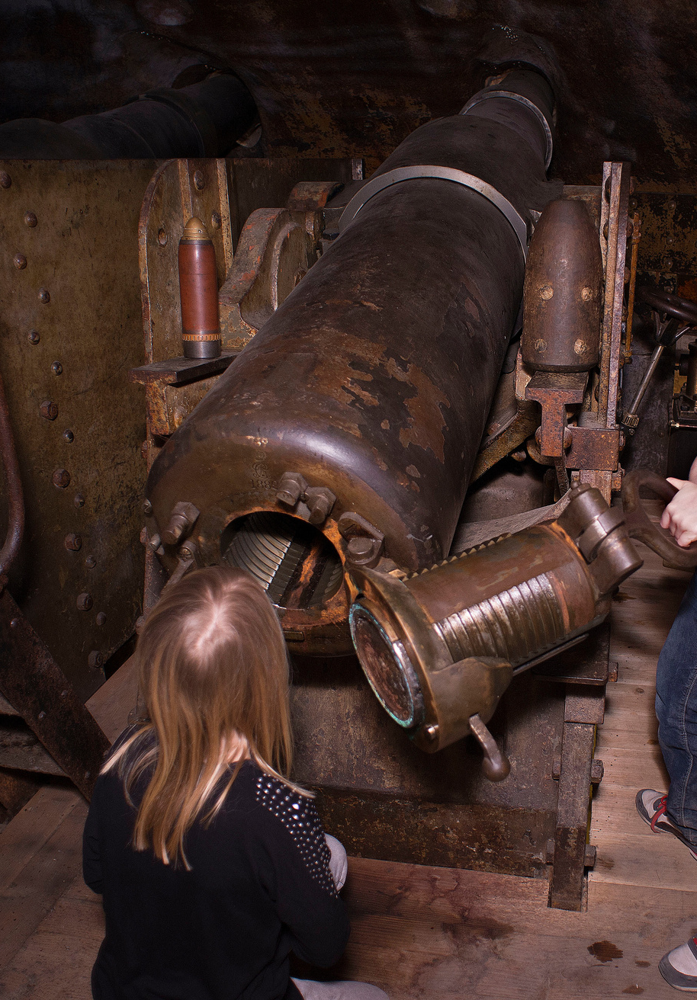
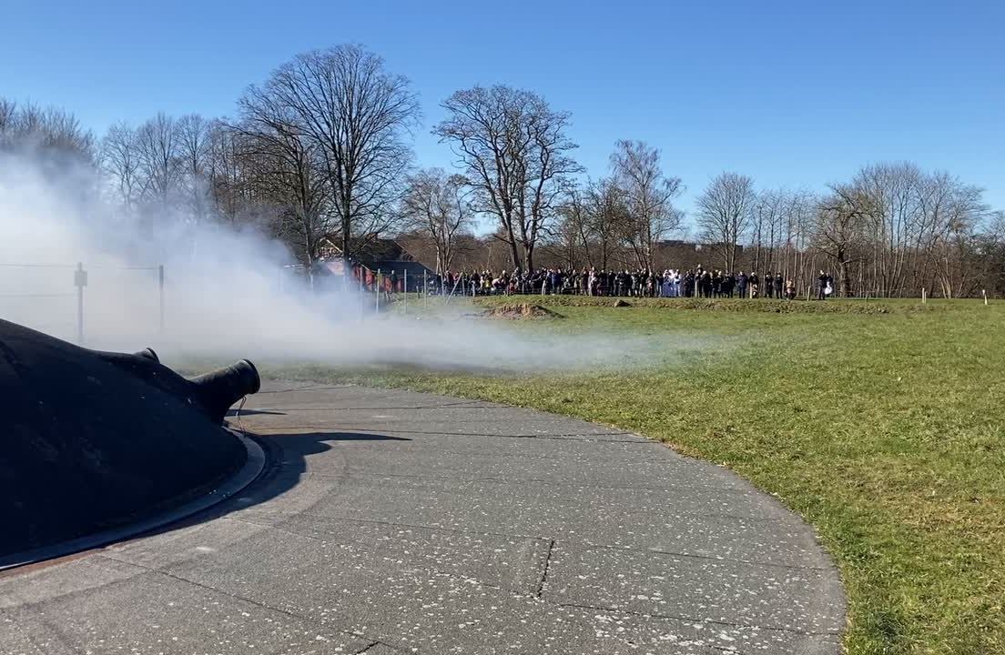
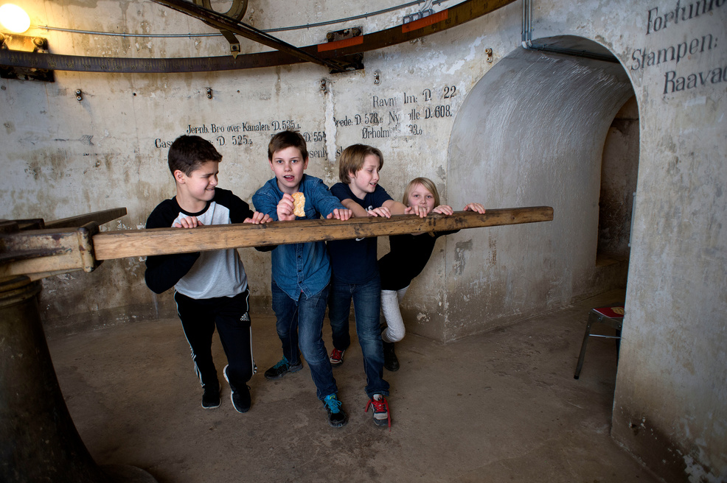
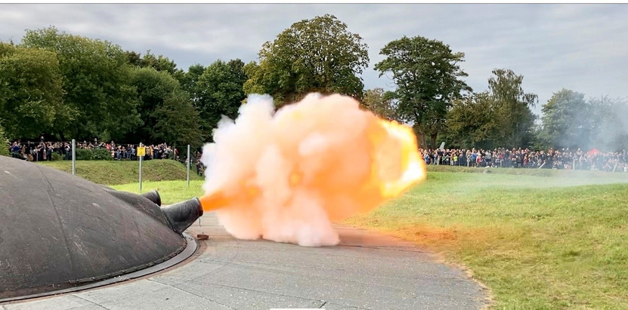
About the fortress
The fortress is still very much intact because it has never been part of a war. Uniquely, the double 15 cm cannon turret is fully functional. All guests are allowed to push it into position, and the cannons are fired once a month.

Slide 7
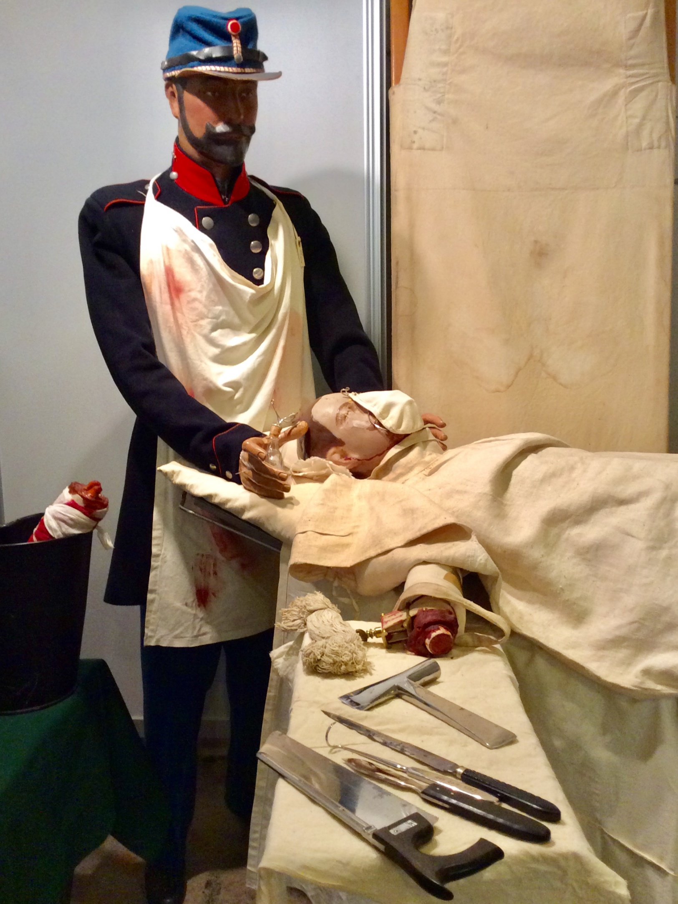
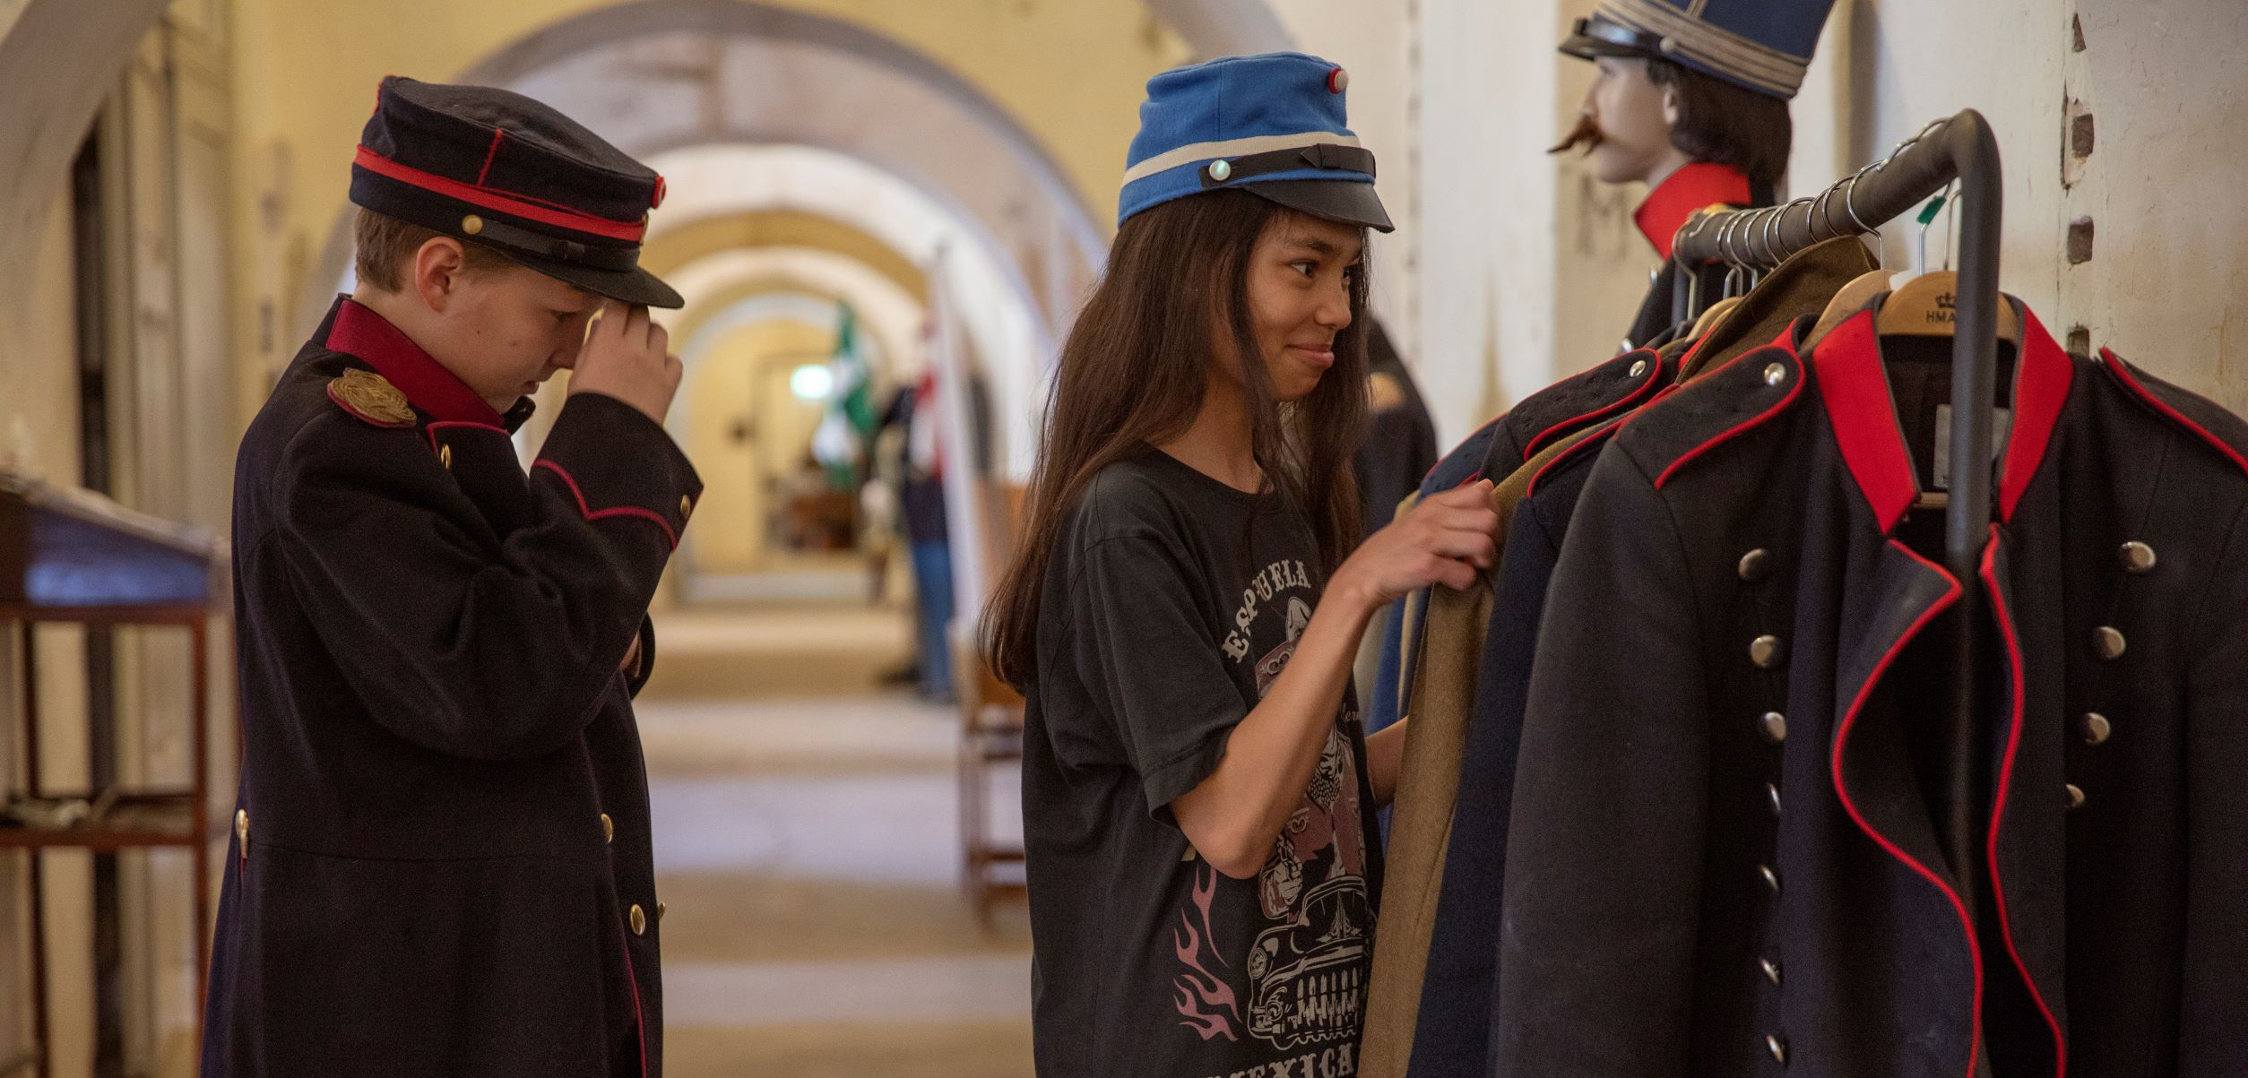
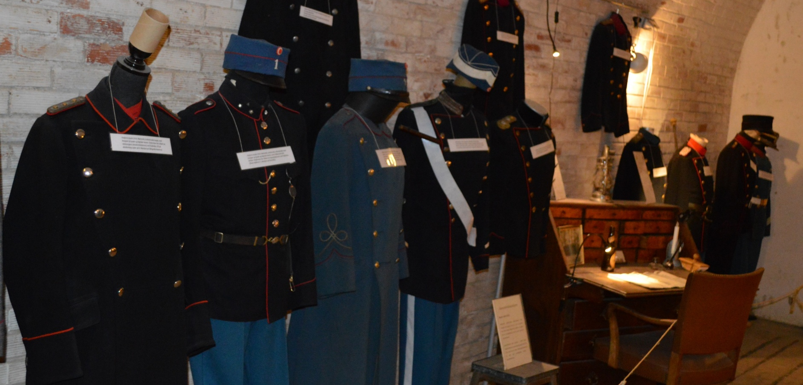
Our exhibitions

Slide 8
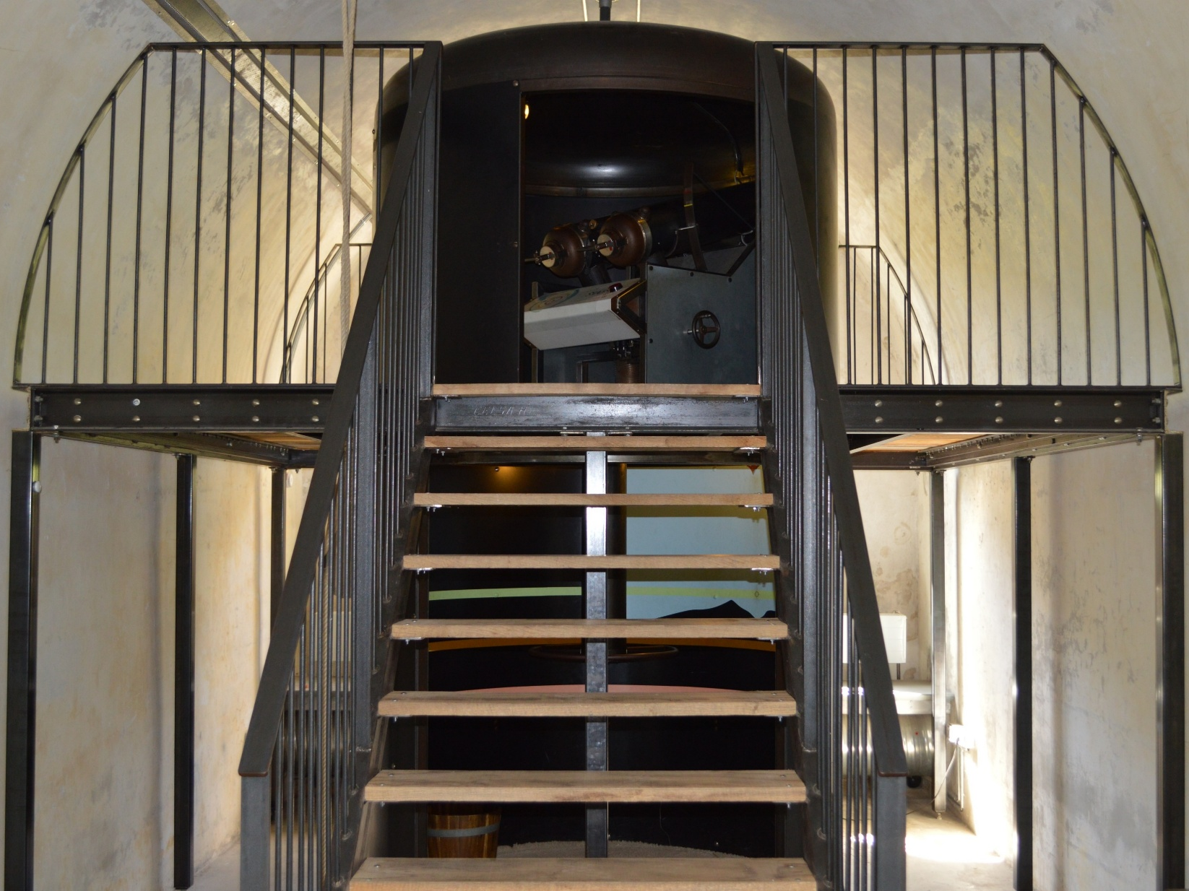
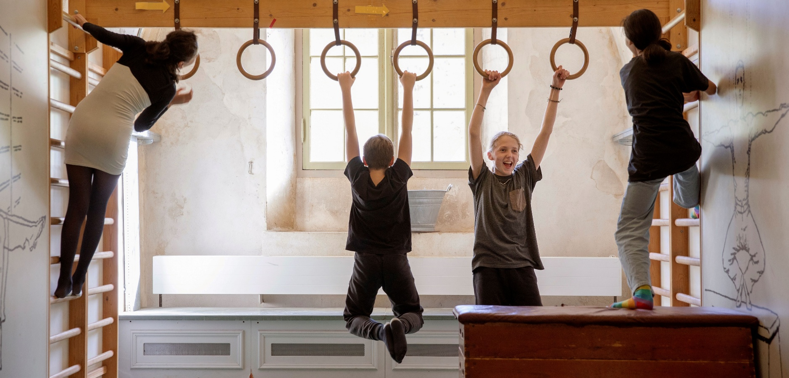
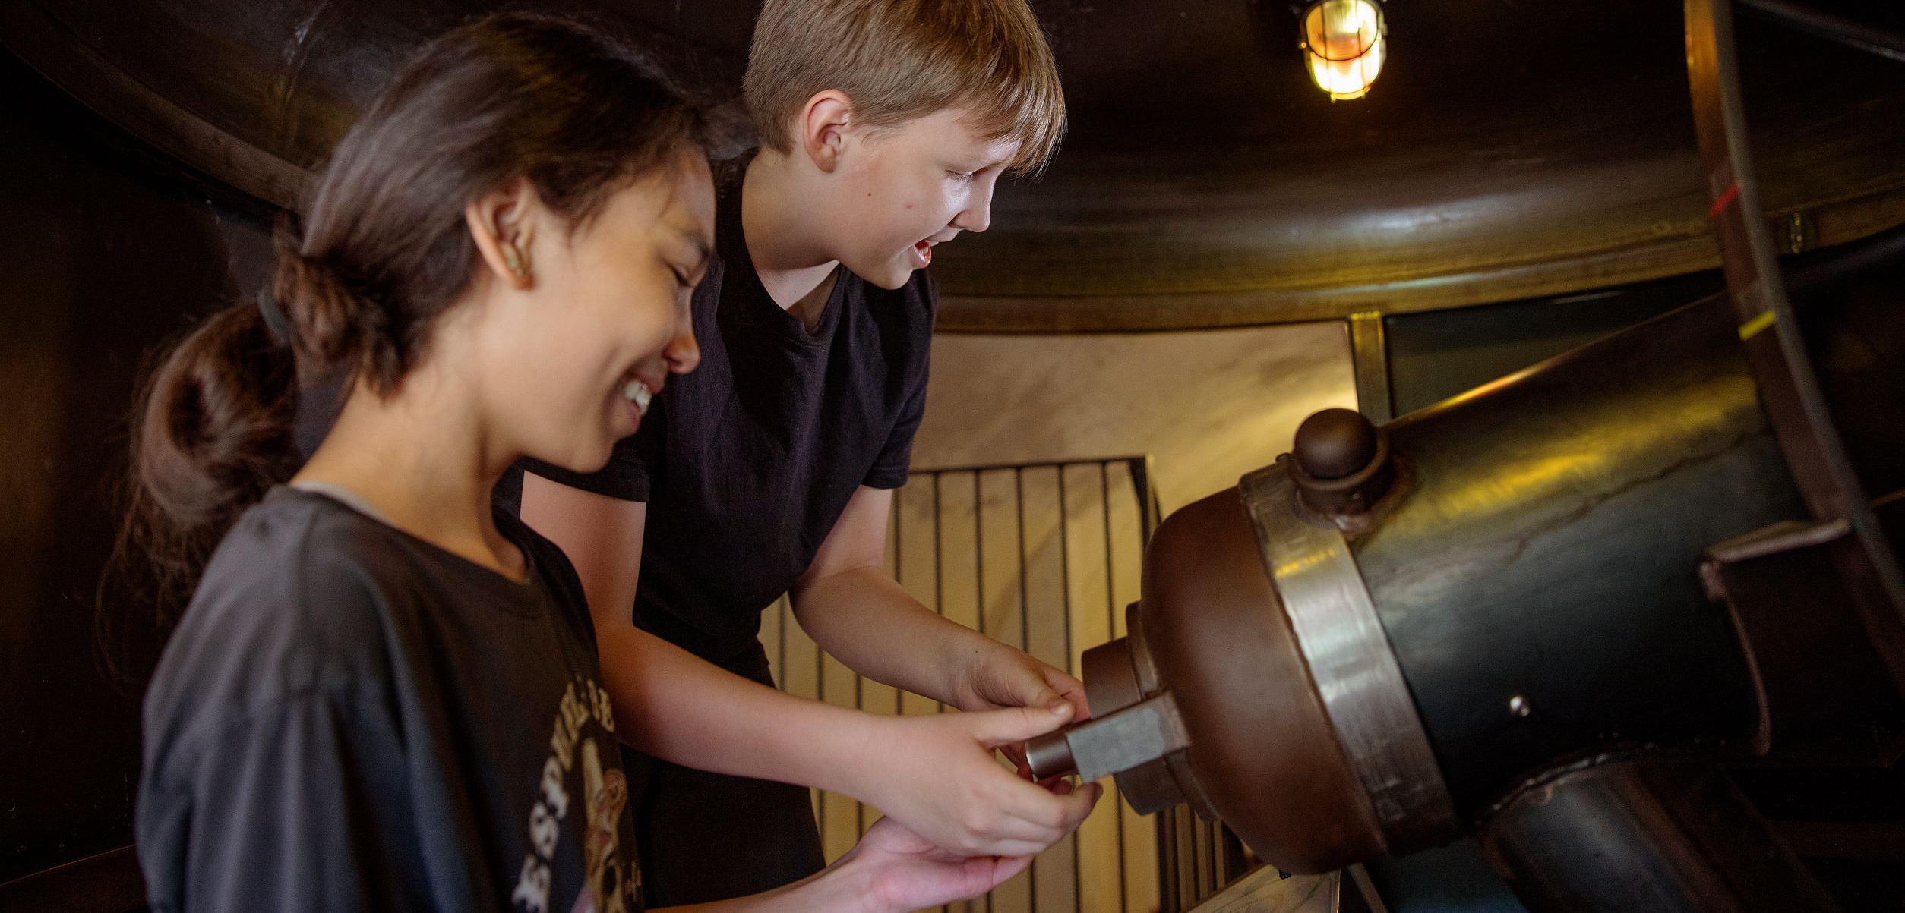
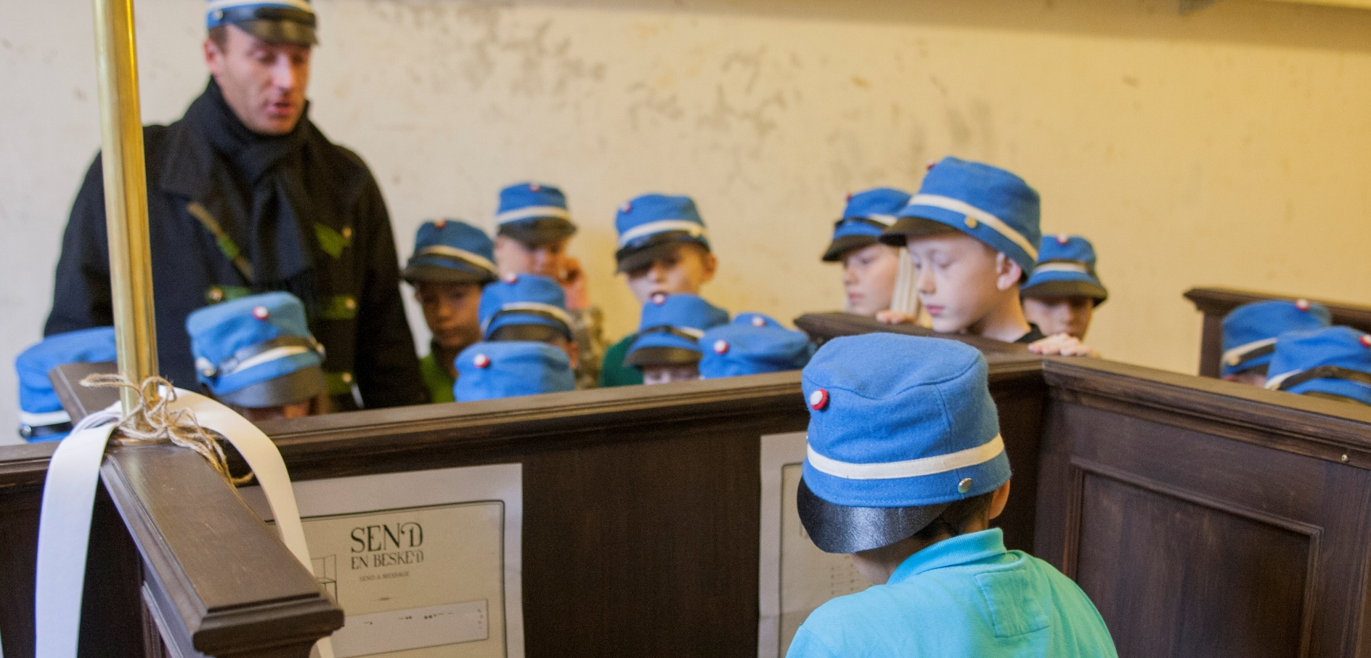
Our exhibitions

Slide 9
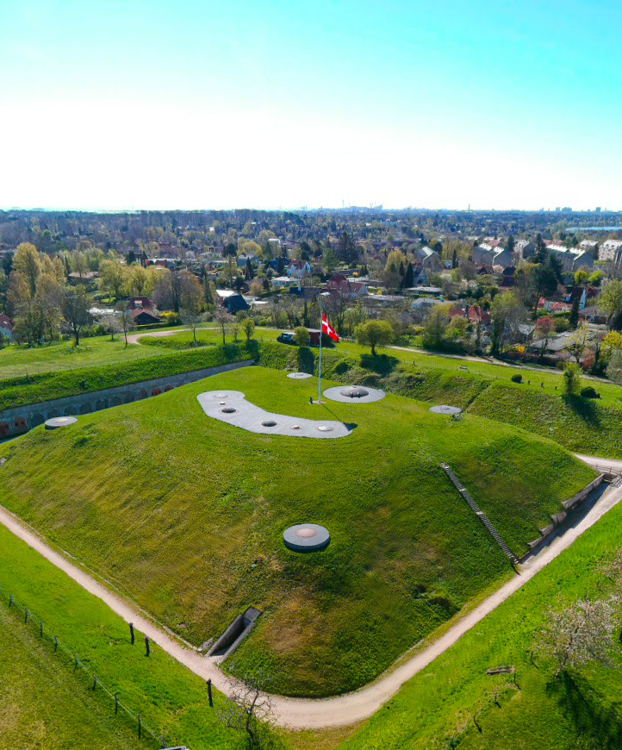
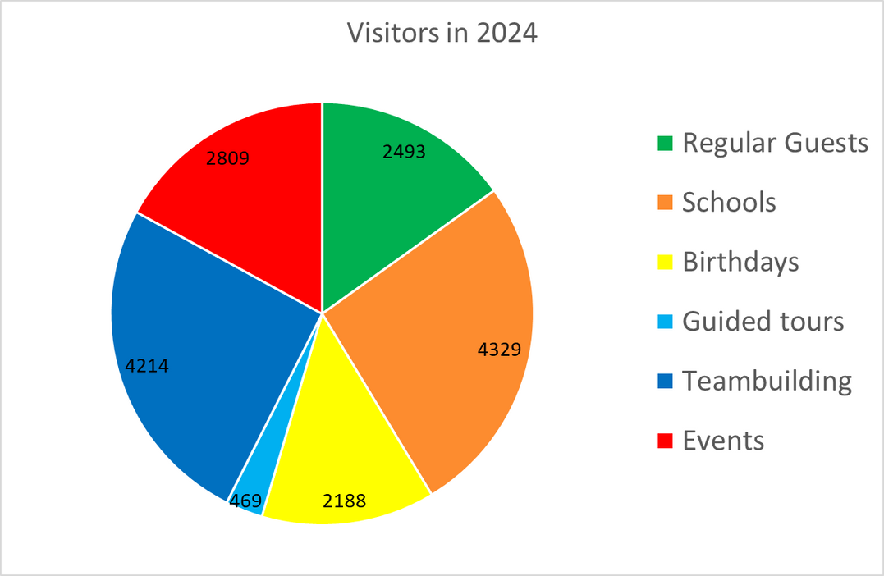
We do many different activities at the fortress, all of which convey the history of the place - but in different ways.
Our activities
16502 guests in 2024

Slide 10
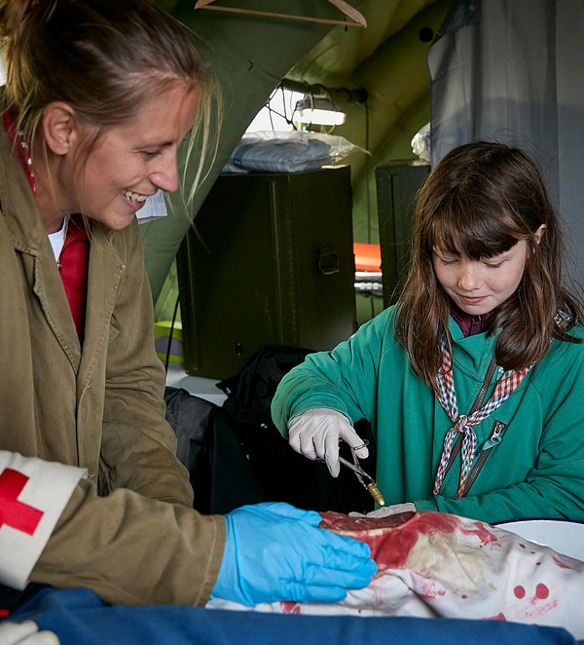
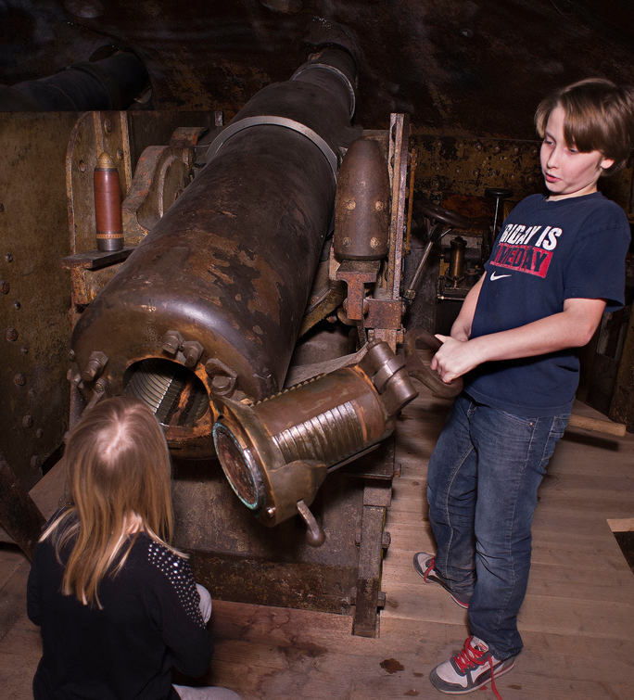
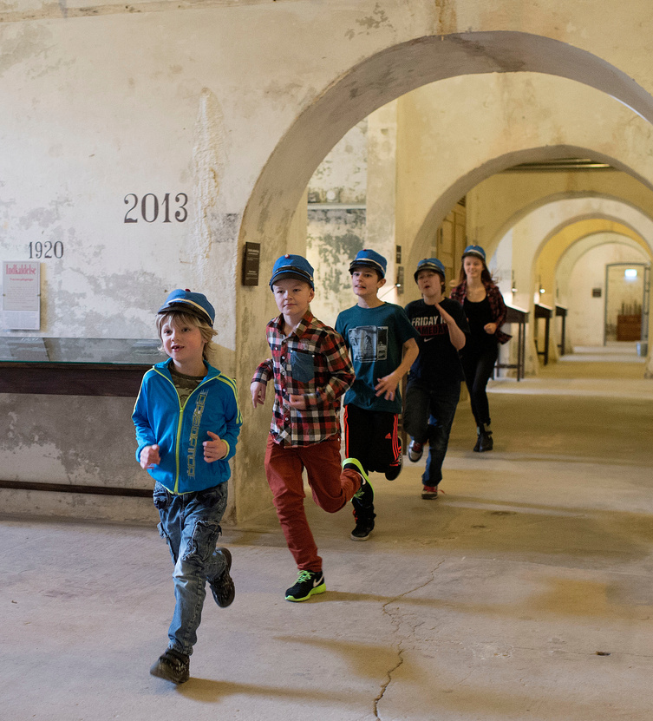
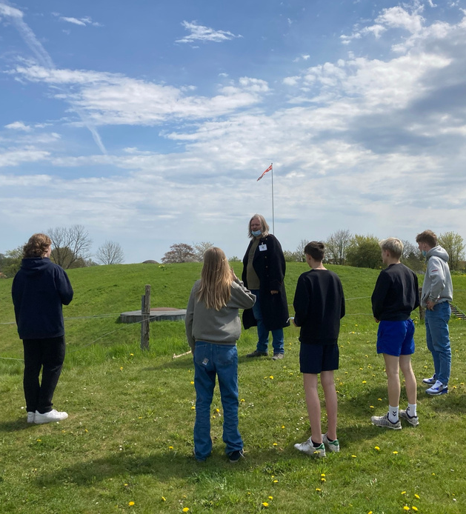
Activities
Events
Teambuilding
Education
Guided tours

Slide 11
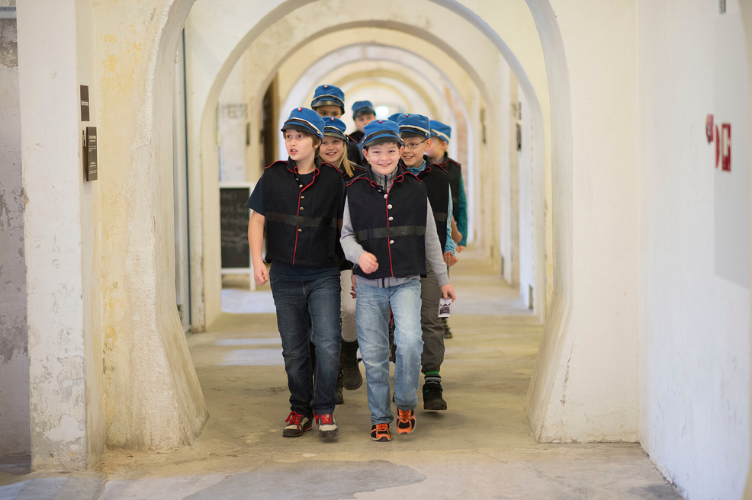
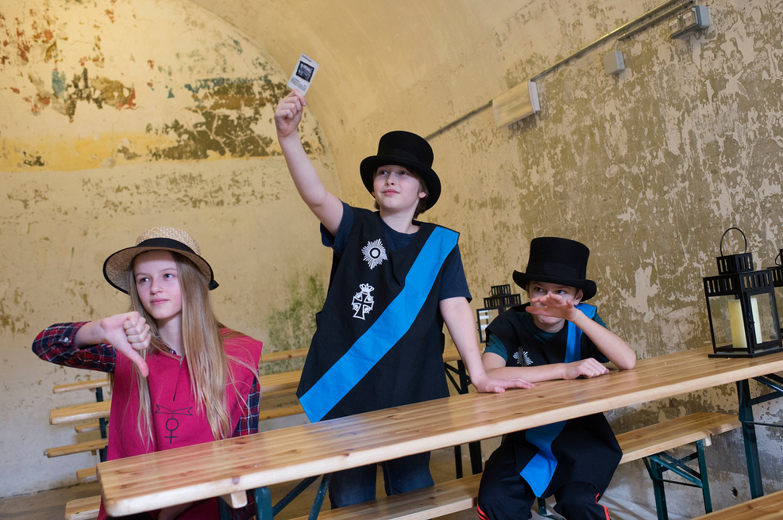
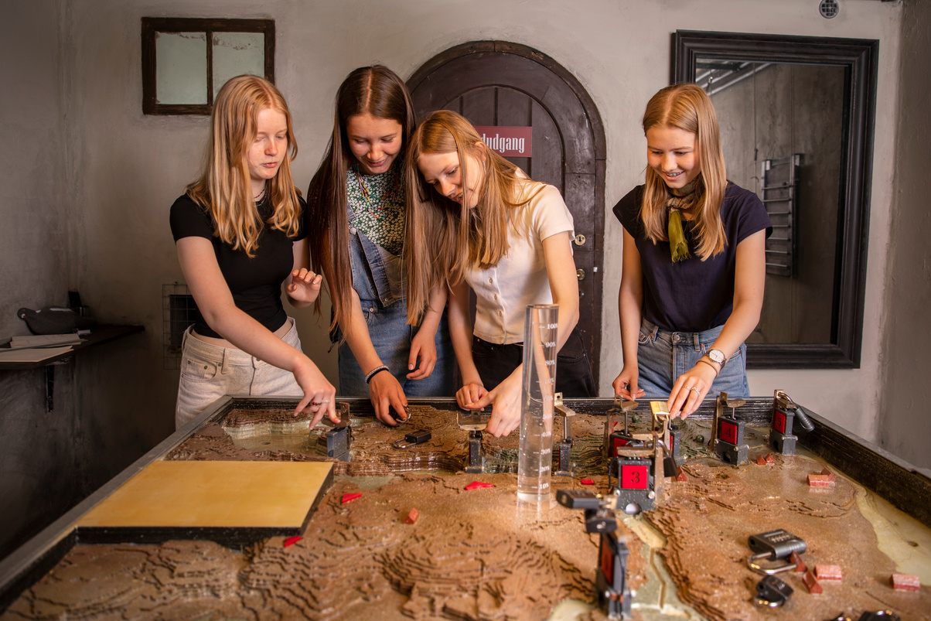
Our Educational activities
We offer educational programs for kindergartens, all levels of primary school, and youth education. Common to all programs is that they involve dialogue, role-playing, and movement as learning methods.
Our most popular educational-activities are those that combine history and Math.

Slide 12

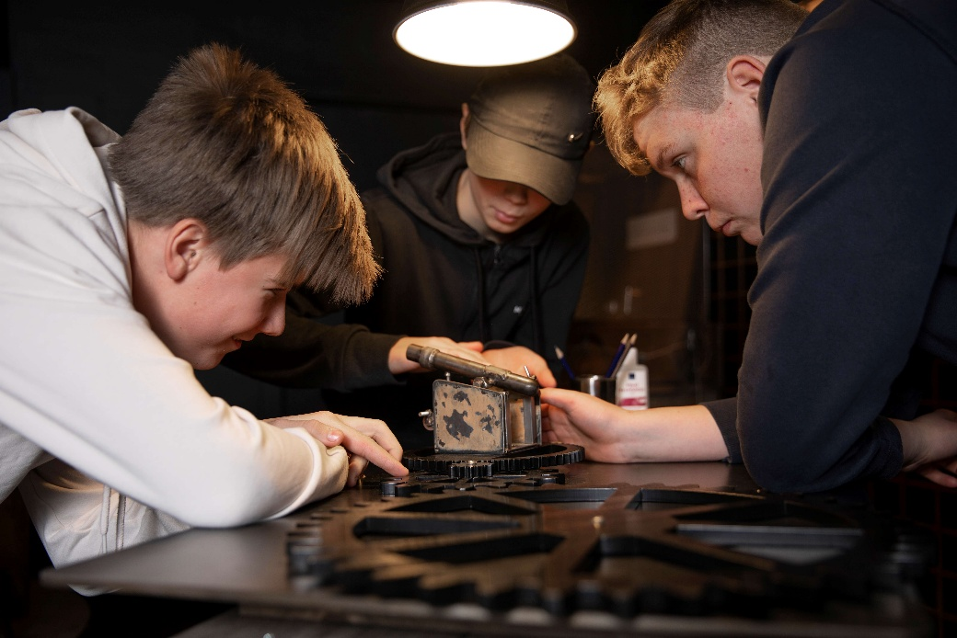
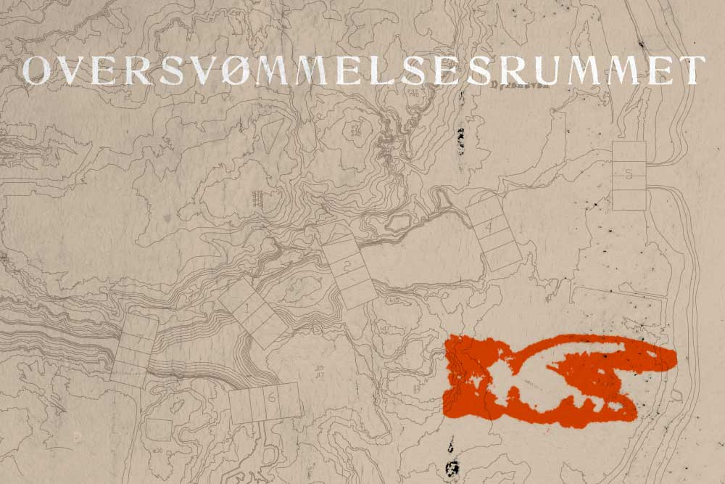


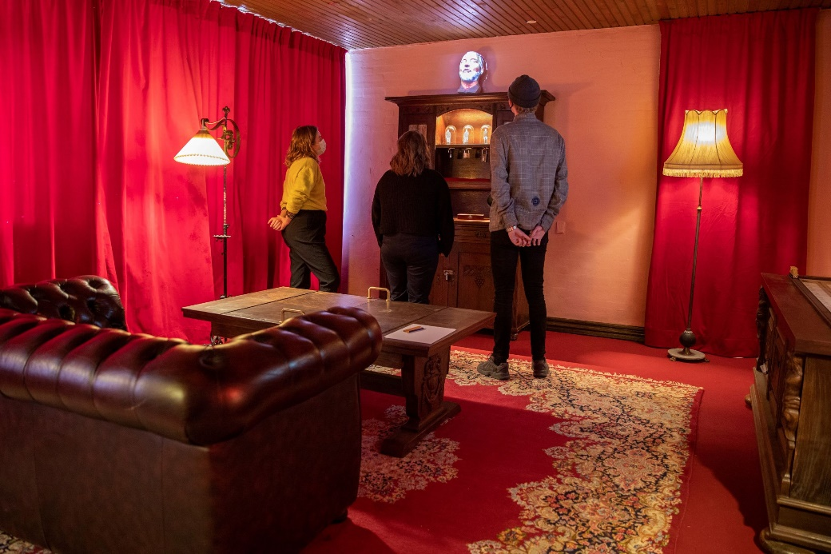
Educational activities
In 2021 we got approx. 550.000 € from the Novo Nordisk Foundation for the “Mathematical Escape room”-project. We made 3 new Escape Rooms in a building beside the fortress where we teach Math and History.
From 7th to 10th grade
A time travel back to WW1
The scenarios are a copy of the preparations for war in 1915.
The class tries both an Escape Room and a guided tour of the fortress with a focus on math

Slide 13
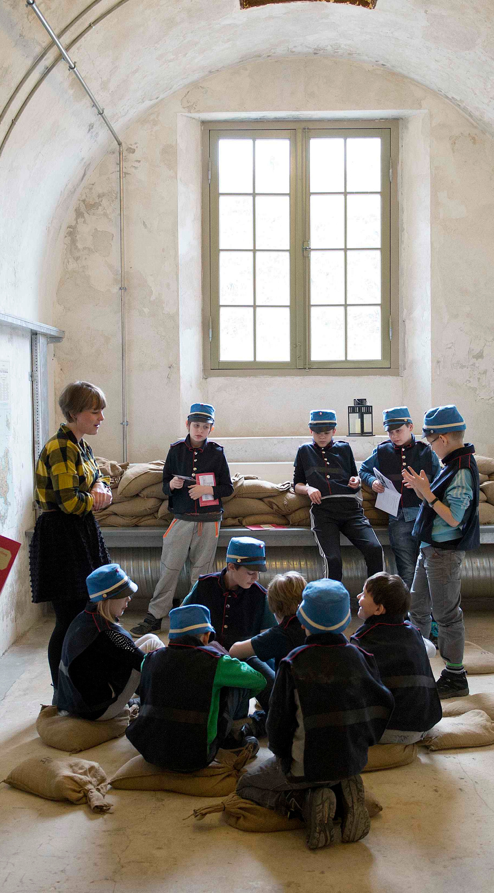
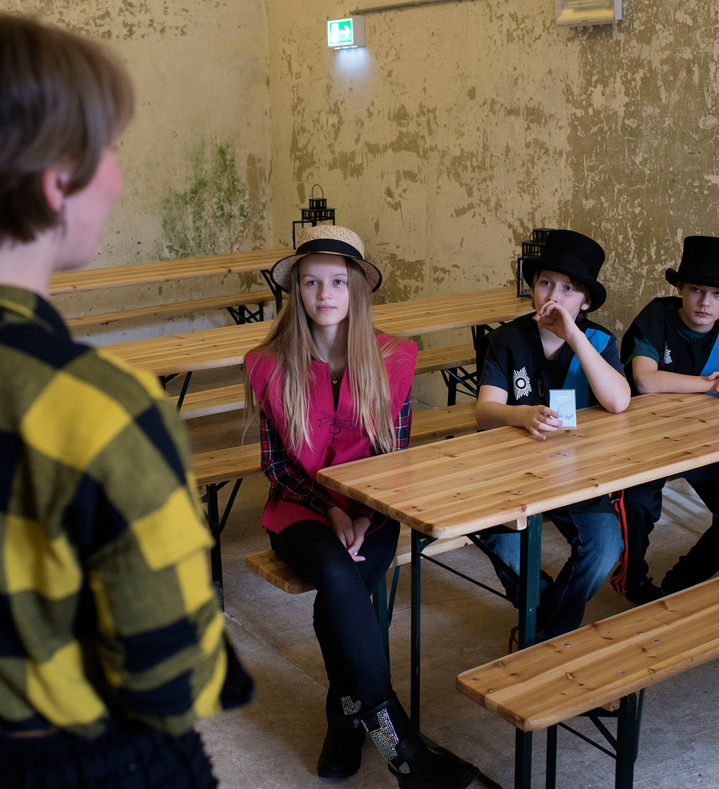
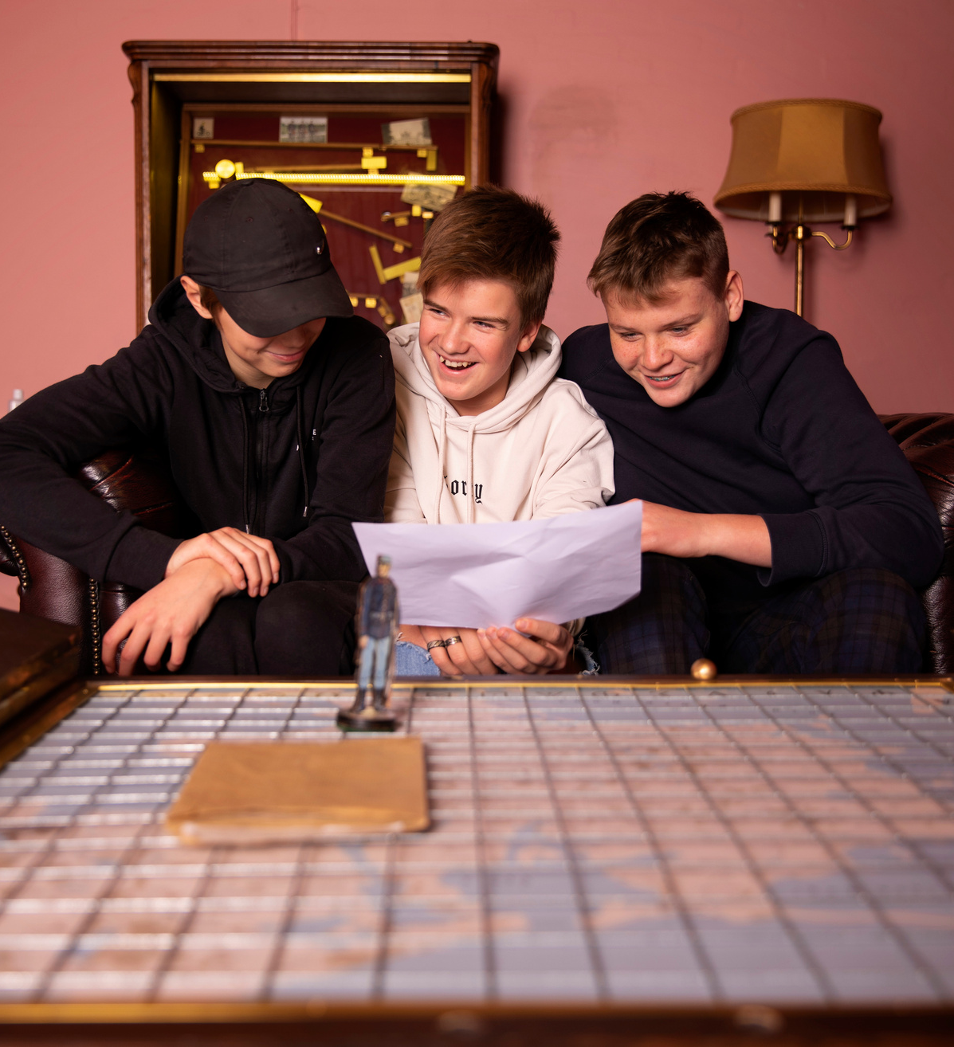
Idea 1: Education
We teach kids about military history in school-sessions that we have developed at our museum. We think that the sessions we have developed would be possible to use at other fortresses all over Europe – and that we could probably also adapt school sessions from other fortresses. We hope that a cross-border teaching collaboration could be of interest to some of you?

Slide 14
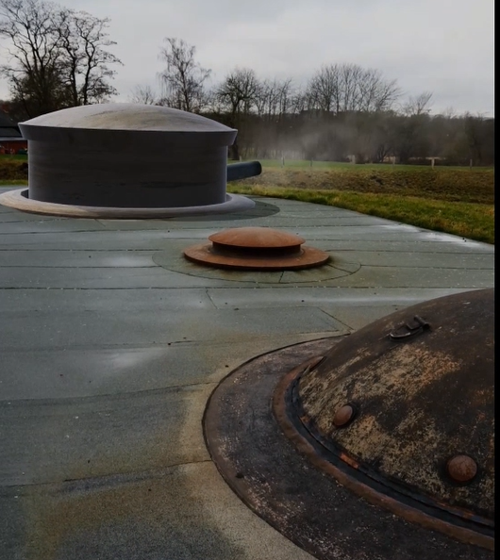
Idea 2: Augmented reality
For a few years now, we have had an AR app where guests can see some of the objects that are no longer at the fort. For example, an ammunition elevator and a fence, as well as the gun turrets that are no longer functional.
AR turret
Authentic turret

Slide 15

AR-App

Slide 16
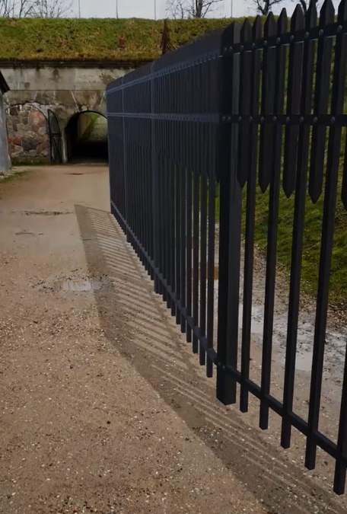
Idea 2: Augmented reality
We are in contact with an educational institution in Denmark who would like to create an AR app that allows guests to experience the daily lives of soldiers at the fort. Once we have created the Danish version, it could be interesting to find other fortresses in Europe that would show the daily lives of their soldiers.
If it was done as a joint project, guests at the fortressess could choose to experience everyday life in several different countries.

Slide 17
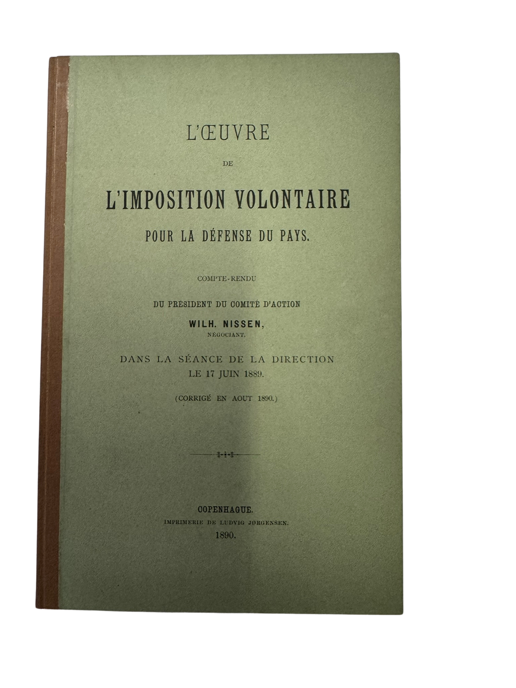
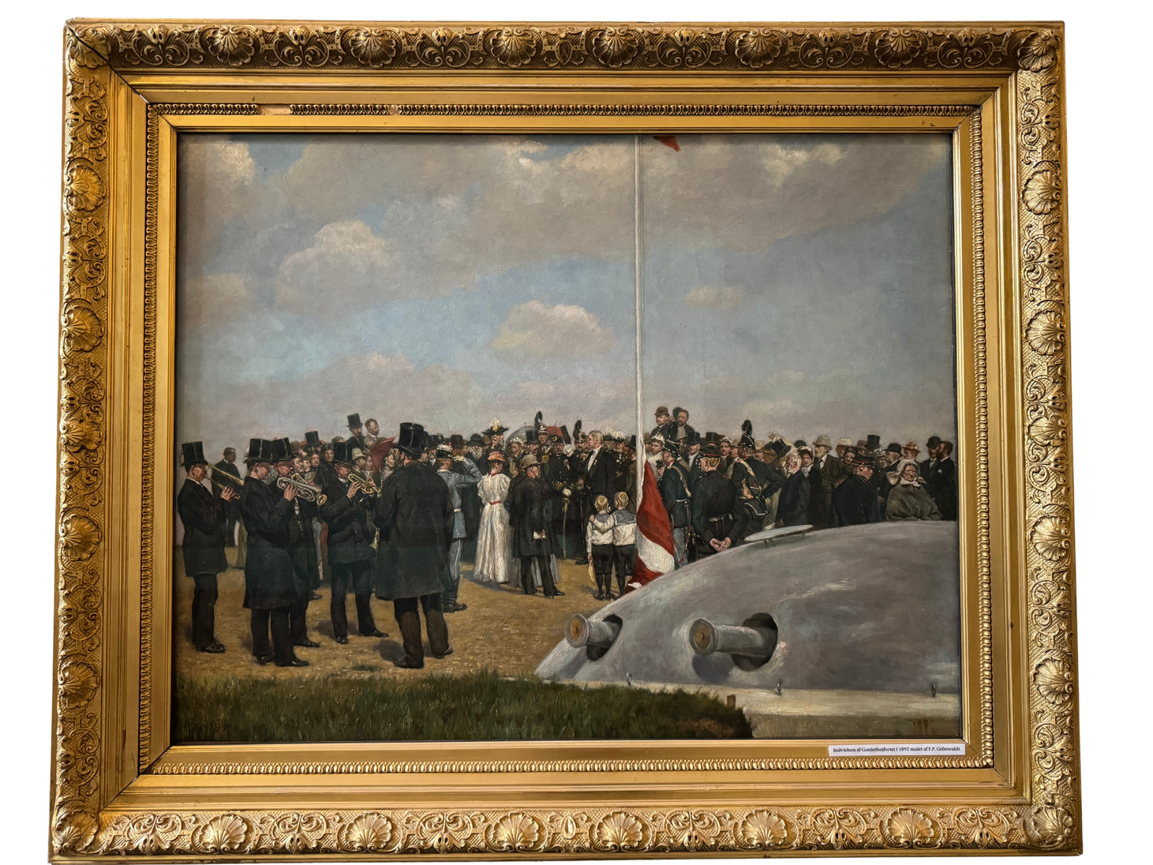
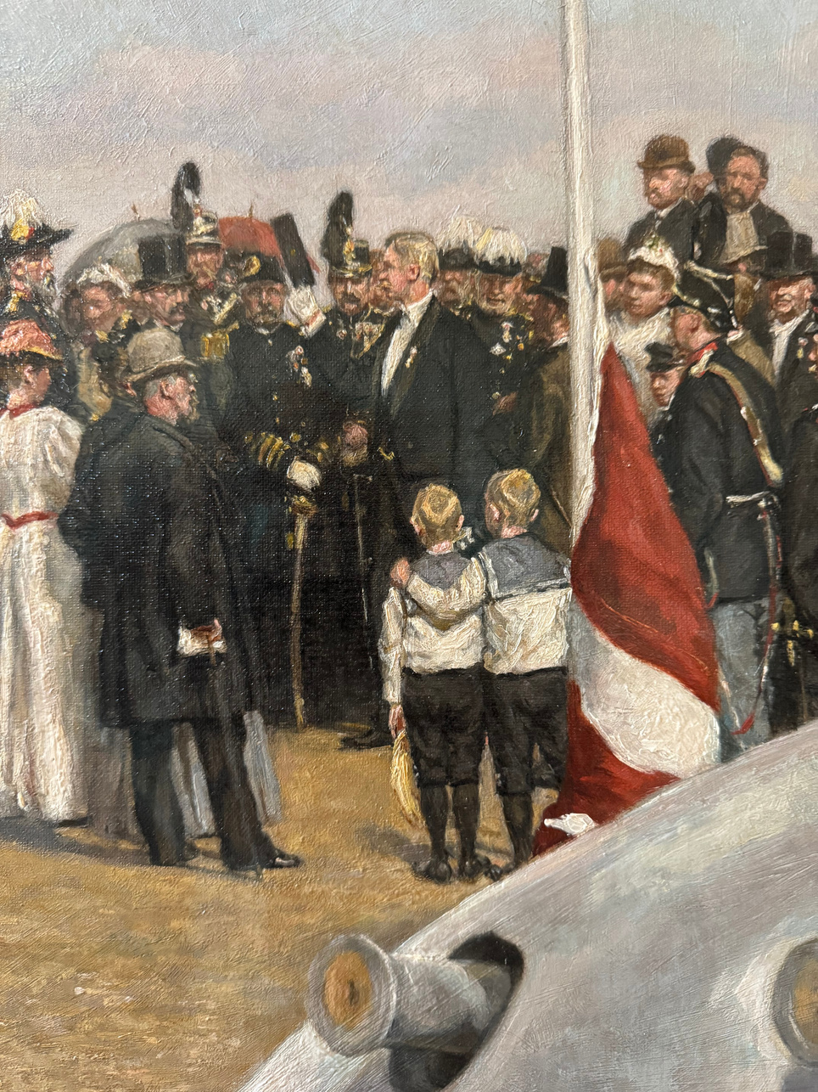

A question for our research
The Garderhojfort was financed by private citizens. The money was collected by a number of foundations, among others: ”Voluntary Self-Taxation for the Advancement of the Armed Forces”. Has there been similar collections in other European countries?

Slide 18
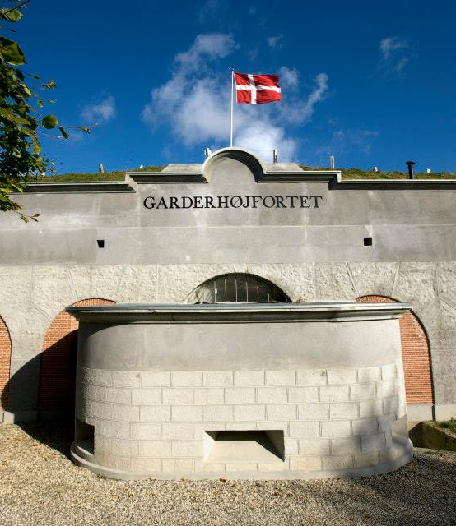
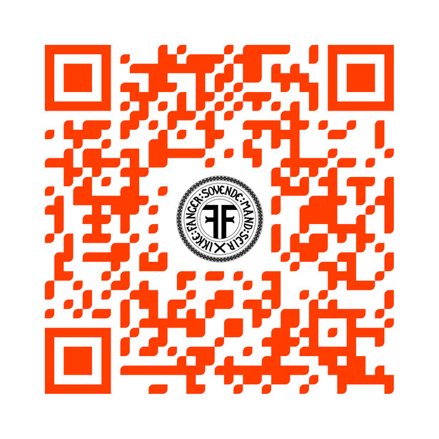
Thank You
For Your
Attention
Watch a 6 minute guided tour of the Garderhøj Fortress

