Slide 1


Beta: Concept for a Digital Museum of Ukrainian Urbanism
+ European Identity: Urban development of Historic Fortified Cities in Ukraine
+ Methods of Interpretation and Commemoration
Travelling Congress 2025 `Inspiring across borders`

Slide 2
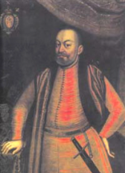
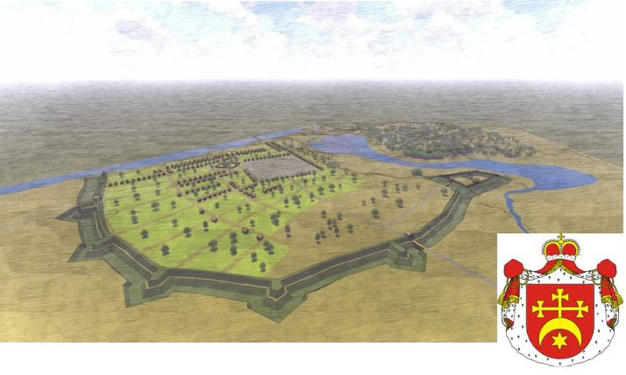
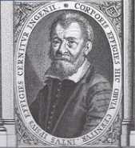

Historical Justice – Remember The Origin
Ladyzhyn was initially a Renaissance-era town, but during Soviet times it transformed into an energy industry town.
Prince Yurii Zbarazkyi – Castellan of Kraków
3D-reconstruction of the Urban Fortification Complex of Ladyzhyn, late 16ᵗʰ cent., Vinnytsia region (author Illia Lytvynchuk).
It is currently not listed among Ukraine's historical towns, and a historical-architectural reference plan has not been developed for it.
Vincenzo Scamozzi

Slide 3
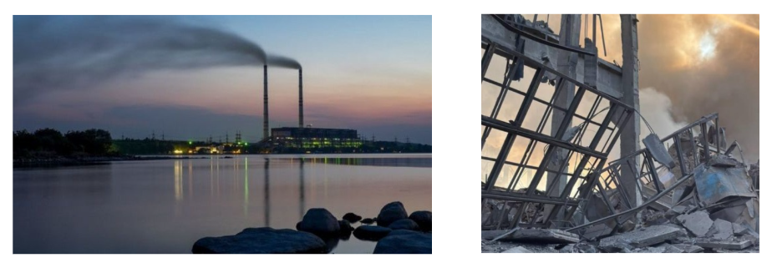
Historical Justice – Remember The Origin
Ladyzhyn – the City of Power Engineers.
Ladyzhyn Thermal Power Plant (TPP)
Consequences of the russian Terrorist Strike on the Ladyzhyn TPP

Slide 4
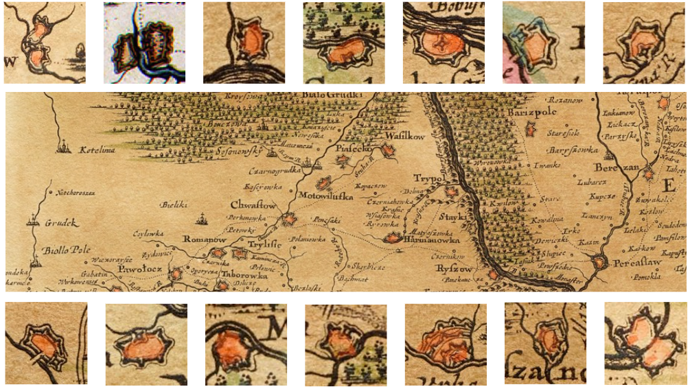
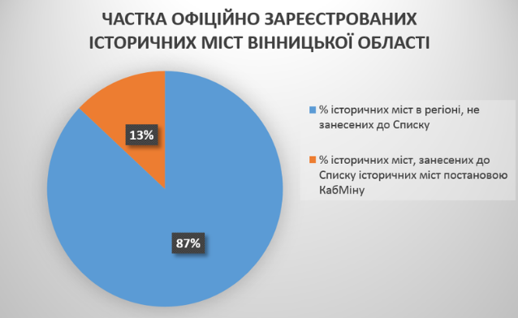
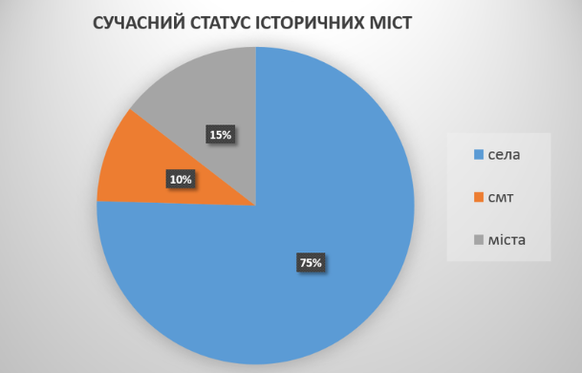
In Vinnytsia region, many fortified towns are marked on the Boplan map of 1650.
However, only 13% are officially registered as historical towns, and only 15% currently have city status.

Slide 5
The Interpretation of the Historic Cities Urban development in Ukraine. Issues:
Loss of the original/historically formed planning of the historical city in the imperial/Soviet period.
2. Replacement of accents – leveling of attributes of self-government, autochthonous spiritual and cultural life, typification of cultural landscapes.
3. Provincialization of settlements.
4. The dominance of old imperial-Soviet russian narratives.

Slide 6
Beta: A Digital Museum [Center] of the History of Urban Planning in Ukraine. Our goal:
To restore The Image of the historical cities in Ukraine.
2. To demonstrate the genesis of Ukrainian urban development through transformation and decline under the influence of occupation policies.
3. To identify forgotten heritage sites and urban relics.
4. To inspire transformation of community’s cultural resources into tools for sustainable development, education, and international partnership.
5. To create a platform for communication between interdisciplinary specialists, particularly in the field of urban development history.

Slide 7
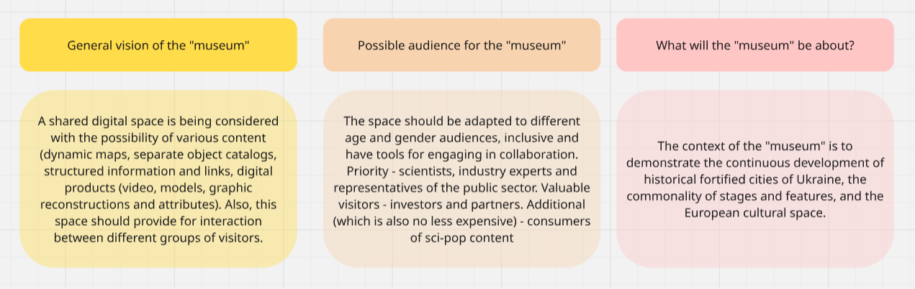
Beta: A Digital Museum [Center] of the History of Urban Planning in Ukraine. Our vision:

Slide 8
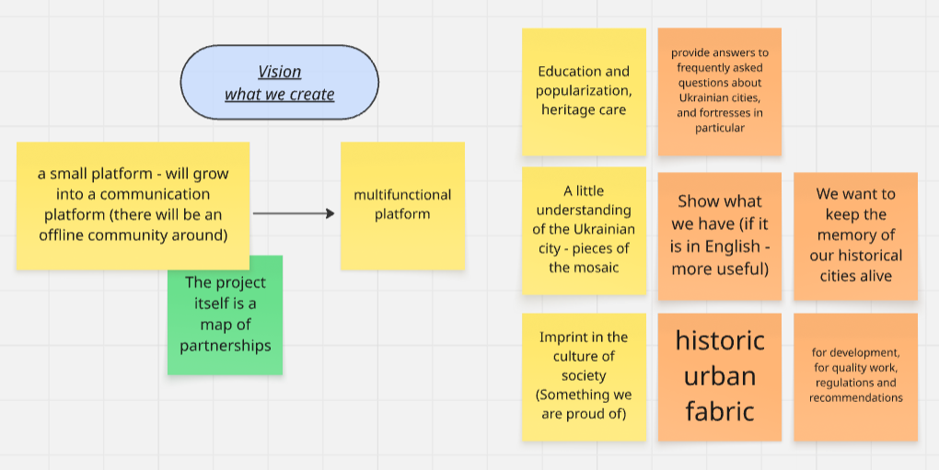
Beta: A Digital Museum [Center] of the History of Urban Planning in Ukraine. Our vision:
The platform functions:

Slide 9
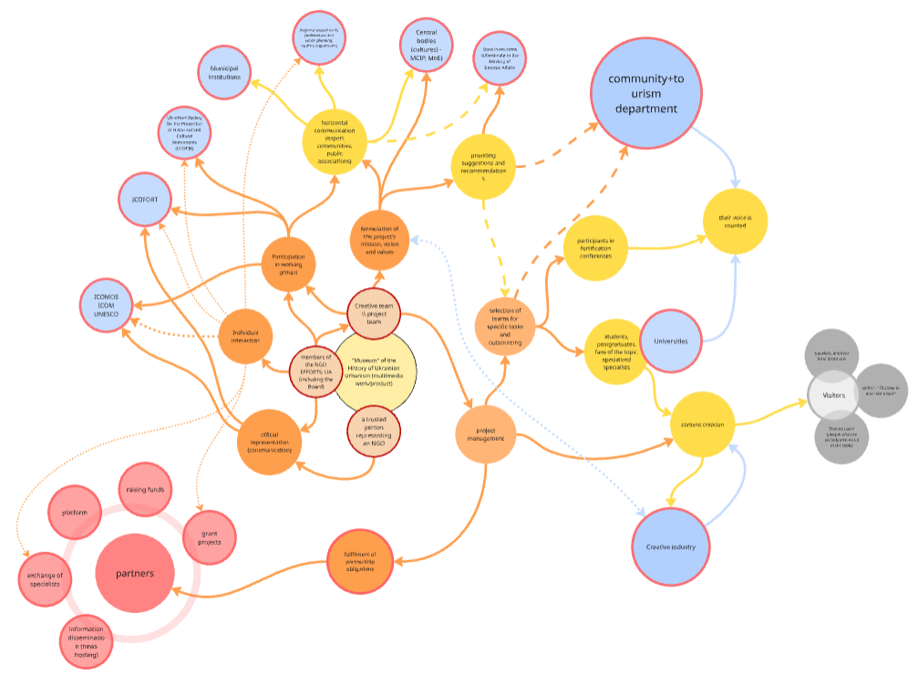
Beta: A Digital Museum [Center] of the History of Urban Planning in Ukraine. Our vision:
Mind-map showing the project's connections.
At the core is the project itself, which is directly linked to our organization's members, the project team, and the representative.
From there, the connections branch out, including both direct and indirect links.

Slide 10
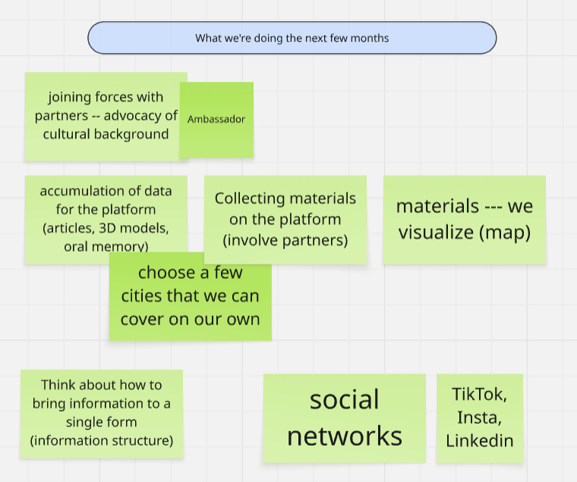
Beta: A Digital Museum [Center] of the History of Urban Planning in Ukraine. Our future plans:
1. Idea
2. Concept
3. Resource search
4. Planning
5. Implementation
6. Assessment

Slide 11
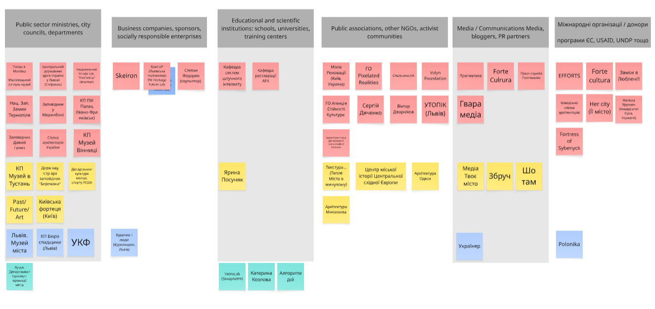
Beta: A Digital Museum [Center] of the History of Urban Planning in Ukraine. Our partners:
This list will definitely be expanded in the future.

Slide 12
CREATIVE TEAMAND THE NULP STARTUP
A startup proposing the creation of a team specializing in the full digitization cycle. This will be used for the improved functioning of a museum of urbanism.
Technologies Used by the Museum:
Digitization of preserved fragments (LiDAR, photogrammetry)
3D modeling of development stages and lost elements
3D printing, lenticular printing, video mapping, holograms
- Integration into augmented, and virtual reality (XR/AR/VR)

Slide 13
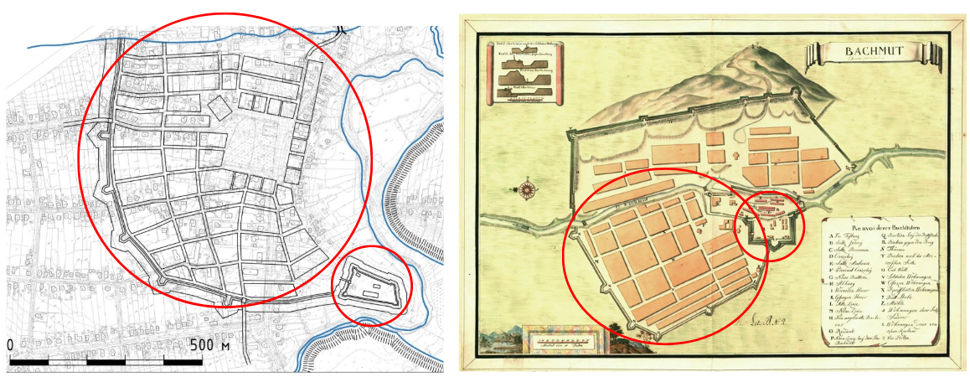
THE IMAGE OF THE UKRAINIAN HISTORIC CITY – What Is It?
Urban Fortification Complex of Ladyzhyn,Vinnytsia region in 16ᵗʰ century
Urban Fortification Complex of Bakhmut, Donetsk region in 18ᵗʰ century.
The towns of Ladyzhyn and Bakhmut share a common genesis across centuries.

Slide 14
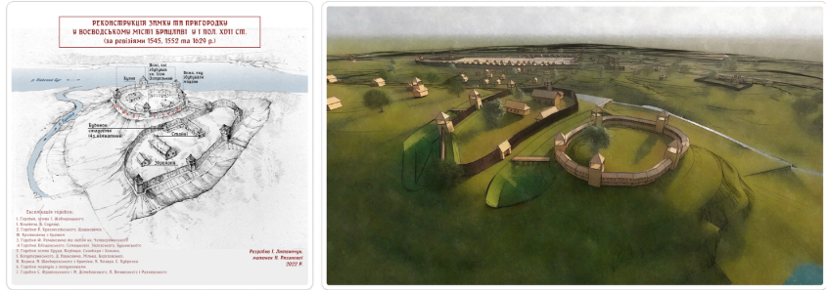

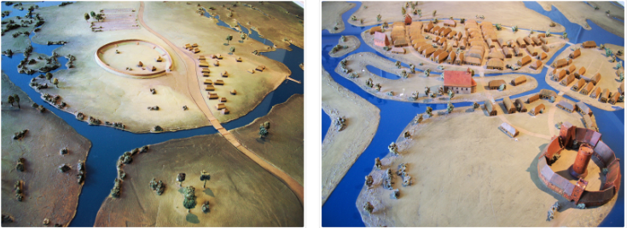
Bratslav, Ukraine
The towns of Bratslav and Oldenburg share common features characteristic of Central Europe.
The Sun Over Bratslav: How the Empire Extinguished It
Oldenburg, Germany
Based on the twin cities concept, an exhibition could be hosted in cities with similar structures and construction principles.

Slide 15
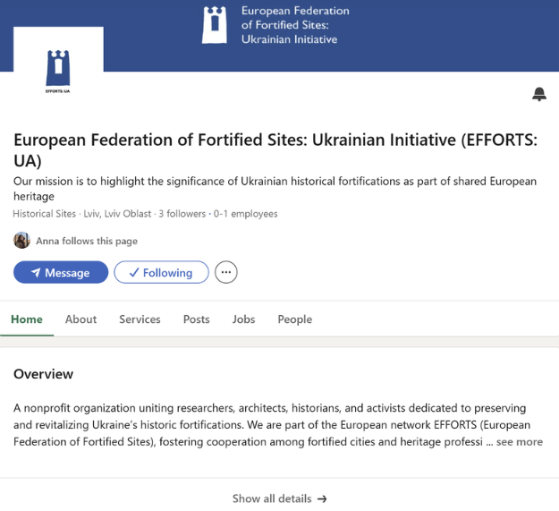

EFFORTS:UA
Join us on LinkedIn:

Slide 16
THANK YOU!
PhD. Illia Lytvynchuk
The Head of the Border of NGO “EFFORTS:UA”
PhD. Yuliia Frolova
Master`s st. Diana Akparsheva

