Slide 1

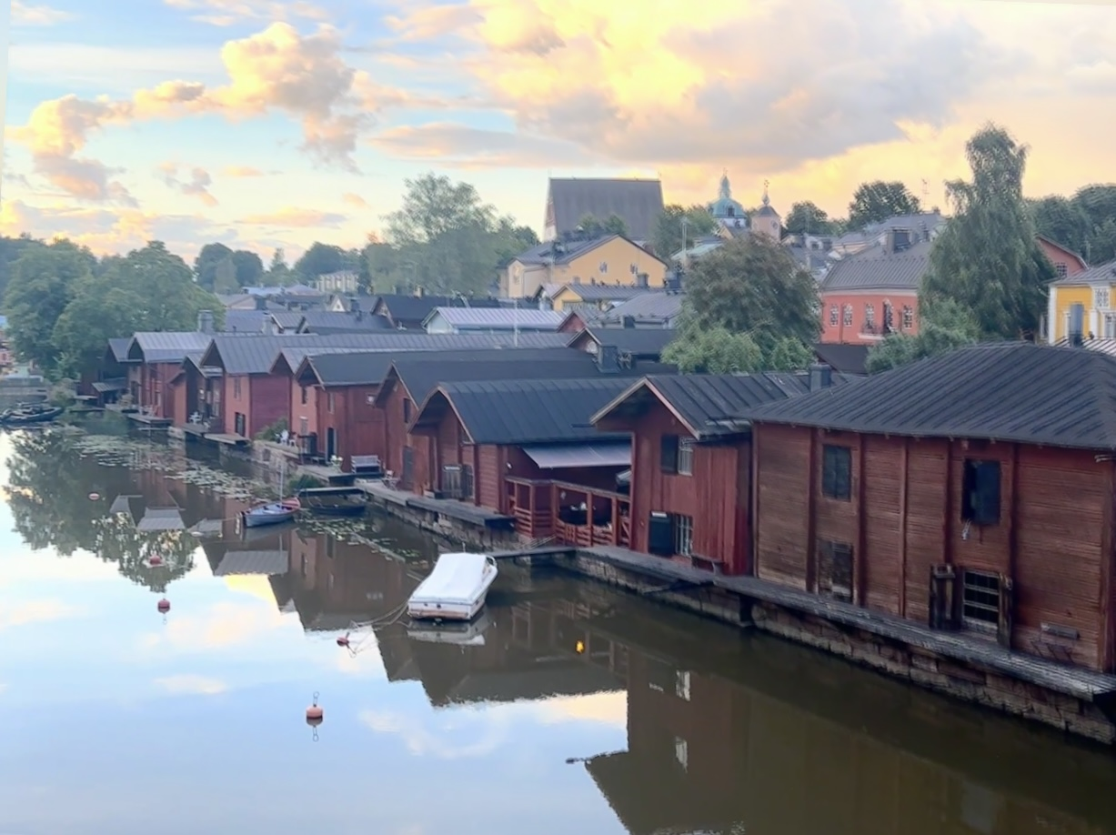
New EUROPEAN CITY VISIONS
Rafaël DEROO, SG EFFORTS Europe

Slide 2
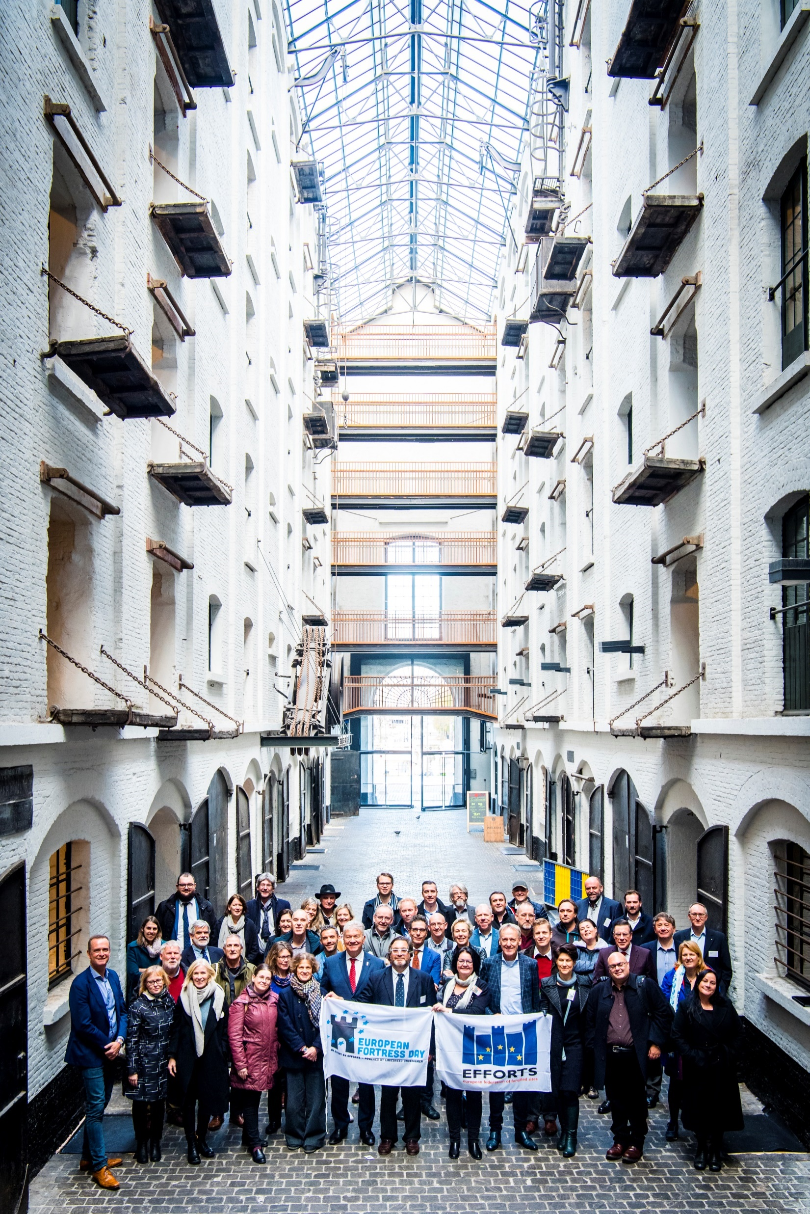
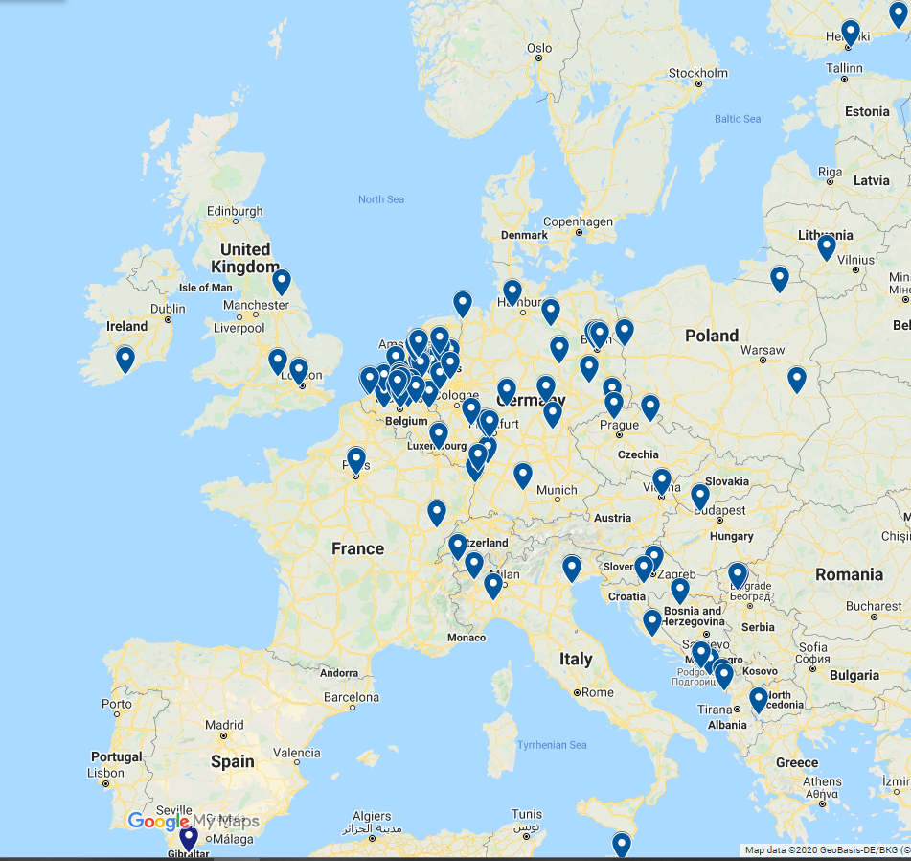
EFFORTS Europe
is the European federation building a network of national, regional and local authorities and site owners, using their fortified heritage assets to share innovative heritage re-use experience,
working together on regional or local environmental, social, economic, mobility, spatial and inclusive policy challenges to contribute to the EU’s policy goals i.e. climate change adaptation, regional or local development, or urban regeneration priorities.

Slide 3
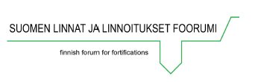





EFFORTS Member Network : 150 / 23
Oudenaarde BE
City of Antwerpen (i.e. Fort Merksem, Fort 8) BE
Citadel Antwerpen BE
Schans Landmolen, Kruibeke BE
Stafort BE
Stabroek, BE
Province West-Vlaanderen BE (Atlantikwall Europe)
Regionale Landschappen BE
Zoutleeuw BE
Menen, BE
Diest, BE
Dendermonde, BE
Mons, BE
Philippeville, BE
Herentals, BE
City of Namur BE
Simon Stevinstichting VVC BE
Garderhojfortet Gentofte - Copenhagen, DA
Suomenlinna Governing Body UNESCO FIN
Hamina FIN
Åland FIN
La Rochelle FR
Association Espaces fortifiés H-d-France FR
Cork County IE
Fondazione Forte Marghera IT
ISAM IT
Forte di Bard IT
Citadella Alessandria IT
Centro Studi Medfort IT
Valle Alpino and Galla Placidia line IT
Terezin Masto CZ
Jaromer CZ
Fortress of Culture Sibenik HR
Karlovac HR
Fort Monostor HU
Kaunas Fortress Regional Park LT
Daugavpils LA
Paola Heritage Foundation MA
Herceg Novi MNE
Ingolstadt DE
Erfurt DE
European Cooperation Center DE
Polytechnic University of Lviv UA
City of Ivano-Frankivsk UA
Pidhirsti castle town UA
Kuressaare EST
‘s-Hertogenbosch NL
IJsselstein NL
Breda NL
Bergen op Zoom NL
Hellevoetsluis /Op-Voorne NL
Grave, NL
Heusden NL
Oost Gelre NL
Culemborg NL
Maastricht NL
Kasteel ten Bergh NL
Stichting Monumentenbezit - Vesting Naarden NL
Stichting Menno van Coehoorn NL
Stichting Liniebreed Ondernemen NL
Vauban Grands Sites UNESCO Association FR (12)
Zuiderwaterlinie cities (all 12 cities full members, NL)
Vereniging Nederlandse Vestingsteden (15 full member cities, NL)
Associated with member Forte Cultura (all 50 members as associate, # EU member states)
Associated members from Ukraine in ‘EFFORTS:Ukraine’ (8)
+International Fortress Council (13 members, INT), Fortress Study Group, Palmerston Forts (UK), Coastal Defense Study Group (USA) and partenered by ICOFORT Europe
+War Heritage Institute, Belgium Battlefield of Europe BE
+EFFORTS Knowledge Center Forte Marghera 40 Individual Memberships across Europe (IT, PO, GR, ES, CH, UK, UA, BE, NL, ...)
Memorandum of cooperation with Liberation Route Europe.

Slide 4
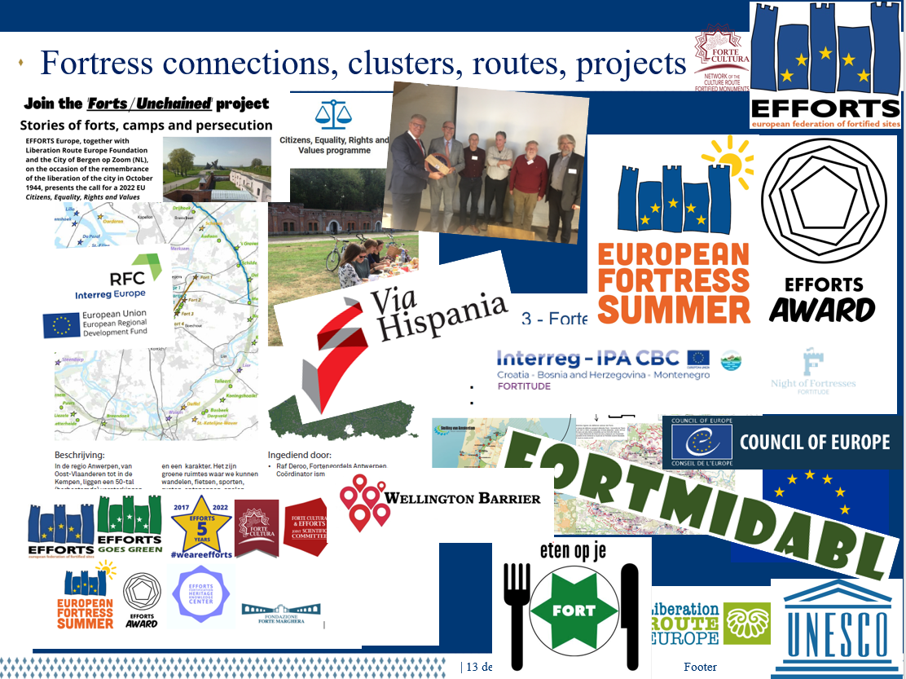





Slide 5

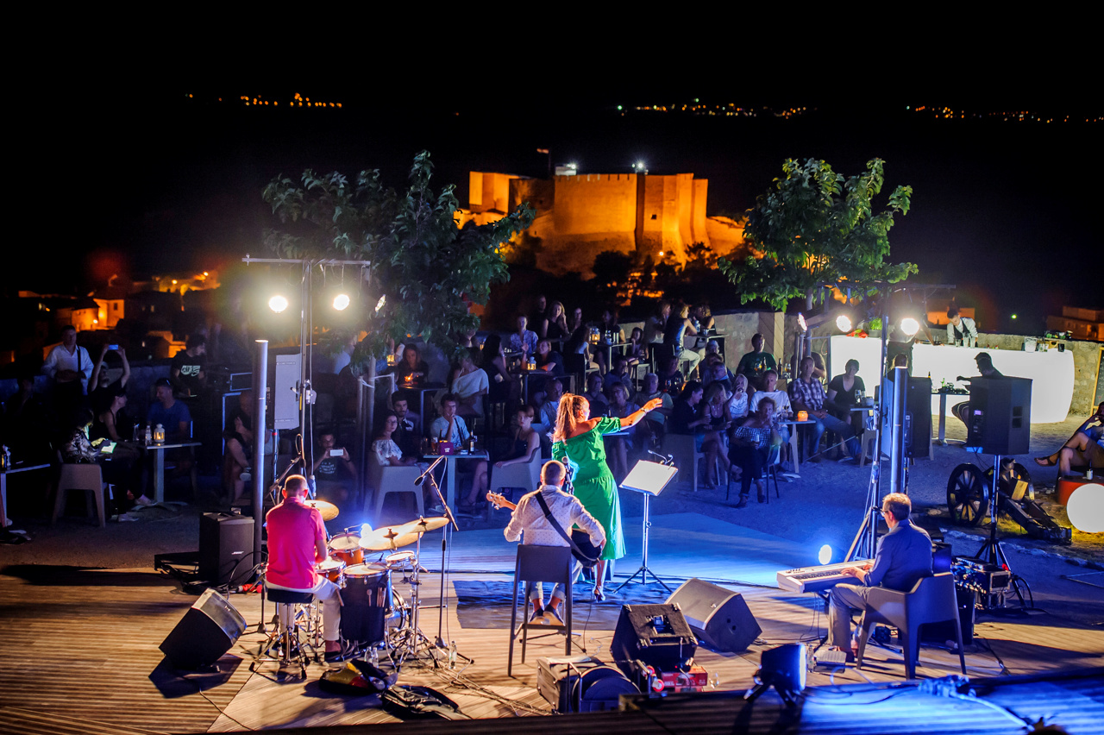

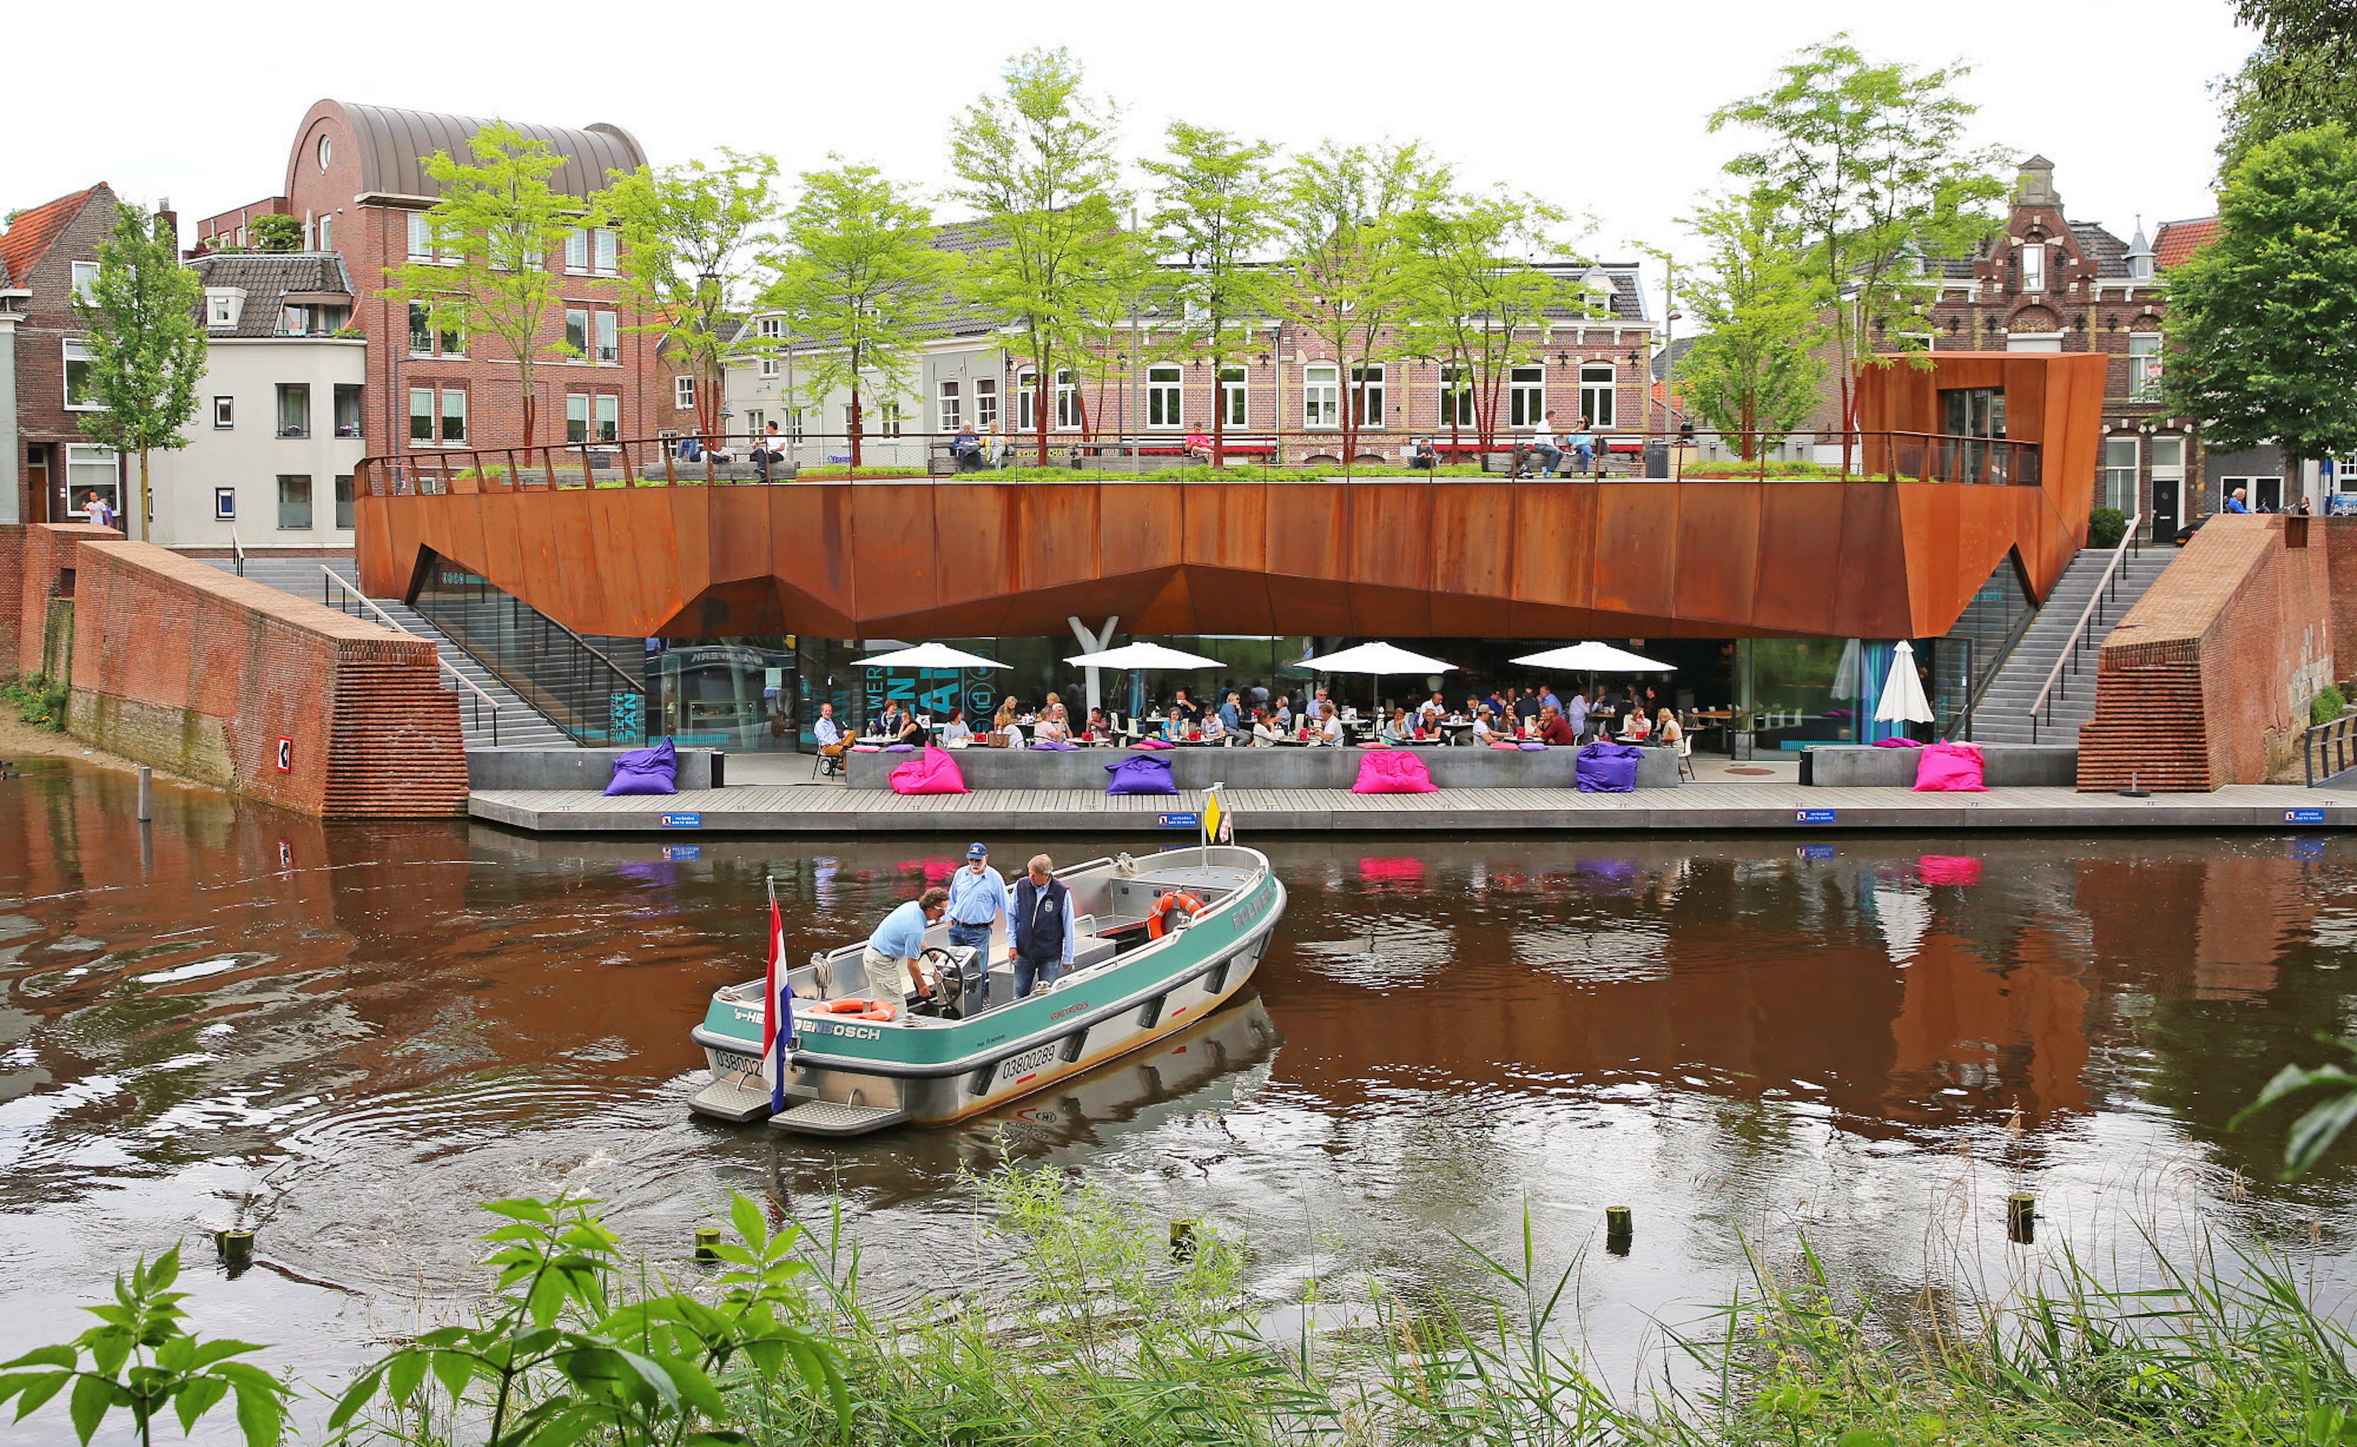
Driver for European and regional projects
European Fortress Day (2018)
EFFORTS Goes Green (2019)
Recapture the Fortress Cities (2019)
Forts/Unchained (2020)
Partner of Kaunas 2022 Cultural Capital of Europe (2022)
Fortitude (2022)
Reviving the Fortresss Regions (Forthero) (2023)
Fortic (2024)
Resilient Fortress (2024)
Interlinie (2024)
Fort Union (Poland – Lithuania 2025-2028)
Baltic Route (2026)

Slide 6
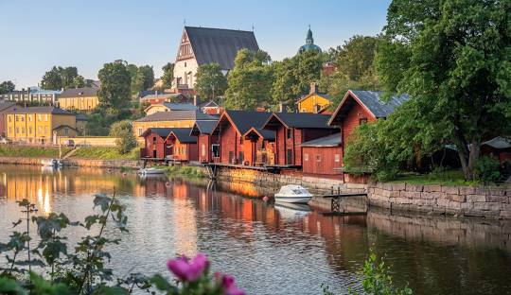
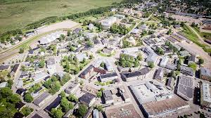
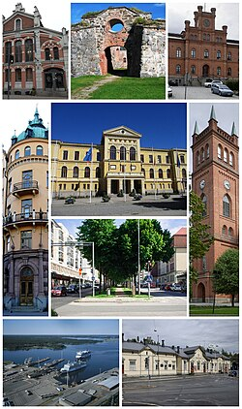
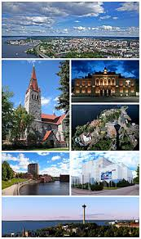
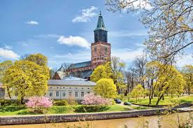
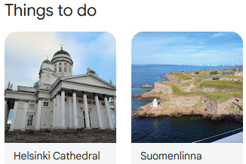
HERITAGE IDENTITY
Cities presenting themselves online (first page in search)

Slide 7
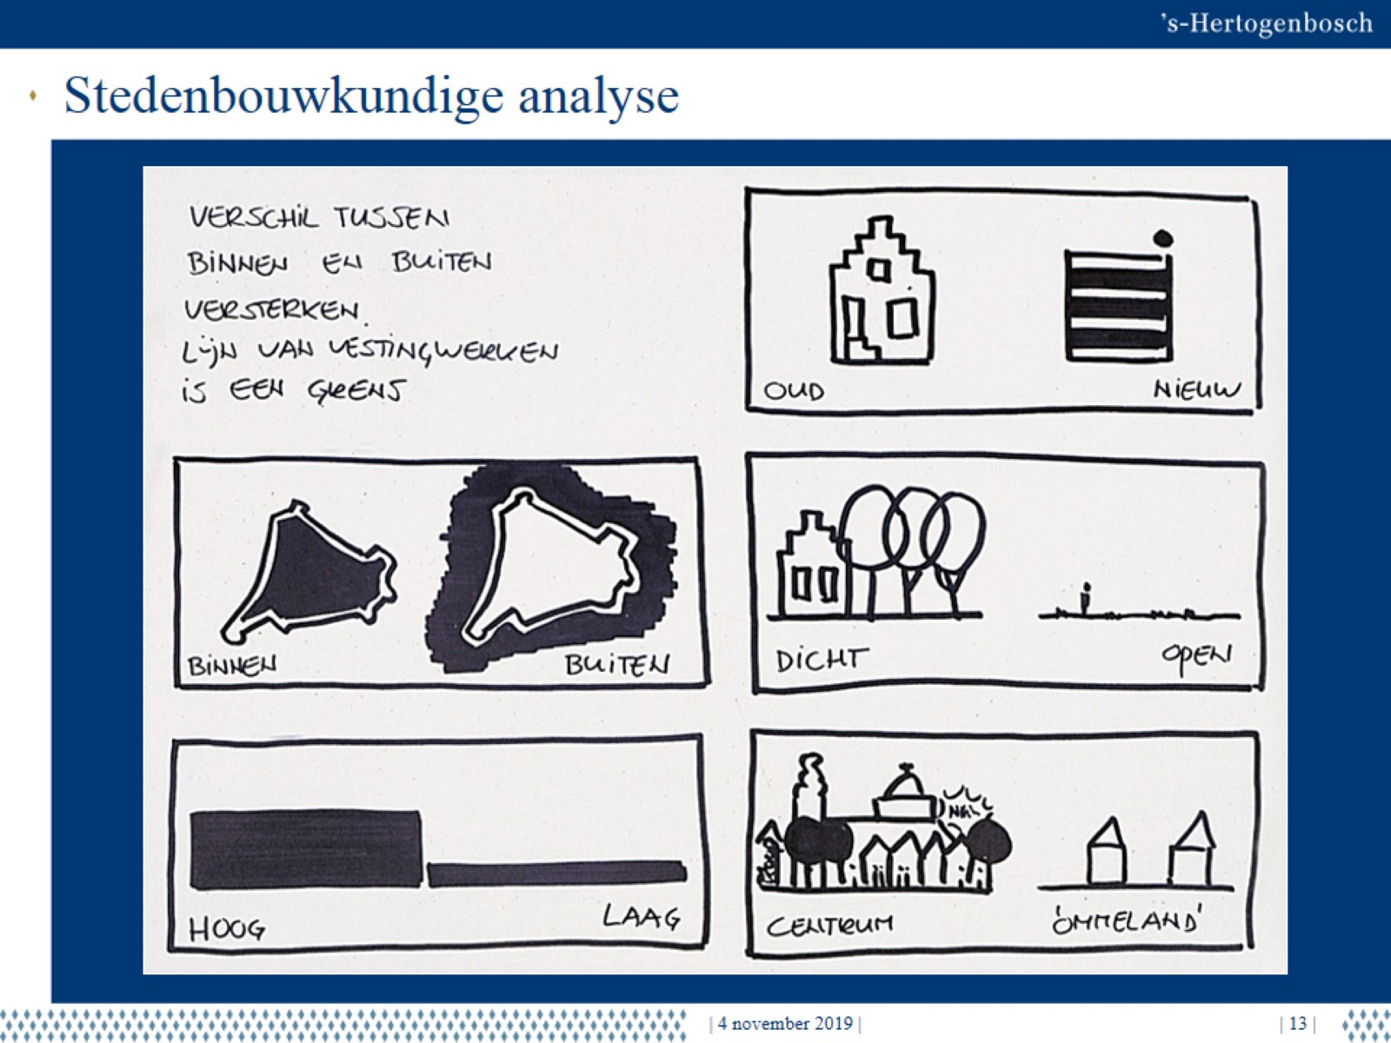
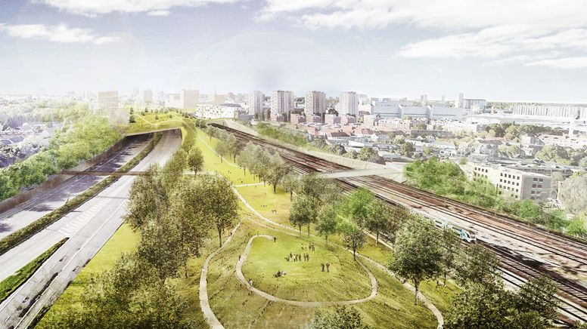
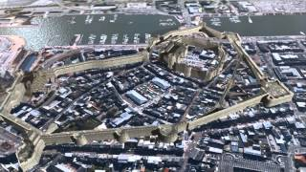
Fortified cities opportunities
Until 19th century : Make life safe
From 21th century : Make life prosperous

Slide 8
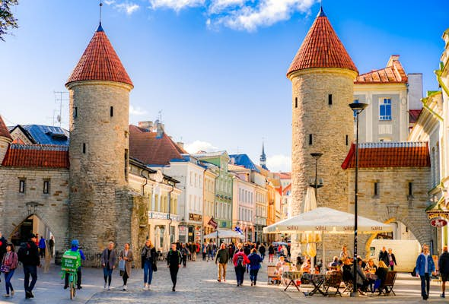
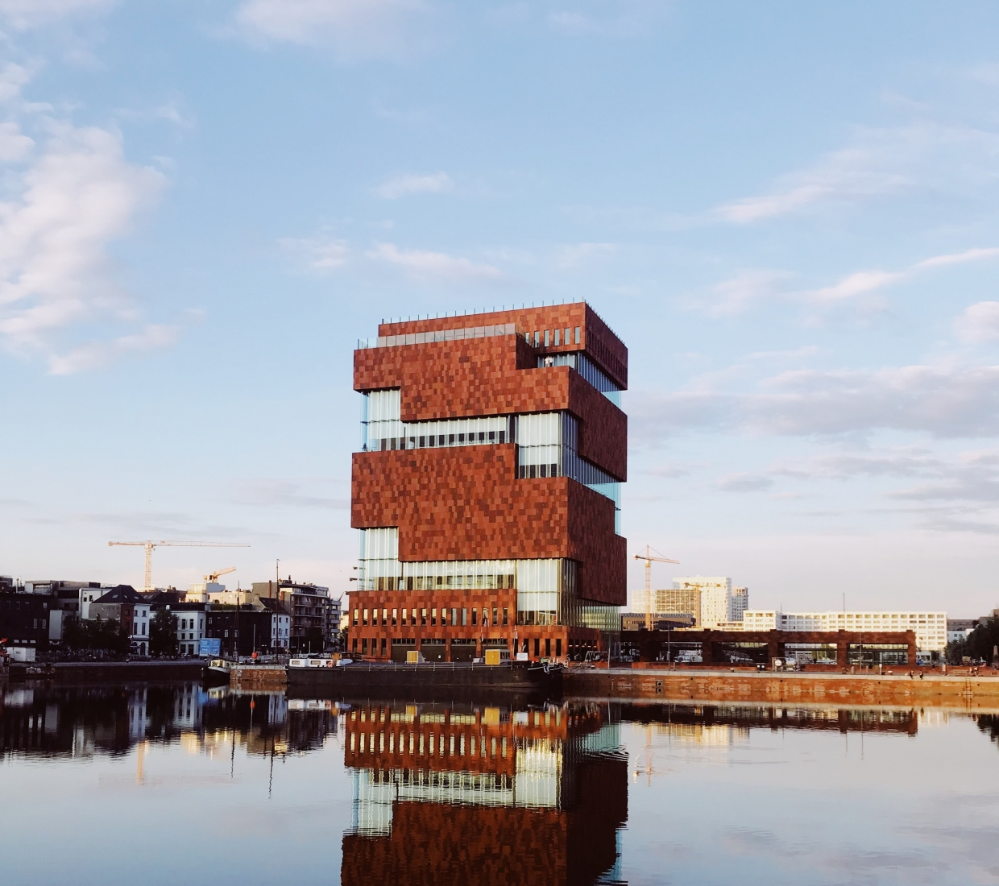
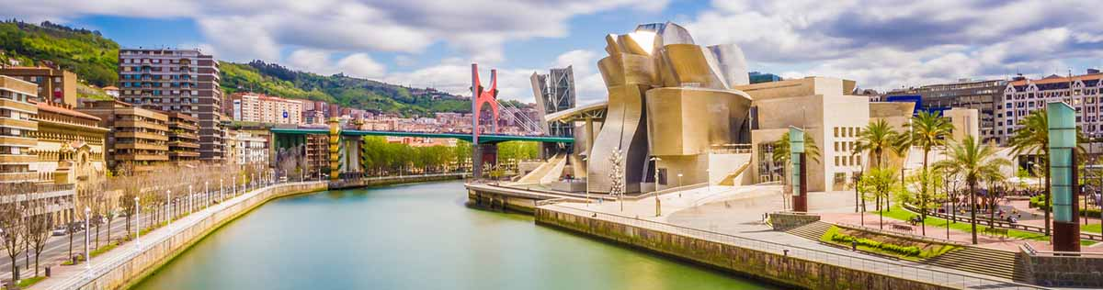
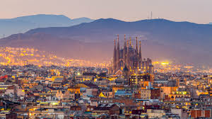
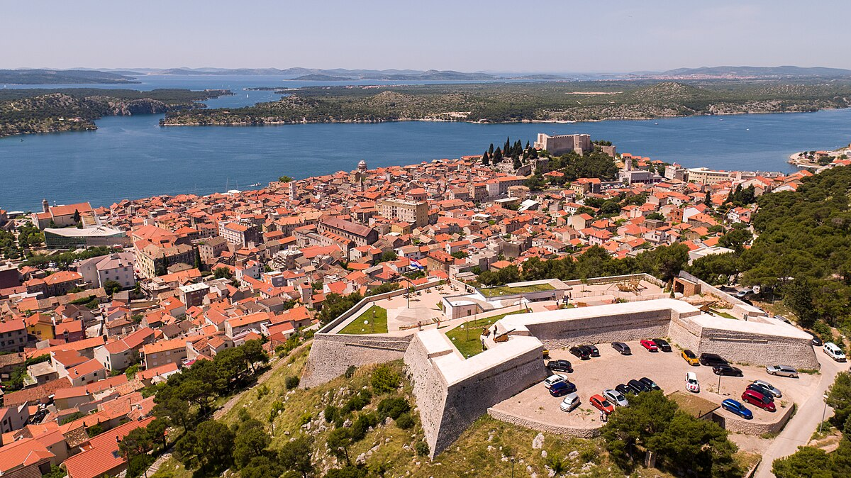
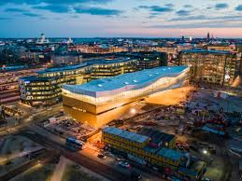
New visions: old & new heritage
Helsinki, FIN
Tallinn, EST
Šibenik, HR
Antwerp, BE
‘s-Hertogenbosch, NL
Bilbao, ES
…

Slide 9
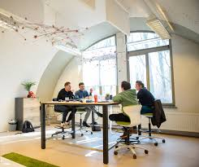
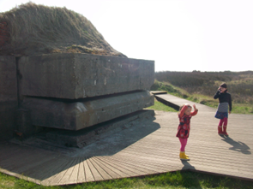
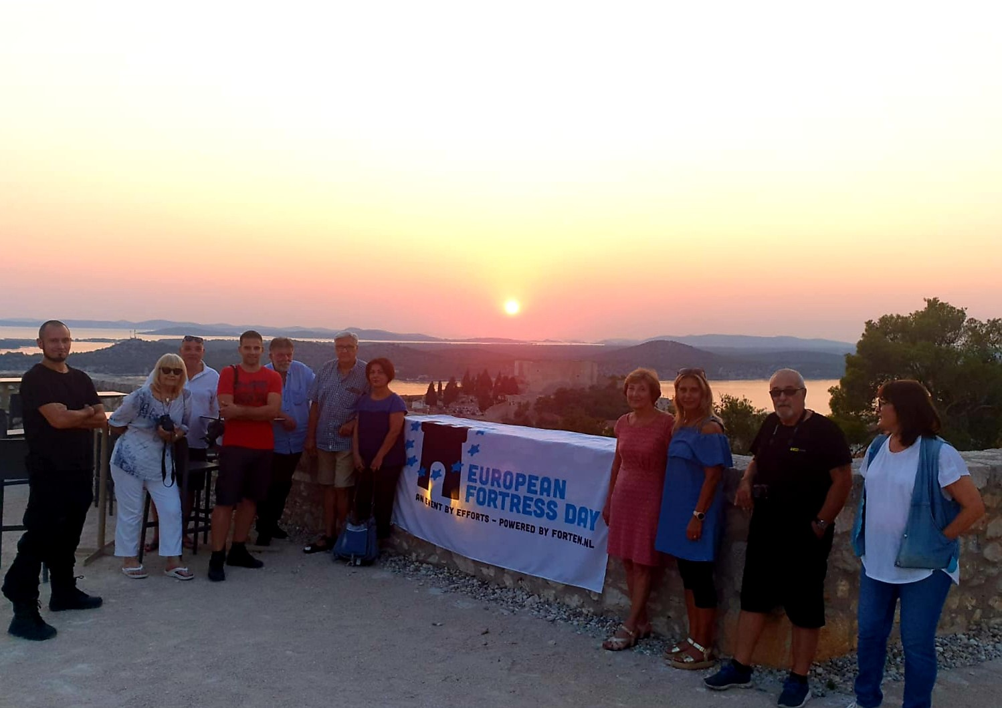
‘Blue City’ core principles
1. Active mobility: infrastructure for walking, cycling, and public transport instead of car-oriented design. Accessibility, slow traffic.
2. Green and accessible public spaces: parks, gardens, and meeting places for tranquillity, nature, and social interaction.
3. Healthy food (nearby): promoting local food production, markets, and healthy eateries.
4. Strong social networks: fostering a sense of community through neighbourhood initiatives, meeting places, and participation.
5. Meaning and mental health: focusing on culture, education, tranquillity, spirituality, and participation.
6. Livable built environment: compact, safe, and inviting residential neighbourhoods with mixed-use functions.
→ REUSE of heritage and connection with the site, creating identity
PLACE commands POSSIBILITIES
Based on the Dutch adapation in Rotterdam (the Blue City) of ‘The Blue Economy’, by Gunther Pauli, 2010 (BE).
Used by EFFORTS / Maarten de Winter in the preparation of the Terezín Master Plan (CZ).

Slide 10
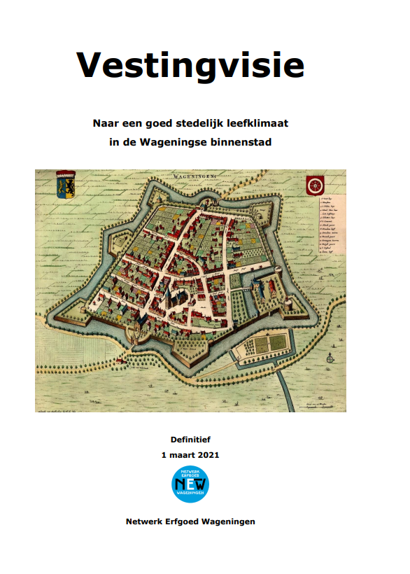
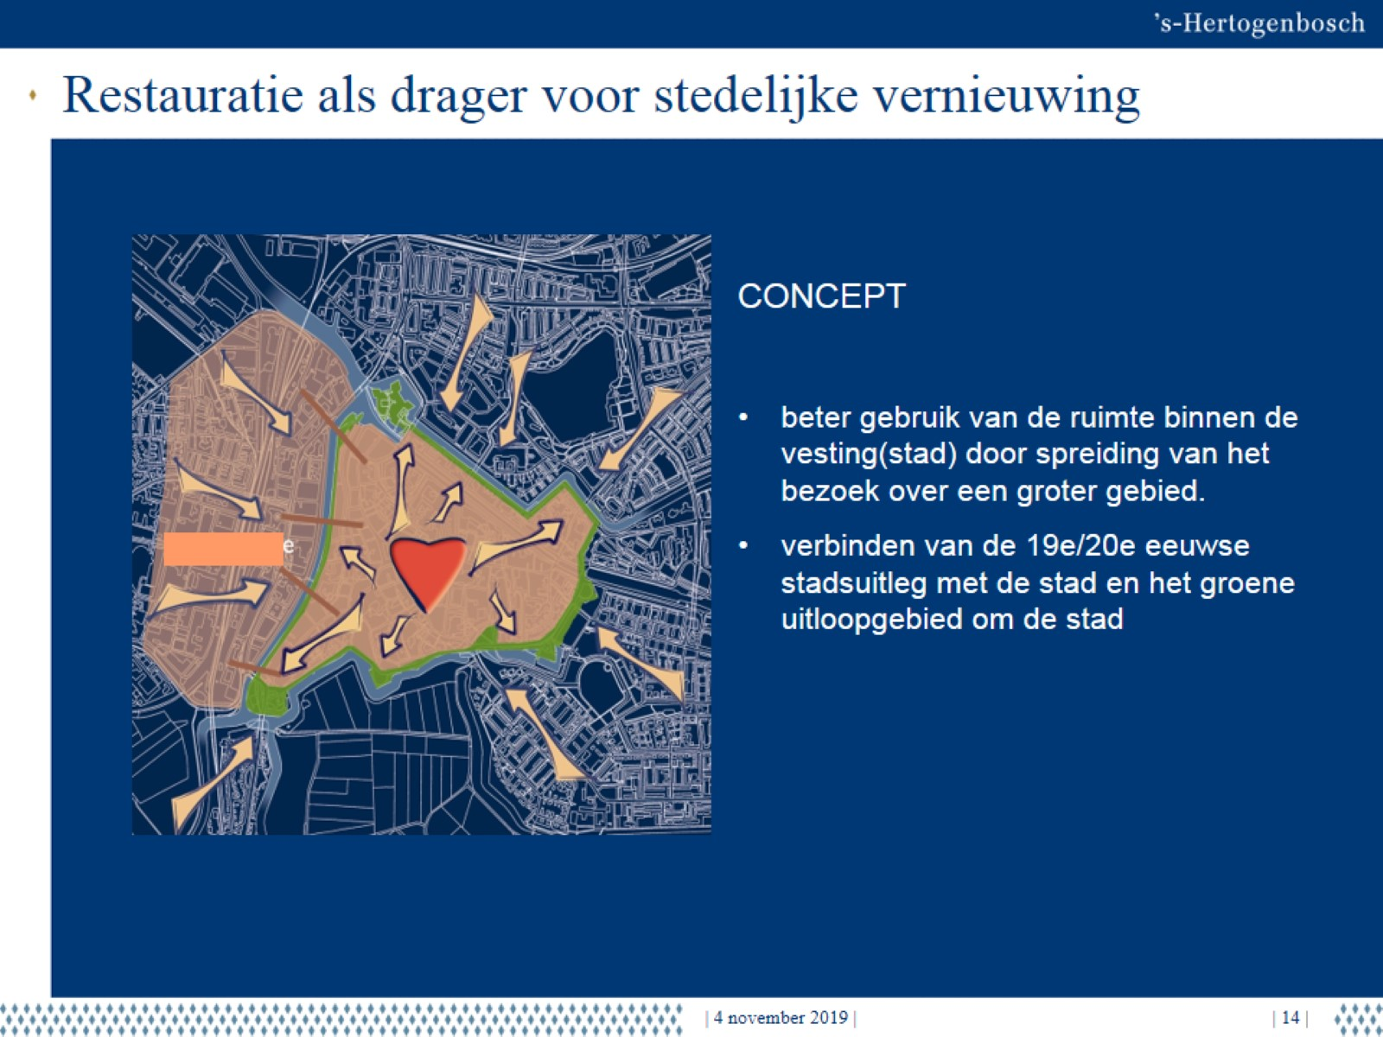
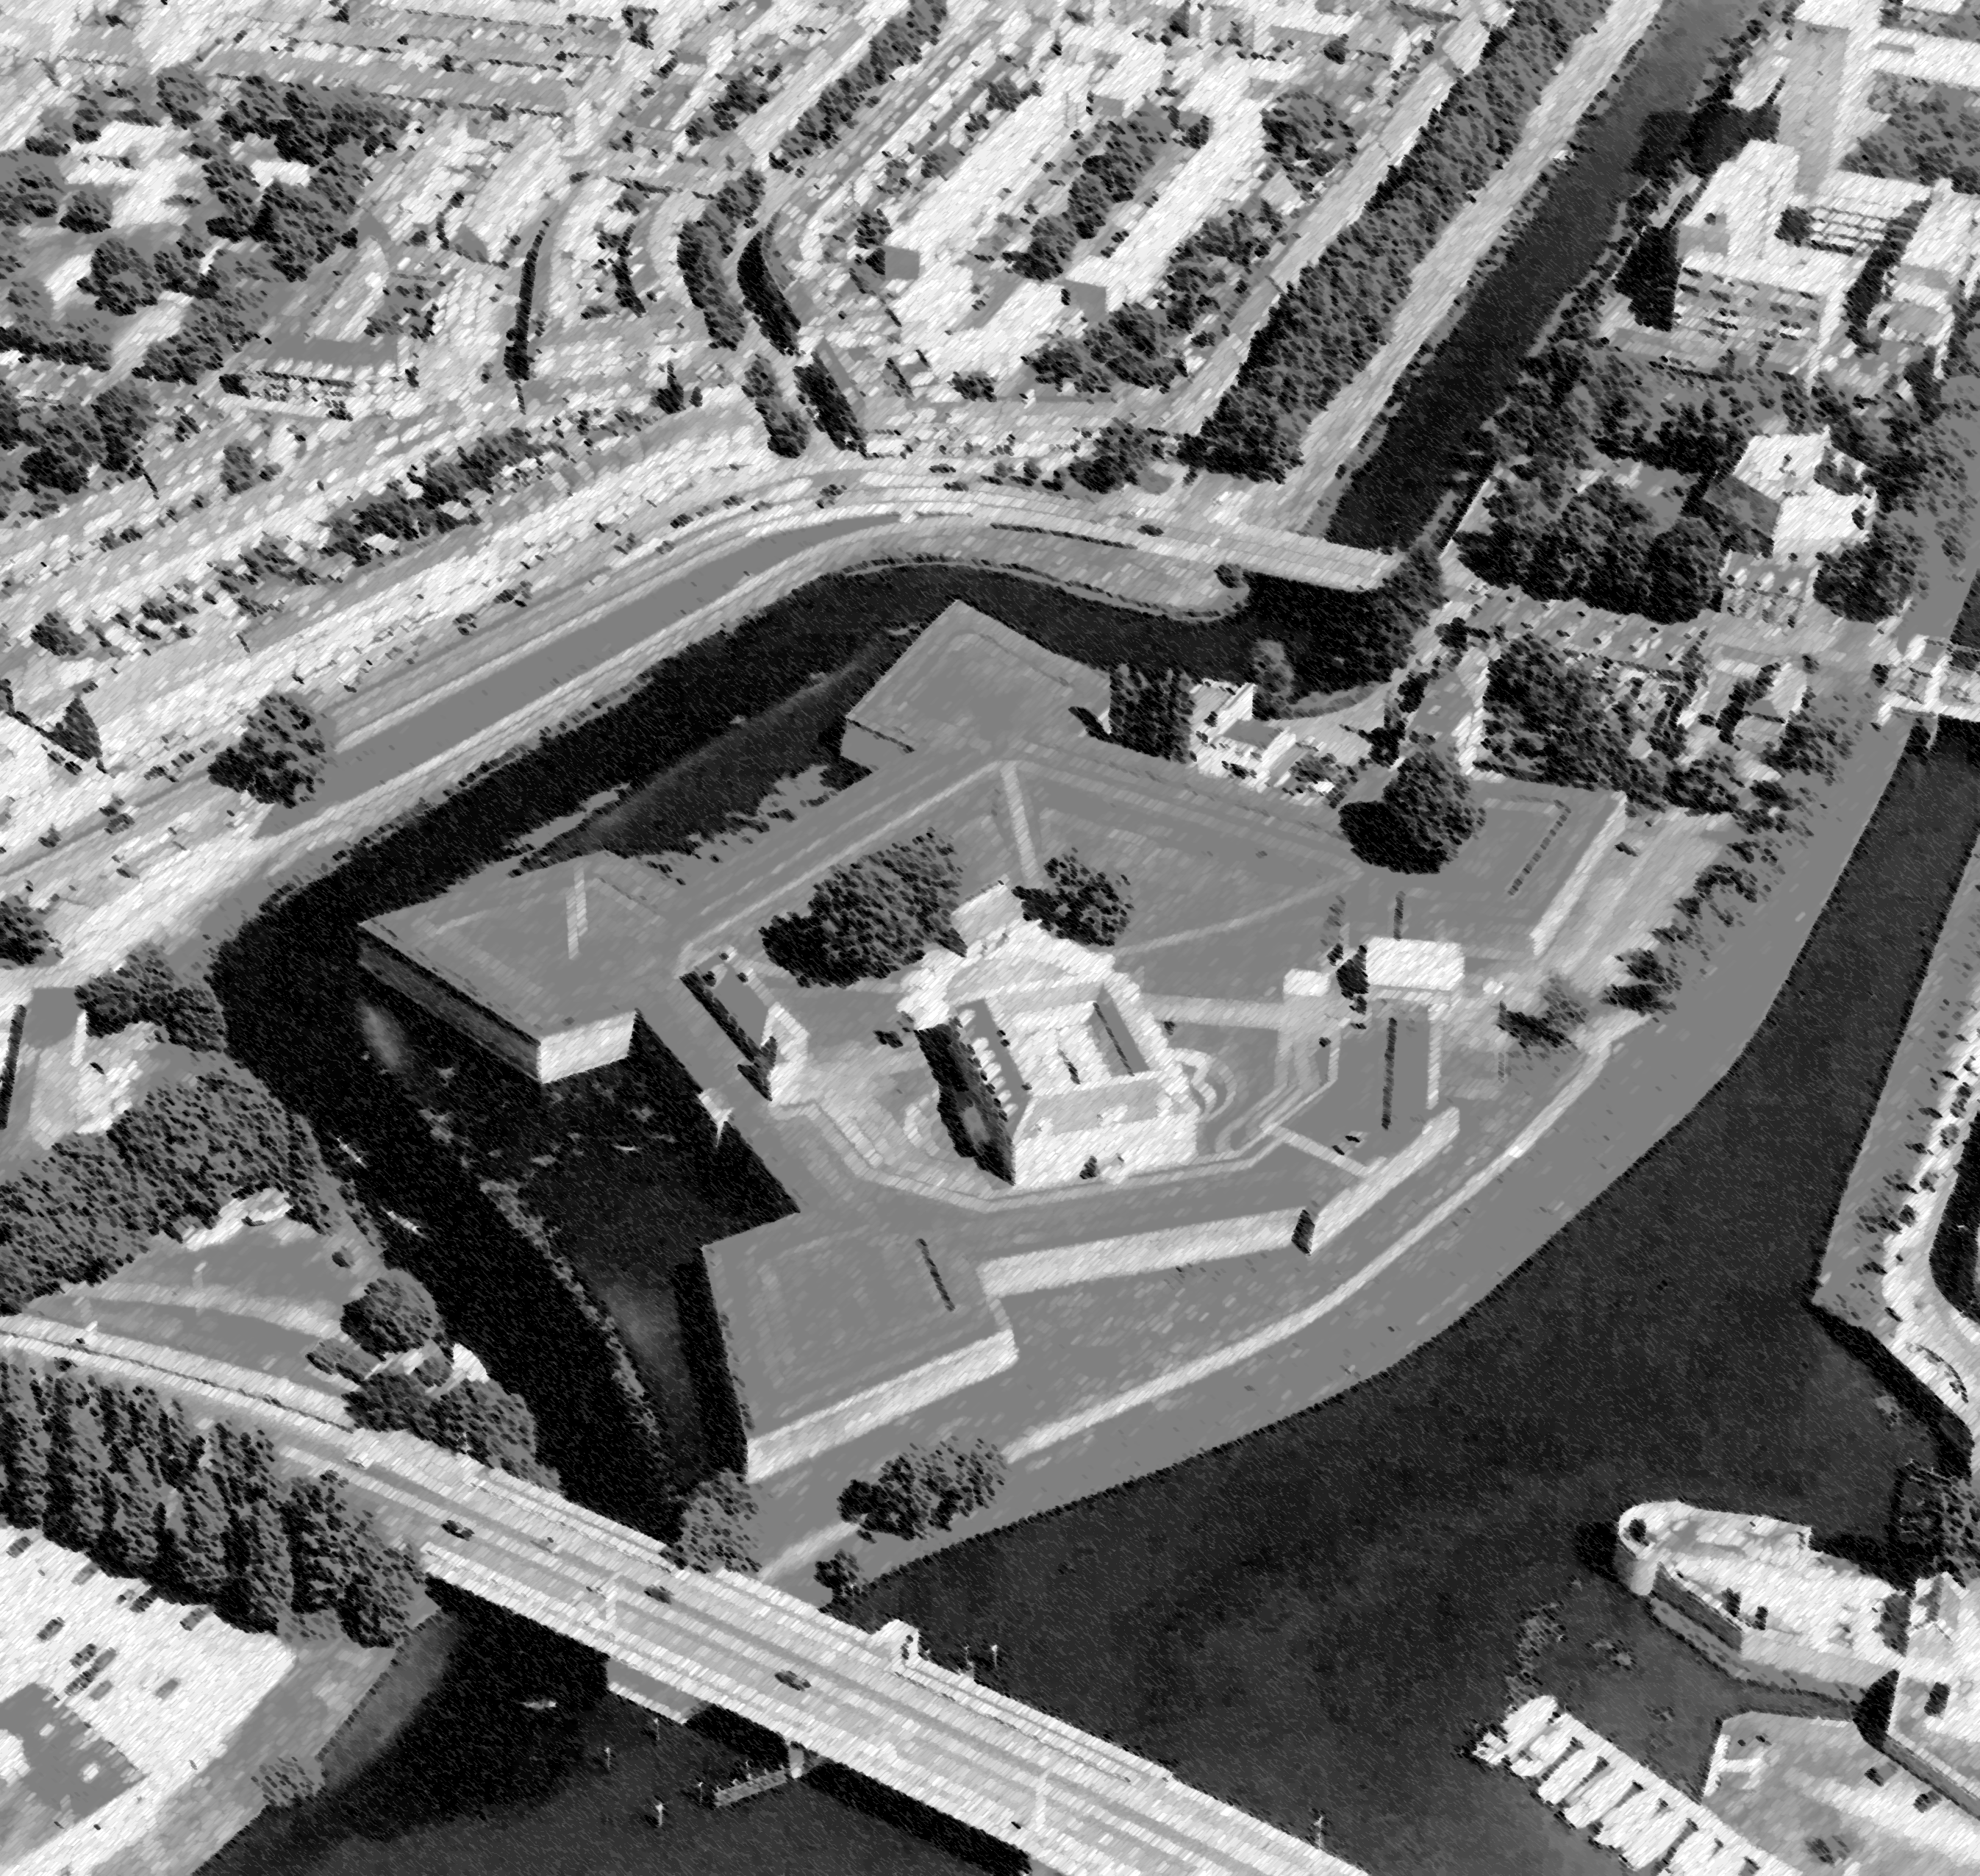
‘s-Hertogenbosch

Slide 11
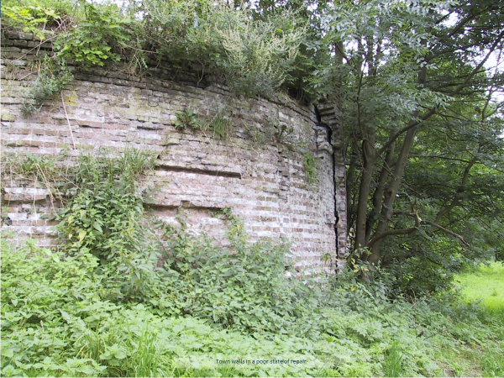
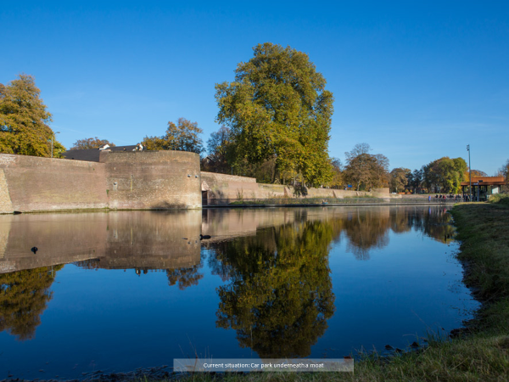

Slide 12
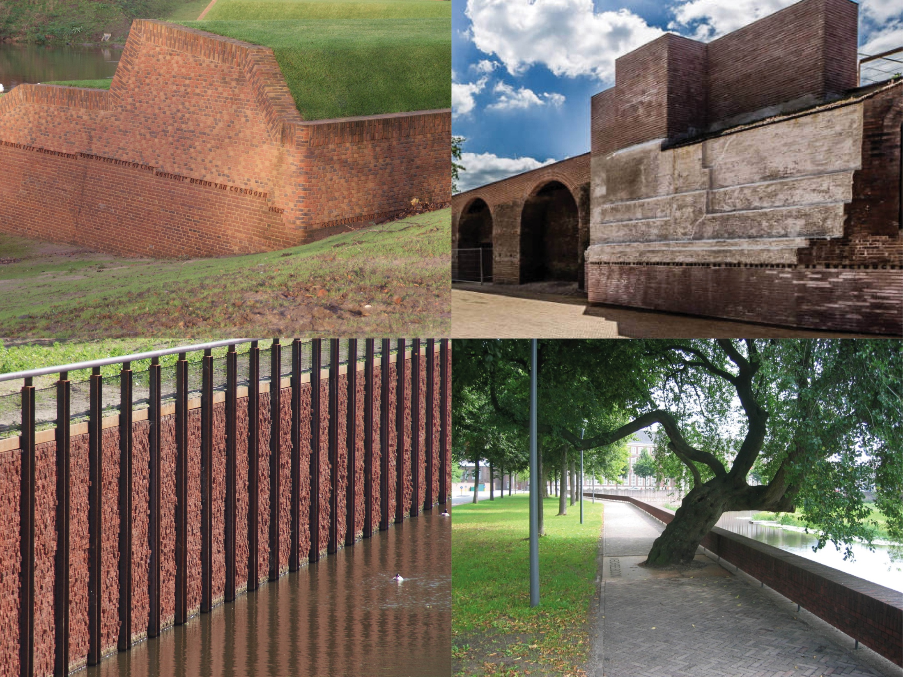
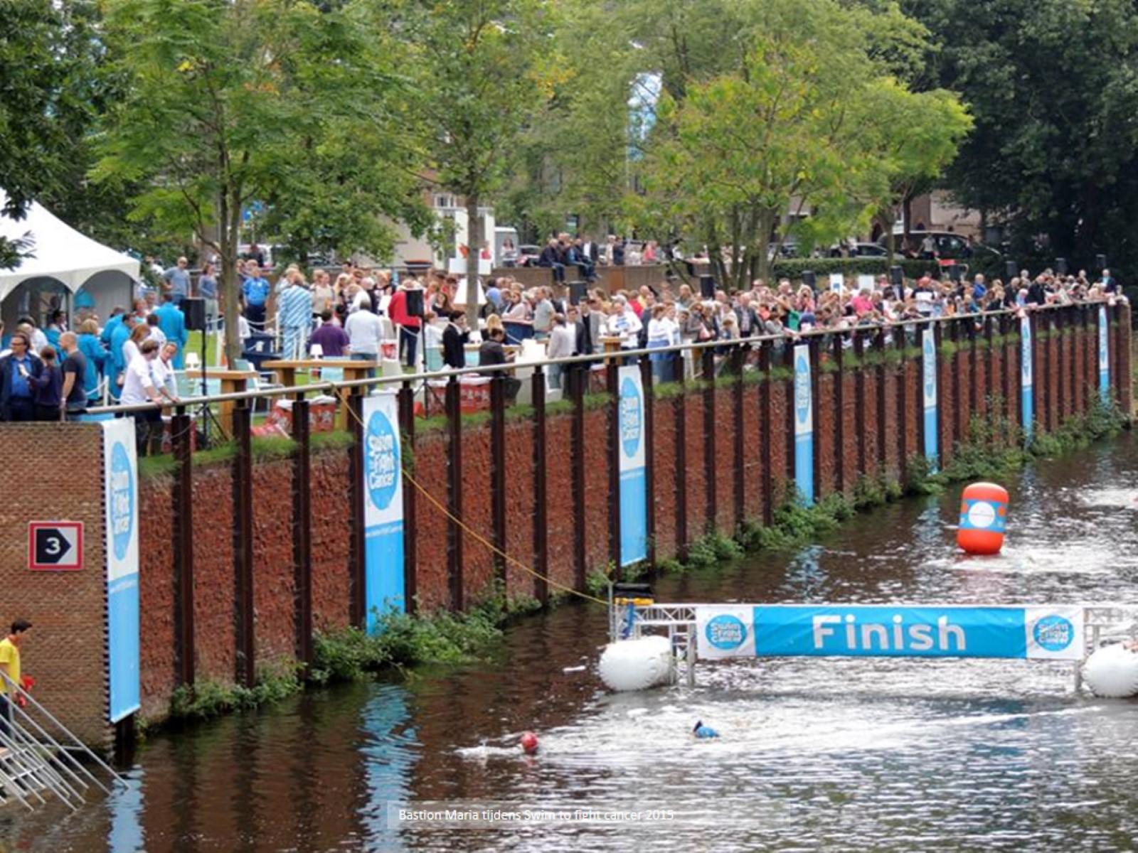
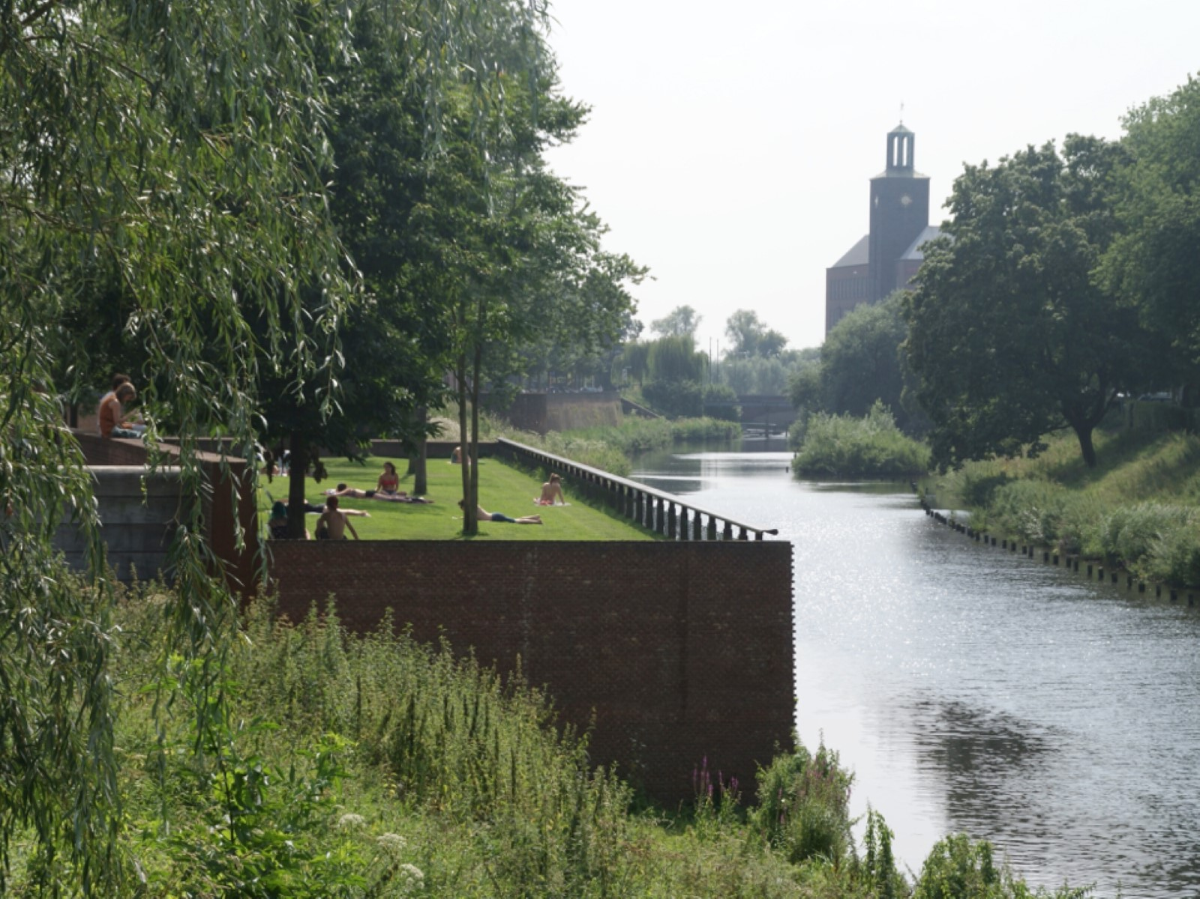

Slide 13
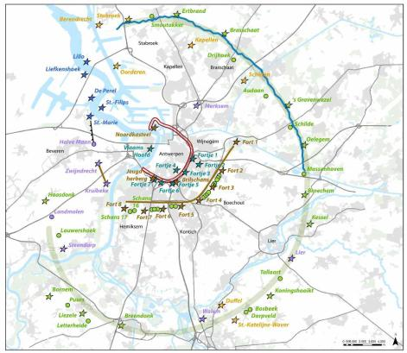
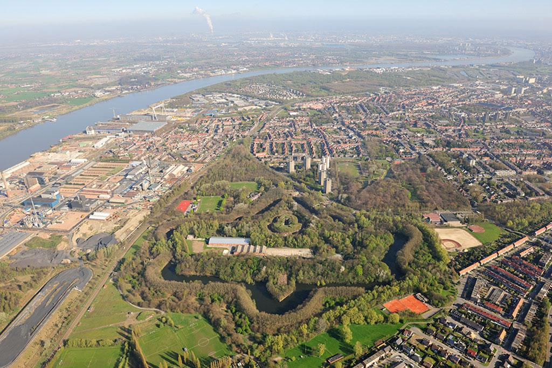
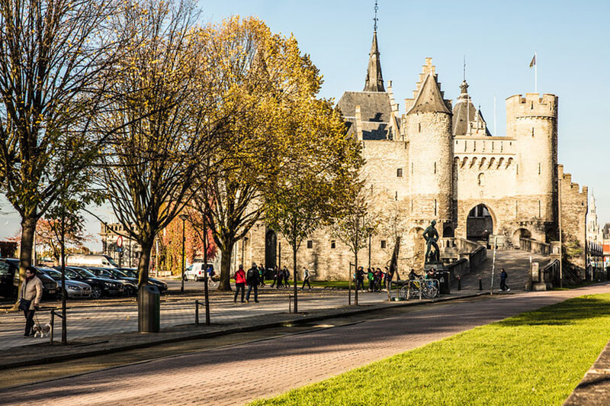
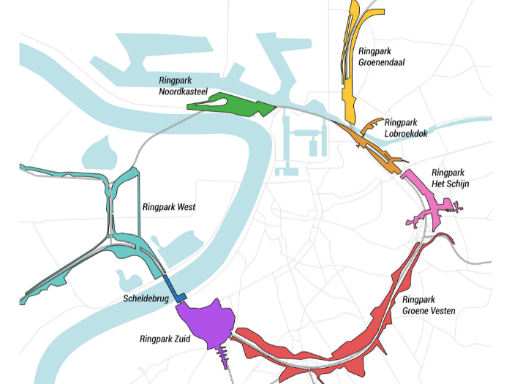
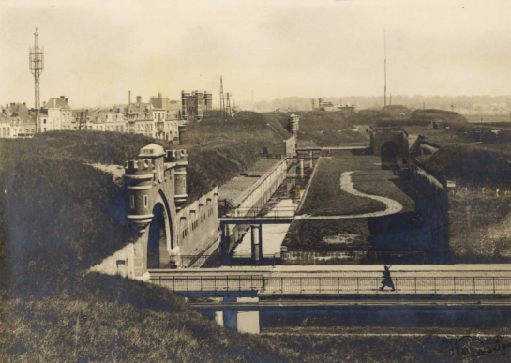
Antwerp

Slide 14
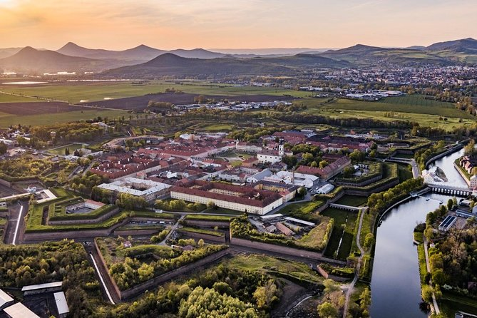
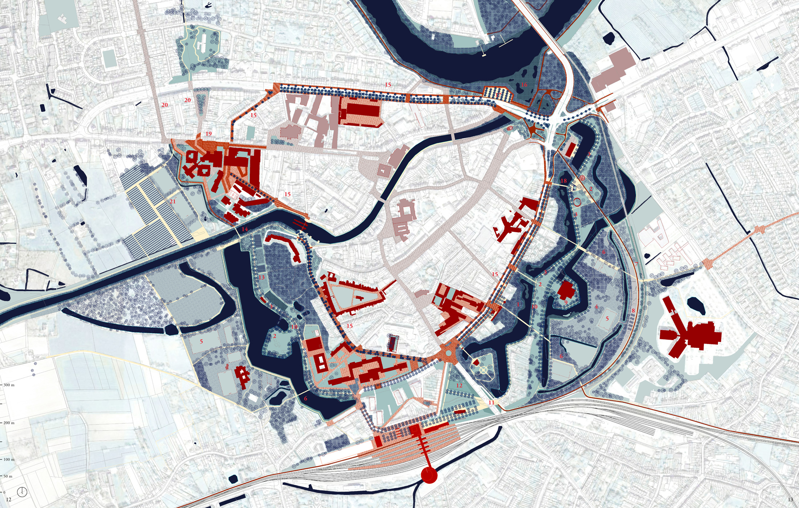
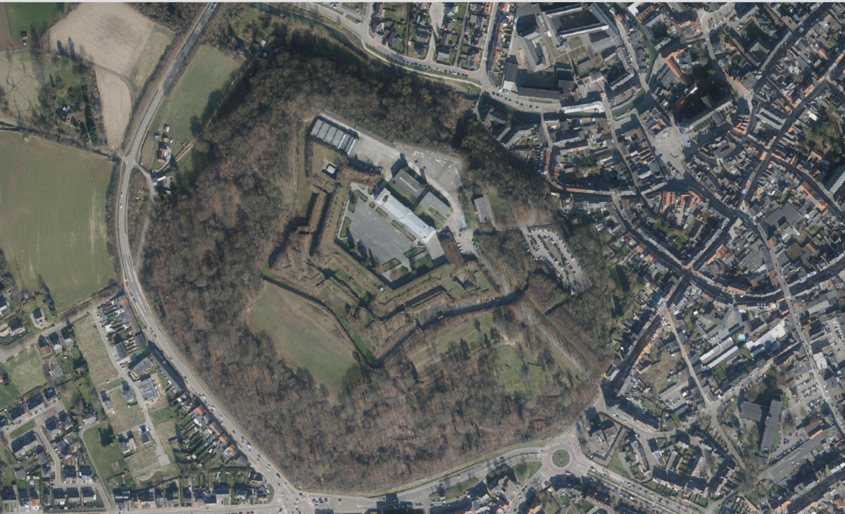
Fortified heritage cities planning
(Terezín (CZ), Diest, Dendermonde (BE), …)

Slide 15
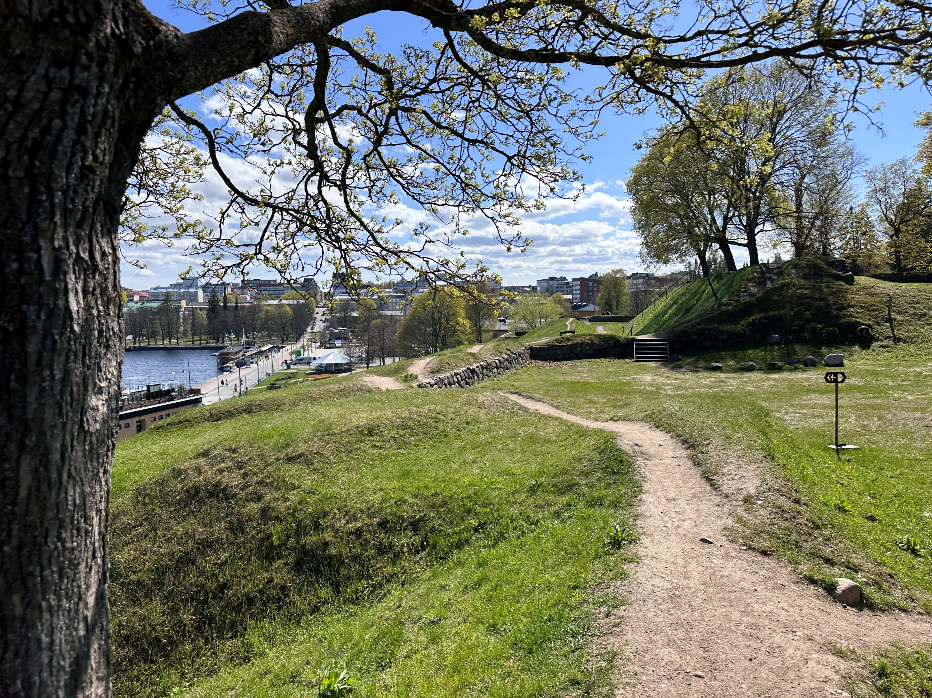
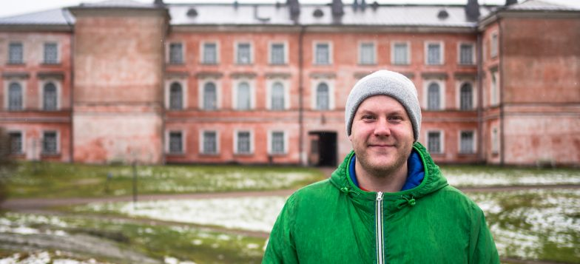
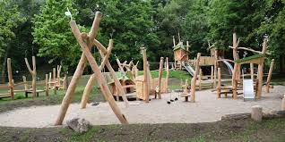
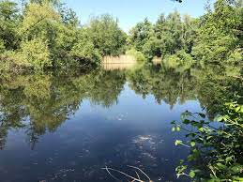
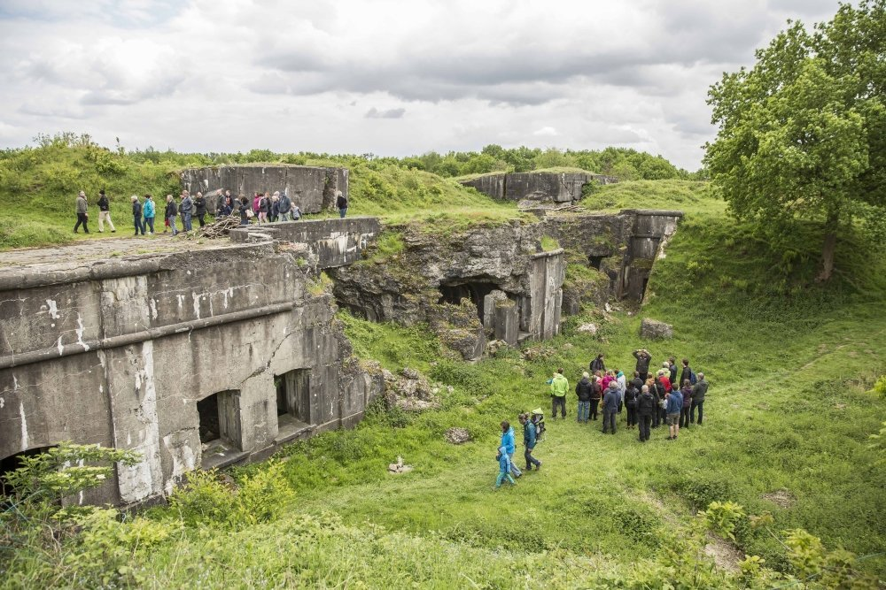
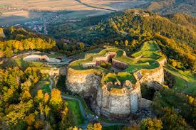
Connection and Ownership
Development and Tourism
Environment and Nature

Slide 16
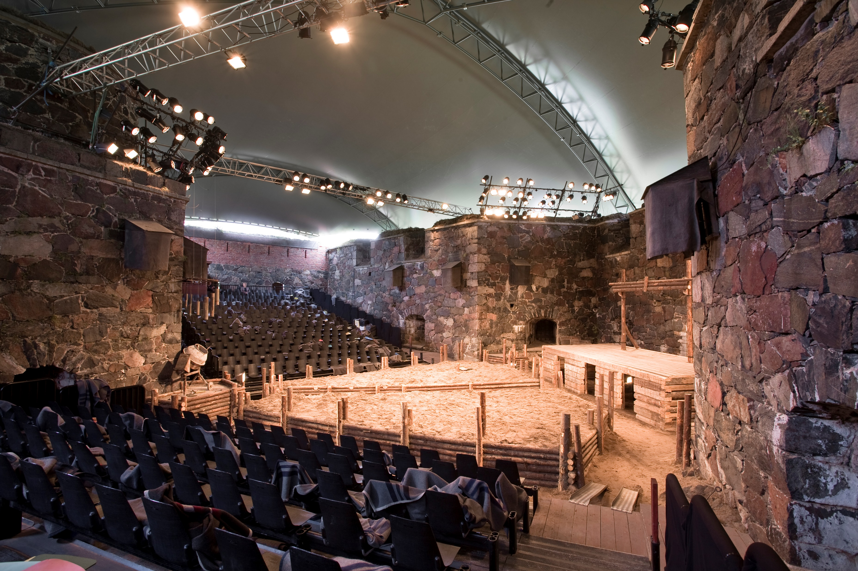
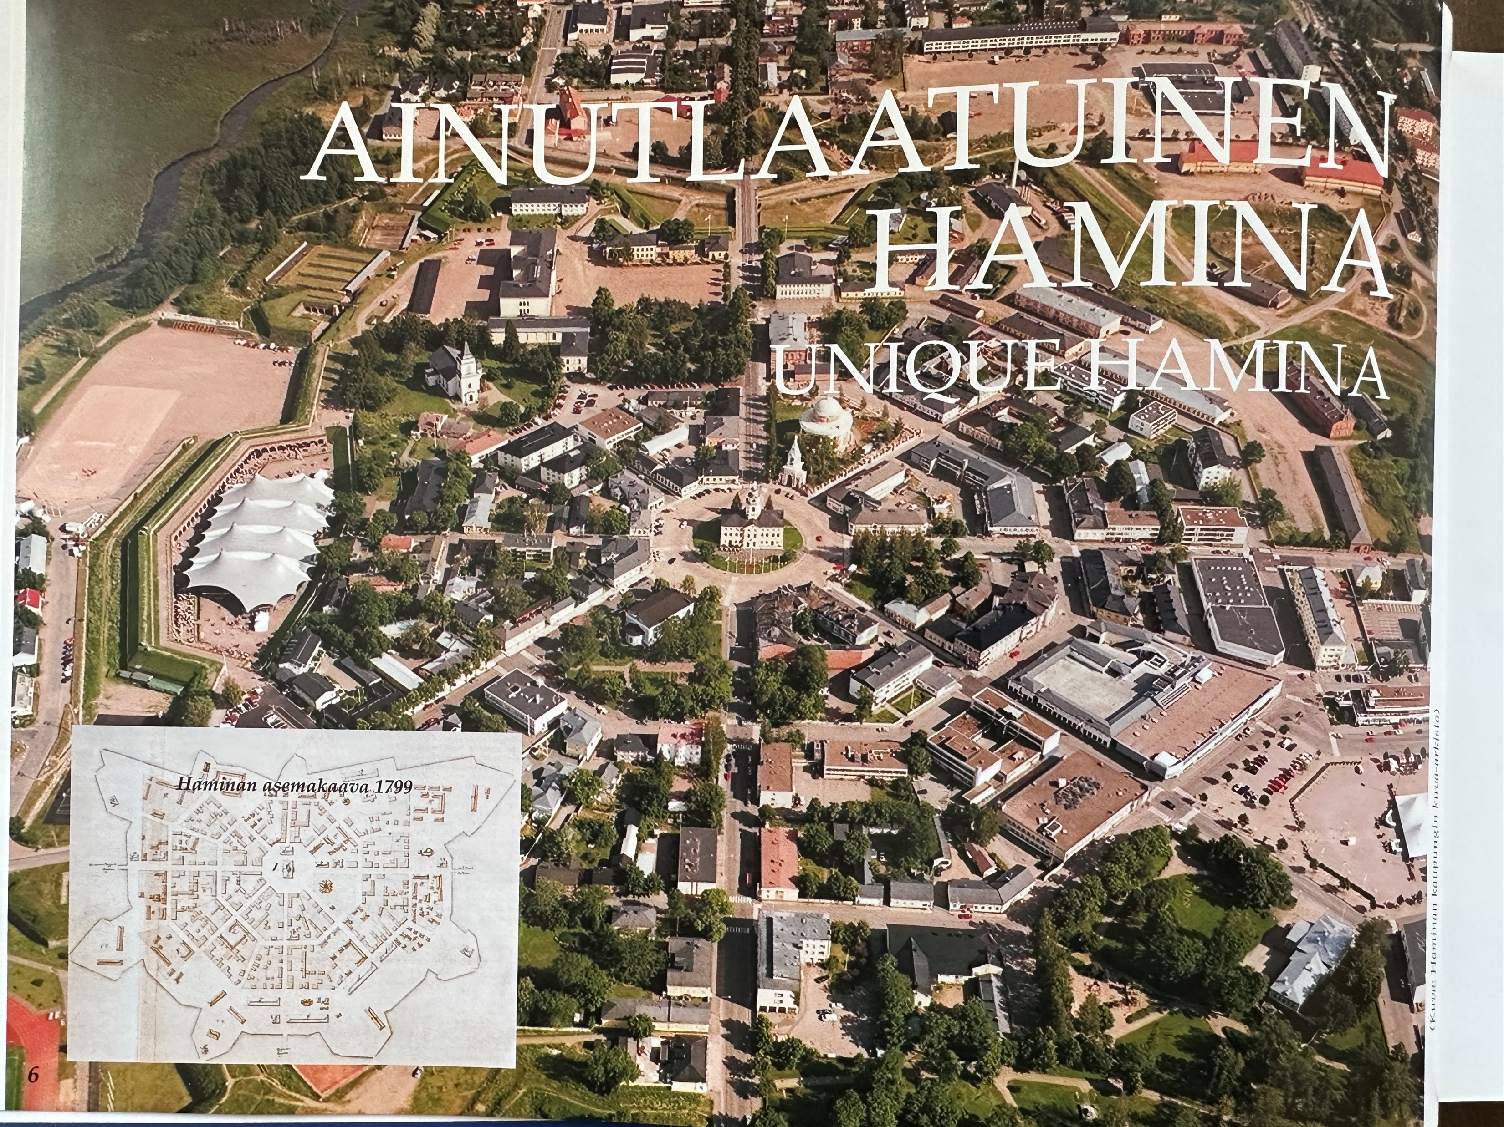
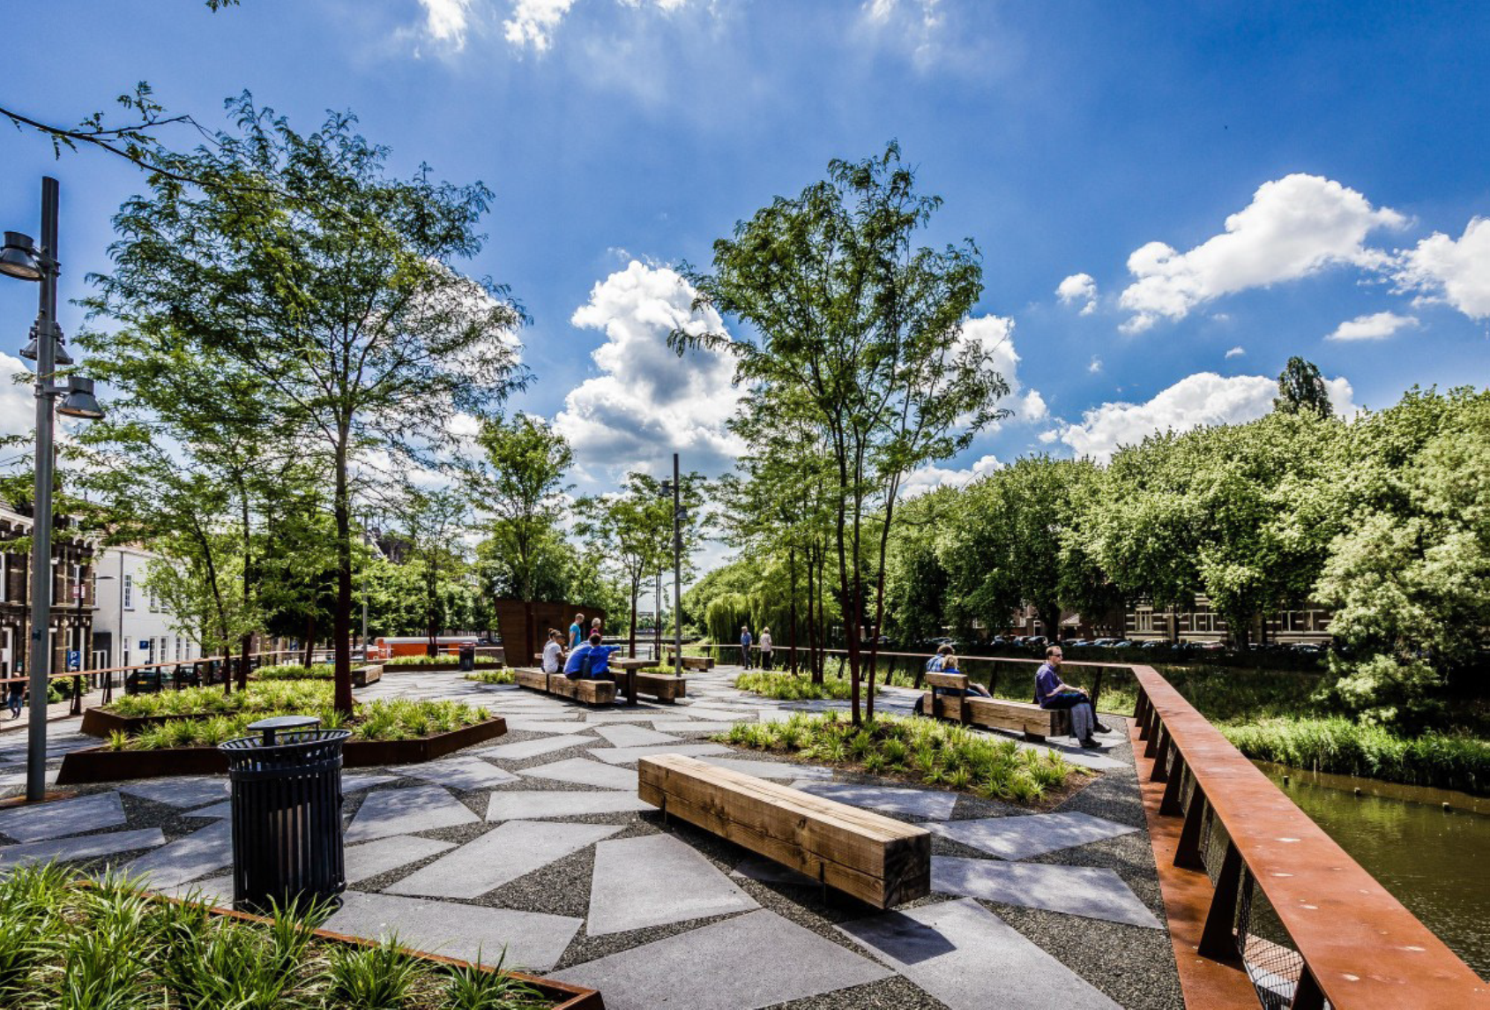
Take-away
Change the point of view (‘reuse’)
  Not only focusing on restauration, ‘historical’ narrative
Heritage is a major driver for city development
On the basis of the effects of :
  Identity and ownership (transaction)
  Proximity and well-being
  Multiplication effect
  since 2018

Slide 17

Thank you!
https://www.efforts-europe.eu
Facebook : Efforts
Instagram : efforts_europe
LinkedIn : EFFORTS – European Federation of Fortified Sites
Address : Trierstraat 67, 1000 Brussels
info@efforts-europe.eu

