Slide 1

EFFORTS AWARD 2025

Slide 2


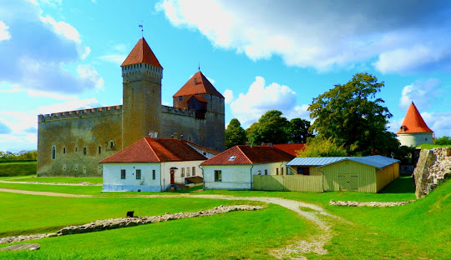
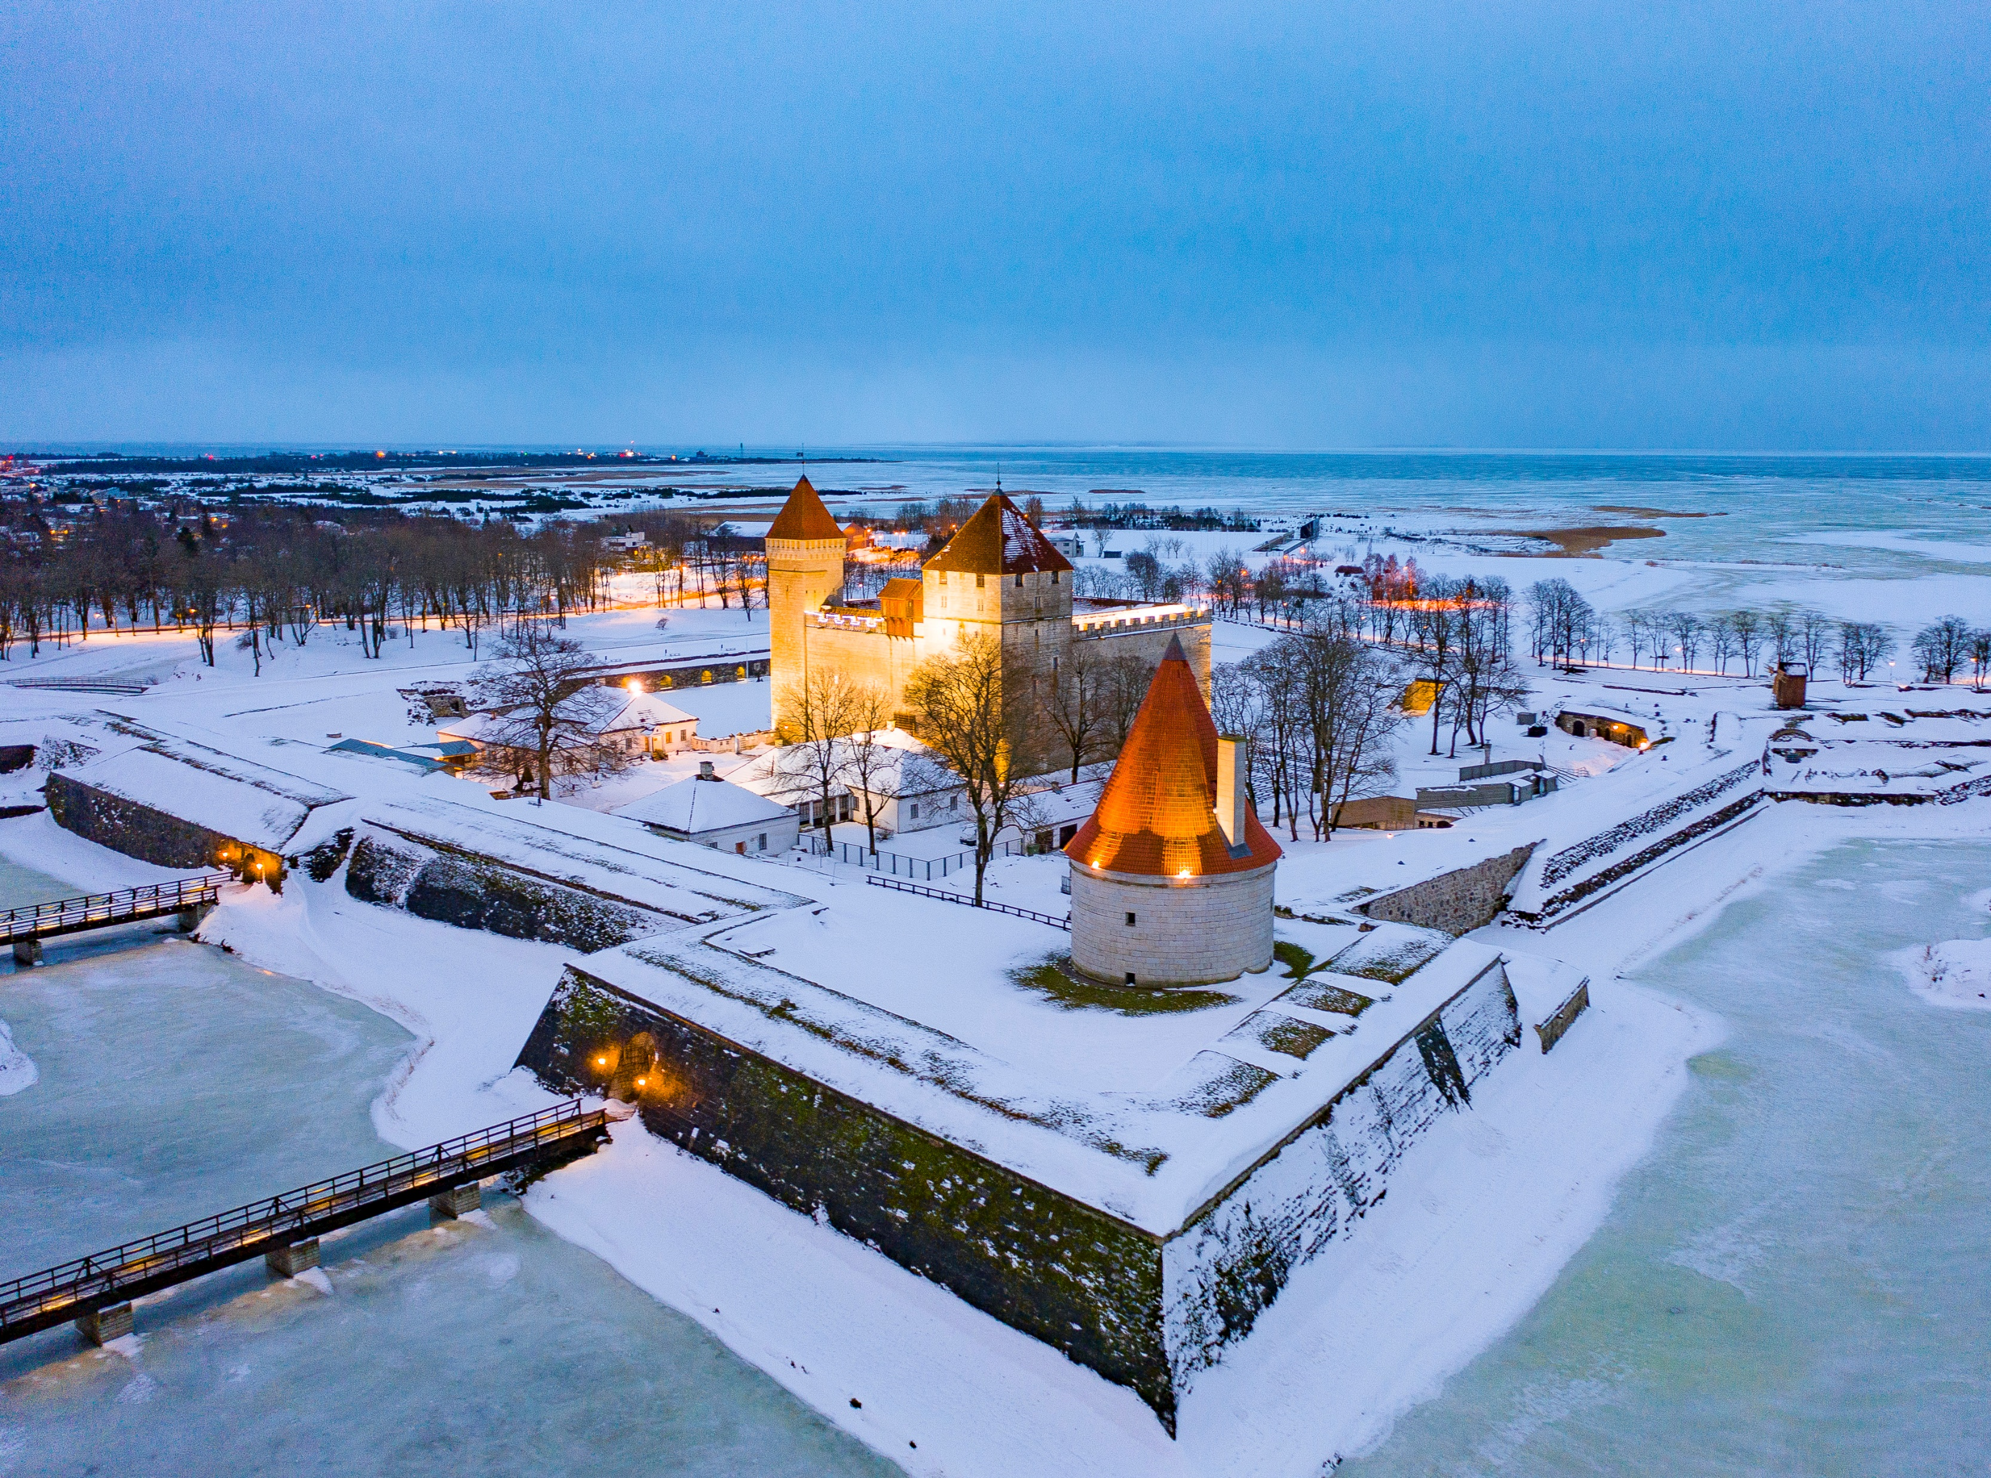
EFFORTS AWARD 2025
Kuressaare, Saaremaa (Estonia)
Baltic Culture Fund 2025 : LT, LA, EST + FIN, UA, PO (EFFORTS)
Baltic Route EFFORTS

Slide 3
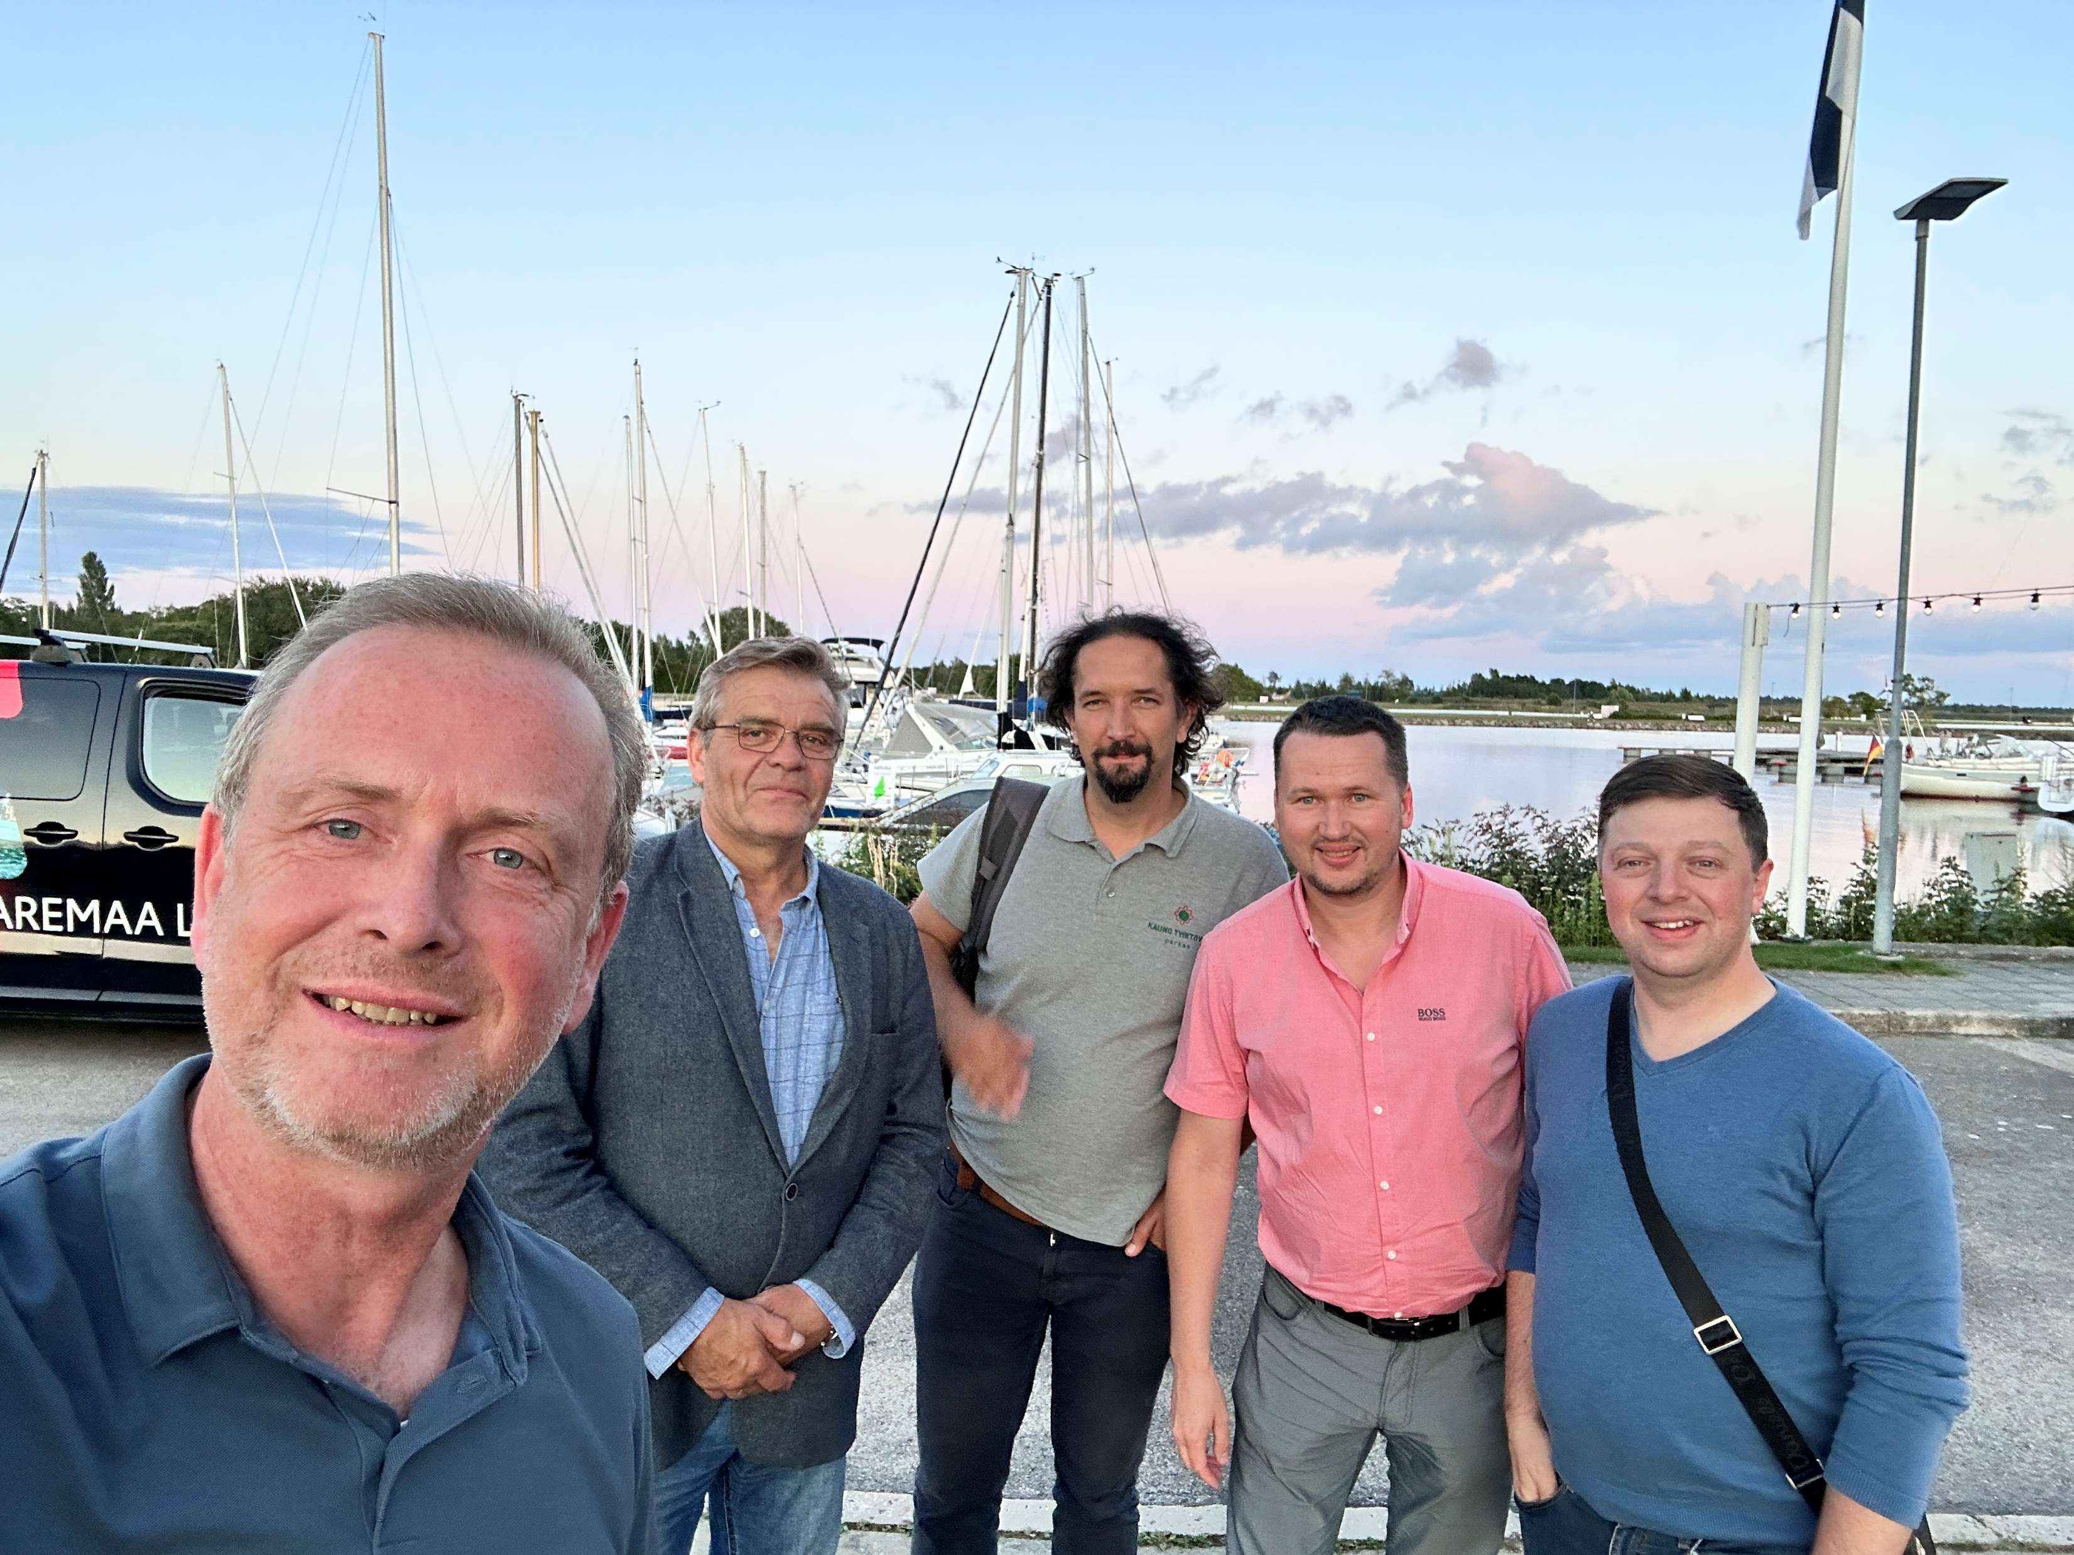
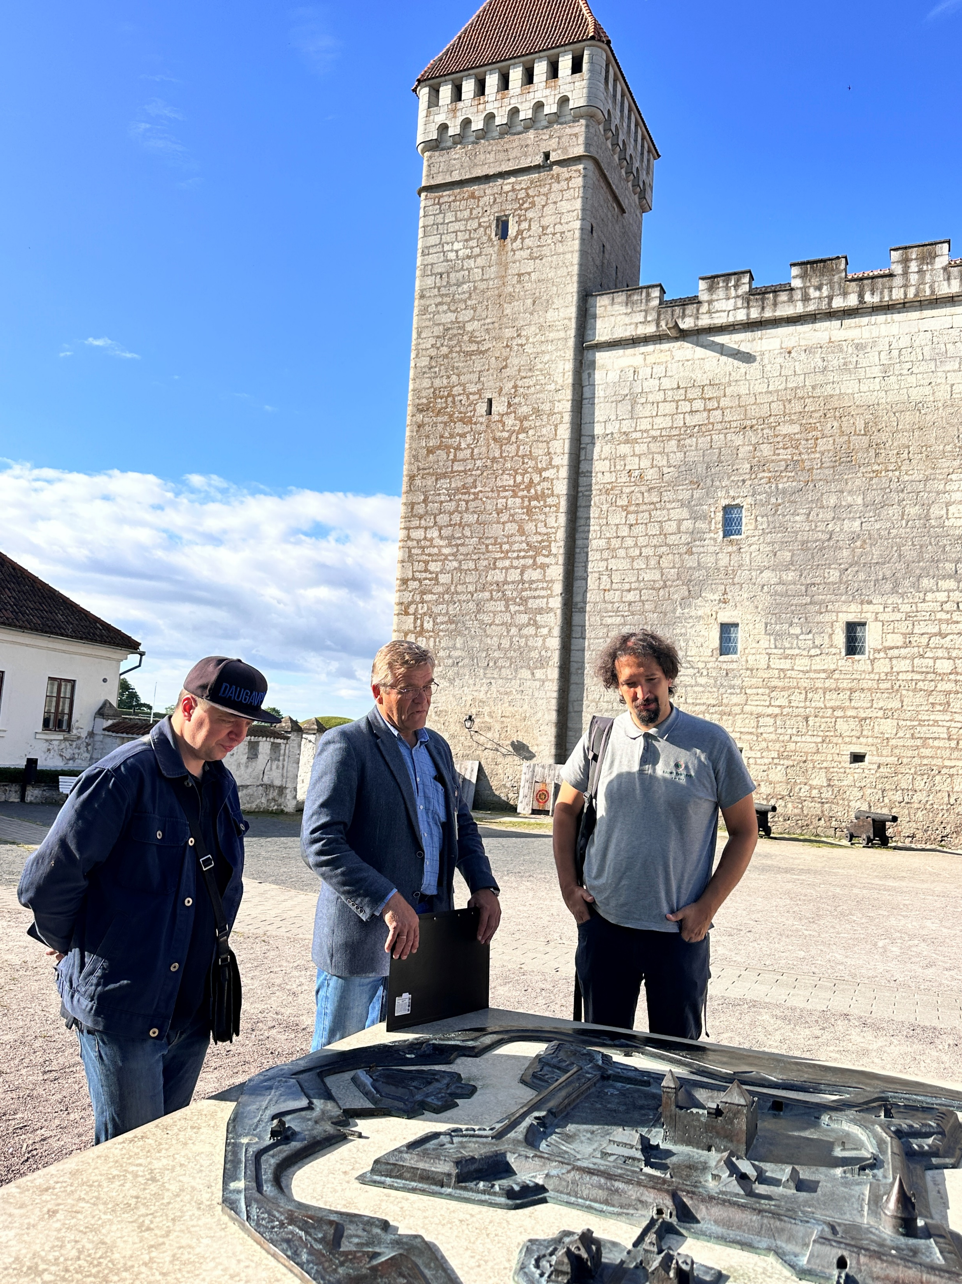
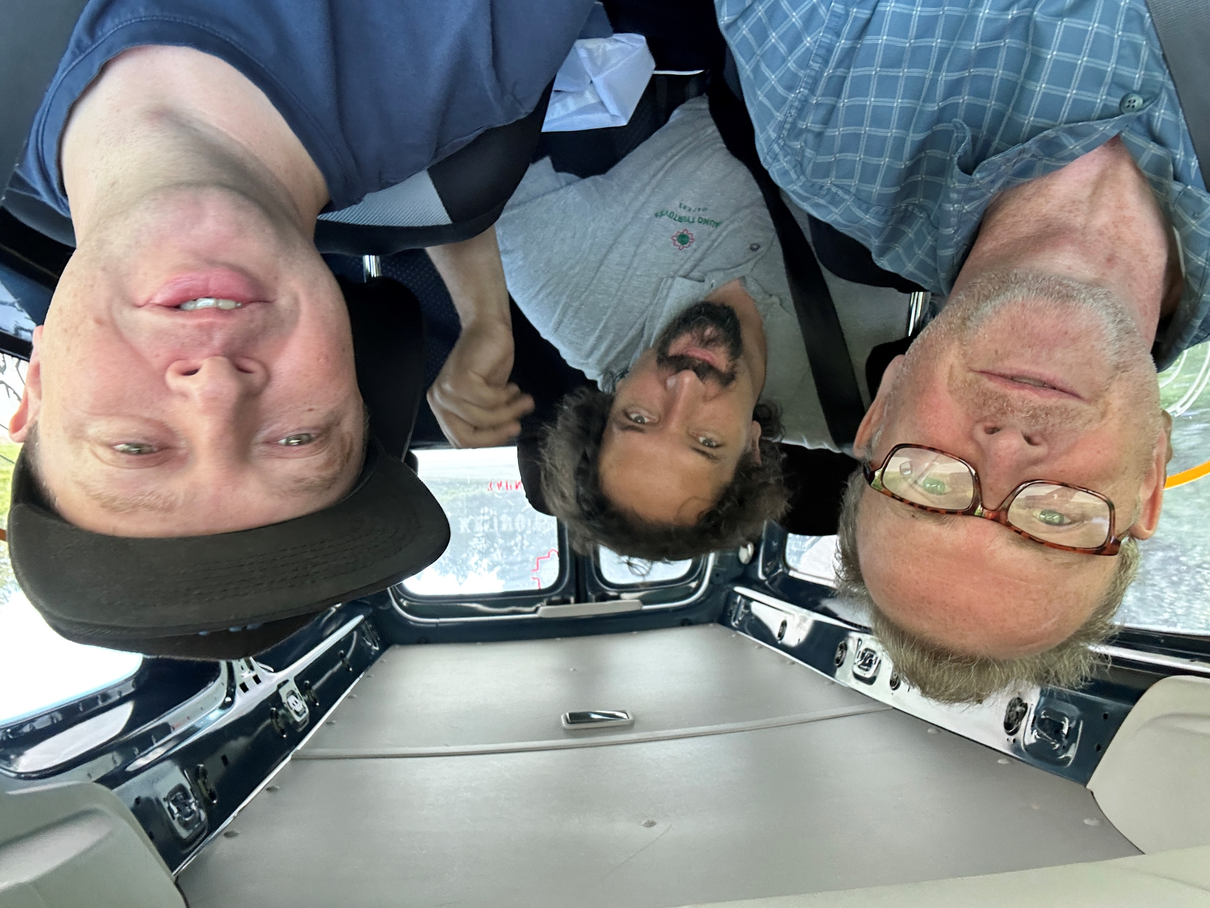
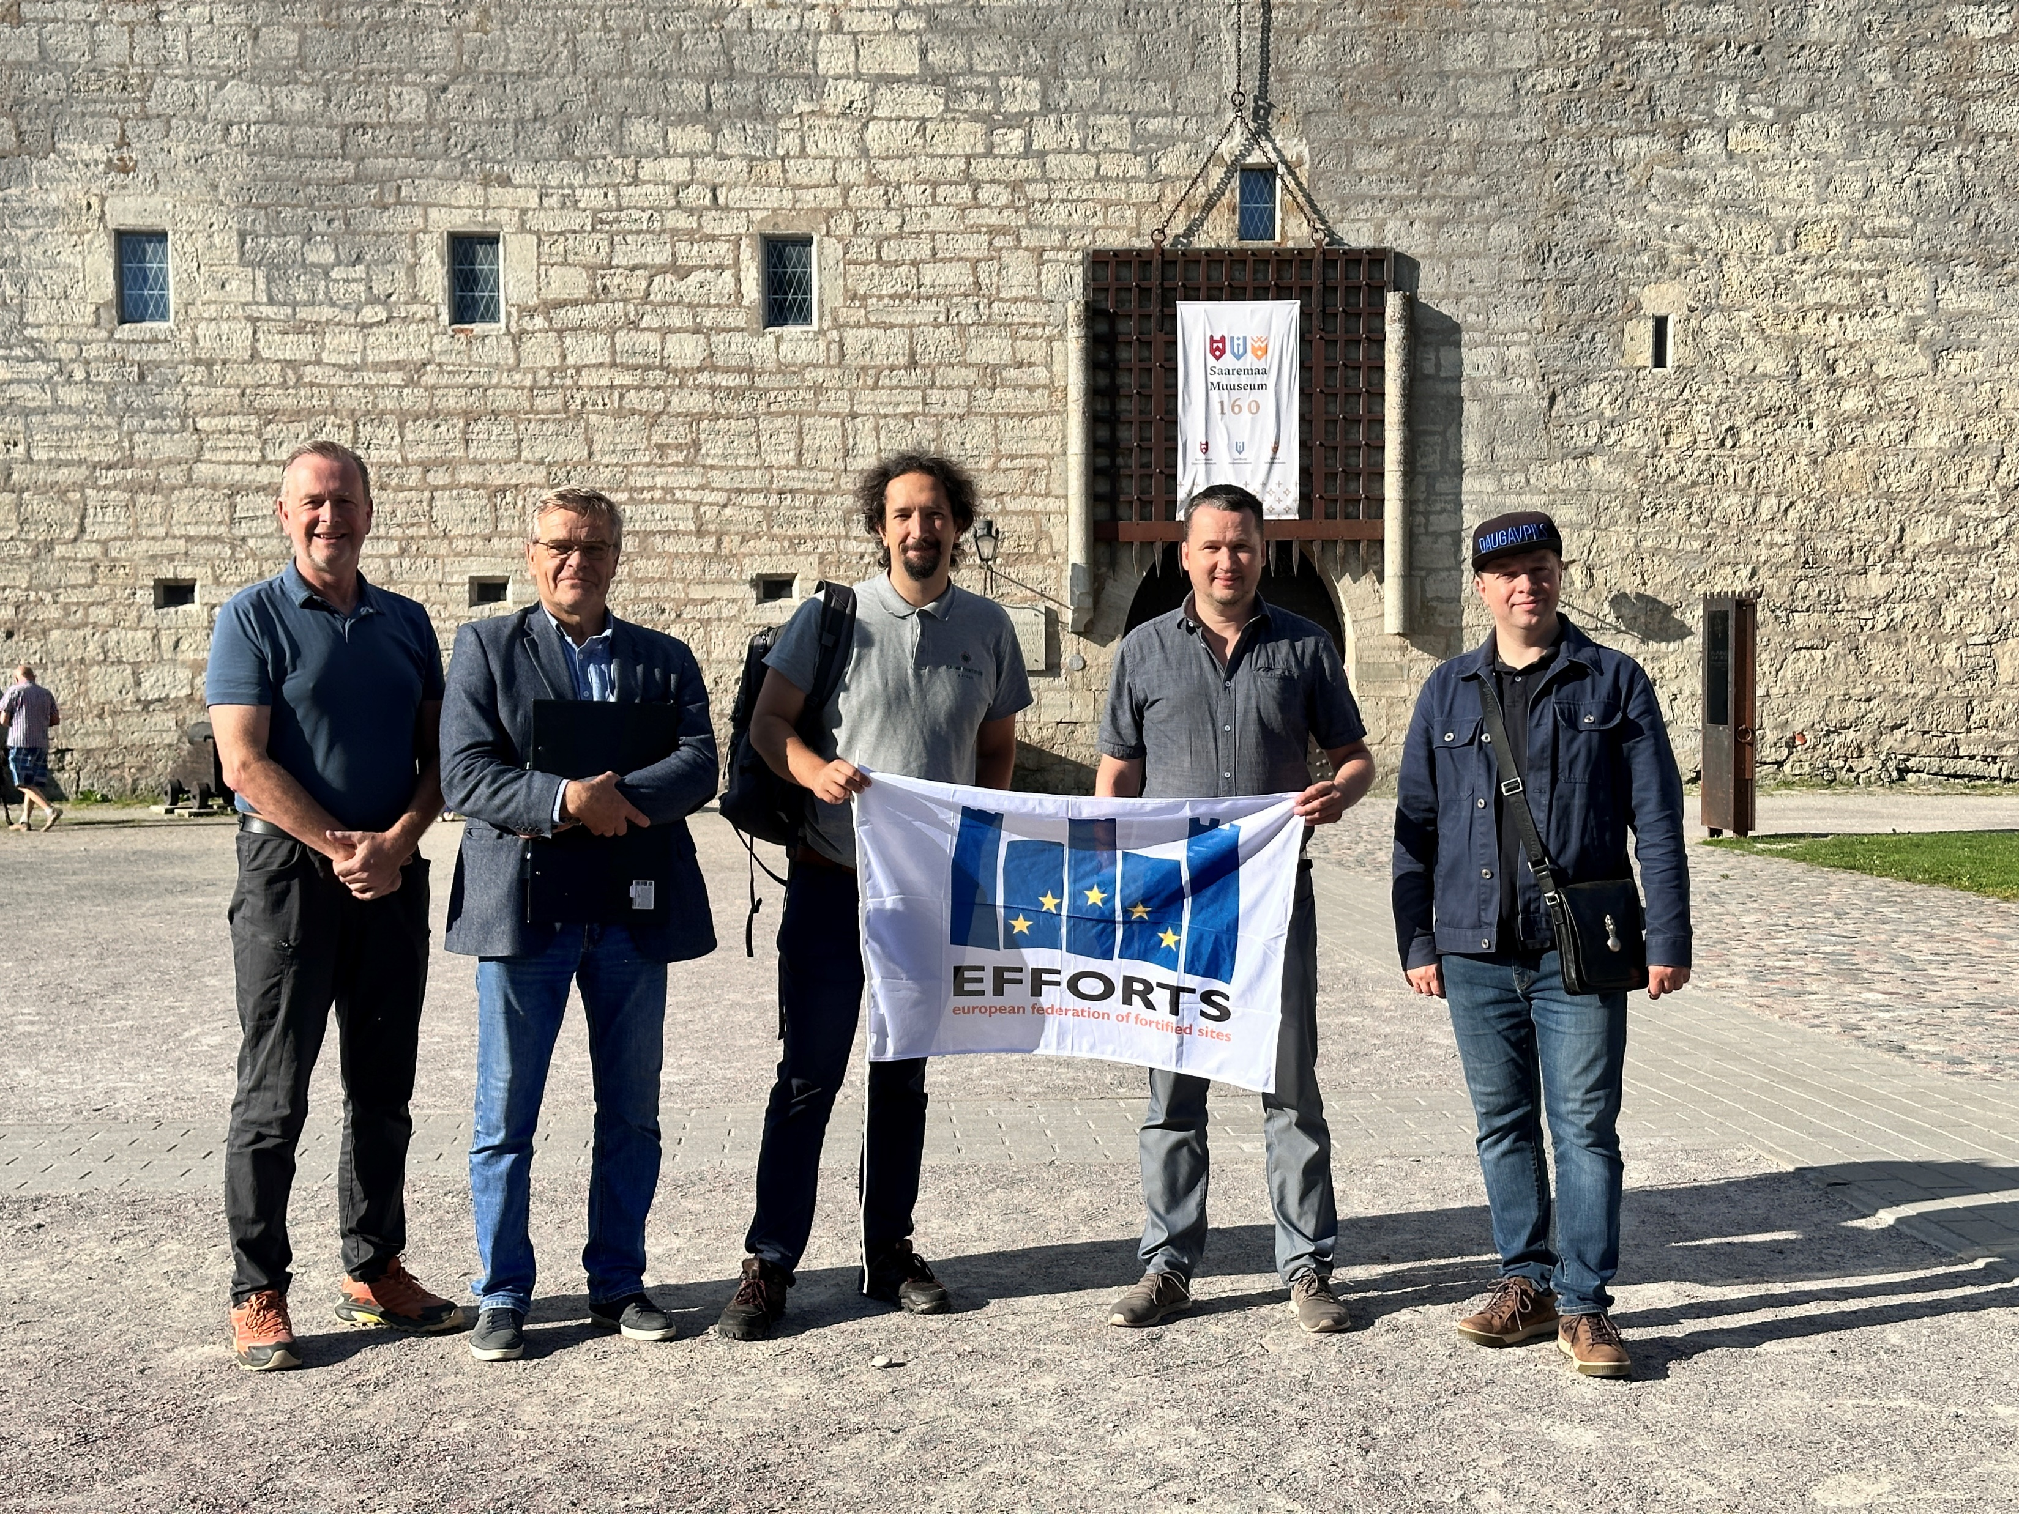
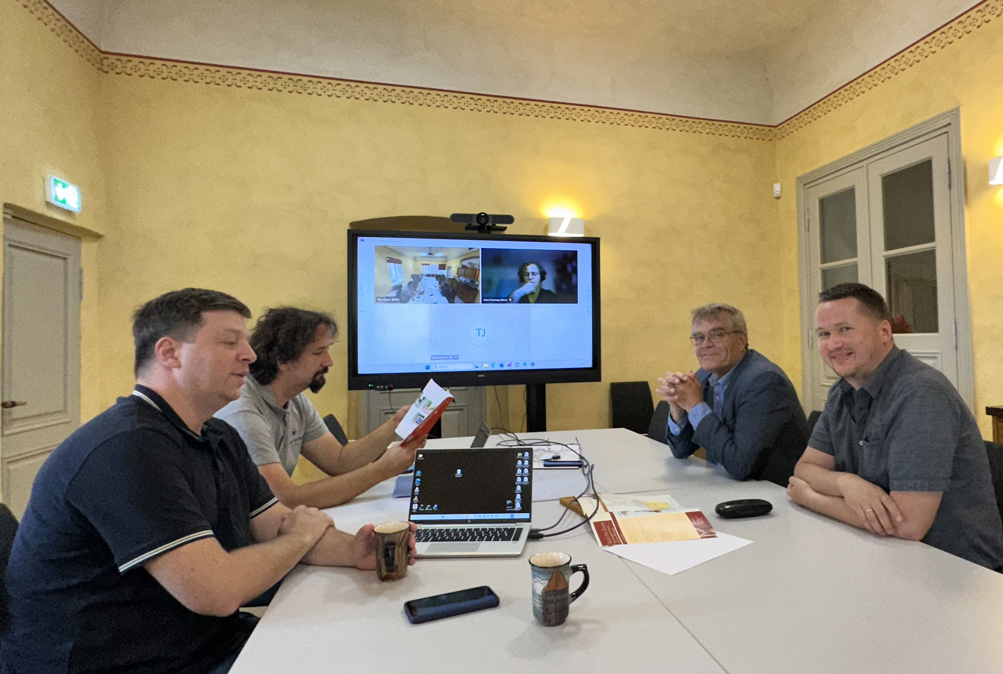
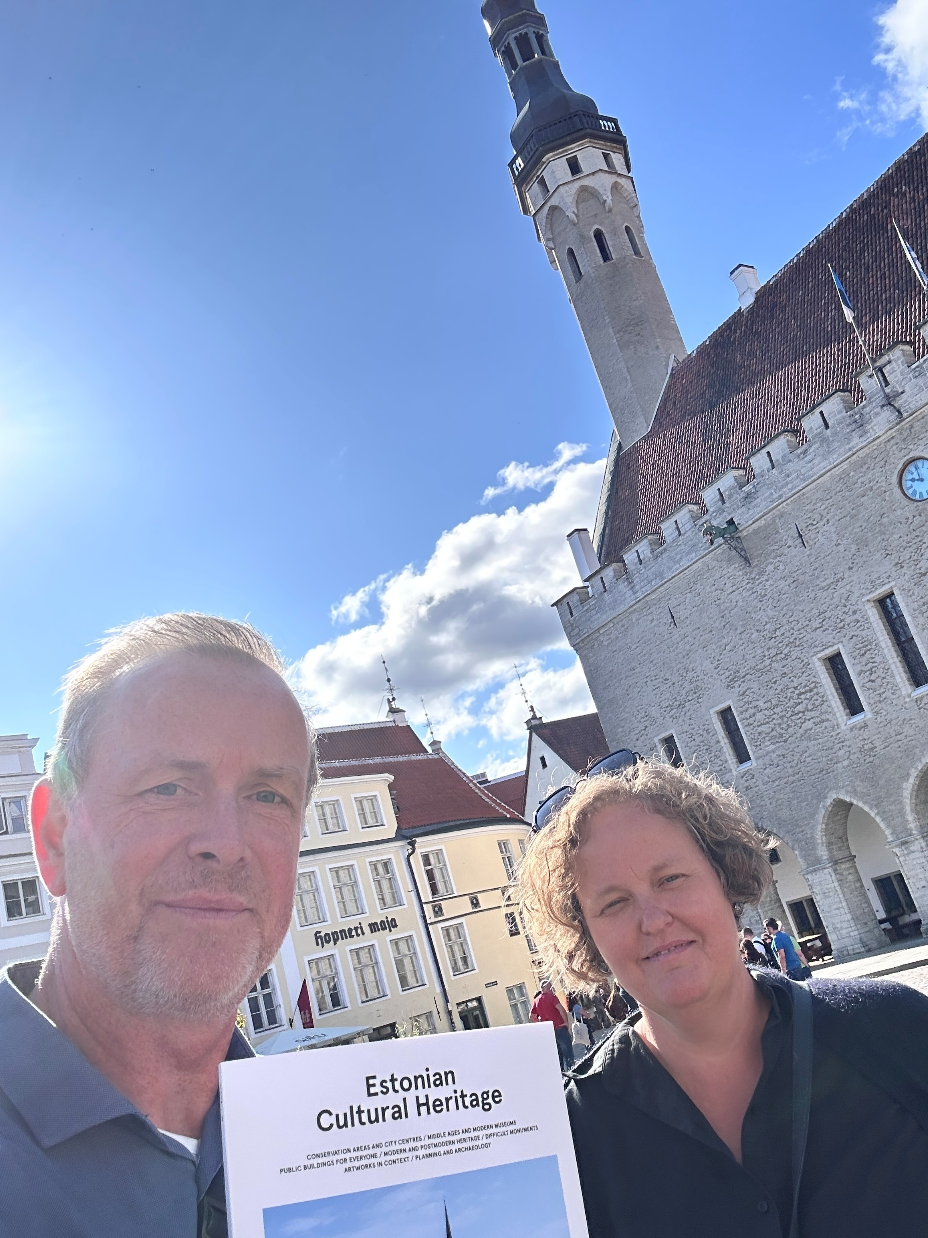
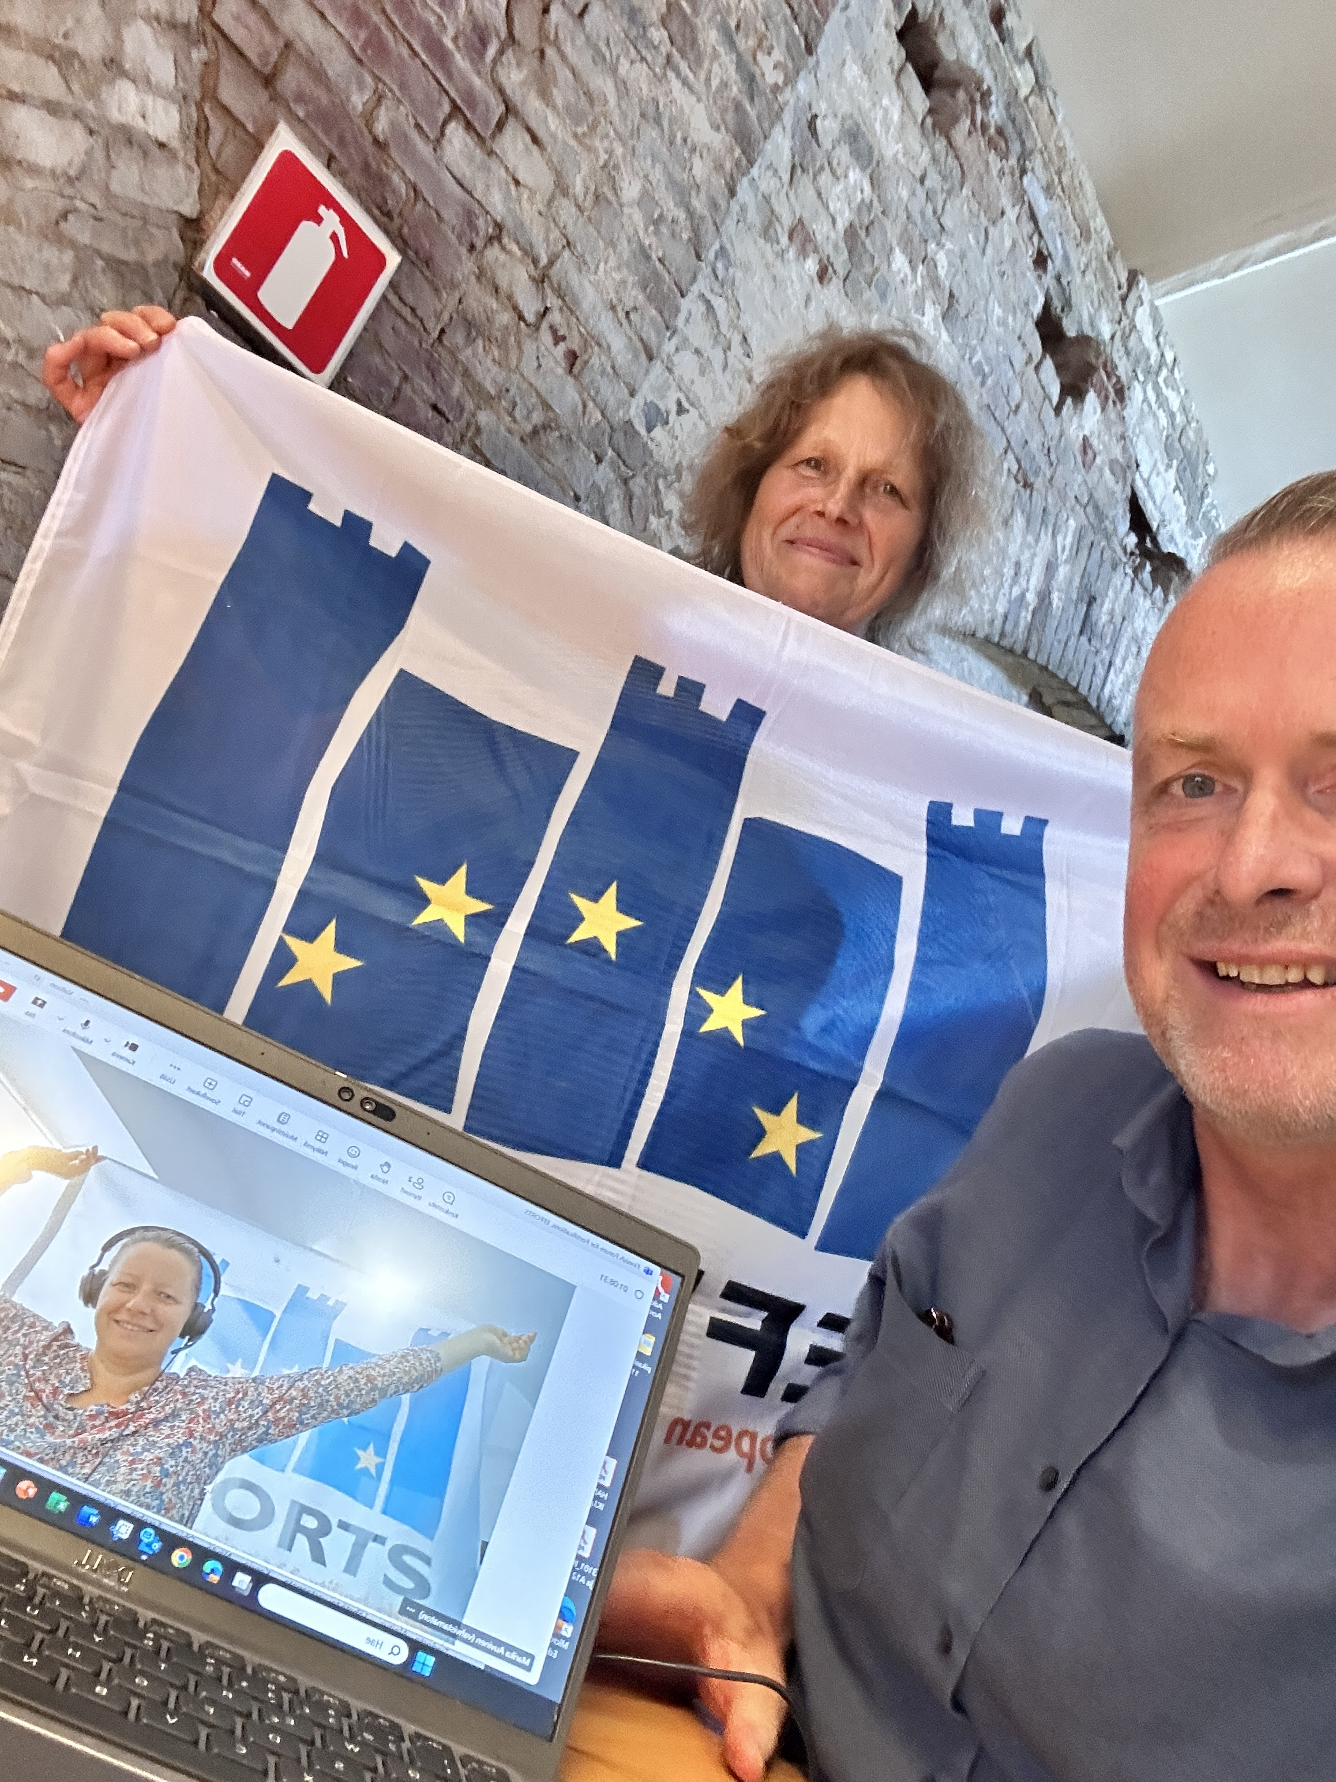
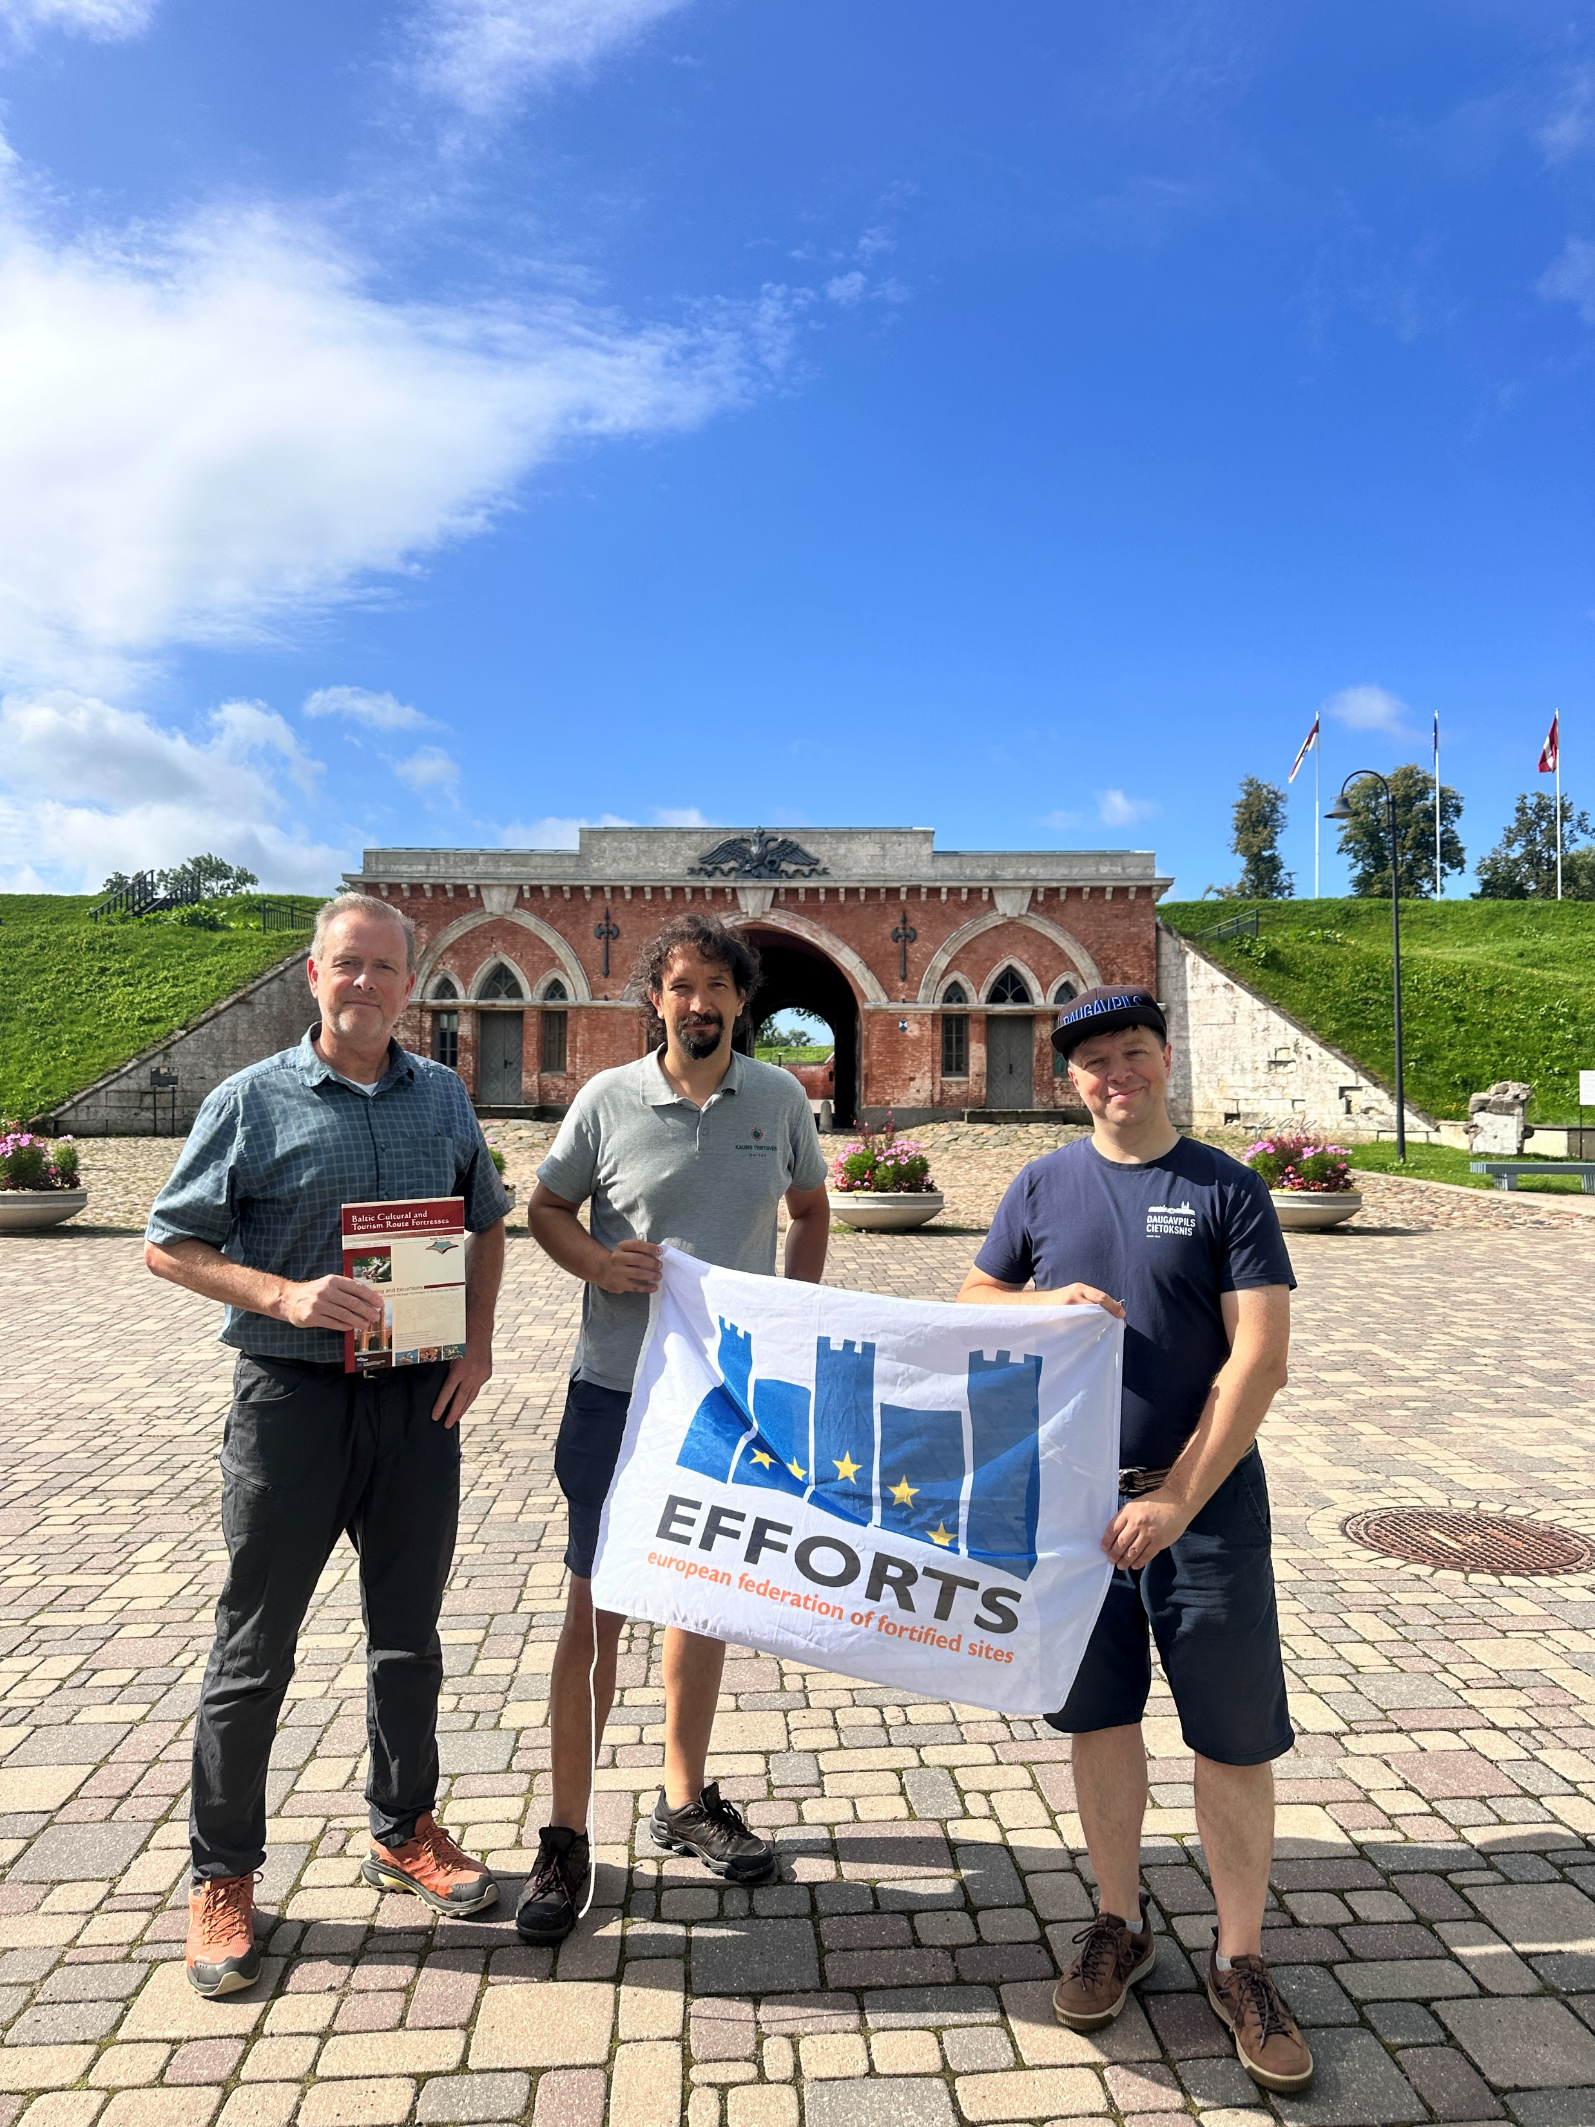
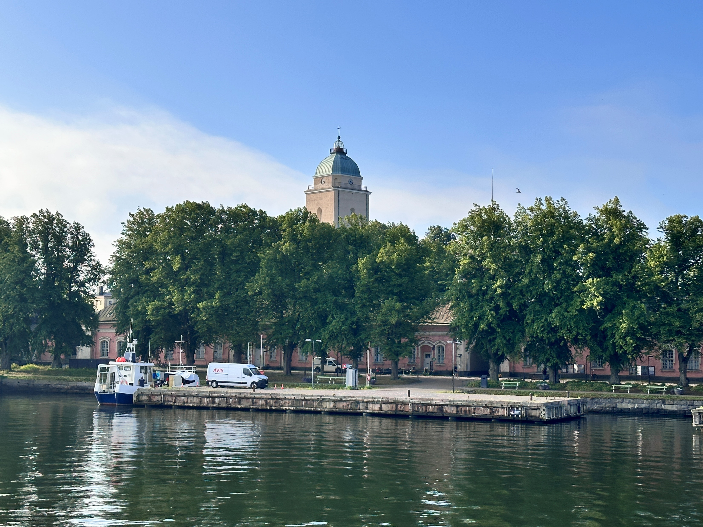
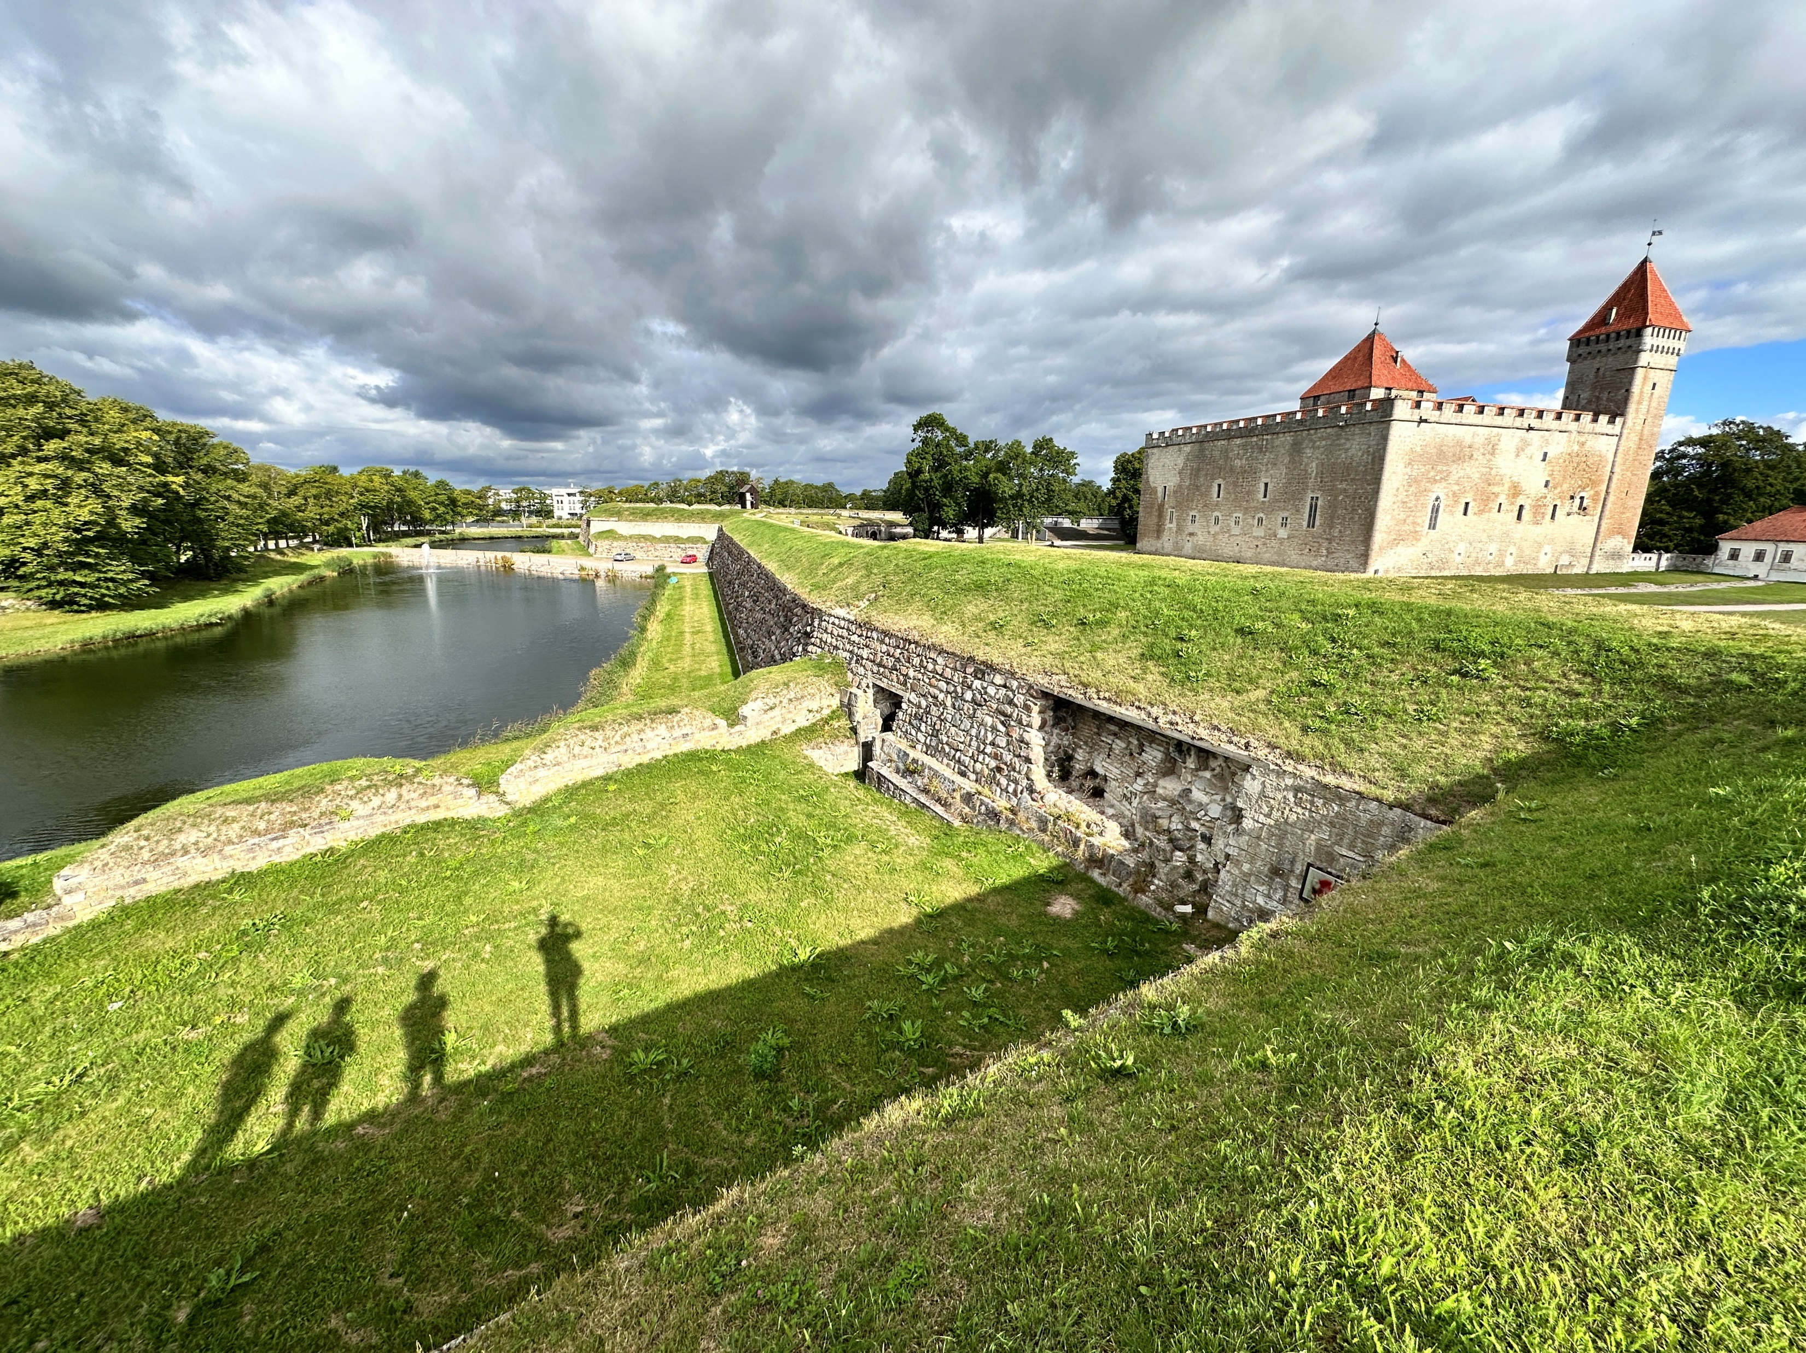
EFFORTS Award 2025 Kuressaare Baltic Route

Slide 4
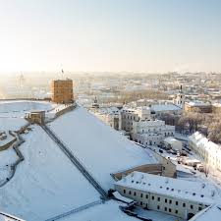
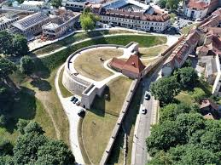
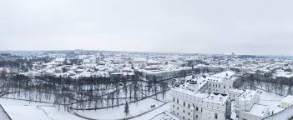
1st Baltic Route conference: VILNIUS 23/1/2026
Lithuania, Latvia, Estonia, Finland, Poland
All EFFORTS members interested

Slide 5
EFFORTS ANNUAL CONGRESS 2026

Slide 6

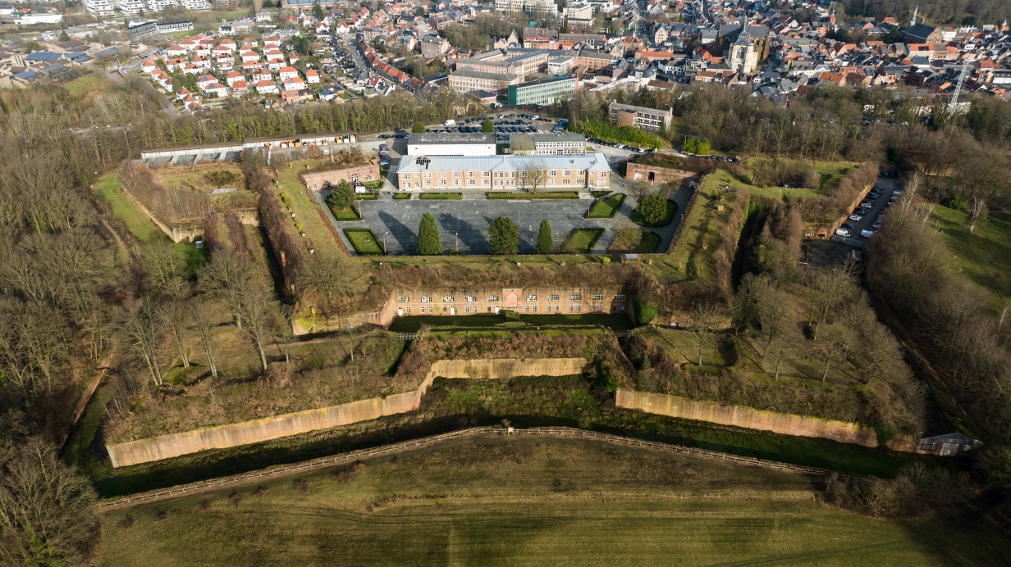
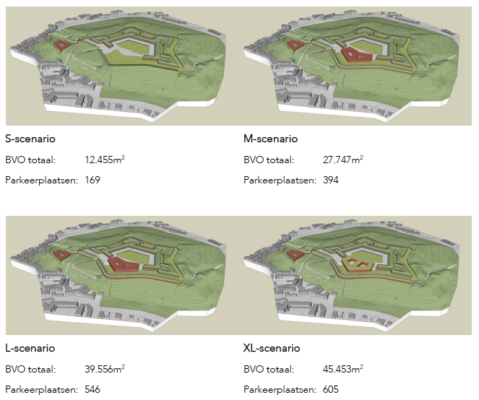
EFFORTS ANNUAL CONGRESS : 2nd half May/ first half June 2026
DIEST, Belgium

Slide 7
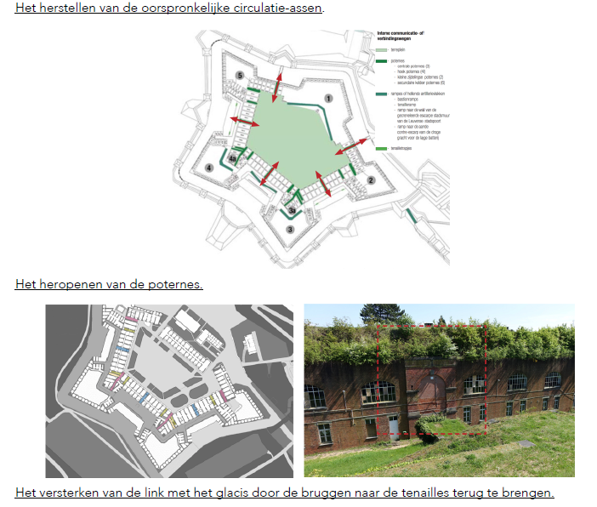
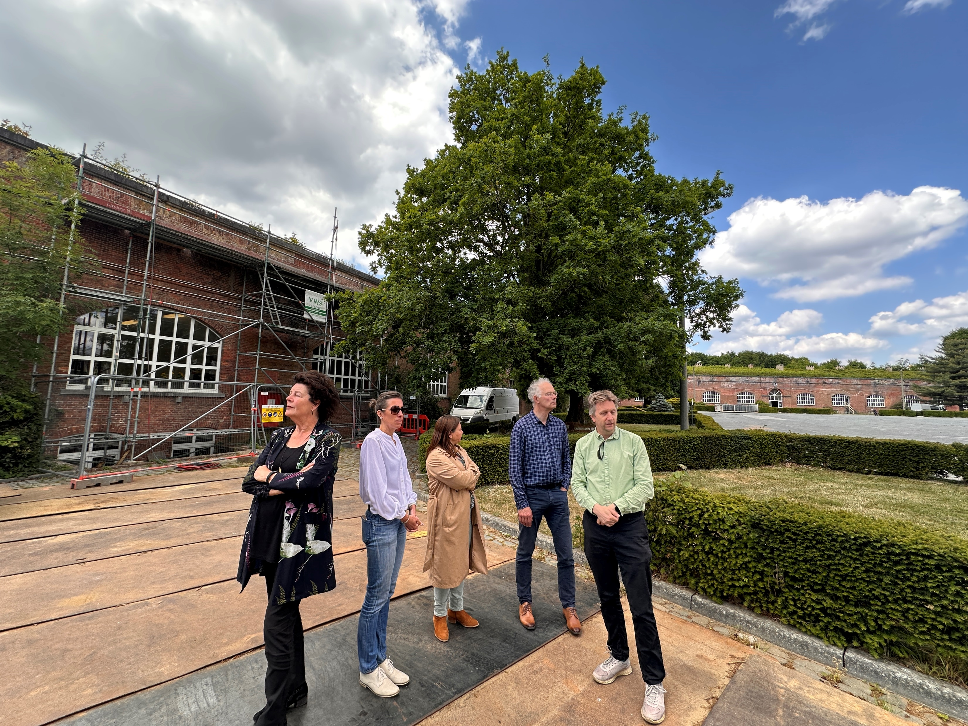
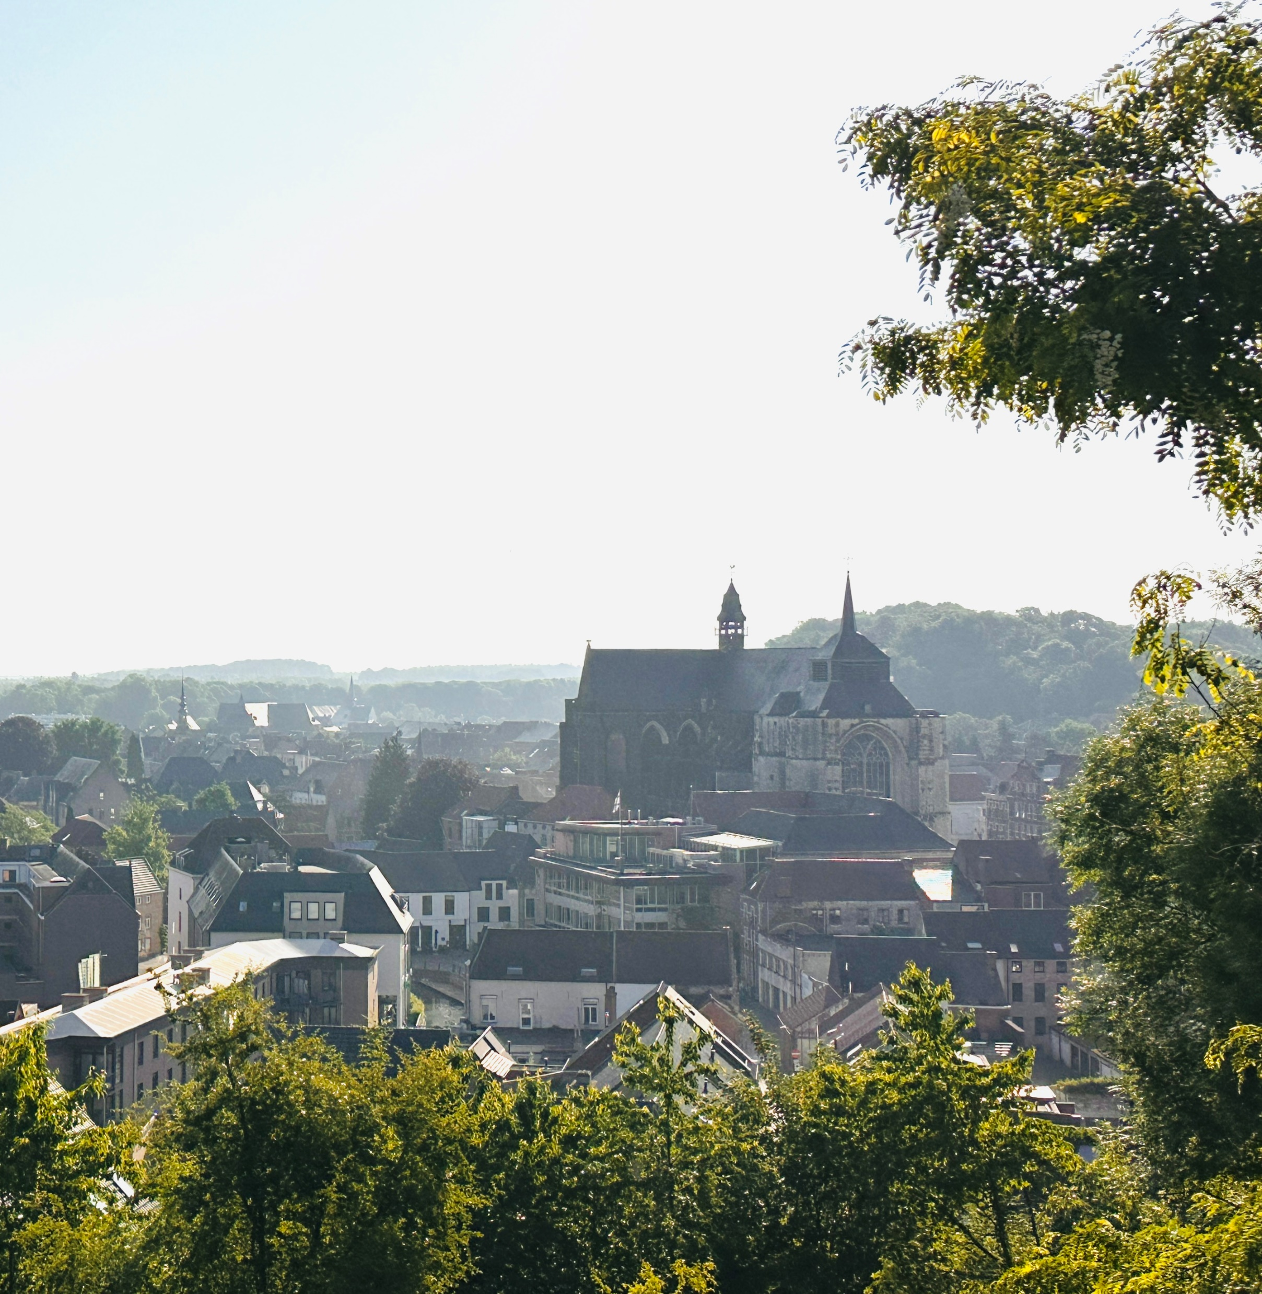
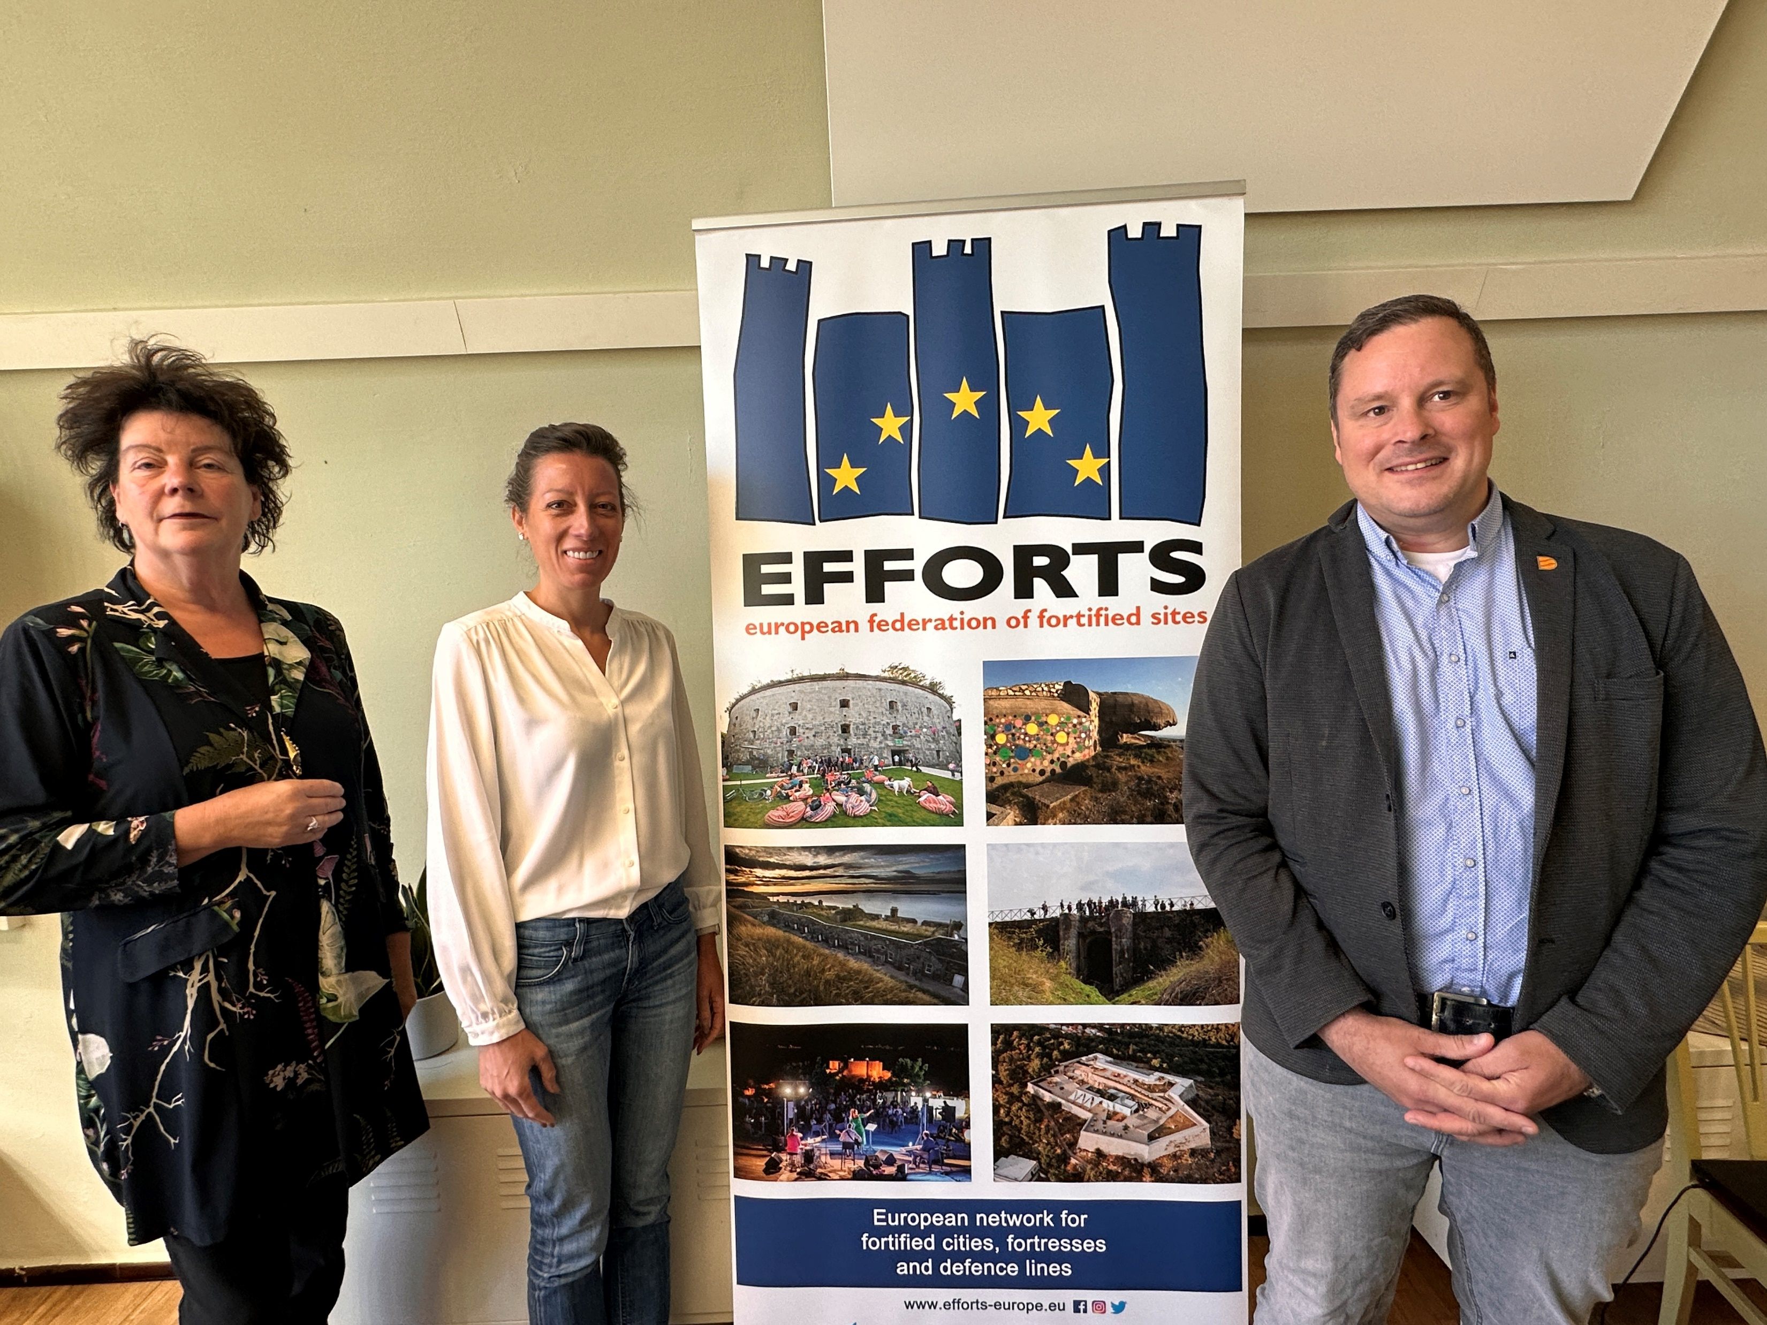
Diest EFFORTS Annual Congress 2026

Slide 8
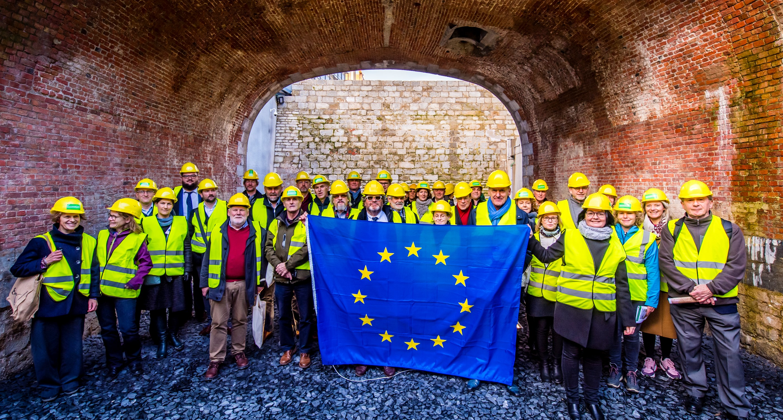

See you in 2026!
https://www.efforts-europe.eu
Facebook : Efforts
Instagram : efforts_europe
LinkedIn : EFFORTS – European Federation of Fortified Sites
Address : Trierstraat 67, 1000 Brussels
info@efforts-europe.eu

