Slide 1
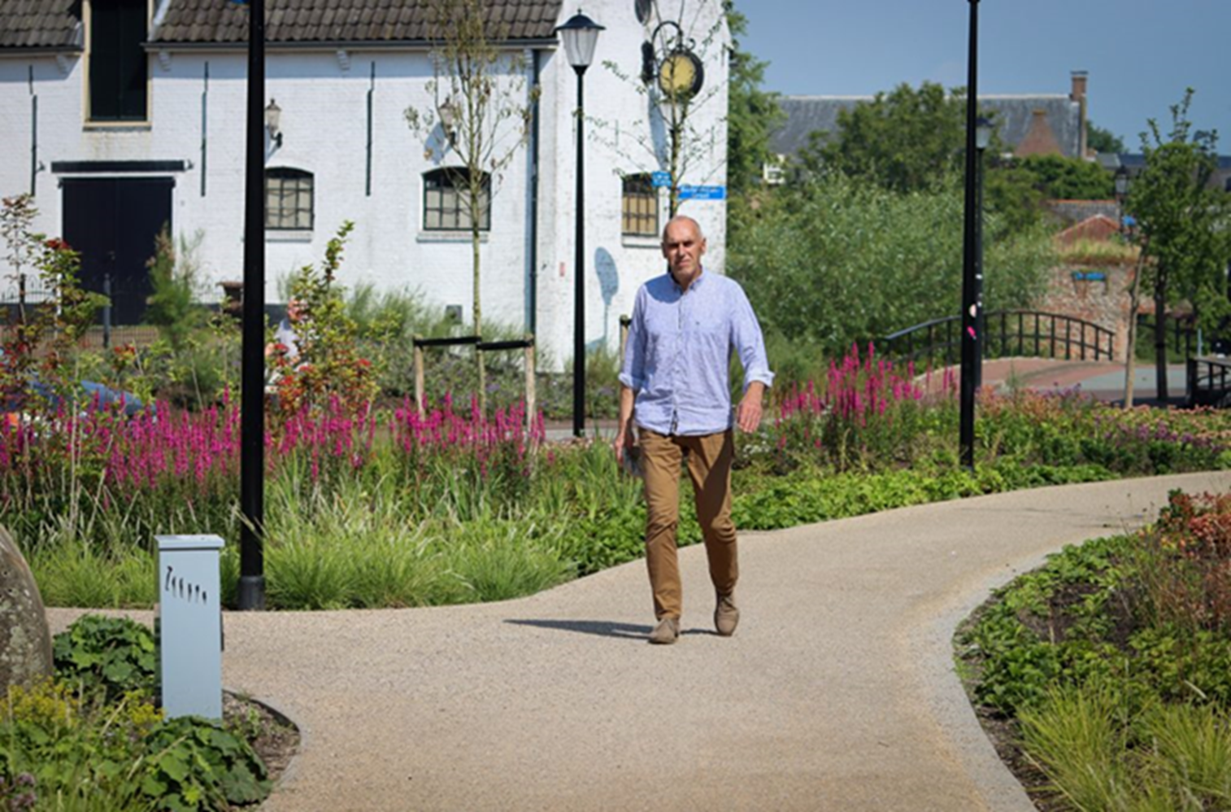
Redesigning the entrances to the fortified town

Slide 2
Green Oasis while preserving historic features fortified town of Culemborg
ugly petrified area
improve the spatial future of Culemborg's fortified downtown
ensure that the identity of the city
spatial quality will be improved the economic strength
cooperation between the municipality, entrepreneurs, property owners and residents

Slide 3
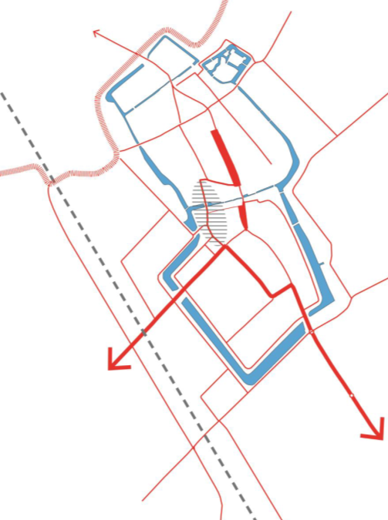

Slide 4
The result
a greener entrance
more resistant to heavy rainfall and extreme heat
city wall that is more visible

Slide 5
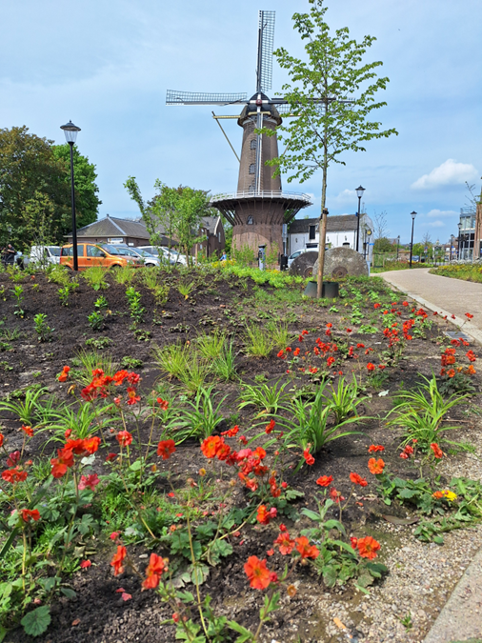

Slide 6
Why redevelop these two squares?
a location of rich historical value
problems such as heat stress, flooding, and a lack of biodiversity
the answer to the urgent need for quality of life in the inner city
a response to the Efforts European Green Deal
increasing the attractiveness of the fortified city through climate-adaptive measures.

