Slide 1
The EIB and cultural heritage
EFFORT Congress (Maastricht 3 October 2023) Bruno Rossignol, Head of Climate and Heritage programme, EIBI)

Slide 3
EIB’s tools for financing cultural infrastructure
Instrument and examples of financing
Investment Loans
Direct loan for a specific investment project or programme, usually > EUR 100
Loan to finance a single cultural building
Loan to a city to finance an investment programme including cultural infrastructure
Loan to a city to finance an urban regeneration programme including a cultural facility
Municipal Framework Loans
Loan for a programme of investments meeting defined criteria but not finally prepared at time of signing
Framework loan to a city dedicated to cultural infrastructure
Framework loan to a city to finance a programme of small or medium investments, including cultural infrastructure upgrades.
Regional or National Programme Loans
Investment in a fund
National framework for financing cultural investments
Framework loan to co-finance sustainable urban investments under a structural fund operational programme, including cultural infrastructure

Slide 4
Projects must
Meet at least one of the EIB’s public policy goals:
Climate Action; Environmental sustainability; Economic and Social Cohesion; Innovation; Infrastructure development; SMEs and mid-cap finance
Be technically sound
Be financially viable
Show an acceptable economic return
Comply with environmental protection and procurement regulations
Comply with urban and regional planning and development strategies

Slide 5
The EIB Institute and cultural heritage
EIB Institute: the philanthropic arm of the EIB
Partnership since 2013 with Europa Nostra, the leading heritage NGO for the annual 7 Most Endangered Programme
EIB experts carry out on-site missions and produce technical reports on feasibility and funding options
European Cultural Heritage Green paper
Partner of the New European Bauhaus, European Heritage Alliance and the Climate and Heritage Network

Slide 6
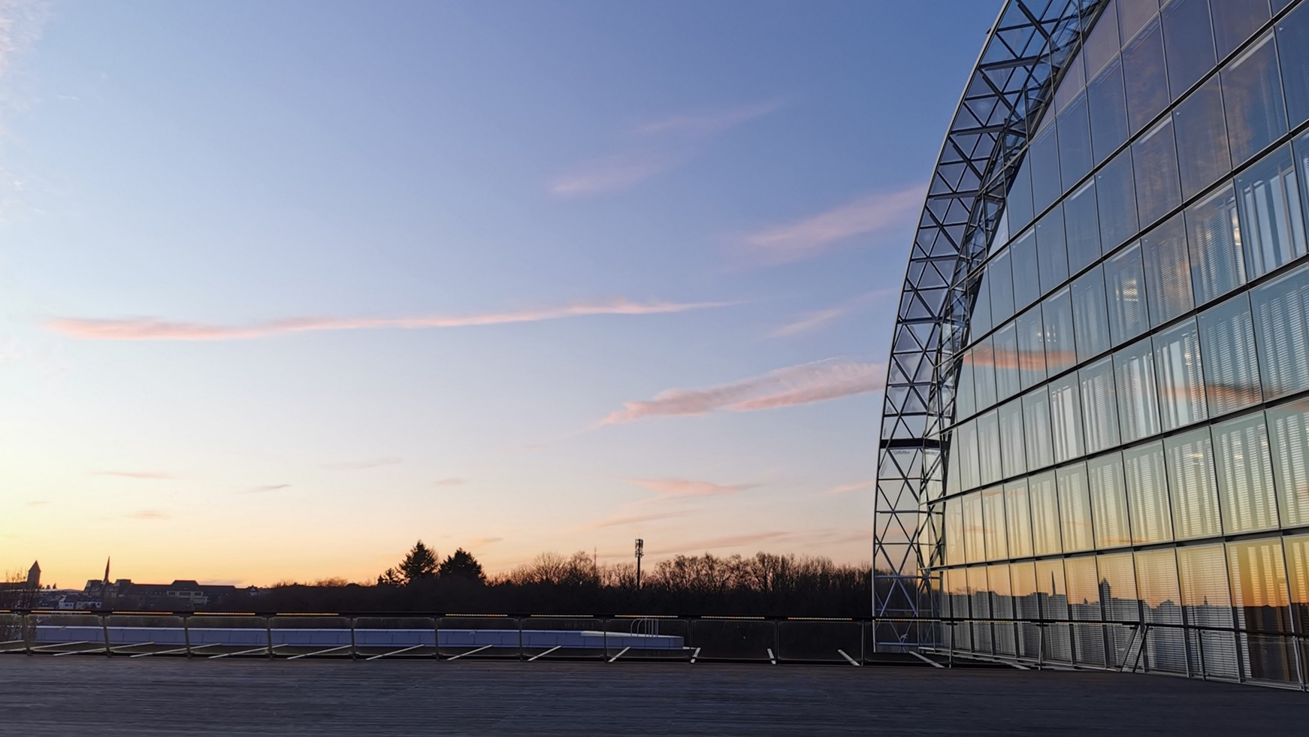
THANK YOU

