Slide 1
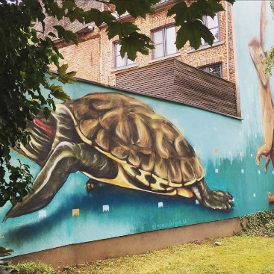
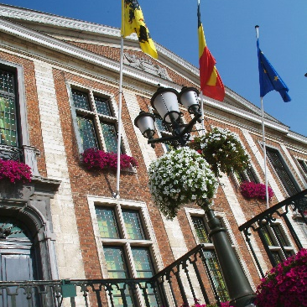
Renewable Heath Sources for the Citadel of Diest
Redevelopment of a large heritage site in a small city

Slide 2
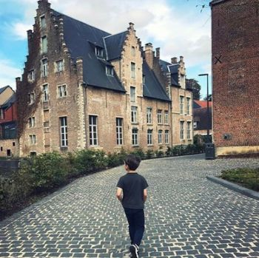
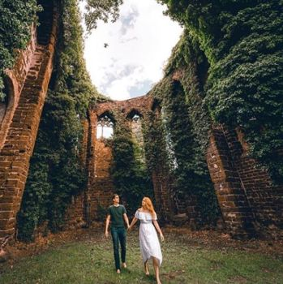
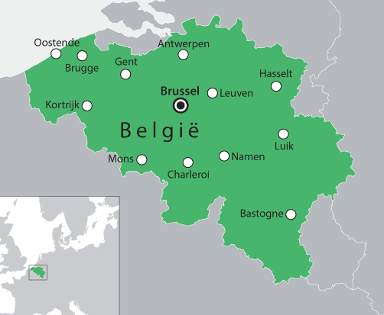
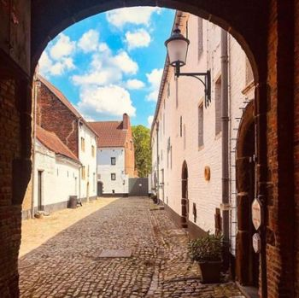
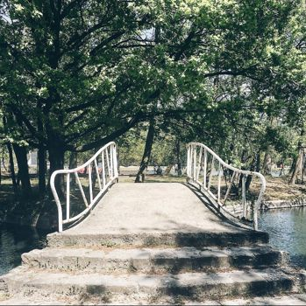
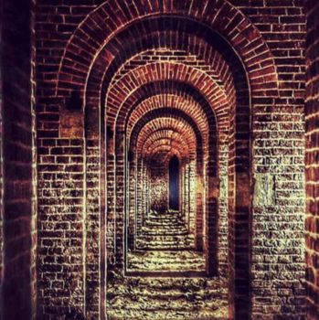
City of Diest
Diest
Fortified city
25K inhabitants
Unique heritage sites

Slide 3
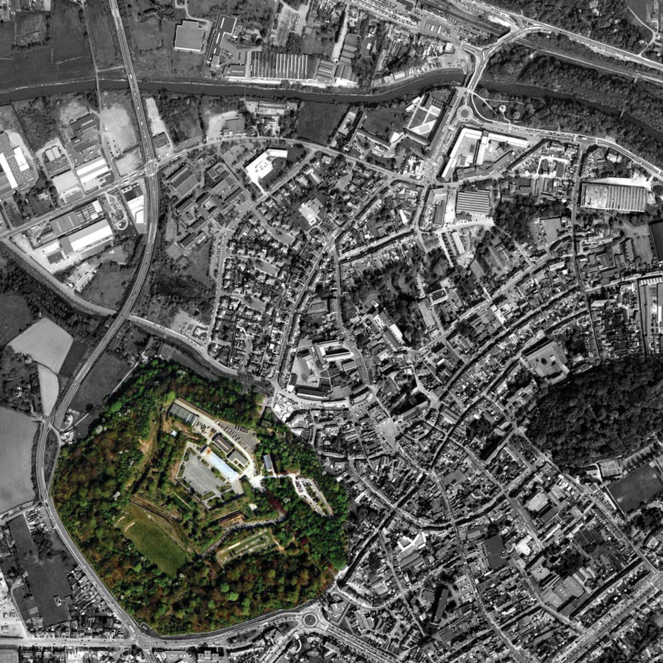
Location of the Citadel
Takes up 15% of the city centre
Constitues a large green lung
→ Redevelopment into a new urban area

Slide 4
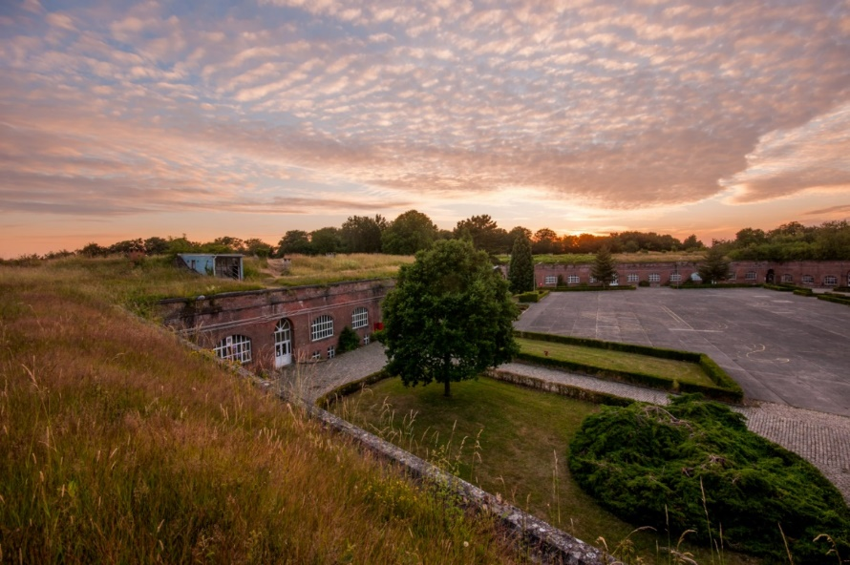
Historic value
Fortification
Built 1837-1856 as protection against foreign threats
Contains some unique threats of military architecture
2011: acquired by the City Council

Slide 5
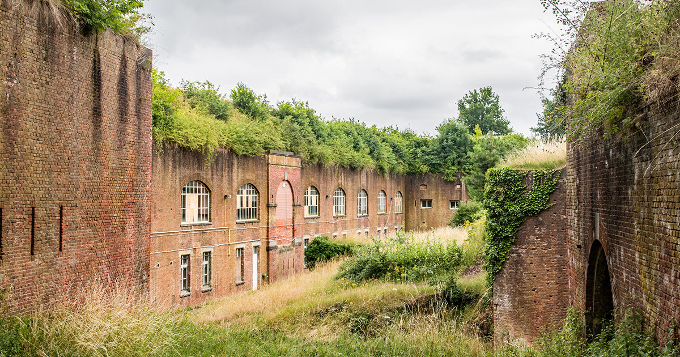
Renewable energy
Integral vision on durable redevelopment of the site
Inspired by the characteristics 19th-C principles
Vegetated roofing, stable temperature conditions…

Slide 6
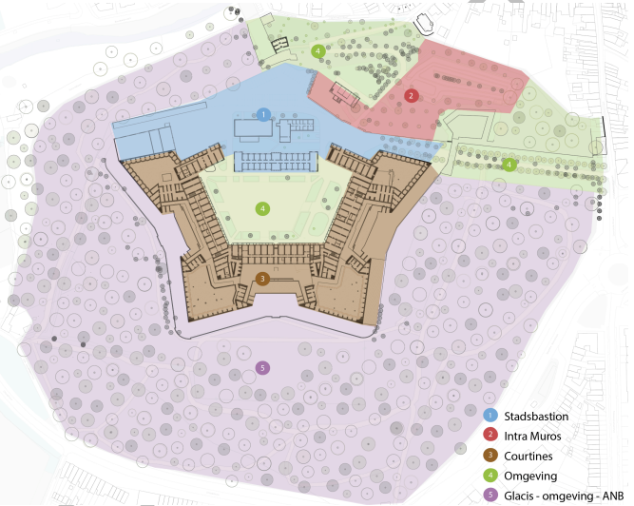
The goal
Supplying +30.000 m² with renewable energy
Challenges:
development heavily fased in time
With a currently largely unknown heat demand

Slide 7
Opportunities
river Demer
geothermal probes in water rich layers
ca. 0,28 MWh
large sewage pipe
ca. 0,4 MWh

Slide 8
Feasability study
In progress
Targets:
calculate the energy potential
Design a scenario of preference
Partners
Aquafin, Vlaamse Milieumaatschappij, Vlaamse Waterweg, provincie Vlaams-Brabant

Slide 9
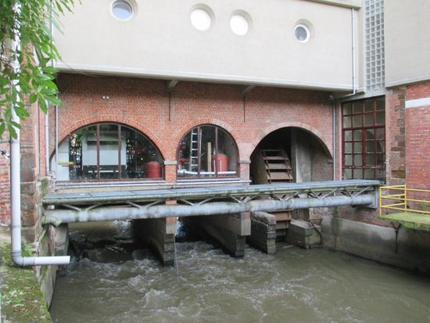
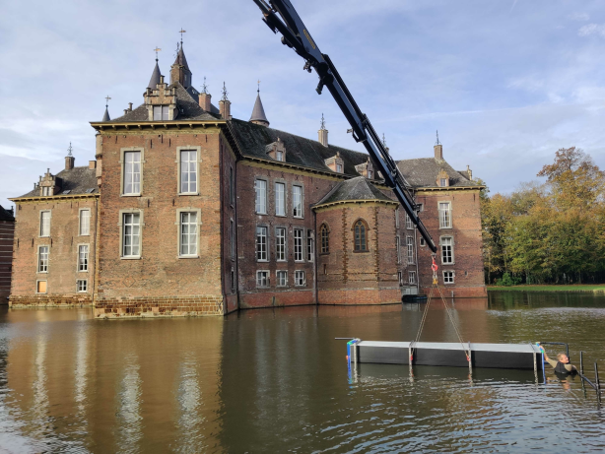
Unique opportunities for heritage sites
Dijlemolens, Louvain (Belgium)
Castle of de Merode, Westerlo (Belgium)

Slide 10
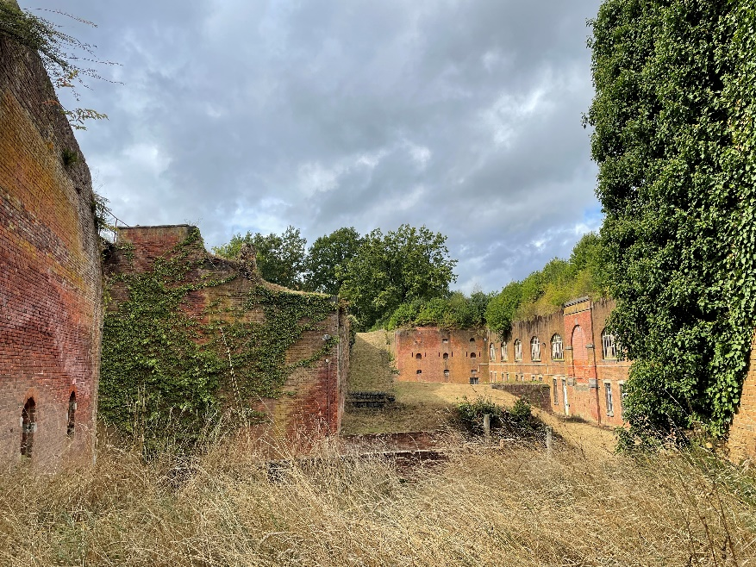
More information on the project
Results will be shared on www.diest.be/herbestemmingcitadel

