Slide 1
EFFORTS EFFORTS GOES GREEN

Slide 2
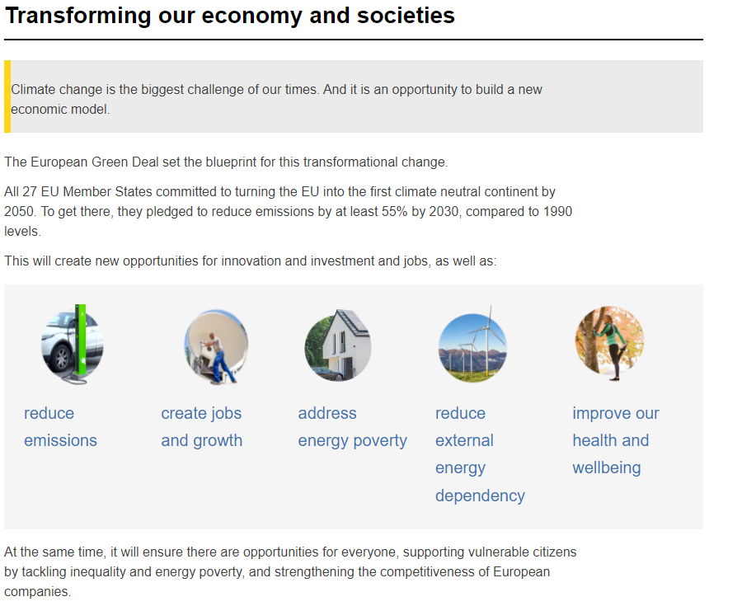
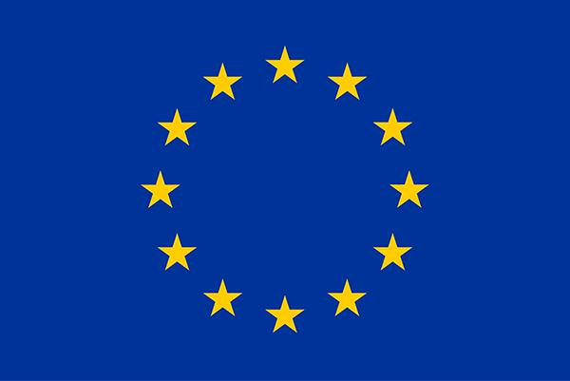

Slide 3
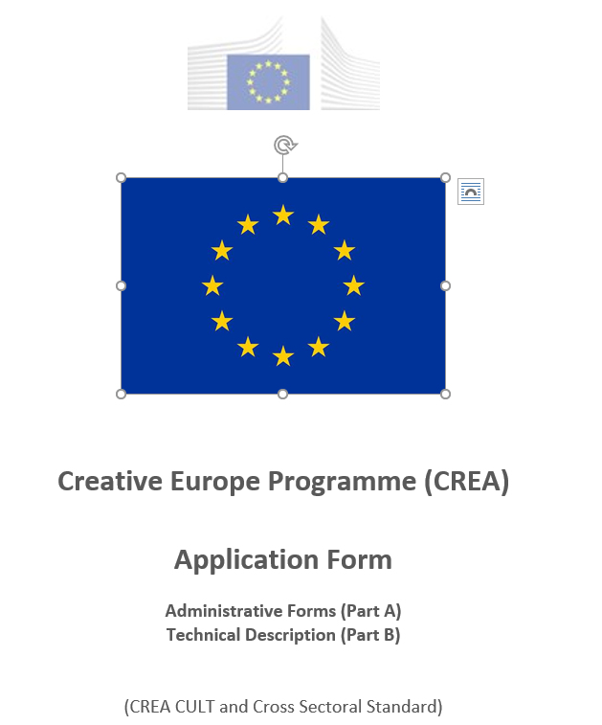
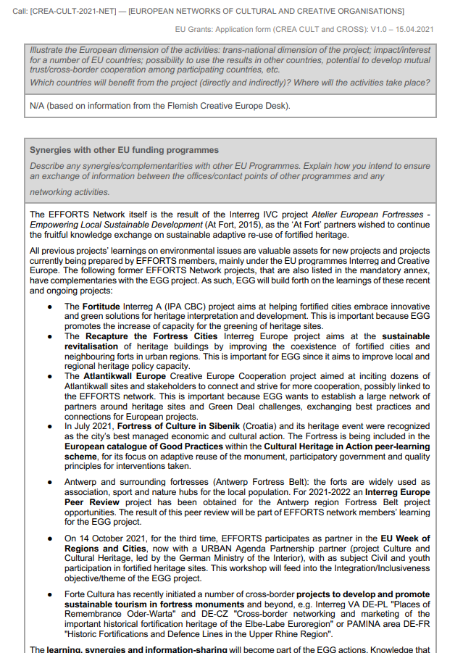
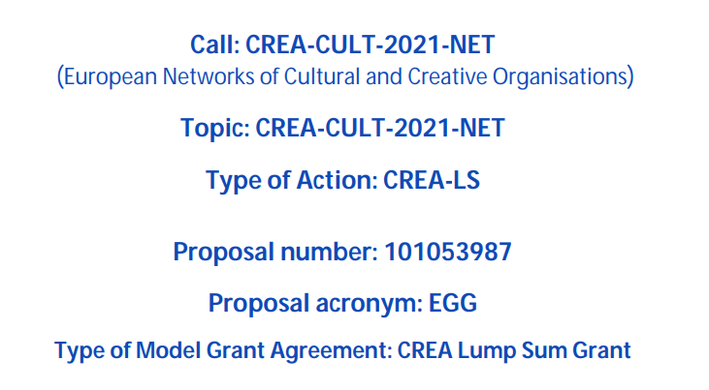

Slide 4
-'EFFORTS Goes Green' Creative Europe network project aims at improving and intensifying the cooperation between its members in all European countries, in particular between the local and regional cultural authorities, owners and users of fortified heritage, and all other cultural actors and professionals working with fortified European heritage. -The EGG project builds capacities, enhances cross-sector and cross-border cooperation and the exchange of experience on how to get the best out of this specific type of heritage and its social, cultural, economic, and environmental impact on the territory. Therefore ‘learning by sharing’ is the motto of the new collaborative digital platform FORTMEET, promoting active exchange and cooperation between the network members. In this platform project, fortified heritage’s shared environmental and societal solutions become the framework for -future European cooperation. -Essential are also the Network Training Meetings based on three training modules (Climate actions / Energy efficiency, Green Tourism, Social Integration and Inclusiveness), the EFFORTS Fortified Heritage Impact Study and regional Network Outreach Meetings, with specific Peer Trainings, Green Innovation Awards. Through the annual European-wide public event on its sites (European Fortress Summer Goes Green), the possibilities and achievements of integrating fortified heritage into climate action and the improvement of fortified sites' inclusiveness and accessibility for all, will be highlighted. -A #photocontest is added for the larger public, encouraging youth participation. Finally, by means of the Charter on Green and Inclusive Fortification Sites, the EGG project will promote its networks' potential for a sustainable, culturally inclusive and safe Europe, demonstrating the solutions fortified heritage has to offer for the social, cultural and environmental challenges we face.
RESUME ‘EFFORTS GOES GREEN’

Slide 5
EFFORTS GOES GREEN OBJECTIVES
The Green Deal: building capacity for military heritage sites to adopt (more) environmentally sustainable and socially inclusive practices.
Ensuring adaptive measures that make heritage and heritage professions more accessible to all, disregarding background, beliefs, or (potential) disabilities.
Making fortified sites partners for the implementation of the European Green Deal and Europe as an inclusive society, incl. the New European Bauhaus Initiative, building forth on the extensive and representative network of EFFORTS.

Slide 6
3 Years leading into the next call 3 Themes : climate-energy / green tourism / social integration 3 Network Training Meetings :1 per theme, experiences / BP 3 Conferences in 1 Platform ‘FORTMEET’ with 1 Green Innovation Award leading to 1 Charter on Green and Inclusive Fortification Sites supported by : -European Fortress Summer goes Green -Fortified Heritage Impact Study ‘Green’ -New European Bauhaus Initiative actions -#photocontest
EFFORTS GOES GREEN : 2022 – 2024

Slide 7
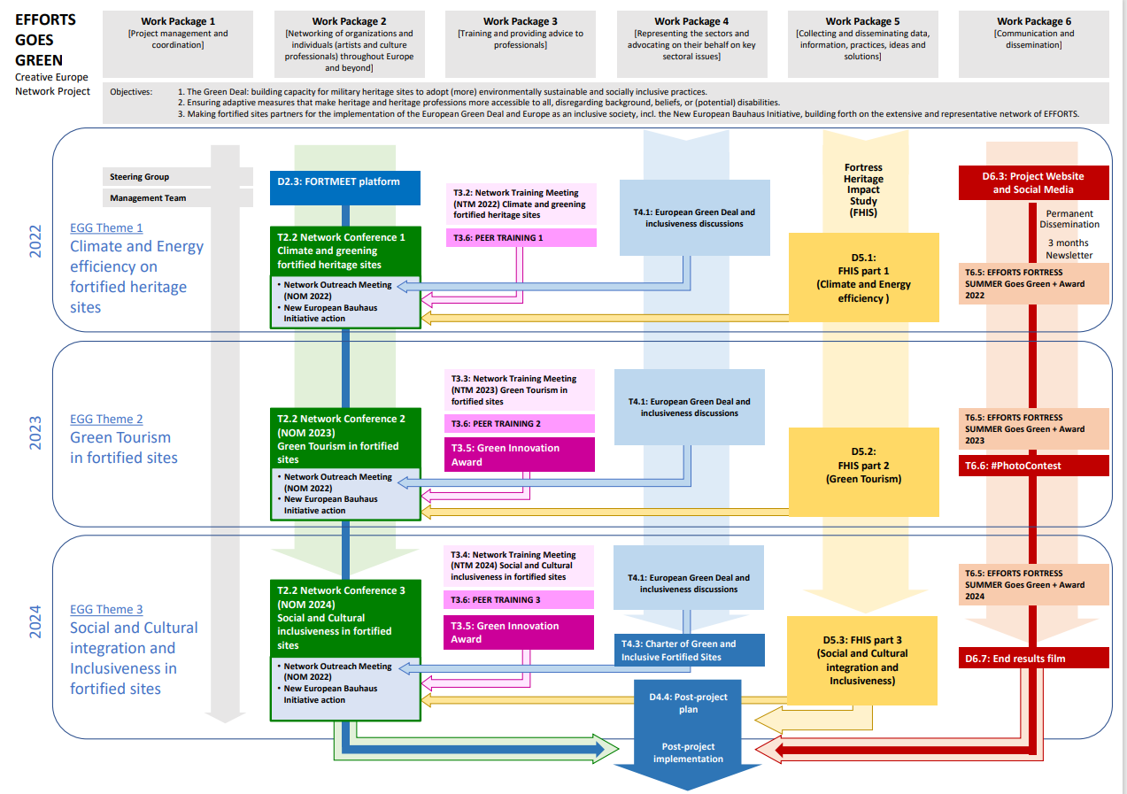

Slide 8
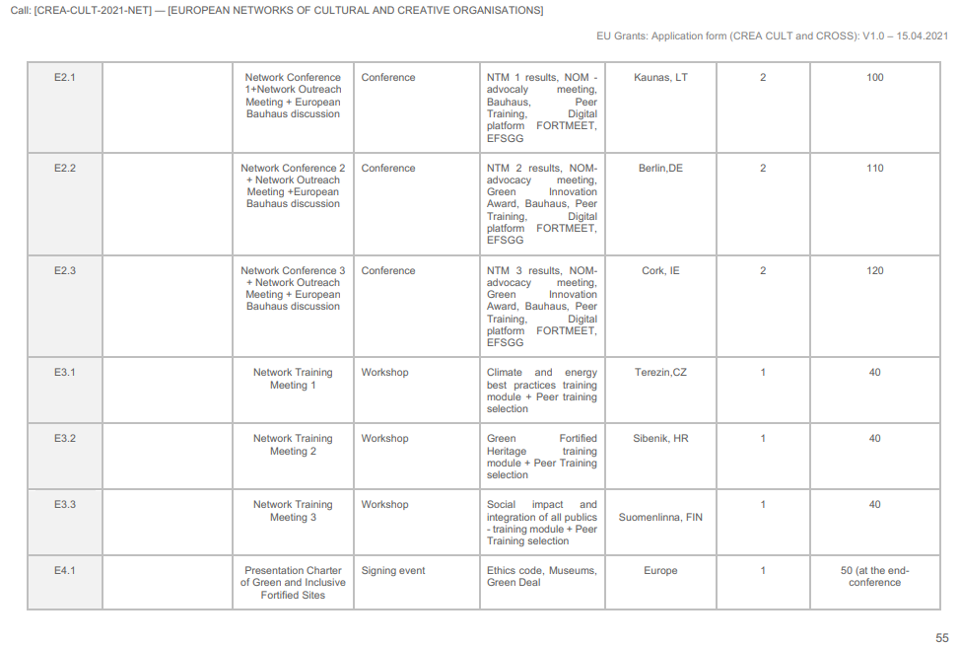

Slide 9
2022-2024

