Slide 1
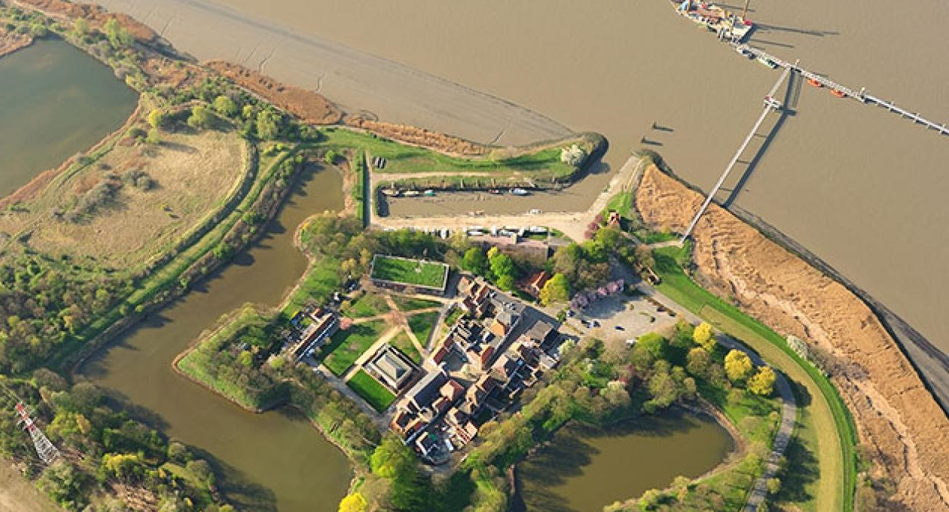
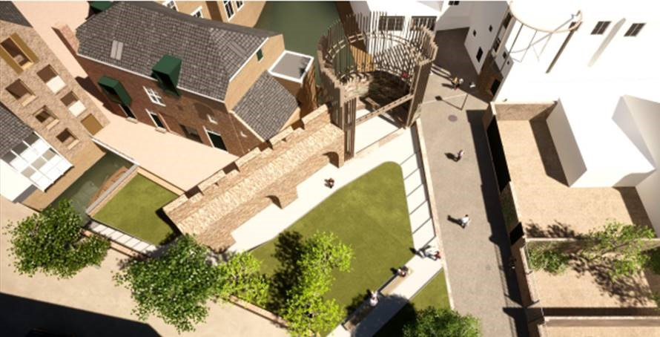
EFFORTS 6th Annual Congress
REPORT
13 January 2022

Slide 2
147 Registrations* from 23 countries
*Excluding team

Slide 3
121 Participants* from 23 countries (no-shows: 17,7%)
*Excluding team

Slide 4
77 Participants* on average, 97 maximum concurrent and 5h24 average watching time
*Excluding team

