Slide 1
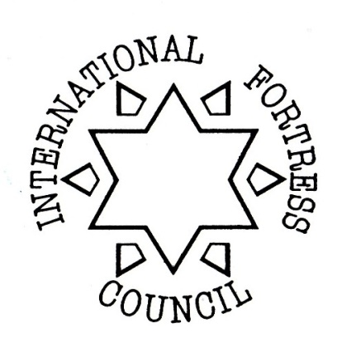
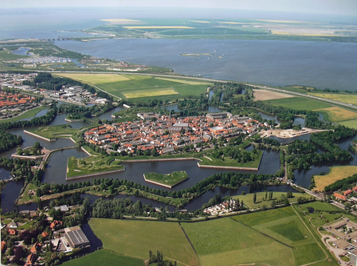
INTERNATIONAL FORTRESS COUNCIL

Slide 2
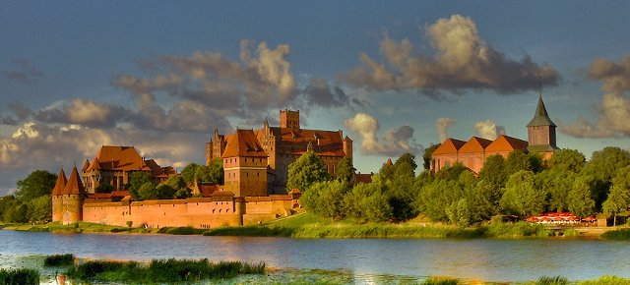
AIMS OF IFC
Preserving fort, defensive works and military architecture
Furthering of knowledge and information between members

Slide 3
MEMBERS
Austria, Belgium (1/2), Croatia, Czech Rep., France, Germany, Luxembourg, Netherlands, Switzerland, UK, USA
Malta

Slide 4
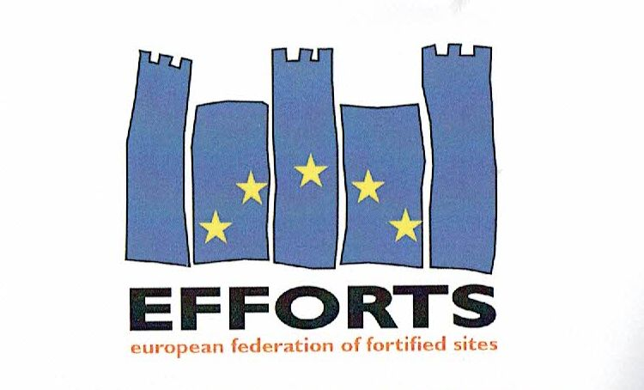
Multilingual Fortification Dictionary
The Multilingual Fortification Dictionary (MFD) contains a illustrated list of fortifications and their translations in multiple languages
(Bastion system)
EFFORTS project:
Other time periods/system (Polygonal, 20th cent.)
More languages
3D

Slide 5
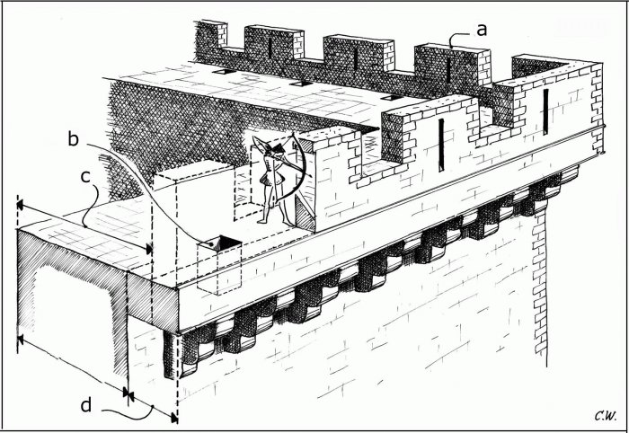
Croatian prsobran
Czech cimbuří
Dutch kanteel/tinne
English merlon, crenel
French merlon (un)
German Zinne (f)/ Schießschartenzinne (f)
Italian Merlo
Lithuanian ambrazūra
Polishząb krenelażu
Portugueseameia, merlão (a partir do século XV)

Slide 6
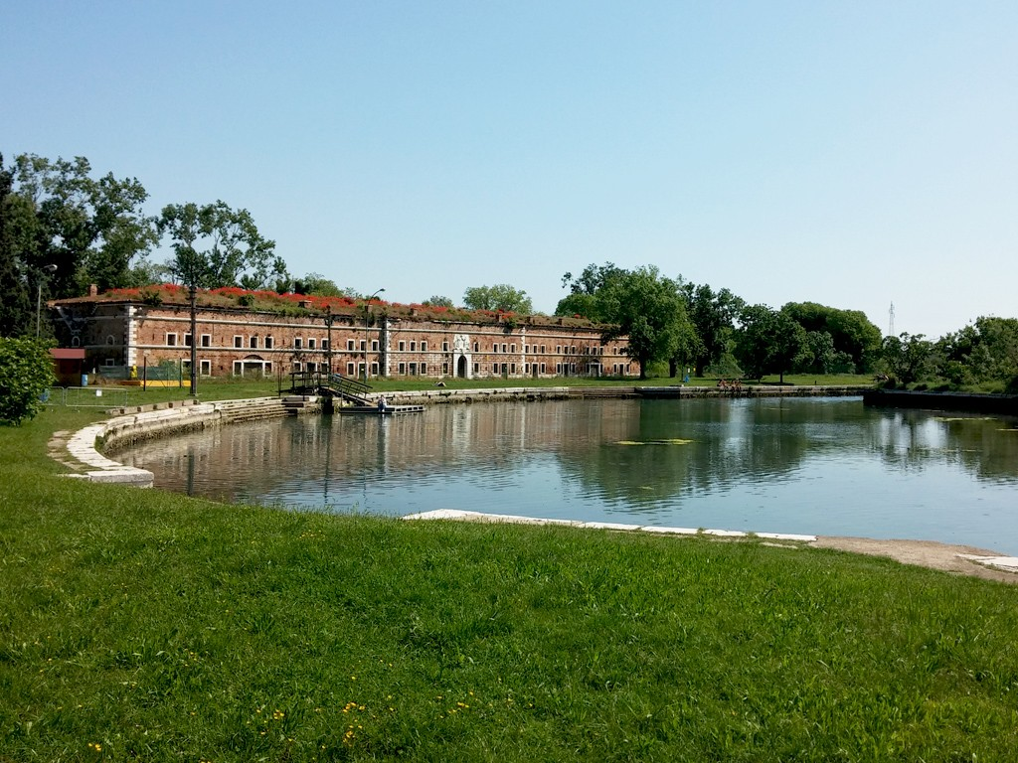
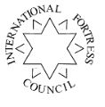
EU PILOT PROJECT PROPOSAL
EFFORTS European Knowledge Center for Fortification Heritage in Transition
(‘EU FORT KNOW’ )

