Slide 1
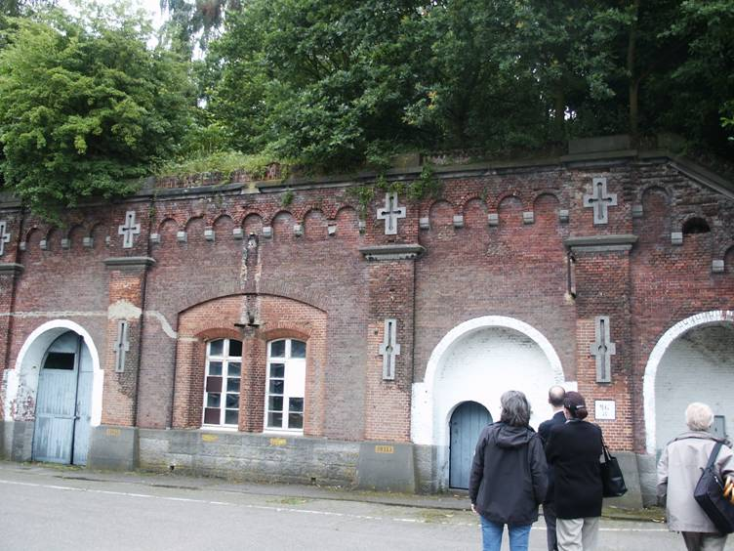


Cultural heritage and sustainability, which impact?
Prof. Koenraad Van Balen, dr. ir.-arch.
KU Leuven – Raymond Lemaire International Centre for Conservation
This project has received funding from the European Union’s Horizon 2020 Research and Innovation Programme under grant agreement No 821394

Slide 2
Content
Cultural Heritage and the obvious: well being
Sustainability & Cultural Heritage
Preventive Conservation, Monitoring and Maintenance of Monuments and Sites
Challenging governance: heritage as commons?
Conclusions
Objective: to inform on steady development of insights on preventive conservation in today’s cultural heritage and sustainability societal discourse
Context: EFFORTS congress 2020

Slide 3
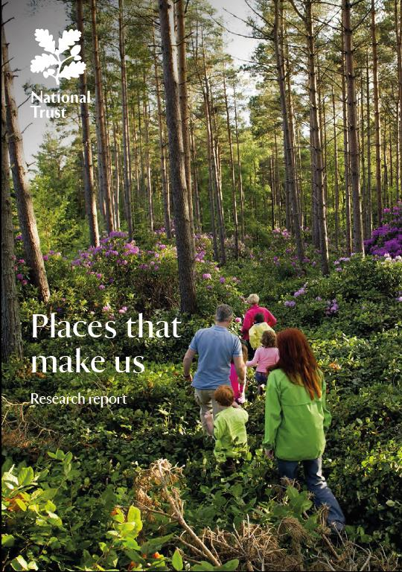
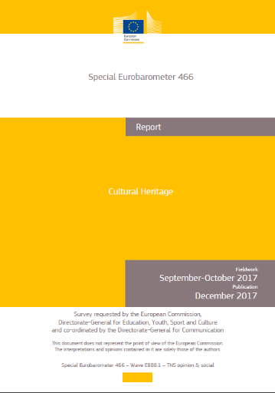
1. Cultural Heritage and the obvious: well being
More than we are often aware of, people and society need heritage as “beacons in time and space”.
Significant places “make” people;
People like to share the satisfaction they feel about places with other people;

Slide 4
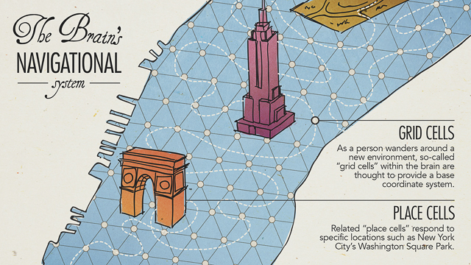
Neurophysiology
Places with meaning evoke powerful emotional reactions, indicating that places can be more than just physical spaces.
These emotional reactions have an impact on us physically and psychologically
The research highlighted that personally relevant places are able to “transport ourselves mentally back to places of meaning”
http://blogs.jpmsonline.com/2015/01/14/place-cells-and-grid-cells-the-human-bodys-marvelous-internal-gps-system/

Slide 5
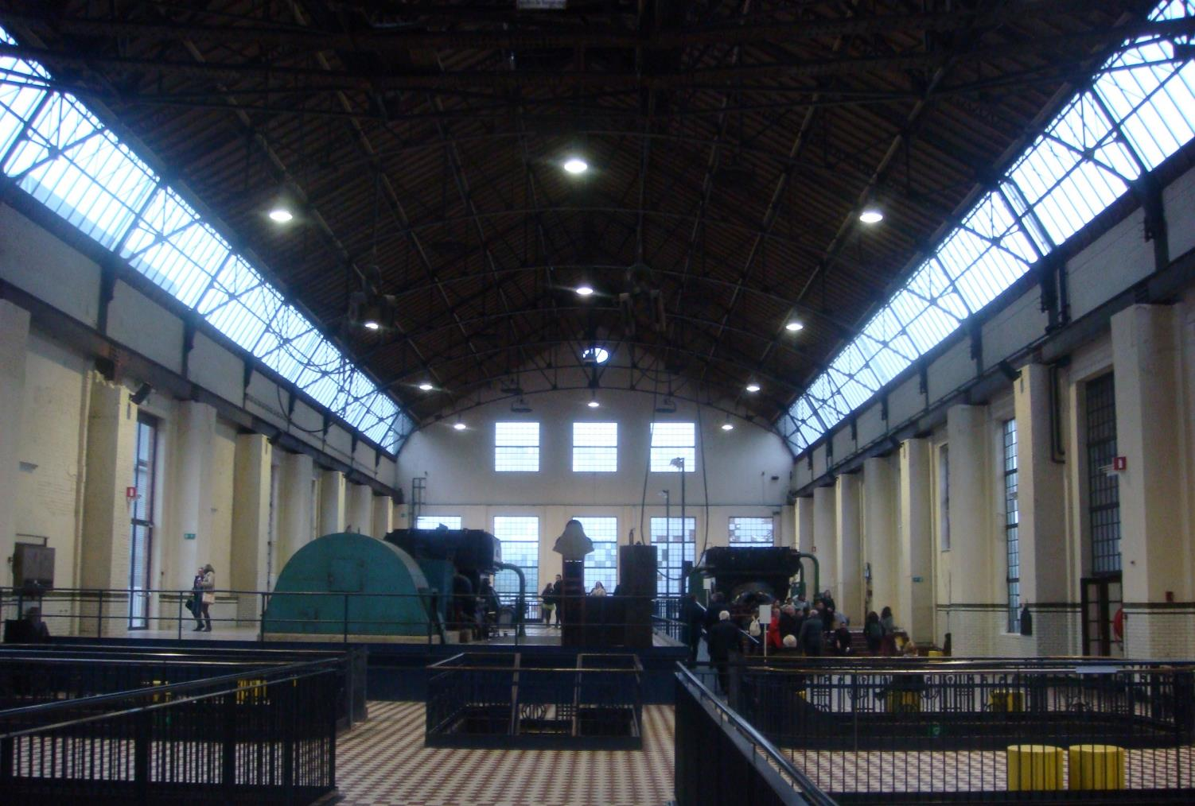
Behavioural
Connections people have with places:
8 out of 10 describe their place as being part of them and 58% agree that they ‘feel like I belong’ when visiting this place
75% agree that they would like to pass on their love of their place to significant others and there is also a desire to share the connection they have with the place with others (79%)

Slide 6
2. Heritage and sustainable development
Those “beacons” help us understand that we borrow our (heritage) environment from previous generations for future generation, similarly as we do with planet earth;
It forces us to be respectful, cautious while acknowledging and passing-on the integrity of our heritage in an ever-changing society and environment.
It integrates the Cultural Heritage discourse in that on sustainable development;
While it puts Cultural Heritage “on the agenda for the future of human being” it has been shown that it just makes various resource streams more sustainable (double win & we enjoy it!)

Slide 7
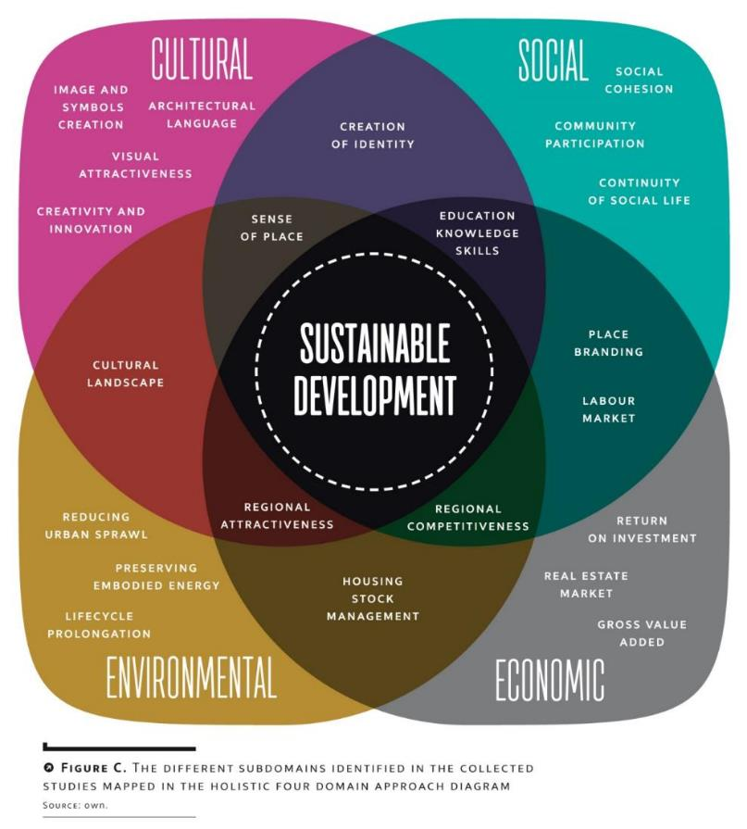
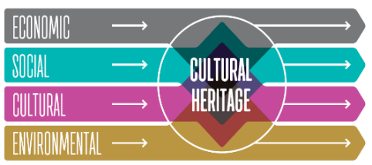
Cultural Heritage Counts for Europe
4 pillars of sustainable development
Towards the upstream model:
Cultural heritage makes most resource streams more sustainable
The report in English and the executive summary in 14 languages is available online: http://www.encatc.org/culturalheritagecountsforeurope/outcomes/

Slide 8
3. Preventive Conservation of heritage values
Being a societal construct: heritage is about values, so heritage values are core (not only their physical expression), requiring the input and hands of the stakeholders.
What we learn for pandemics and all threats to society at large is that we should “prevent” instead of “cure”. It leads us to preventive conservation, that require holistic and integrated approaches.
But such approaches are complex, i.e. the outcome is unpredictable thus the process prevails, and it requires “all
people’s mind and resources on board”. (see > 4.)

Slide 9
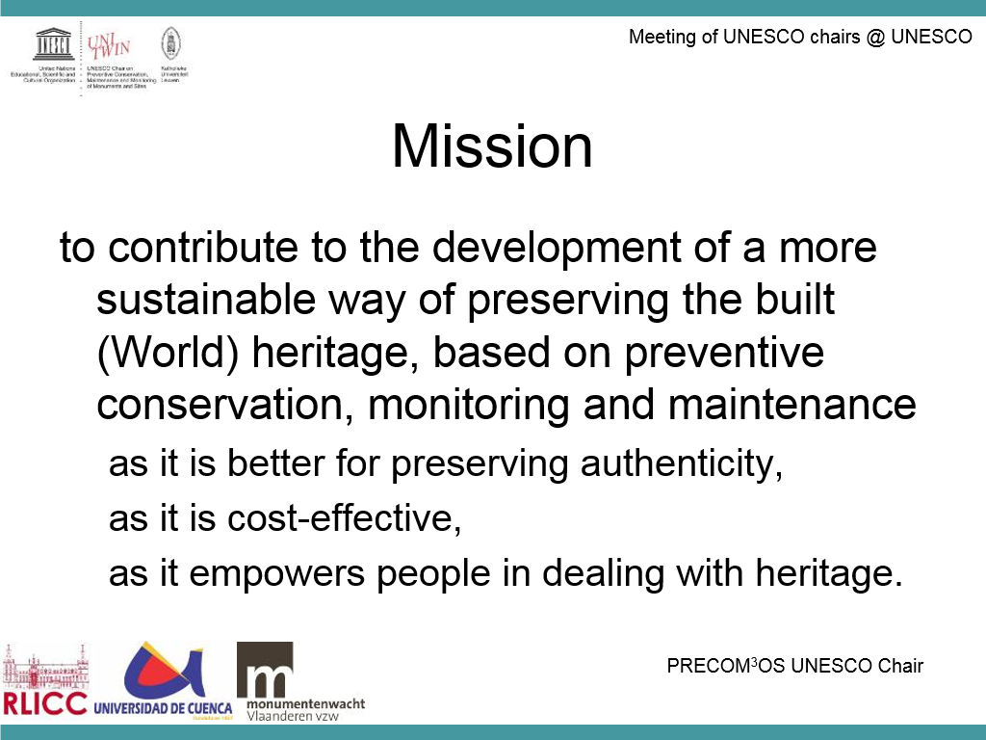
PRECOM³OS UNESCO chair on PReventive COnservation, Monitoring and Maintenance of MOnuments and Sites (2008 - )

Slide 10
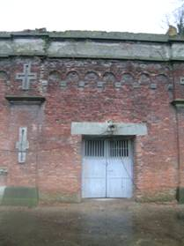
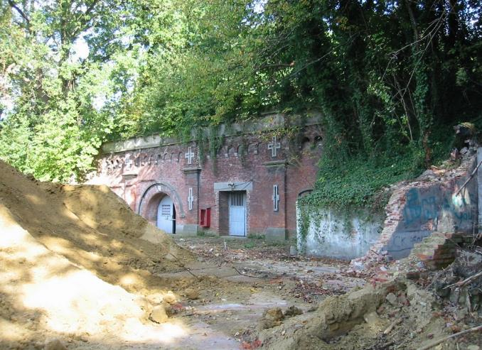
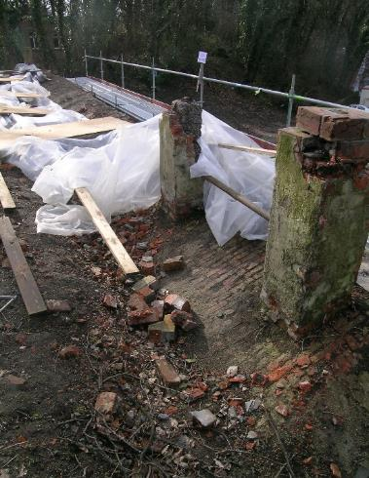
Three levels of prevention
Primary prevention: actions to stop the causes of the unwanted effect (loss of heritage values / damage);
Secondary prevention: actions of monitoring that allow an early detection of the symptoms of the unwanted effects (loss of …);
Tertiary prevention: actions that stop the further spreading of the unwanted effect (damage) or the generation of new unwanted effects (loss of …).

Slide 11
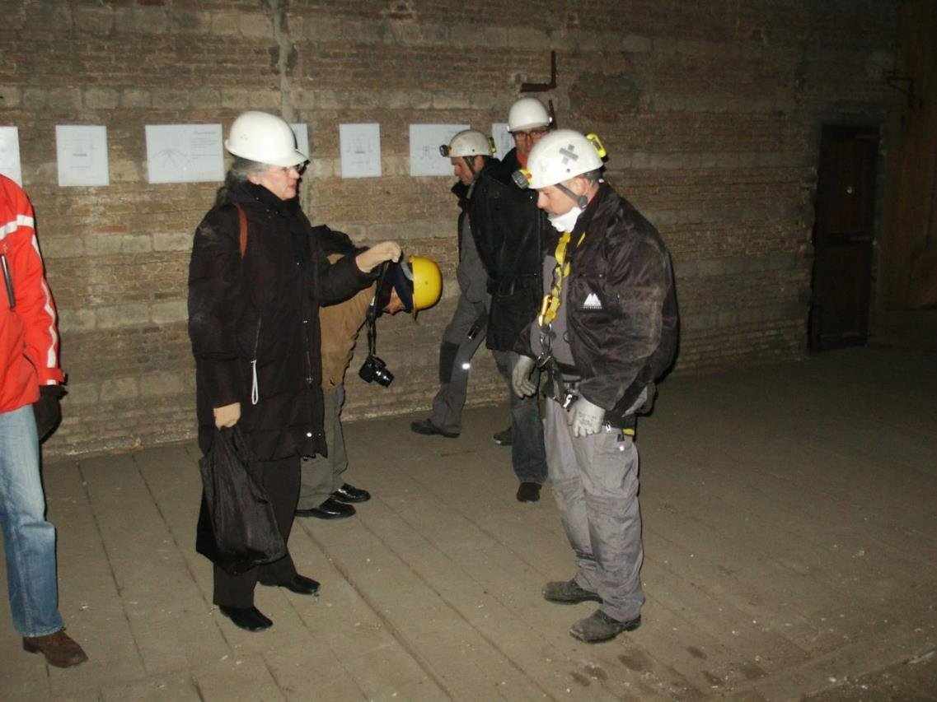
Monitoring: (role of monumentenwacht)
A supporting agent for the owner
distinct from the authority
! A governance aspect!

Slide 12
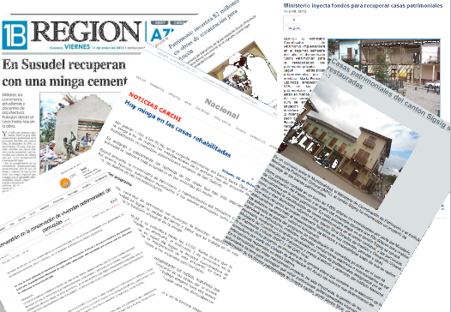
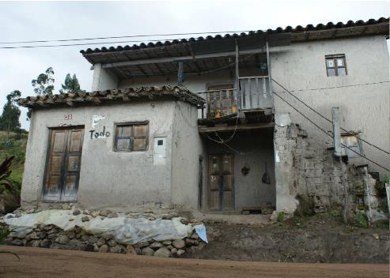
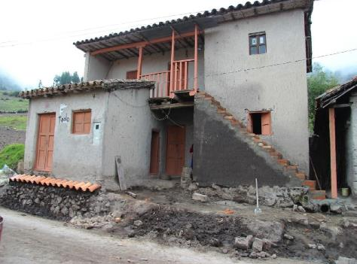
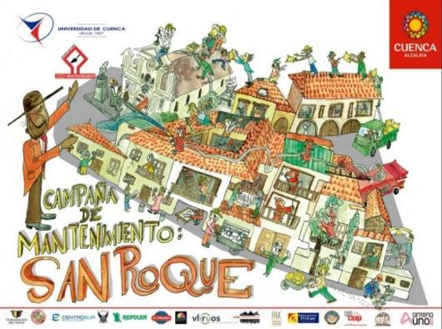
Monitoring heritage values, state of preservation and actions

Slide 13
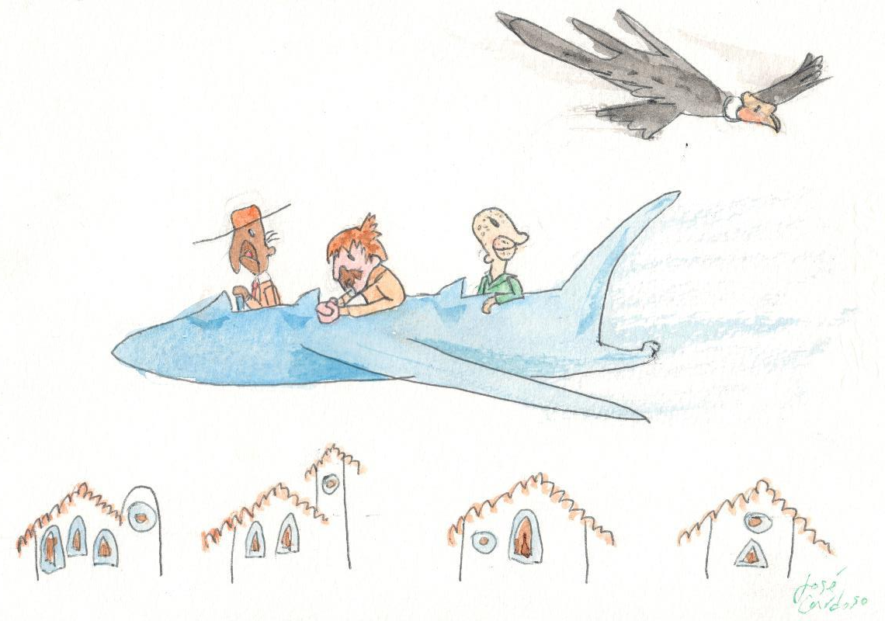










Insights gained over 10 years
Experience
Young Team
Creativity
Social involvement
Compromise
Herrerías Campaign 2018
Clarified and redefined the concept of preventive conservation in cultural heritage:
  >< museum, archaeology
  “system thinking”: holistic and integrated
  “Preventive conservation” inspired by “public health” (!COVID-19!)
  Integrated in societal debates with outreach to the public and to authorities
Credibility
Benigno Malo Project
Later Eris
Tierras de Color
Cervecería de Llaviucu
Casa de Osmara
Heritage as a resource

Slide 14
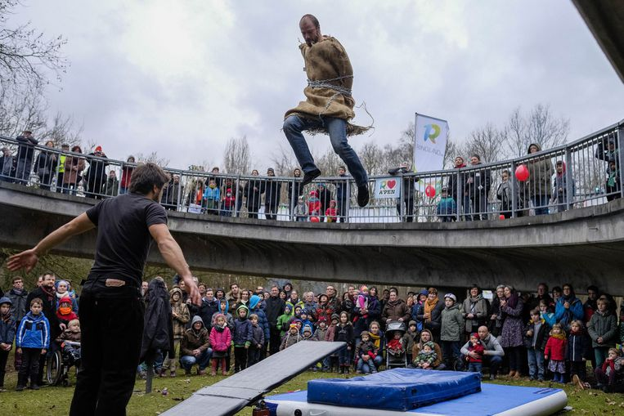
4. Challenging governance: heritage as commons?
A commons is
  shared resources (i.e. there is something objective about it)
  maintained or co-produced by a community or group of stakeholders …
  it is managed according to the rules and values of that community ….
Source: https://wiki.p2pfoundation.net/Commons#Definition
Image: www.hln.be/regio/antwerpen/ringland-viert-verjaardag-met-valentijnsfeest~a750622f/

Slide 15
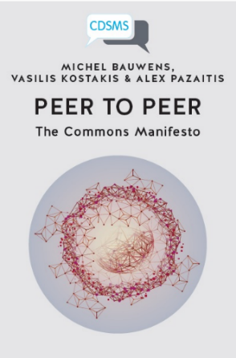
Participatory governance & cultural heritage.
Peer-to-peer
  Put simply, peer-to-peer (P2P) is the capacity that we now have to connect to each other, to create value together and to organise ourselves. It cuts out the middleman, and instead adopts a model of decentralised peer production, whereby value is delivered back to the place where it largely came from in the first place — the commons.
  (https://medium.com/enspiral-tales/rise-of-the-commons-fundamentals-of-p2p-economies-f737e6d8adfc)

Slide 16
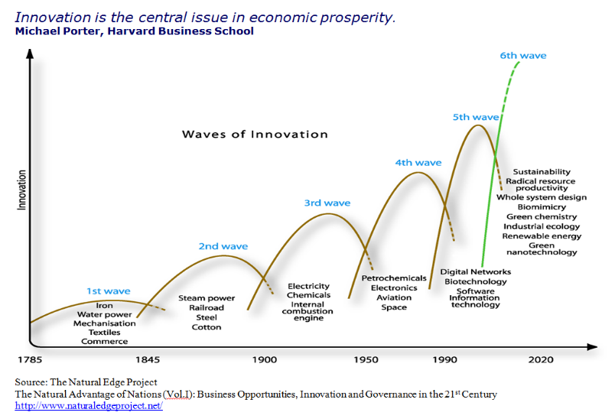
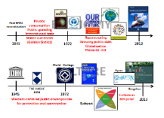
Dealing with heritage in changing societies!
Christian Ost 2014

Slide 17
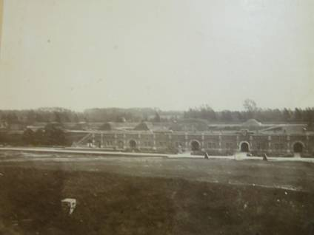
Final reflections
Cultural heritage as anchors in time and space helps people to “orient” themselves, to share this sense of place with their peers … contributing to well-being;
We recognise how the interest for this approach matches with a wider societal trend and perception of the role and contribution of cultural heritage to sustainable development;
Preventive conservation as a system with an integrated, holistic and systemic approach has been clarified gradually; (COVID-19 helps us understand this better!)
New governance systems could facilitate enhanced involvement and process driven contributions to preservation of cultural heritage values.
A “crisis” creates the opportunities for shifts and changes!
Joostens, F. 1865

Slide 18
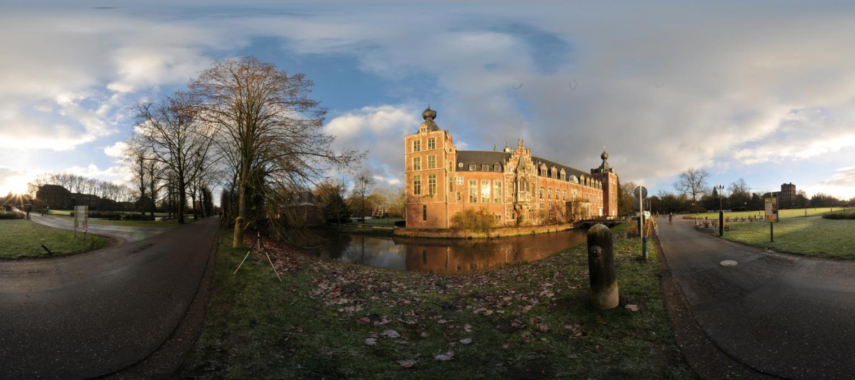
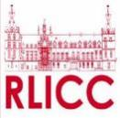

Thank you for your attention
Prof. Koenraad Van Balen, dr.ir.arch.
koenraad.vanbalen@kuleuven.be
http://set.kuleuven.be/rlicc
RAYMOND LEMAIRE INTERNATIONAL CENTER FOR CONSERVATION
Faculty of Engineering Science
Kasteelpark Arenberg 1, 3001 Heverlee

