Slide 1
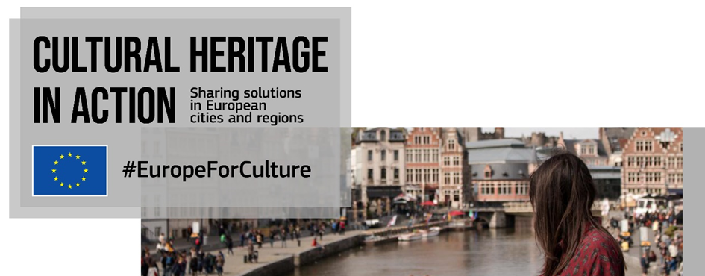



Slide 2

A peer-learning programme for cities & regions
Exchanging knowledge
Developing innovative solutions

Slide 3
A peer-learning programme for cities & regions
Focus on:
Participatory governance of cultural heritage
Adaptive reuse of heritage buildings
Quality of interventions on cultural heritage

Slide 4
A peer-learning programme for cities & regions
A catalogue of good practices
Peer learning visits & online activities

Slide 5
32 good practices
4 fortified sites
Strategic vision
Relation to EU strategic documents
Impacts and results
Potential for replicability
Thematic balance
Geographical balance

Slide 10

What cities & regions are telling us
Cultural heritage ranks high in cities & regions’ strategic priorities
It connects to most urban policies
Powerful to foster social inclusion and bring groups together
Built heritage areas brought become open public spaces
Impacts and added value

Slide 11
New working methods
Local authorities joining forces
  Internally: new cooperation within city administrations
  between themselves (especially at regional level)
  with local stakeholders
Development of local networks of stakeholders
Increased citizens’ involvement

Slide 12
Community engagement & participatory processes
Vision and expectations of future users (preliminary studies, needs assessments)
Co-development: workshops, consultations, activation events, participation through digital solutions
Continuous feedback, evaluation and adaptation

Slide 13
Innovative cultural heritage management and financing
Shared management (initial push by public authorities and take over by associations)
Financing mix & innovative financing models (interest-free loans, public/private investment)
Main funding sources remain public (local/regional, national, ERDF)

Slide 14
How can you be involved?
Share local examples
Attend online peer-learning activities
Stay tuned!

Slide 15
www.culturalheritageinaction.eu
Julie.herve@eurocities.eu
@EUROCITIES

